Slide 1
Sheryl Patterson
DC Regional Chapter Director, MicNOVA Partner
Western Alliance (NYSE: WAL)
Value & Roster Predefined Screens
First Cut– 4-12-23
Ticker Heat Map

Slide 10
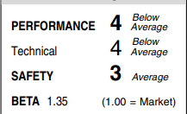
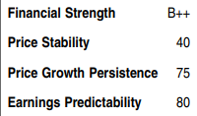
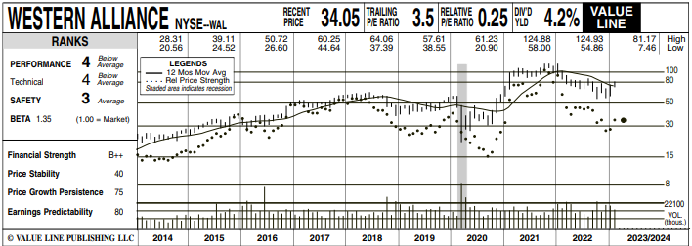
Independent Research

Slide 11
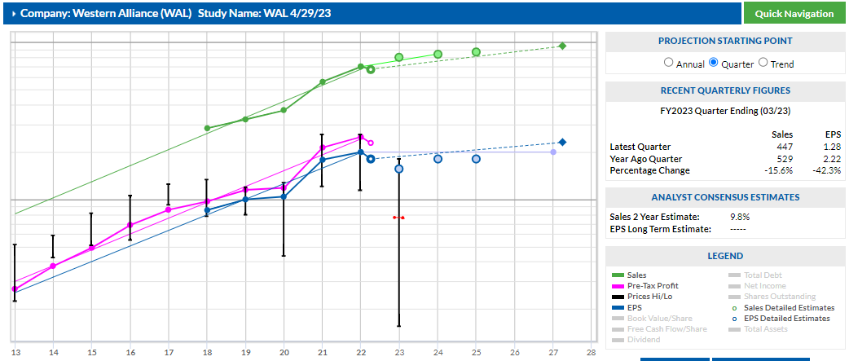

Slide 12
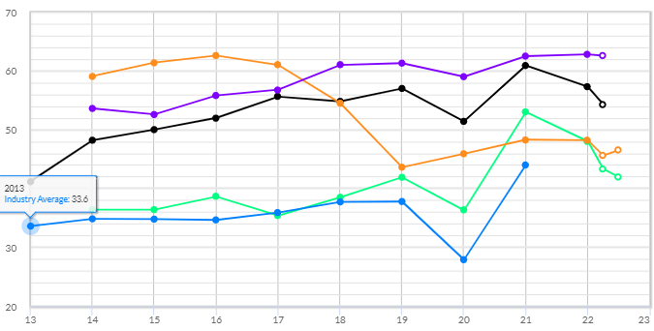
^{Core}SSG Tab 2: Evaluate Management
Step 1: % Pre-Tax Profit on Sales (Profit Margin)
Notes:
Speaker Notes:
Now we’ll Evaluate Management under Tab 2.
Step 1 is the %Pre-Tax Profit on Sales (also called Profit Margin). It shows steady results of a little over 50%, a few percentage points below Visa.

Slide 13
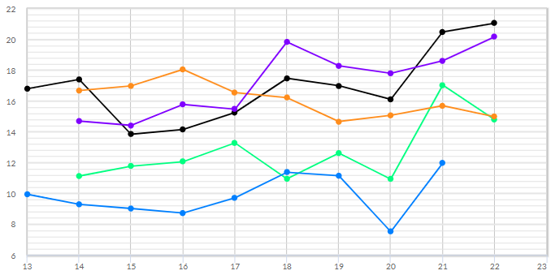
^{Core}SSG Tab 2: Evaluate Management
Step 2: % Return on Equity (ROE)
Notes:
Speaker Notes:
Step 2 is the % Return on Equity. Here you’ll note Mastercard’s returns are significantly higher than Visa or the Peer Group. Even with a couple of outliers in 2017 and 2019 removed, the 5 year % ROE average is over 100 %.

Slide 14
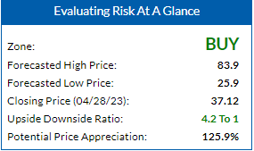
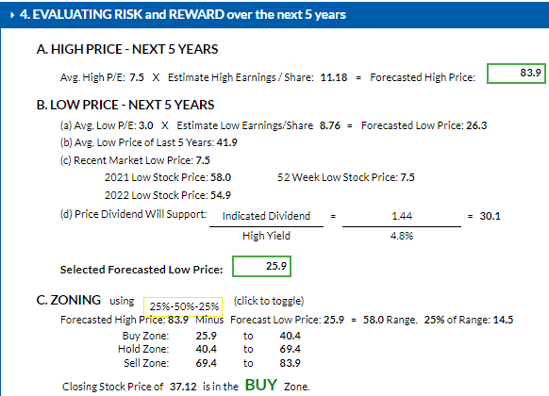
Notes:
Speaker Notes:
Here is the Historic Sales plot showing a 10.9% trendline growth. With the Member Sentiment result of 14.3% in mind, I decided to be a bit more conservative and chose 11% for the 5 Year Sales Growth Rate Forecast.

Slide 15
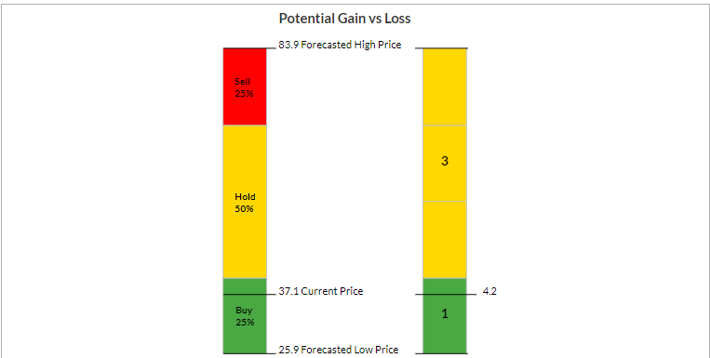
Notes:
Speaker Notes:
In Tab 4, Step 3, we determine the prospective price ranges. With a High Price of $622 and Low Price of $275, the resulting ranges are: 25% Buy range 275 to 361; 50% Hold range 361 to 535; and the final 25% Sell range 535 up to 622.

Slide 16
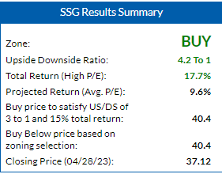
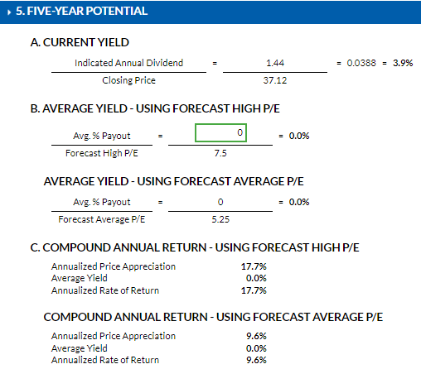
Notes:
Speaker Notes:
Even though both the Member Sentiment and the Historic growth rates were 16.0% and 16.4% respectively, I decided to also be a bit more conservative here and selected a 5 Year EPS Growth Rate Forecast of 15%. This resulted in a 5 Year Projected EPS of $17.62 shown in green. (Also known as the Frontside Connector as it’s the only value from the SSG frontside used in backside calculations.)

Slide 17
Western Alliance Bancorp
Medium size, growth company
Originally had problems similar to failing banks but turned much of that around. Transparency in current quarterly report.
Currently “under-valued”
Trading below its 5 Year Average PE
Closed 4/28/23 at $37.12; is a BUY up to $40.40 (4.2 to 1 U/D & 17.7% Total Return)
Could be a Medium size addition to a portfolio
Notes:
Narrow Economic moat and Exemplary Capital Allocation
So, in conclusion, Mastercard is a well-managed, Large size, Growth company that is “on sale” based on its currently trading near or below its 5 year average P/E.
On Friday, Mar 4, Mastercard closed at $330.76 (~$14 below the Study price of $344). The Upside/Downside moved to 4.9 to 1 with a Compound Total return of 15%. At the current price, Mastercard could be a purchase candidate if it improves your portfolio.

