Slide 1
Introduction to and Review of the McNoVA Watchlist
(as of May 31, 2020)
McNoVA virtual meeting, Wednesday June 10, 2020
-- Wilbert Nixon

Slide 4
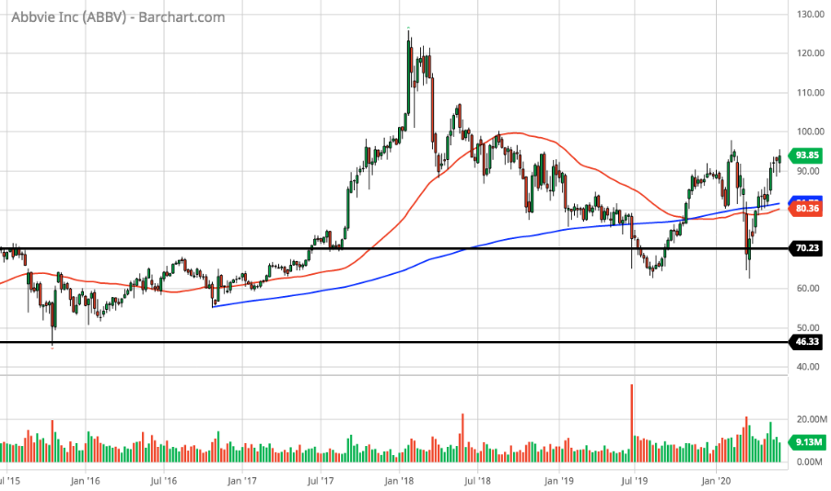
Abbvie (ABBV)(5-year chart)

Slide 5
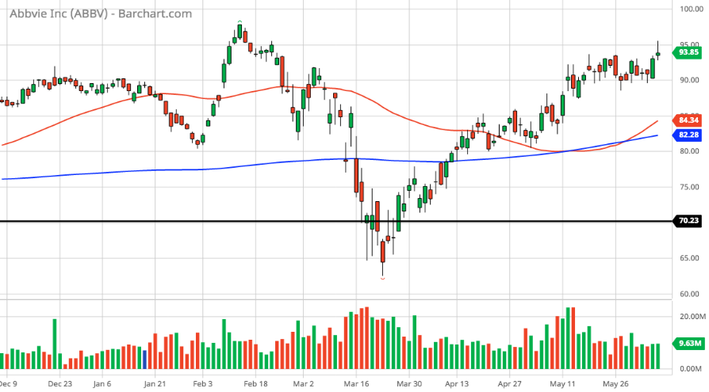
Abbvie (ABBV)(6-month chart)

Slide 6
Abbvie (ABBV)(SSG)

Slide 7
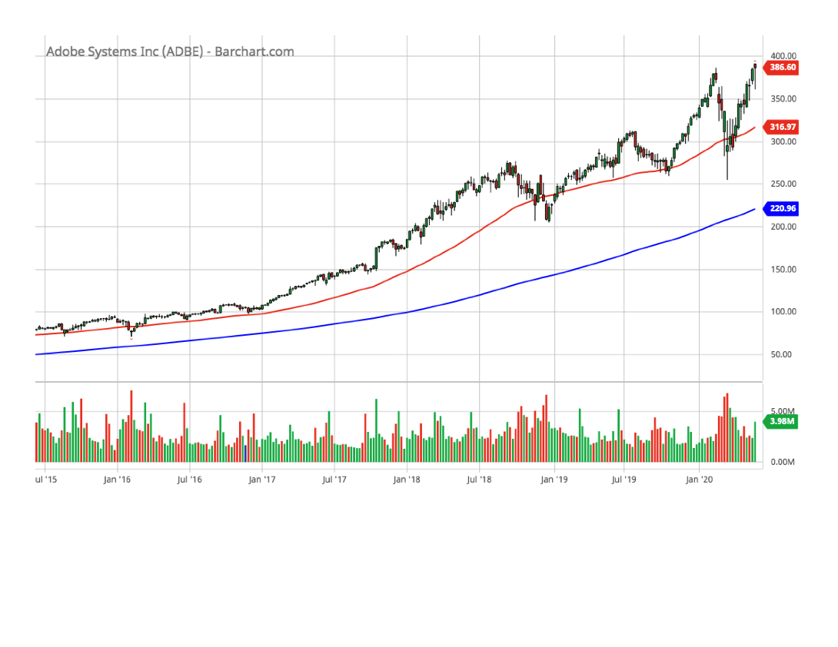
Adobe Systems (ADBE)(5-year chart)

Slide 8
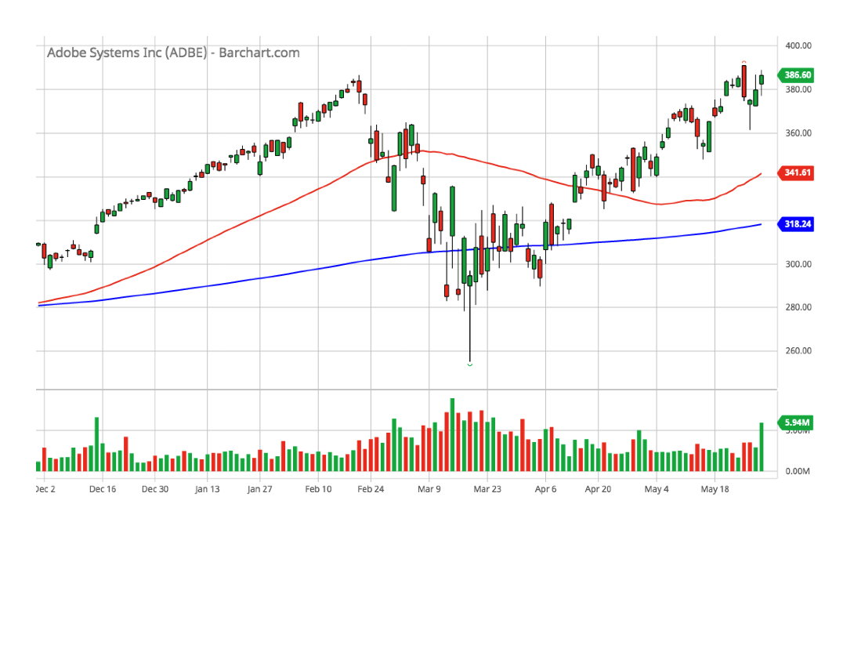
Adobe Systems (ADBE)(6-month chart)

Slide 9
Adobe Systems (ADBE)(SSG)

Slide 10
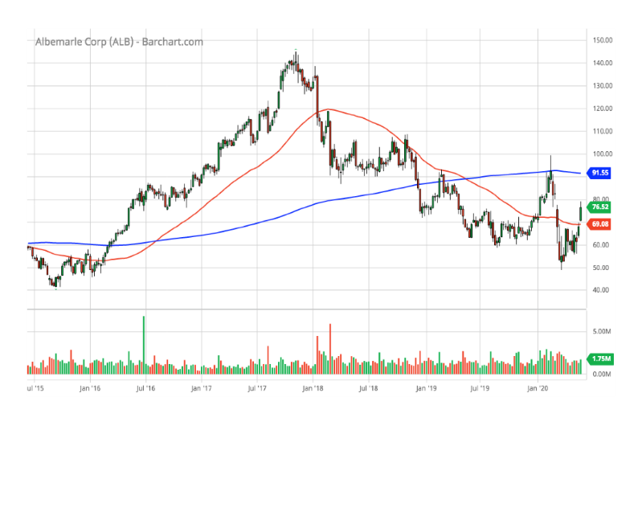
Albemarle Corp. (ALB)(5-year chart)

Slide 11
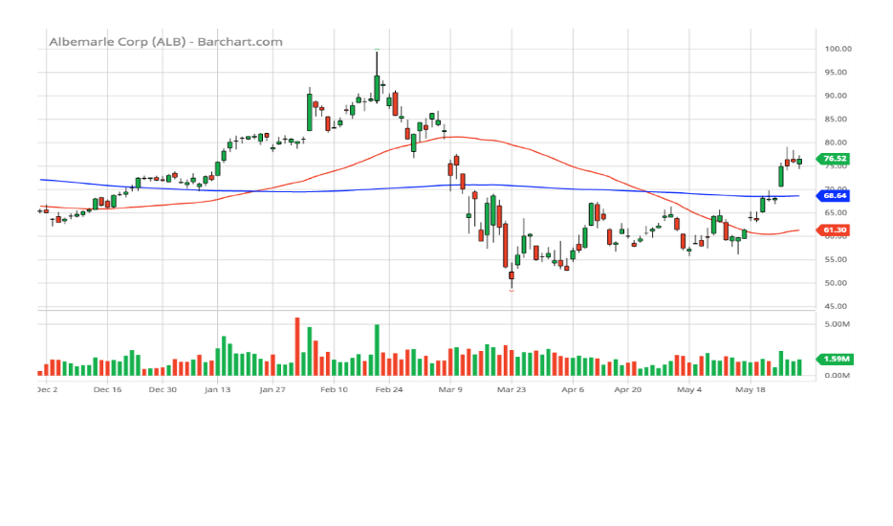
Albemarle Corp. (ALB)(6-month chart)

Slide 12
Albemarle Corp. (ALB)(SSG)

Slide 13
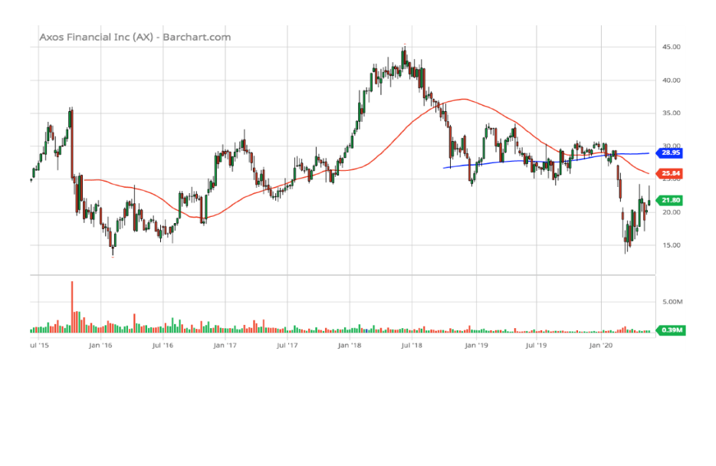
Axos Financial (AX)(5-year chart)

Slide 14
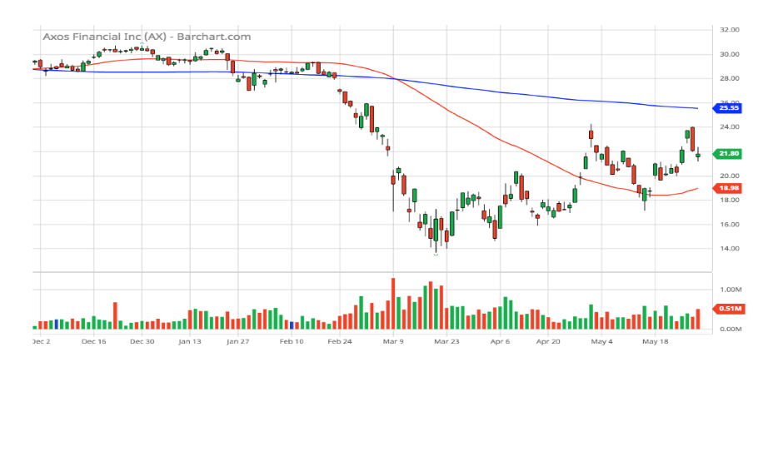
Axos Financial (AX)(6-month chart)

Slide 15
Axos Financial (AX)(SSG)

Slide 16
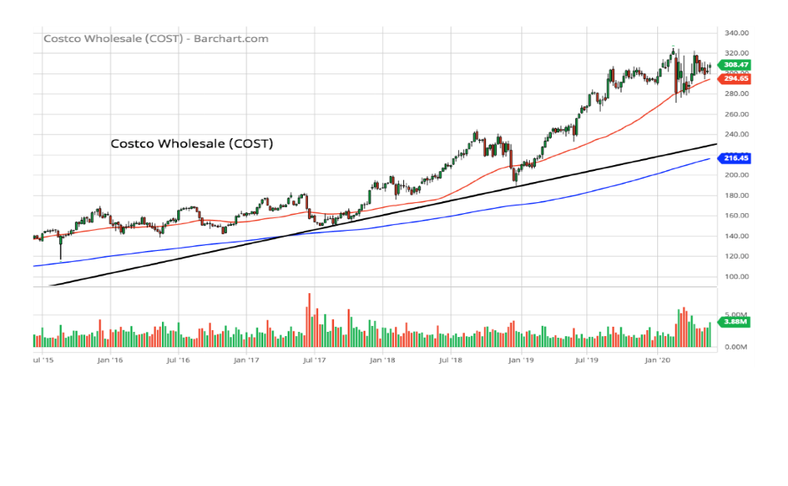
Costco Wholesale (COST)(5-year chart)

Slide 17
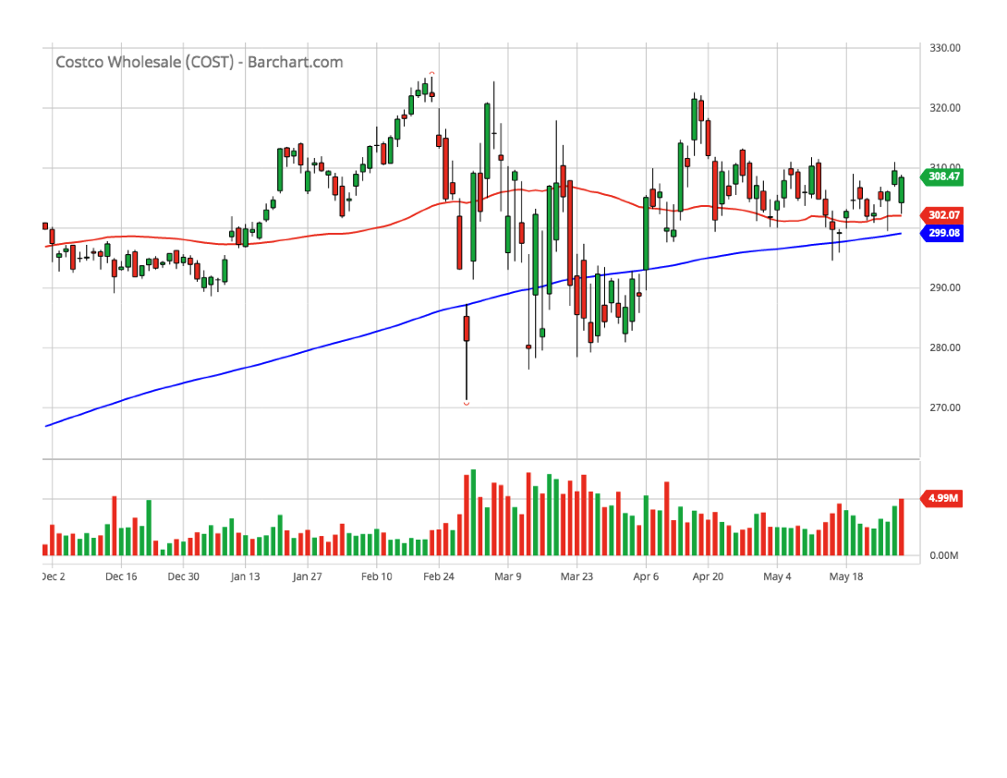
Costco Wholesale (COST)(6-month chart)

Slide 18
Costco Wholesale (COST)(SSG)

Slide 19
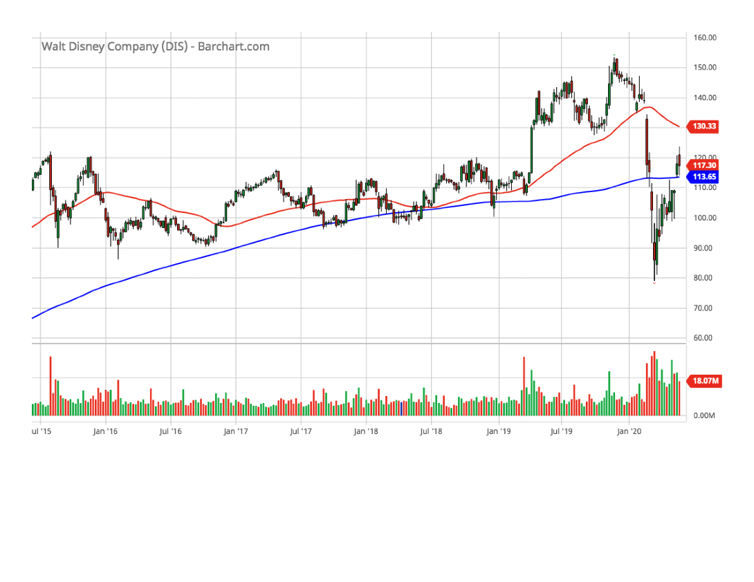
Disney (Walt) (DIS)(5-year chart)

Slide 20
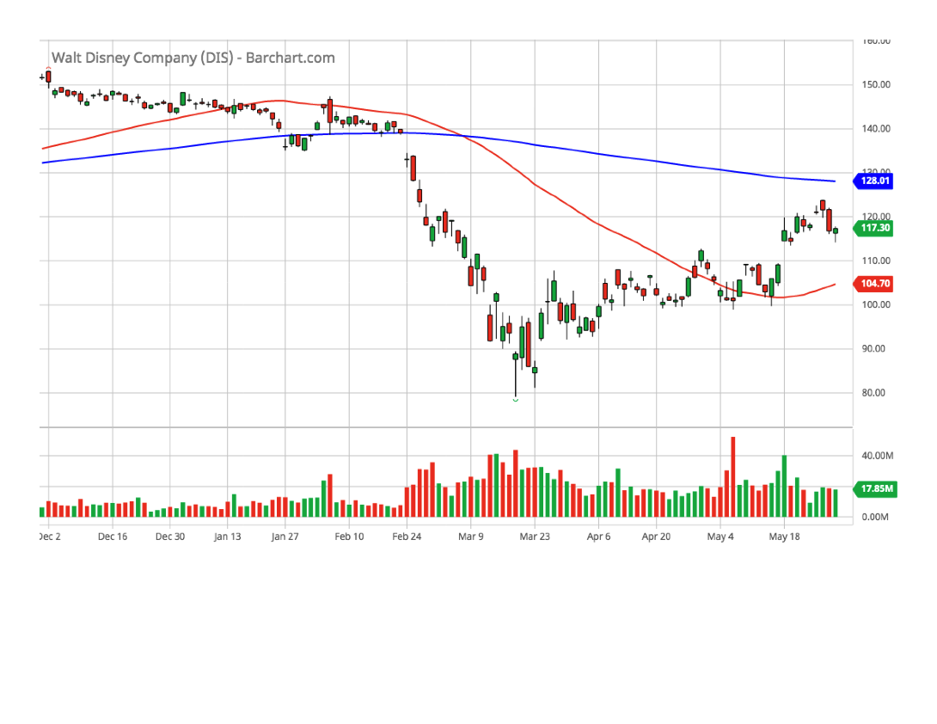
Disney (Walt) (DIS)(6-month chart)

Slide 21
Disney (Walt) (DIS)(SSG)

Slide 22
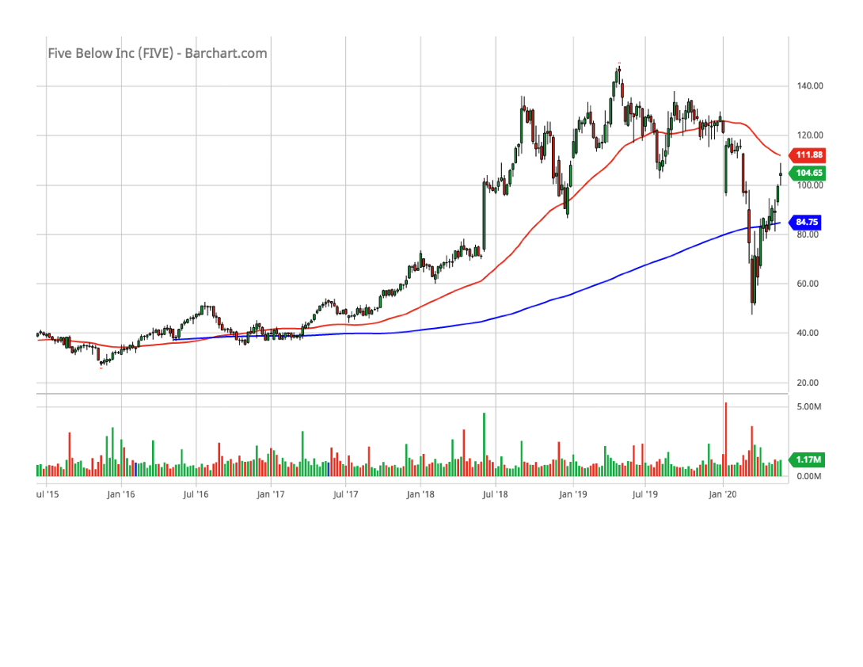
Five Below (FIVE)(5-year chart)

Slide 23
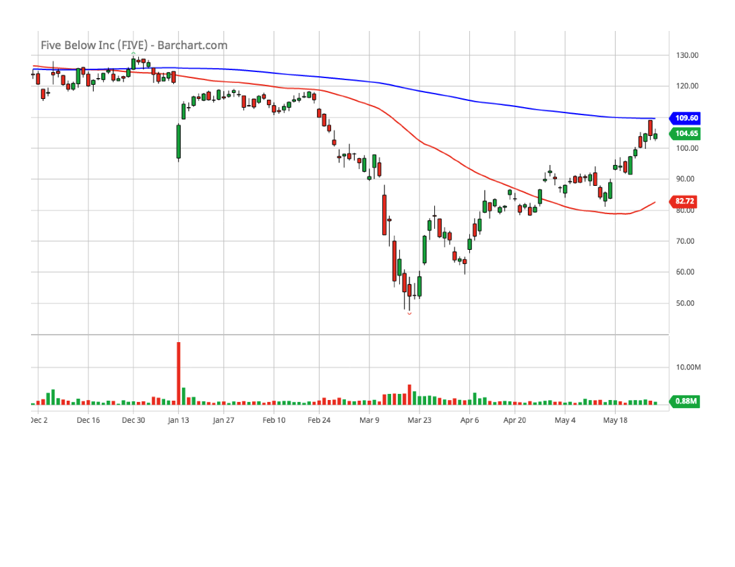
Five Below (FIVE)(6-month chart)

Slide 24
Five Below (FIVE)(SSG)

Slide 25
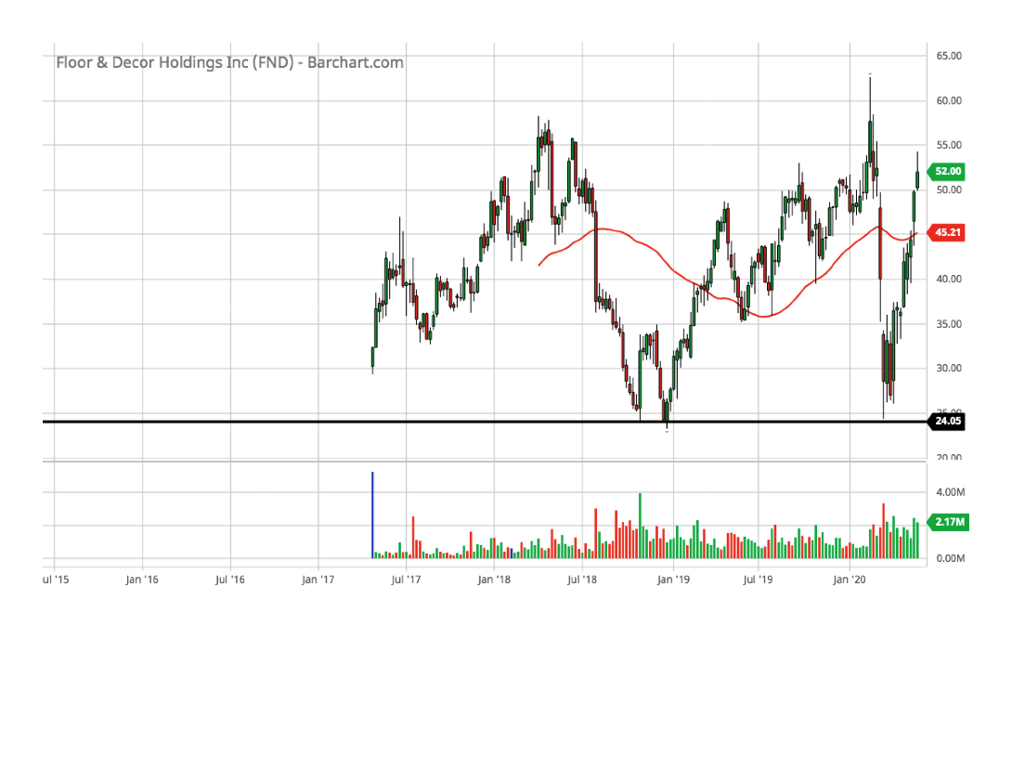
Floor & Décor (FND)(5-year chart)

Slide 26
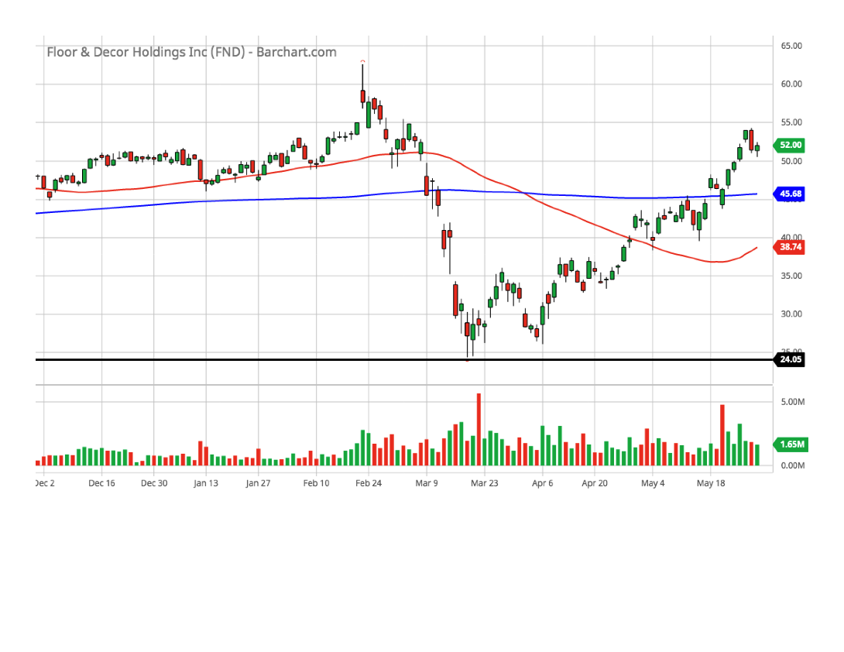
Floor & Décor (FND)(6-month chart)

Slide 27
Floor & Décor (FND)(SSG)

Slide 28
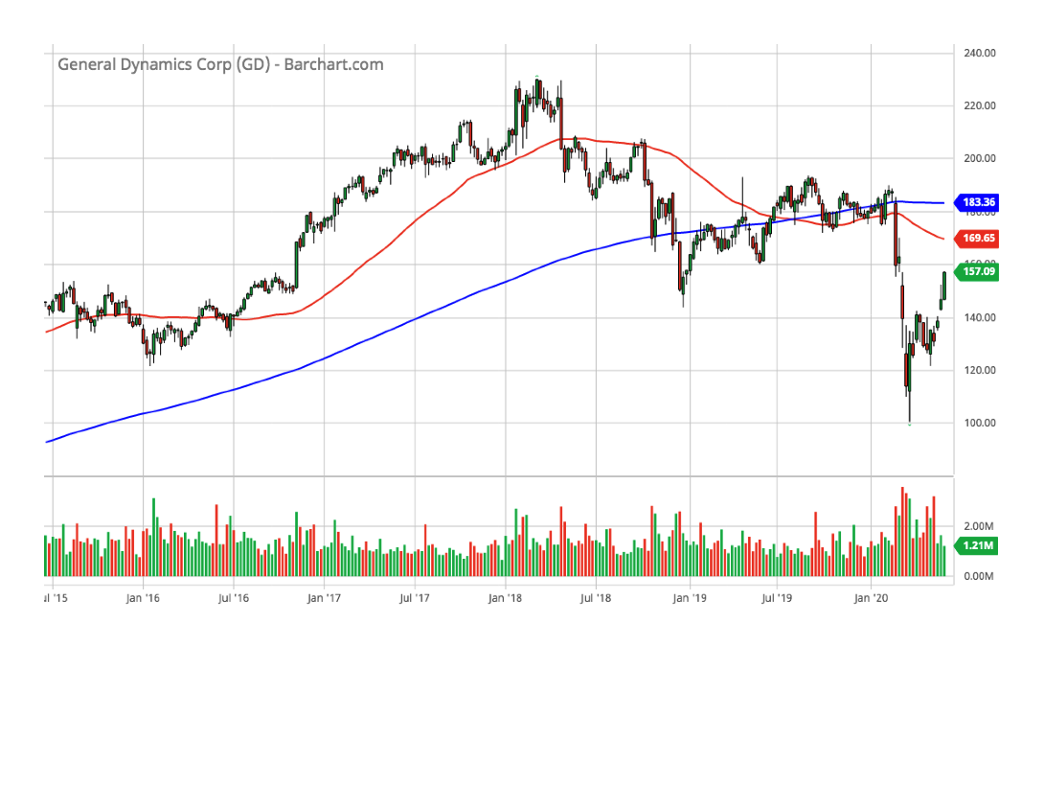
General Dynamics (GD)(5-year chart)

Slide 29
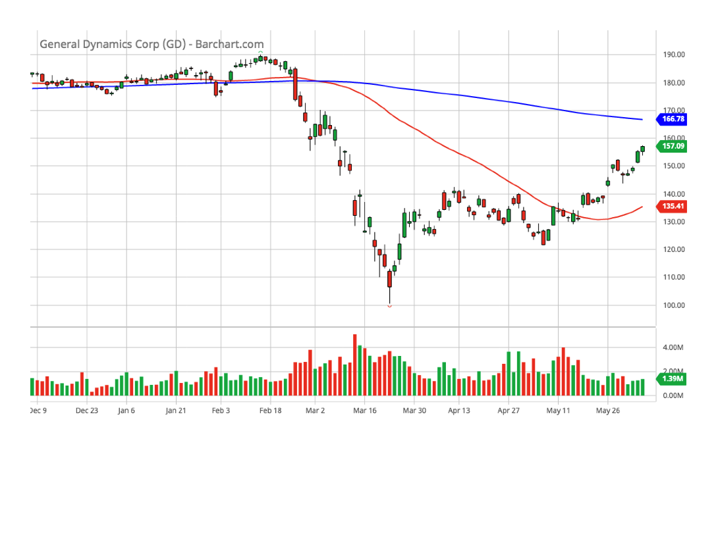
General Dynamics (GD)(6-month chart)

Slide 30
General Dynamics (GD)(SSG)

Slide 31
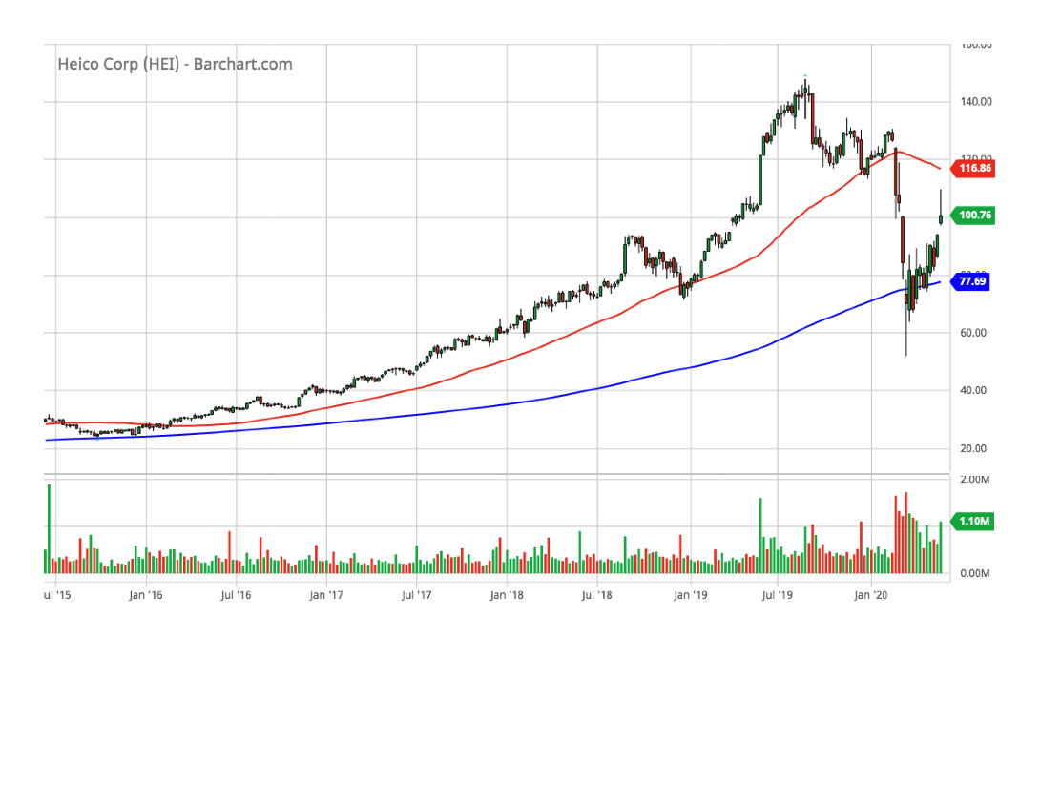
HEICO Corp (HEI)(5-year chart)

Slide 32
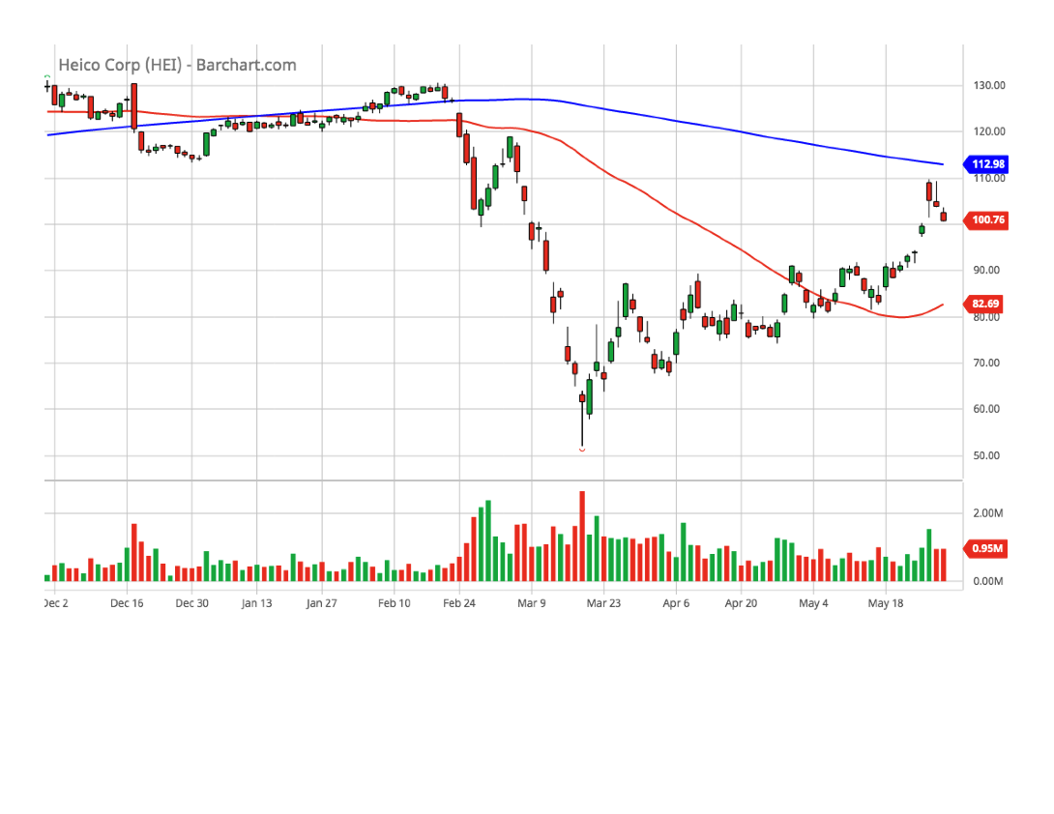
HEICO Corp (HEI)(6-month chart)

Slide 33
HEICO Corp (HEI)(SSG)

Slide 34
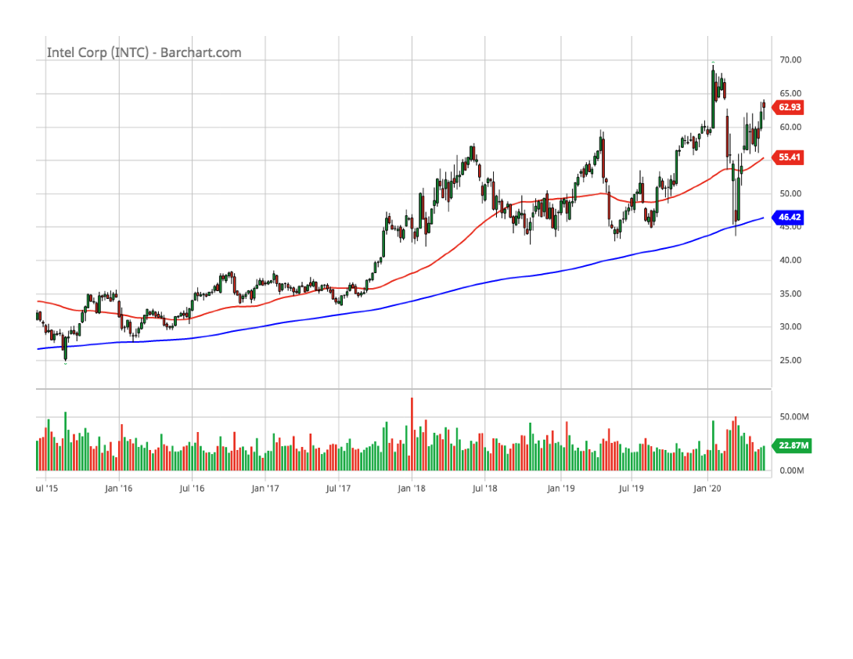
Intel (INTC)(5-year chart)

Slide 35
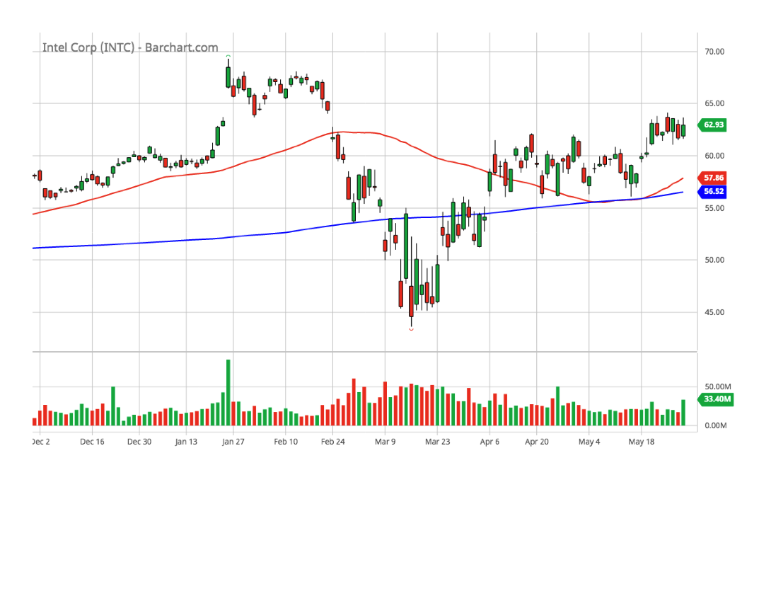
Intel (INTC)(6-month chart)

Slide 36
Intel (INTC)(SSG)

Slide 37
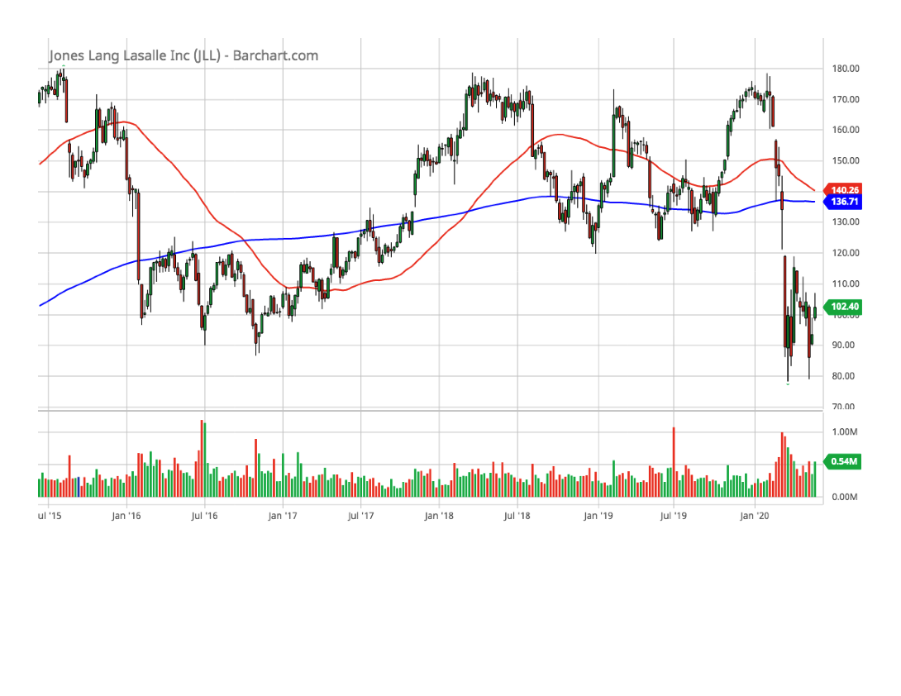
Jones Lang Salle (JLL)(5-year chart)

Slide 38
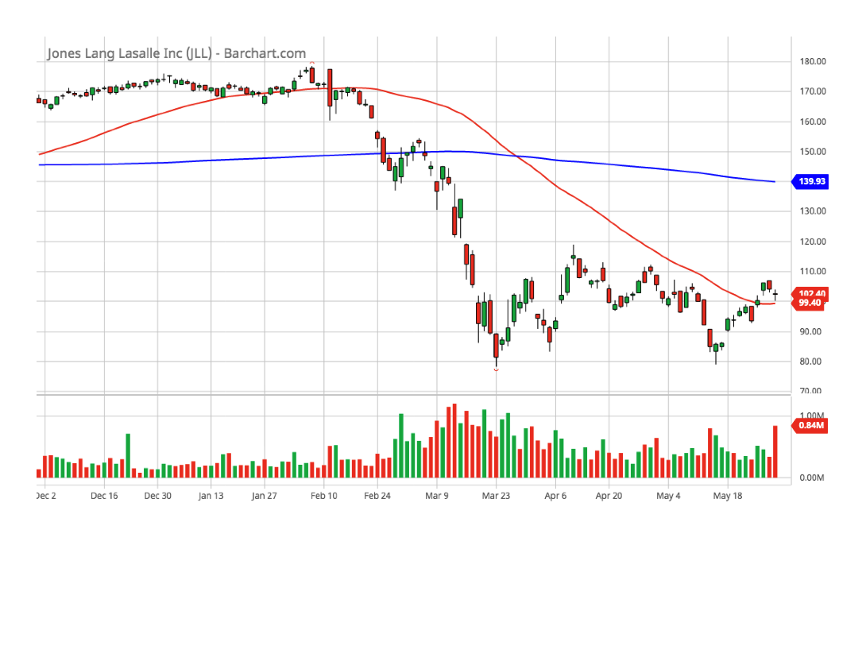
Jones Lang Salle (JLL)(6-month chart)

Slide 39
Jones Lang Salle (JLL)(SSG)

Slide 40
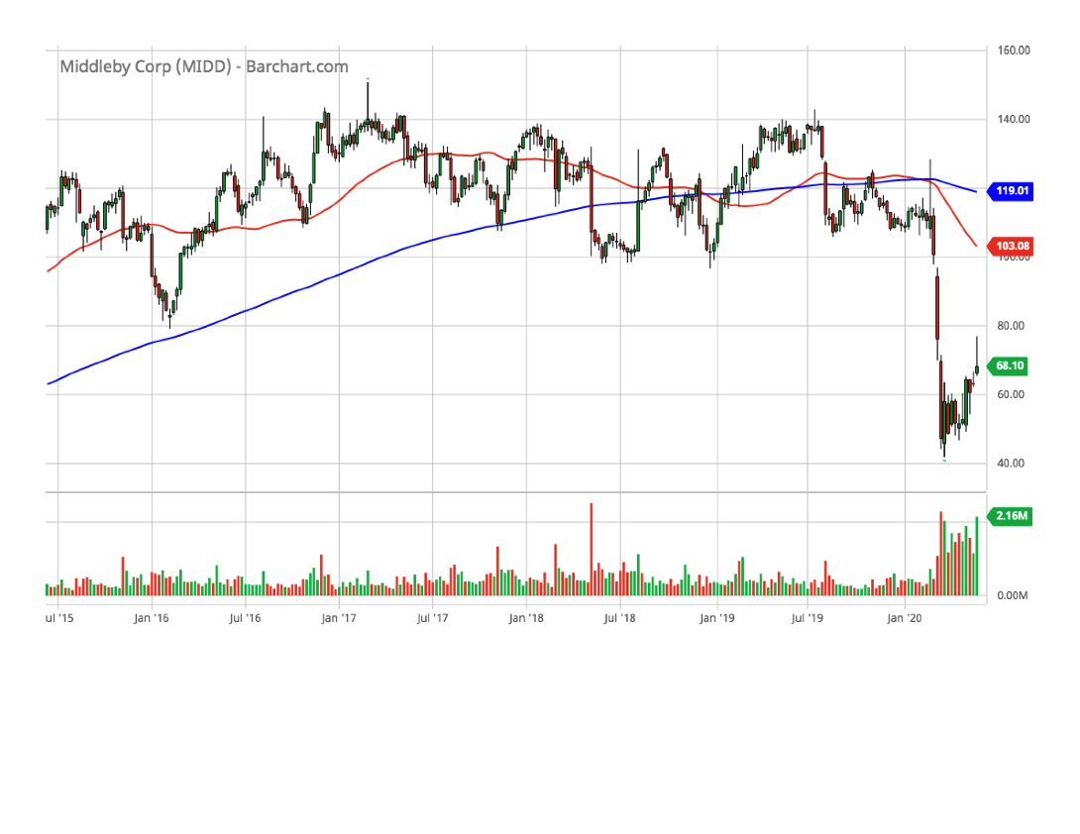
Middleby (MIDD)(5-year chart)

Slide 41
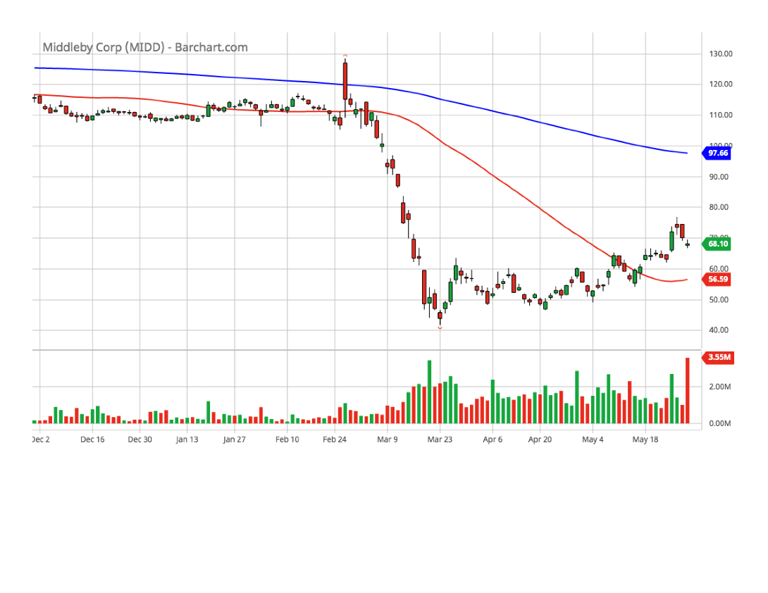
Middleby (MIDD)(6-month chart)

Slide 42
Middleby (MIDD)(SSG)

Slide 43
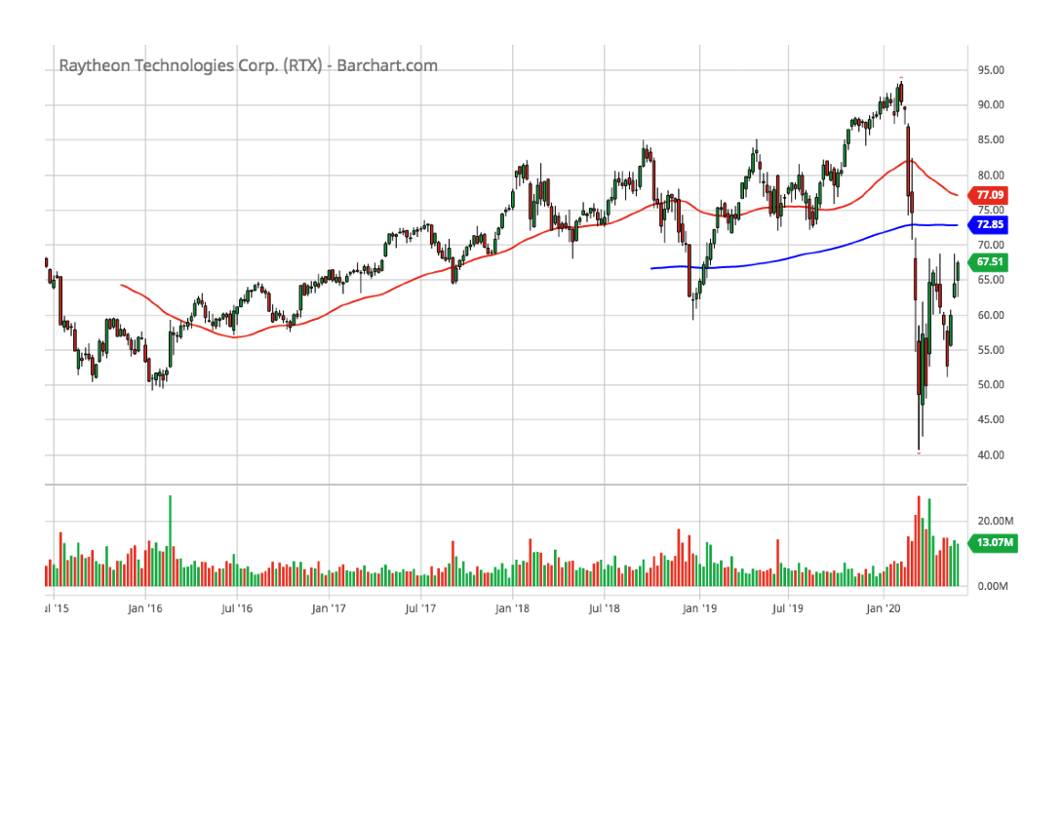
Raytheon Technologies (RTX)(5-year chart)

Slide 44
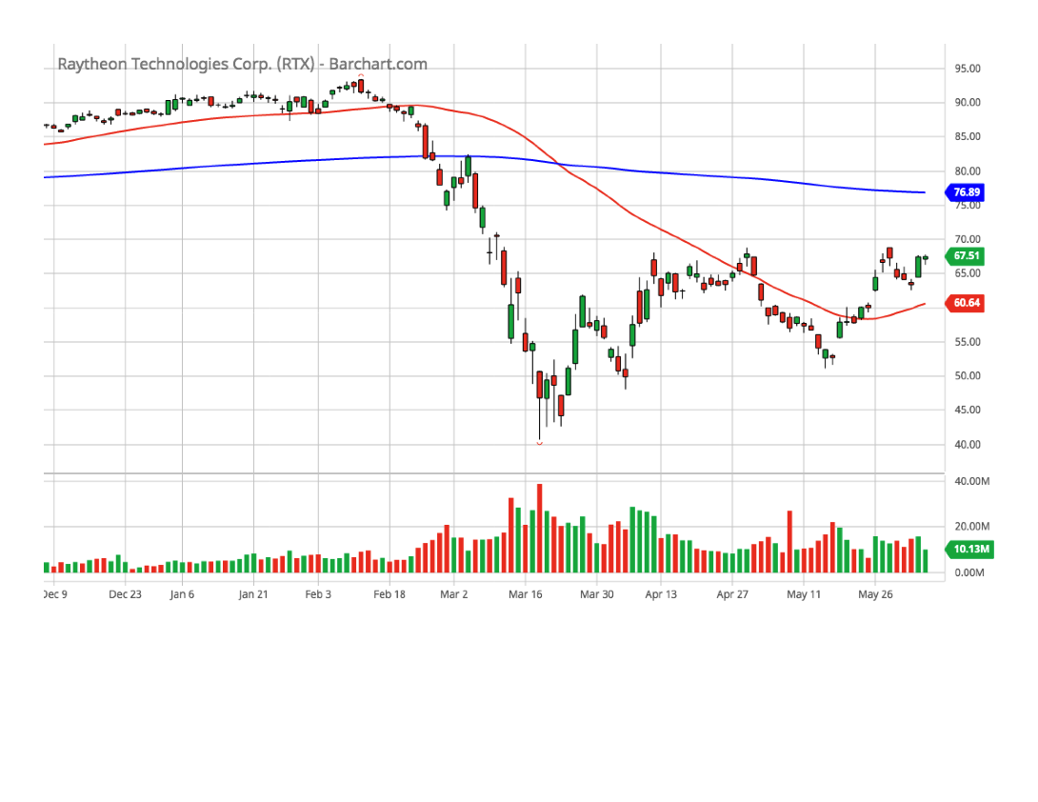
Raytheon Technologies (RTX)(6-month chart)

Slide 45
Raytheon Technologies (RTX)(SSG)

Slide 46
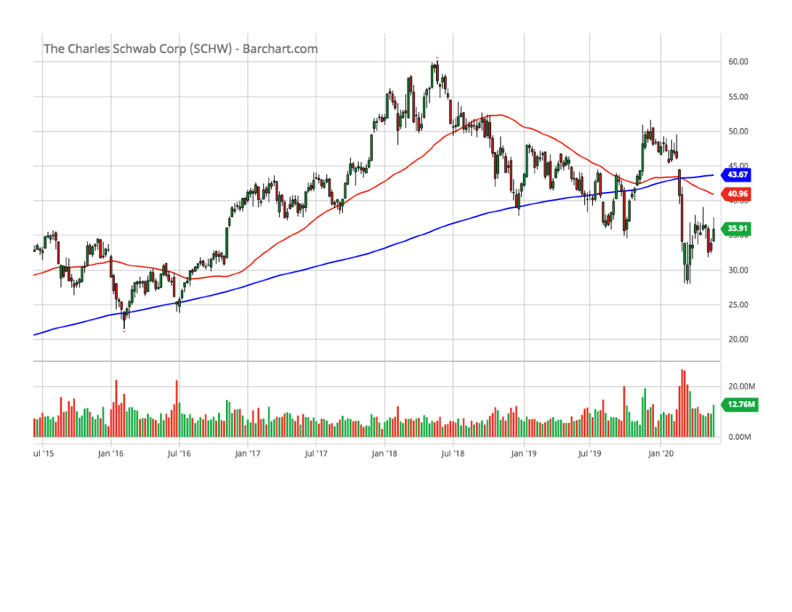
Schwab, Charles (SCHW)(5-year chart)

Slide 47
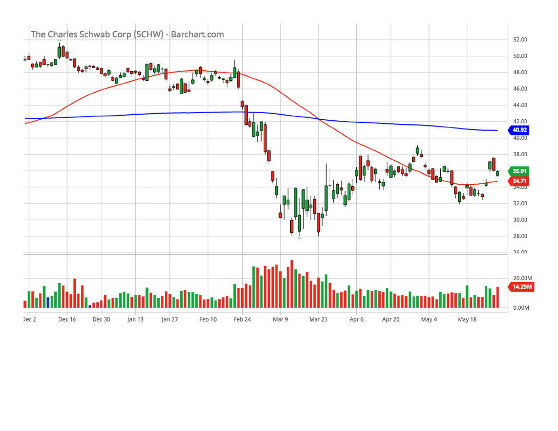
Schwab, Charles (SCHW)(6-month chart)

Slide 48
Schwab, Charles (SCHW)(SSG)

Slide 49
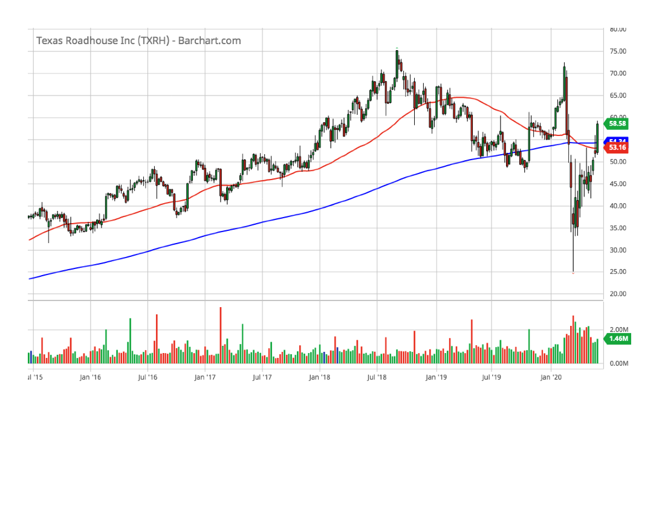
Texas Roadhouse (TXRH)(5-year chart)

Slide 50
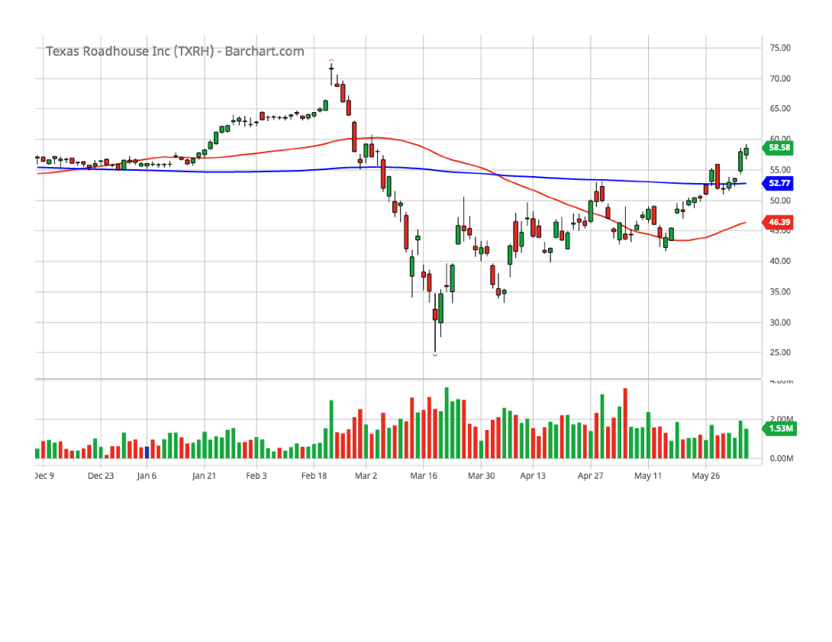
Texas Roadhouse (TXRH)(6-month chart)

Slide 51
Texas Roadhouse (TXRH)(SSG)

Slide 52
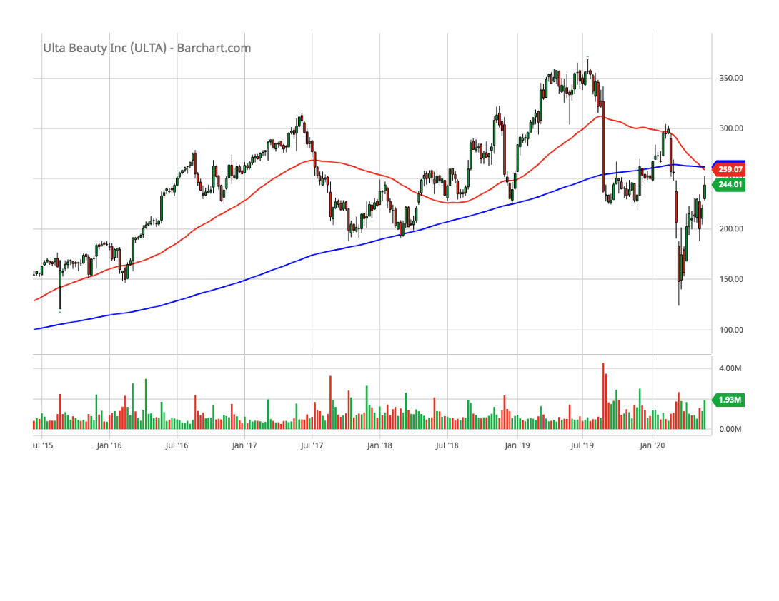
Ulta Beauty (ULTA)(5-year chart)

Slide 53
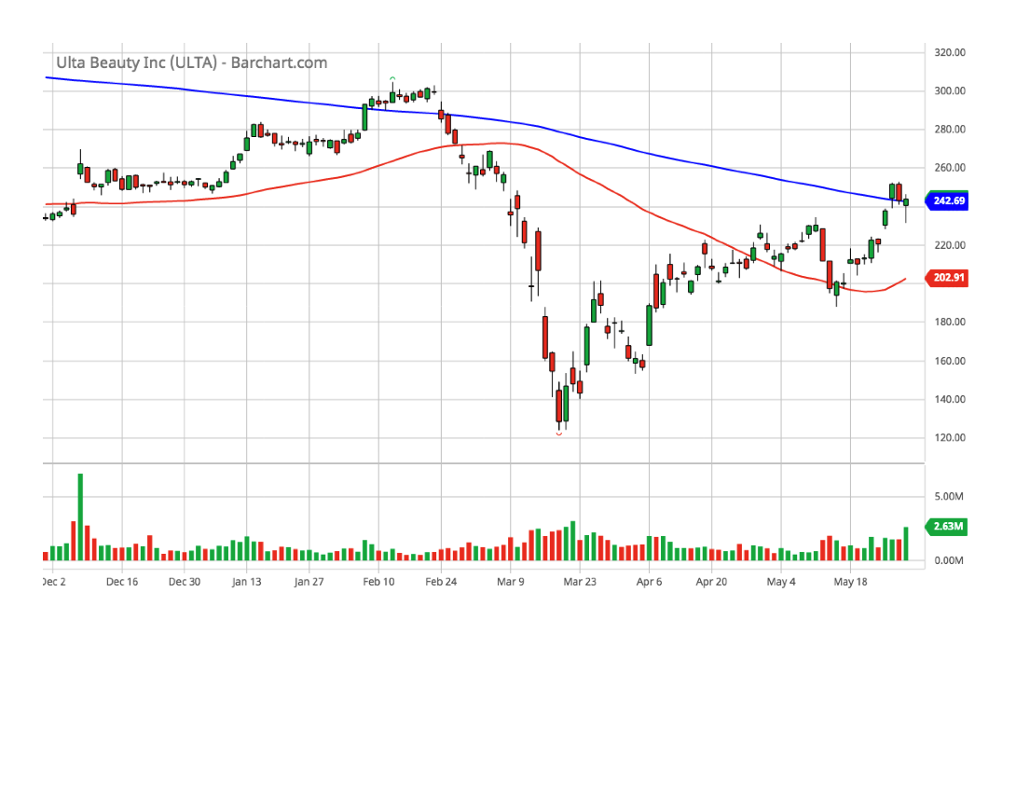
Ulta Beauty (ULTA)(6-month chart)

Slide 54
Ulta Beauty (ULTA)(SSG)

Slide 55
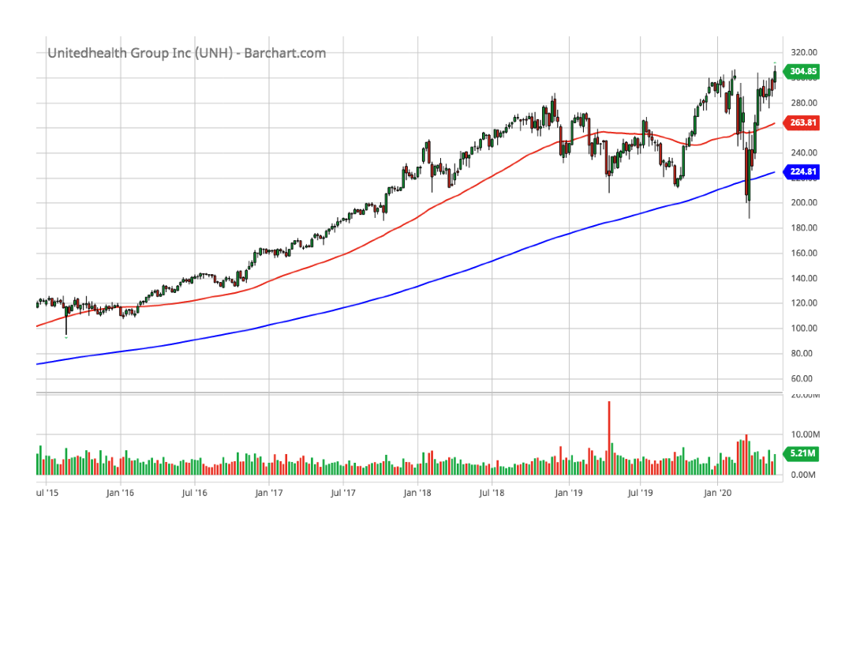
UnitedHealth Group (UNH)(5-year chart)

Slide 56
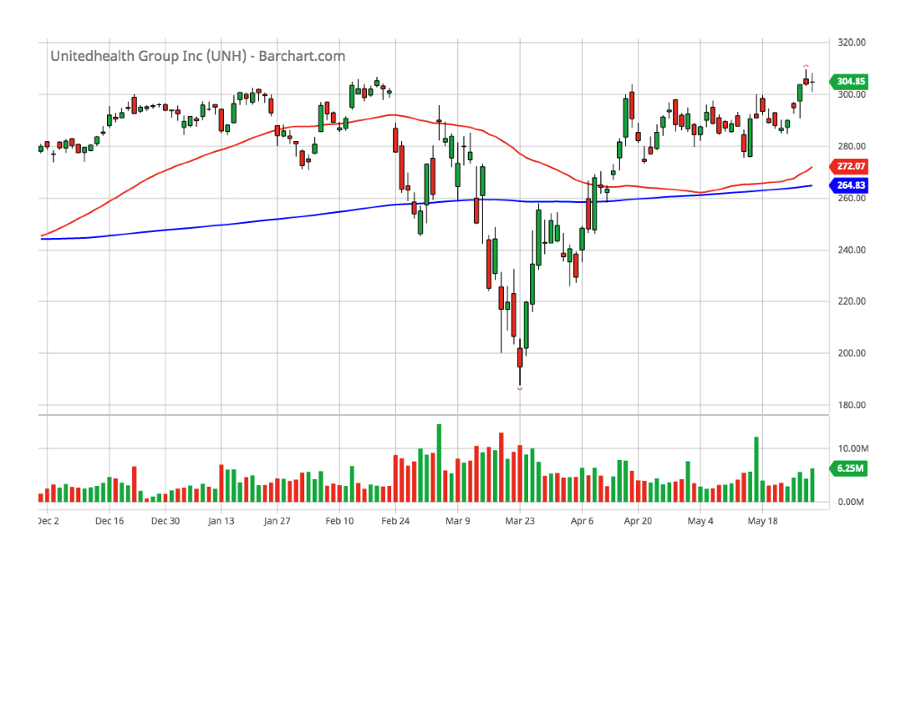
UnitedHealth Group (UNH)(6-month chart)

Slide 57
UnitedHealth Group (UNH)(SSG)

Slide 58
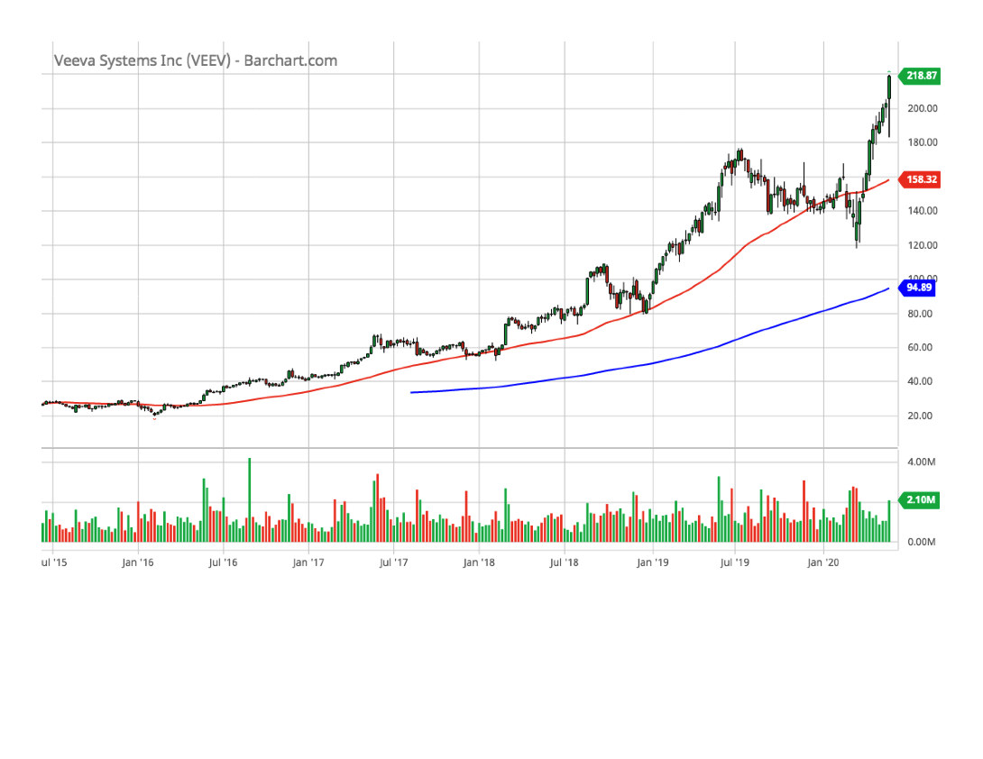
Veeva Systems (VEEV)(5-year chart)

Slide 59
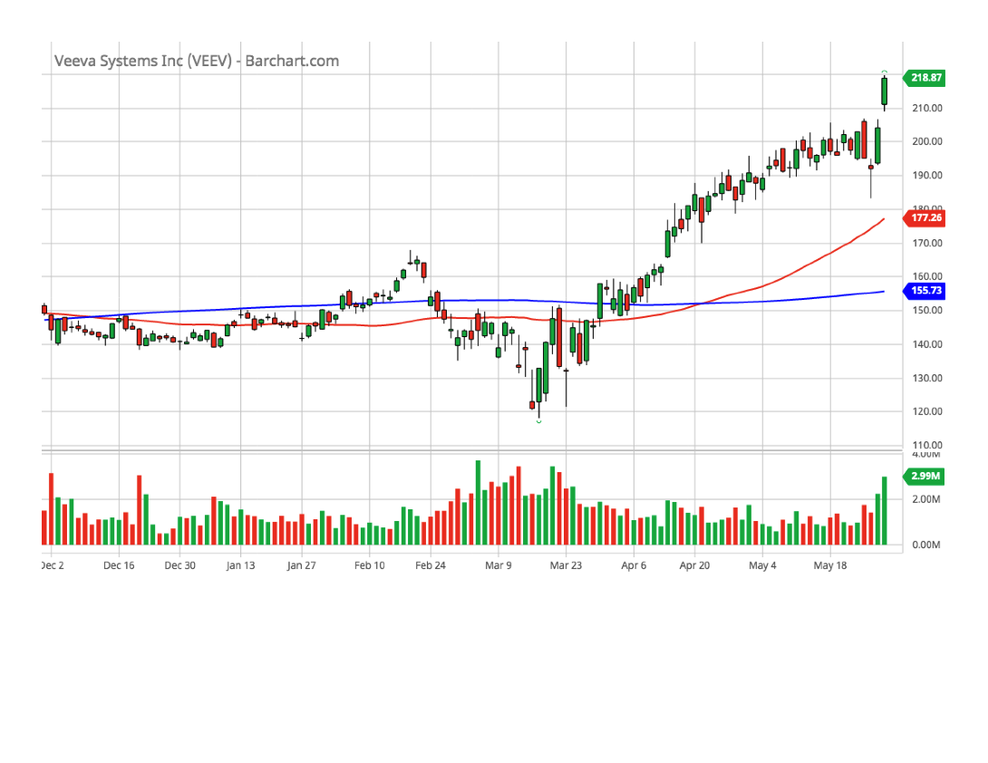
Veeva Systems (VEEV)(6-month chart)

Slide 60
Veeva Systems (VEEV)(SSG)

Slide 61
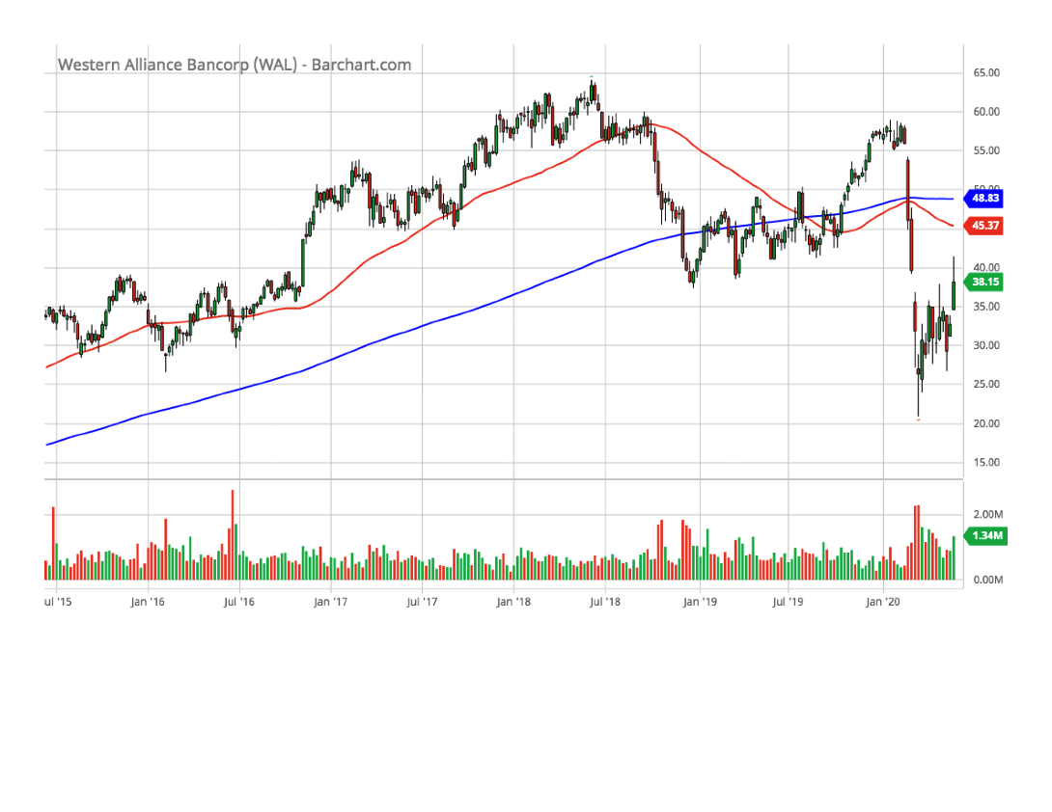
Western Alliance (WAL)(5-year chart)

Slide 62
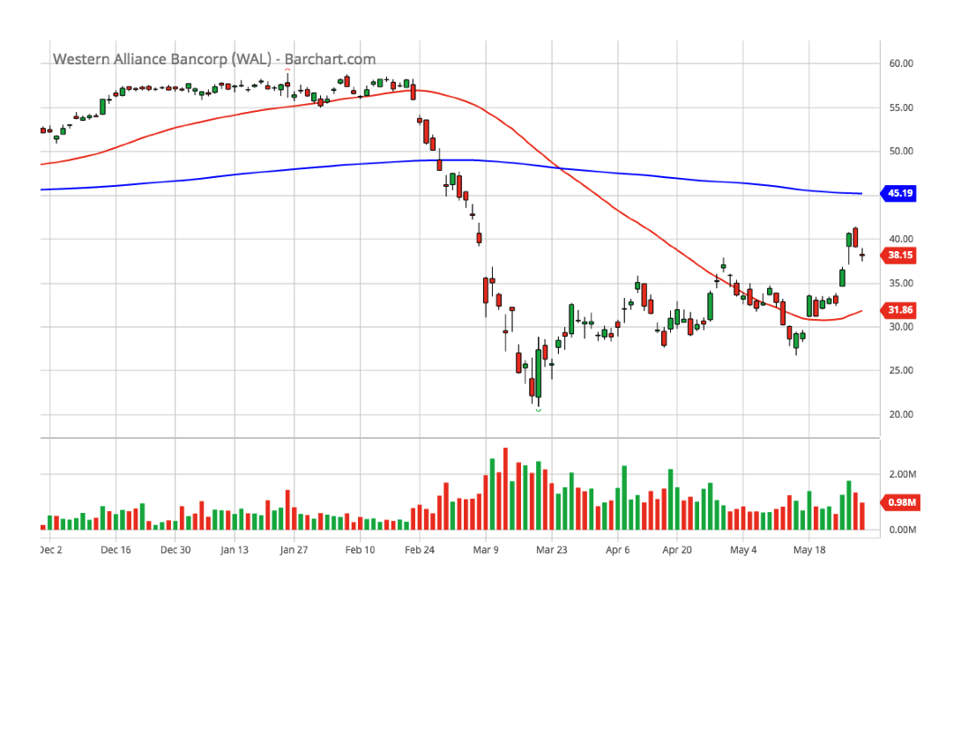
Western Alliance (WAL)(6-month chart)

Slide 63
Western Alliance (WAL)(SSG)

