Slide 1
Research: Beyond the Basics
Sheryl Patterson
Director, DC Chapter BI
bi_dc_chapter@verizon.net
srap14@gmail.com
Notes:
1
Main Title Slide (w/animation)

Slide 2
Disclaimer
The information in this presentation is for educational purposes only and is not intended to be a recommendation to purchase or sell any of the stocks, mutual funds, or other securities that may be referenced. The securities of companies referenced or featured in the seminar materials are for illustrative purposes only and are not to be considered endorsed or recommended for purchase or sale by BetterInvesting™ National Association of Investors Corporation (“BI”) or the National Investors Association, its volunteer advisory board (“NIA”). The views expressed are those of the instructors, commentators, guests and participants, as the case may be, and do not necessarily represent those of BetterInvesting™ or NIA. Investors should conduct their own review and analysis of any company of interest before making an investment decision.
Securities discussed may be held by the instructors in their own personal portfolios or in those of their clients. BI presenters and volunteers are held to a strict code of conduct that precludes benefiting financially from educational presentations or public activities via any BetterInvesting programs, events and/or educational sessions in which they participate. Any violation is strictly prohibited and should be reported to the President of BetterInvesting or the Manager of Volunteer Relations.
Notes:
2

Slide 3
Why do Research?
I would like to share some sites that are beyond the basics.
Notes:
For those of us that use the Stock Selection Guide or “SSG”, the realization that the information derived from the SSG only gives us 80% of the total information needed to decide if the chosen stock to study will potentially give us the profit that we are looking for to round out our portfolio.
But, how do we find that golden stock among the 1,700 stock covered by Value Line and Morningstar and those covered by the S&P 500, Mid-Cap and Small Cap that are the go-to basic research sites for many SSG users.

Slide 4
Sites Covered
1. Investopedia
2. FINVIZ
3. Zacks
4. Yahoo Finance and other news
5. Barron’s
Notes:
The first step to discovering the best investment research sites is to see which sites that the trusted names in investing are choosing and I found ideal recommendations by Forbes, Morningstar,

Slide 5
INVESTOPEDIA
http://www.investopedia.com/

Slide 6
Investopedia
Leading source of Financial Content on the web
Financial Dictionary
News, Education, and Tools
Tutorials and Videos
Notes:
The world of investing brings new and unfamiliar words to our world and investment sites may not take up scarce space to provide its user with appropriate and complete definitions the bring the user understanding within the context of different situations.
Investopedia bridges that gap with tutorials and articles broken down by investment level and style, such as Beginners, Active Traders, Intermediate, Advanced investors and Retirement.

Slide 7
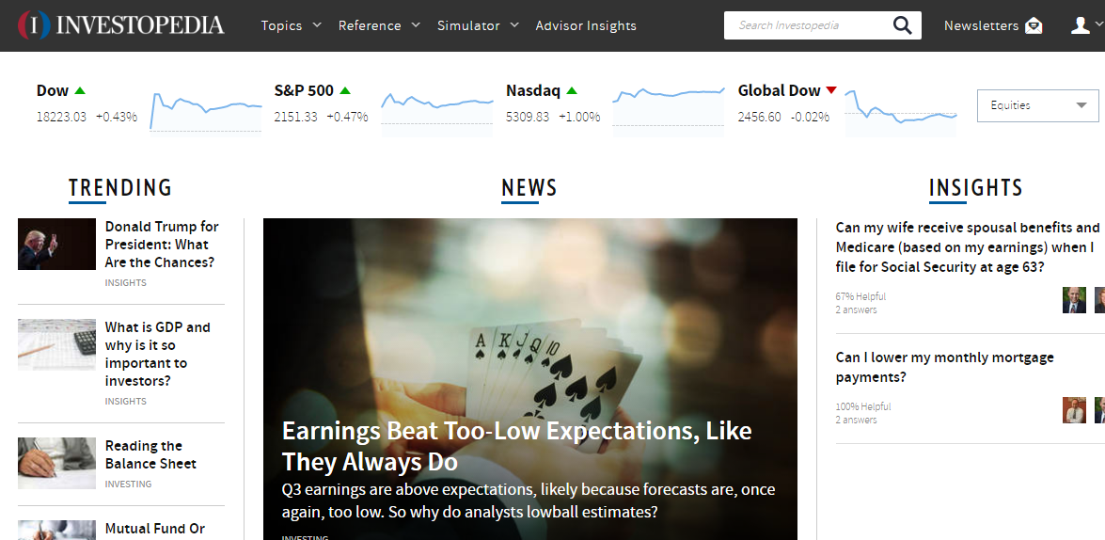
Notes:
On the home page of Investopedia, you can find today’s results of the major exchanges, issues for different levels of investors’ needs, crucial investment news and well thought-out answers to submitted questions.
Under the top black bar:
Topics is a index by groupings of areas found within the site such as Managing Wealth, Retirement and Personal Finances
2. Reference contains the dictionary, videos, Guides to Stock, Options and Economics Basics and Exam Preps for CPA and other financial exams.
3. Simulator contains their Stock Simulator where you can trade with a starting balance of $100,000 with zero risk and their FX trader where your can trade the Forex market.
4. Advisor Insights where their network of financial advisors field community questions, and
5. Newsletter recommendations

Slide 8
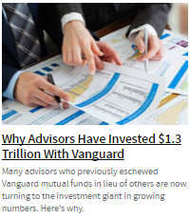
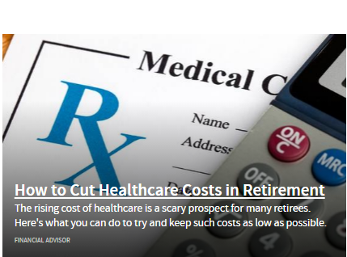
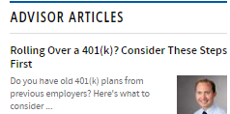
Notes:
A sampling

Slide 9
FINVIZ
http://finviz.com/

Slide 10
ZACKS
https://www.zacks.com/

Slide 11
YAHOO FINANCE
https://finance.yahoo.com/

Slide 12
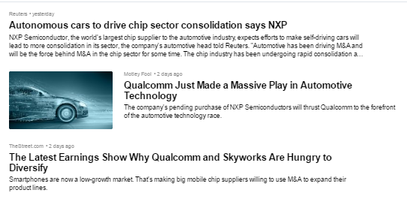
Yahoo Financial

Slide 13
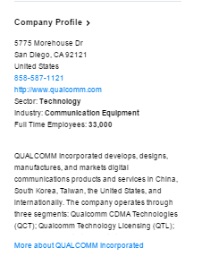
Yahoo Financial

Slide 14
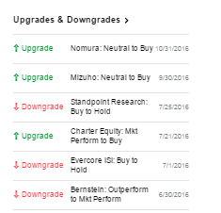
Yahoo Financial

Slide 15
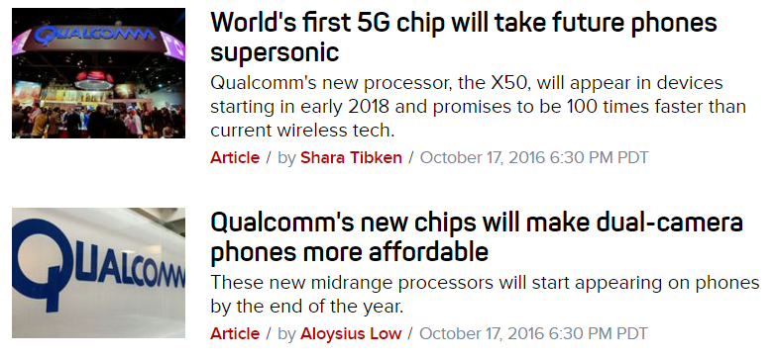
CNET News

Slide 16
Barron’s
http://www.barrons.com/

Slide 17
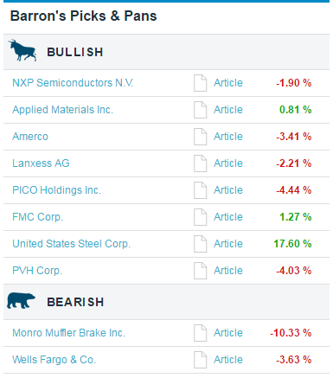

Slide 18
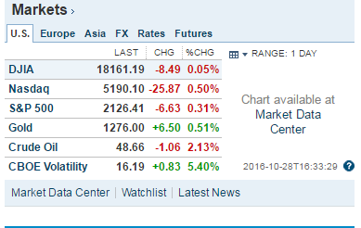

Slide 19
SEC EDGAR: www.sec.gov/edgar/searchedgar/webusers.htm
Seeking Alpha: www.seekingalpha.com
Notes:
The Securities and Exchange Commission (SEC) publishes filings for publicly traded companies in its EDGAR system. Pay particular attention to Form 10-K, which is a company’s annual report and a gold mine of information. Form 10-Q includes complete quarterly information. Free. Seeking Alpha: www.seekingalpha.com
Seeking Alpha publishes quarterly conference call transcripts for many companies. These transcripts can offer insight into a company’s performance over prior quarters and management’s outlook for the future. Registration is free.

Slide 20
Coming Events
Tue Nov 8 – Money Matters Book Discussion at Oakton Library, 7 – 8:30 pm, 10304 Lynnhaven Place, Oakton
Thur Nov 10 – SSGPlus Tutorial. 8:30-9:45pm. Free. Register at www.betterinvesting.org.
Wed Nov 16: Montgomery County Investment Club, Rockville Library, 21 Maryland Ave, Rockville, MD
Thur Nov 17: Virginia Model Club, Dolley Madison Library, 1244 Oak Ridge Ave, McLean, 7-9 pm, Free (check WWW.MICNOVA.net for location changes

Slide 21
SSG CLASSES
Sat Nov 12: Stock Selection Guide (SSG), 9am–4pm at UVA Virginia Center, 7054 Haycock Rd, Falls Church, VA. An in-depth presentation of the BI structure & method of fundamental analysis tool . Cost $50
Sat Nov 19: (2) Software to Improve Stock Picks, 9 a.m. – 12 noon. Bring your laptop. Cost $30
Sat Nov 19: (3) Improve Your Analysis Skills, Practice forming good estimates o (see note) n the 5 judgment points of the SSG. 1 p.m. – 4 p.m. $30*
Note: Nov 12 and 19 classes: $80 total for both days & all three sections, or can pick & choose individual sections at prices indicated.
Register online at Eventbrite (key word Betterinvesting) or at BetterInvesting.org/DCRegional or pay by check using the form on the Fall Newsletter

Slide 22
NEXT CHAPTER WEBINAR
Chapter Webinar: Portfolio Management,
Mon Dec 5: 8:30pm-9:30pm
Leave your email address at Chapter event or
Register at www.betterinvesting.org/dcregional,
Fee waived

