Slide 1
Highlights of 2019 BINC!
< PLACE LOGO HERE >
IF APPROPRIATE
BetterInvesting DC Regional Chapter
June 3,, 2019
Notes:
Presentation Title Slide (w/animation)

Slide 2
Disclaimer
The information in this presentation is for educational purposes only and is not intended to be a recommendation to purchase or sell any of the stocks, mutual funds, or other securities that may be referenced. The securities of companies referenced or featured in the seminar materials are for illustrative purposes only and are not to be considered endorsed or recommended for purchase or sale by BetterInvesting™ National Association of Investors Corporation (“BI”) or the BetterInvesting Volunteer Advisory Board, its volunteer advisory board (“BIVA”). The views expressed are those of the instructors, commentators, guests and participants, as the case may be, and do not necessarily represent those of BetterInvesting™ or BIVA. Investors should conduct their own review and analysis of any company of interest before making an investment decision.
Securities discussed may be held by the instructors in their own personal portfolios or in those of their clients. BI presenters and volunteers are held to a strict code of conduct that precludes benefiting financially from educational presentations or public activities via any BetterInvesting programs, events and/or educational sessions in which they participate. Any violation is strictly prohibited and should be reported to the President of BetterInvesting or the Manager of Volunteer Relations.

Slide 3
Chapter Events
Saturday, July 13th - DC Chapter Planning Meeting – Battery Park Clubhouse, 7908 Glenbrook Road, Bethesda, MD - 9 am-3 pm
All chapter members should plan to attend in person or contact me for an online Go-to-meeting link. The agenda will include filling chapter positions and setting up future chapter events.
Please bring a potluck dish for lunch and an item for breakfast.
Learn about the perks of a chapter visit (either in person or through a Go-to-Meeting conference call). What would benefit your club? We could offer a portfolio review or take a fresh group look at a stock in your portfolio or at a challenging idea. How about a tour of new items on the BI website? Let us help! Contact the chapter at contact@dc.betterinvesting.net
Notes:
We’re getting down to the end of our planned events which means it’s time for our planning meeting and the need for all hands on deck. This year’s meeting will be hosted once again at Joy Garrish’s community clubhouse with WiFi for an Internet conference call, plenty of seating, and a full kitchen. Come prepared to volunteer your time and talent.
BINC was all about sharing information and knowledge and we want to be able to extend that to the over 200 clubs in our chapter region (One at a time, please). If any of our audience would like to discuss how we can assist your club, please contact us.

Slide 4
Reconnect with Conference friends
Make new connections
New Stock Ideas
Learn new methods and teaching ideas
Positive Energy
Notes:
For me, secondary to the sharing of knowledge and stock ideas are the people. Meeting with friends that I usually only see once a year. New acquaintances like the roommate who answered my Chapter Chat, the person I was talking with via email who sat down next to me in the Financial Empowerment class (great event that another director will talk to) or the enthusiastic First Timer from Chicago. All of these and more create the positive energy that keeps me coming back to the National Conference each year.

Slide 5
Notes:
My class highlight is Nicholson’s Triple Play ( a class taught by Nick Stratigos from the Pittsburgh chapter). One of George Nicholson’s favorite subjects has to do with his hunt for undervalued opportunities and the triple play concept. In the triple play, you want a stock whose price has been hammered. The second condition is that the company’s profit margins can improve over time through productivity enhancements or other means. And the third item is this notion of finding a company poised for P/E expansion over the five-year time horizon.I have heard this term often, but never seen it broken down the way Nick has for this class both in terms of the Information available on the Stock Selection Guide and in the popular and available Value Line resource.

Slide 6
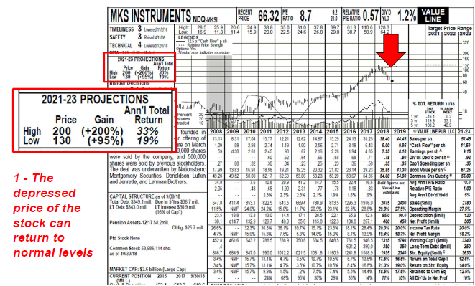
Notes:
Value Line is a popular resource of BI members and is available in either paper form or online at many libraries. The form above is a PDF report that is available for over 6,000 stocks followed by Value Line every 13 weeks. While the jagged price bar line shows that the stock price is down (see red arrow), the Annual Total Return Projections predict between a low of 19% and a high of 33% gain with the price rising from $66.32 to between $130 and $200.

Slide 7
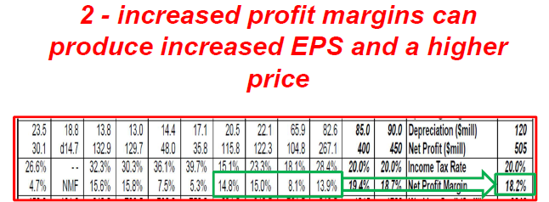
Notes:
Halfway down the Value Line report lists 10 years of more of Net Profit Margins increasing in the last few most recent years and increasing even further in the bold print that are estimates for future years (see the green box above)

Slide 8
Notes:
The possibility of Price to Earning expansion is demonstrated in the Value Line Report by the current P/E ratio above the graph and the Average Annual P/E Ratio five year projection (the number in bold print at the end of the row). For there to be a possibility of expansion, the current P/E must be a lower number than the average future projection with the theory being that the lower number will return to it normal point or the average.

Slide 9
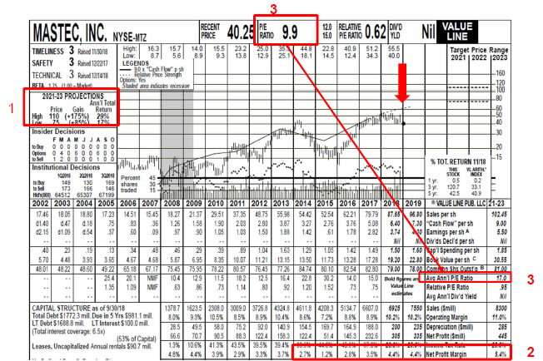

Slide 11
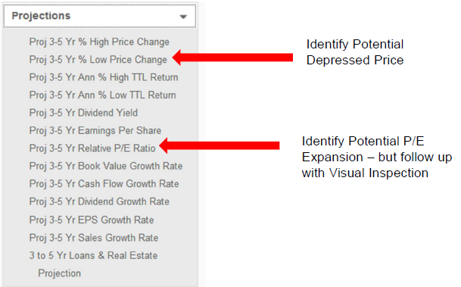

Slide 12
