Slide 1
A look at Cummins Inc. Using ValueLine
Linda Hunt

Slide 2
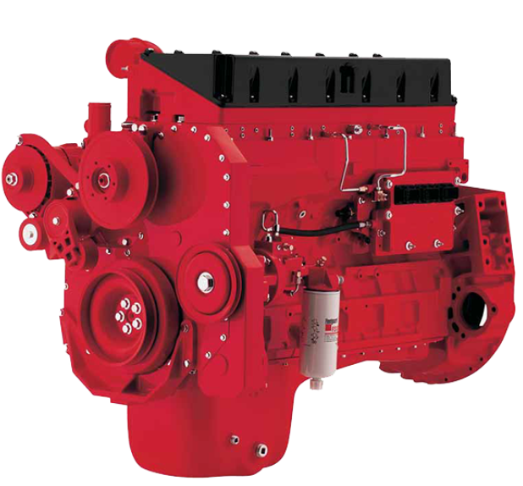

Slide 3
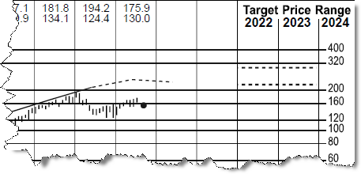
Annual Total Return - Price

Slide 4
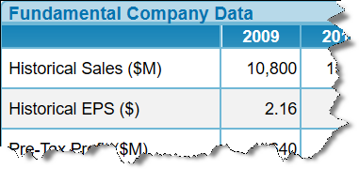
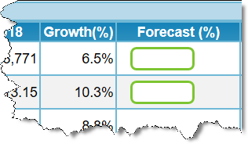
Annual Growth Rates

Slide 5
Yearly Calculations

Slide 6
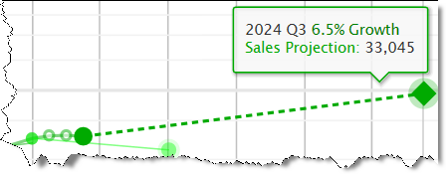
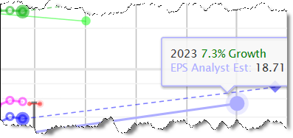

Slide 7
Capital Structure

Slide 8
Analyst’s Analysis and Financial Strength

Slide 9
Stock Selection Guide

Slide 10
Price Earnings Ratio Yearly calculation, middle of page

Slide 11
Return on Equity

Slide 12
Stock Up

Slide 13
Additional Resources
How to Read a Financial Report. John A. Tracy
Financial Statements: a step-by-step guide to understanding and creating financial reports. Thomas R. Ittelson
Financial Shenanigans: how to detect accounting gimmicks and fraud in financial reports. Howard Schilit

