Slide 1
MicNova’s Education Approach to Evaluating Stocks, 2019-2020
(Adapted from BI leader, Kathleen Richards’ “Deep Dive a Stock”)

Slide 2
Club Education Approach to Evaluating Stocks
Begin: Stock Screening
Part 1 – Conduct “Acid Tests (4)” on Stocks Screened to see if they might be “Gold” (Gold is not destroyed by acid)
Part 2 - Explore the “Gold” vein – is it growing or shrinking? How does it compare to similar veins?
Part 3 – Consult the gold mine’s management (company website) and “Geologists” (independent analysts) to determine prospects of investing in this vein
Part 4 – Making independent estimates of the value of investing in this vein (stock)

Slide 3
Club Education Focus Tonight, Oct 9, 2019
Review: Screen for Good Stock Candidates - Pat Onufrak
Review of Acid Tests – Table Team Exercise (Use data from BI SSG graphs and tables)
Part 1 – Conduct “Acid Tests (4)” on Stocks Screened to see if they might be “Gold” (Gold is not destroyed by acid) New – Explore the “Vein” – Table Team Exercise, Cont.
New: Part 2 – Table Team Exercise - Explore the “Gold” Vein (4 “explorations”) (Use data from BI SSG graphs and tables)
A. P/E Ratios – What are they doing? How might they affect future price?
B. “Normalize” P/E Ratios – How might future price look now?
C. Quarterly Data : Trailing Twelve Month Sales and EPS – How are they moving compared to past year?
D. Peers and/or Industry: How do this stock’s earnings compare to its peers or industry?
Demonstration of Next Steps: New Stock Study – Sheryl Patterson
Part 3 – Consult the gold mine’s management (company website) and “Geologists” (independent analysts) to determine prospects of investing in this vein
Part 4 – Making independent estimates of the value of investing in this vein (stock)

Slide 4
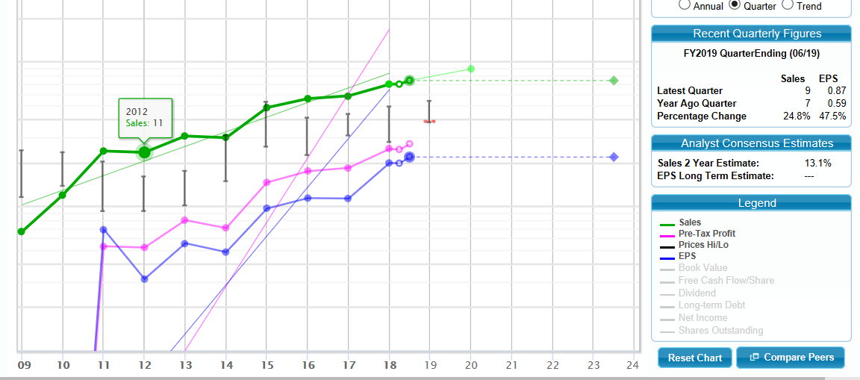
Table Team Exercises: Part I – Review of Acid Tests for Co. “B”
Company “B”
Acid Test #1
Sales: Growing?
Pre-Tax Profit: Growing? Even w. Sales?
Acid Test #2
Acid Test #3
Earnings per Share : Growing? Even w. Sales?
Acid Test #4
Debt: Less than 30%, Declining? Zero?

Slide 5
After Acid Tests: Part 2: Explore the Ore Vein
PRICE:
A. P/E Ratios: What are they doing? Current P/E vs Average P/E Ratio? Higher?___ Same?____ Lower?_____

Slide 6
After Acid Tests: Part 2: Explore the Ore Vein, Cont.
B. P/E Ratios, Cont: If we cross out the exceptionally high P/E ratios, how does the current P/E compare to the new average HIGH P/E (This helps us estimate a more probable future P/E and future price) 1. Current P/E vs New Average HIGH P/E Ratio? Higher?___ Same?____ Lower?_____ 2. Last full year HIGH P/E vs. New Average HIGH P/E? Higher?___ Same?____ Lower?_____ (if lower, P/E may be growing)
Last Yr Hi PE
Avg Hi PE

Slide 7
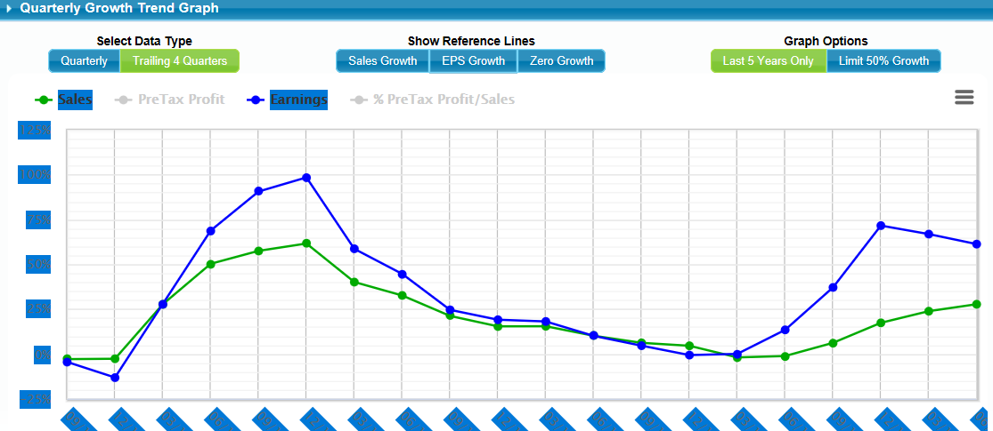
After Acid Tests: Part 2: Explore the Ore Vein, Cont.
C. Examine Quarterly Report: Trailing Twelve Months Sales & Earnings Per Share

Slide 8
After Acid Tests: Part 2: Explore the Ore Vein, Cont.
C. Examine Quarterly Report, Cont: Trailing Twelve Months (TTM) Sales & Earnings Per Share
1. How do the trailing 12 mo Sales and EPS compare to past full year (2018) Sales & EPS?
TTM Sales vs 2018 Sales ($33M) : Higher? ______ Same?__________ Lower?
TTM EPS vs. 2018 EPS ($2.73) : Higher? ______ Same?__________ Lower?
2. Stock’s profitability is probably going ______up, ______ down,______even
3. Stock’s price will probably go ______up, ________down, _________even

Slide 9
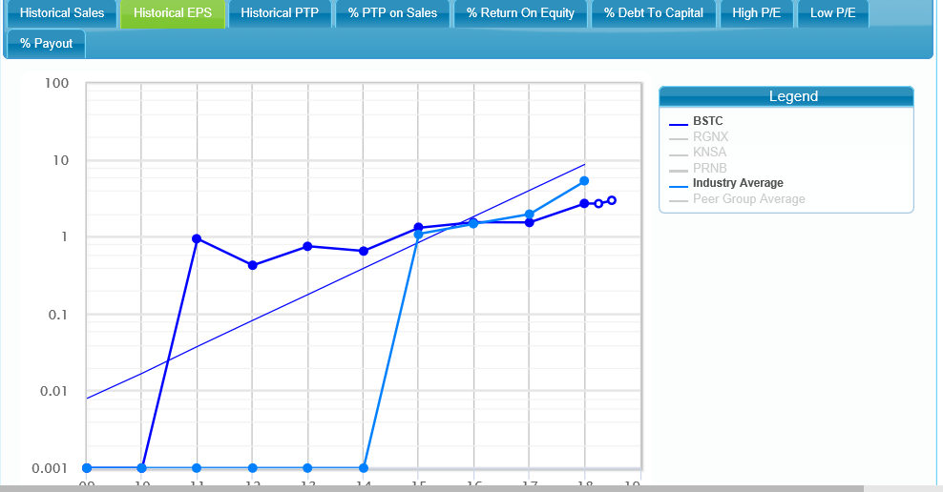
After Acid Tests: Part 2: Explore the Ore Vein, Cont.
D. Peers: Compare Stock Historical EPS to Industry (or Peers)
How does this stock’s earnings compare to peers/ industry? Higher?____ Lower?_____Even?______

Slide 10
After Conducting Acid Tests and Exploring the Ore Vein: Part 3: Consult the “Mine (Stock) Management” and “Geologists”
Consult Mine Management 1. Company Website, Investors 2. SEC filings (Edgar Quarterly and Annual Reports) 3. Other (TBD)
Consult Independent “Geologists” (Analysts) on future prospects of this vein/stock:
Value Line
Morningstar
CFRA
Manifest Investing/Other

Slide 11
After Conducting Acid Tests, Exploring the Ore Vein, and Consulting Mine Management and Geologists (Analysts), Part 4: Estimating the future Performance of this Mine (Stock) and our return

