Slide 1
The Stock Market is Not the Economy and the Economy is Not the Stock Market
McNoVA virtual meeting; Wednesday, June 10, 2020
-- Wilbert Nixon

Slide 2
Dire Economic Headlines

Slide 3
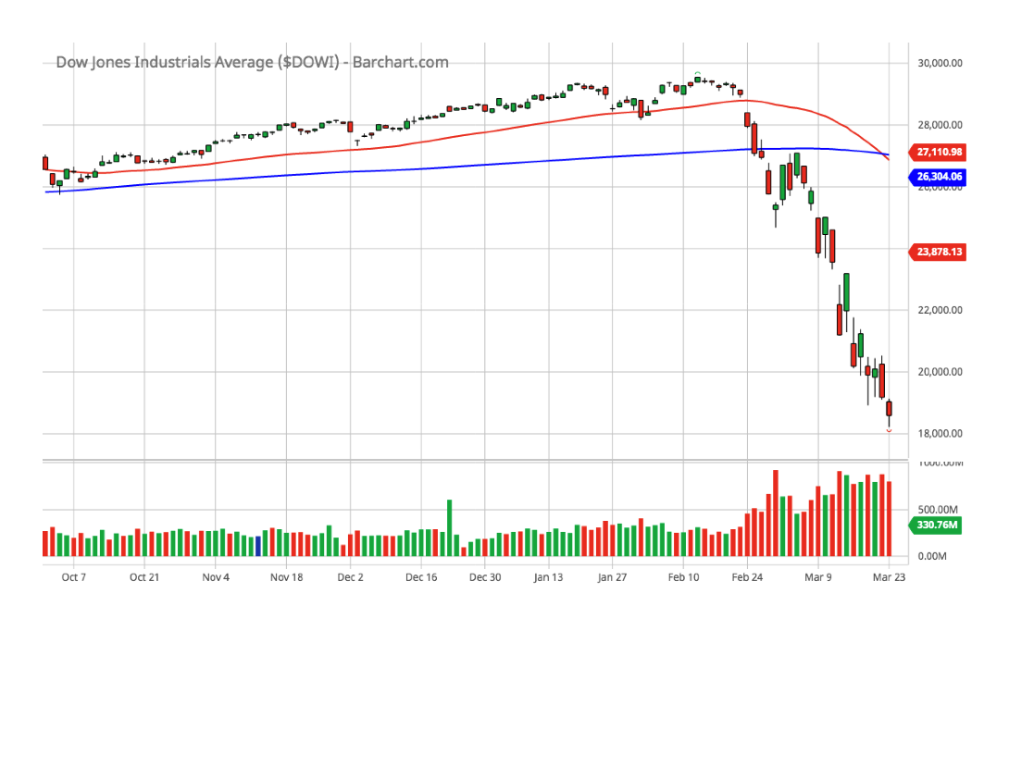
I understand why the stock market fell in March …

Slide 4
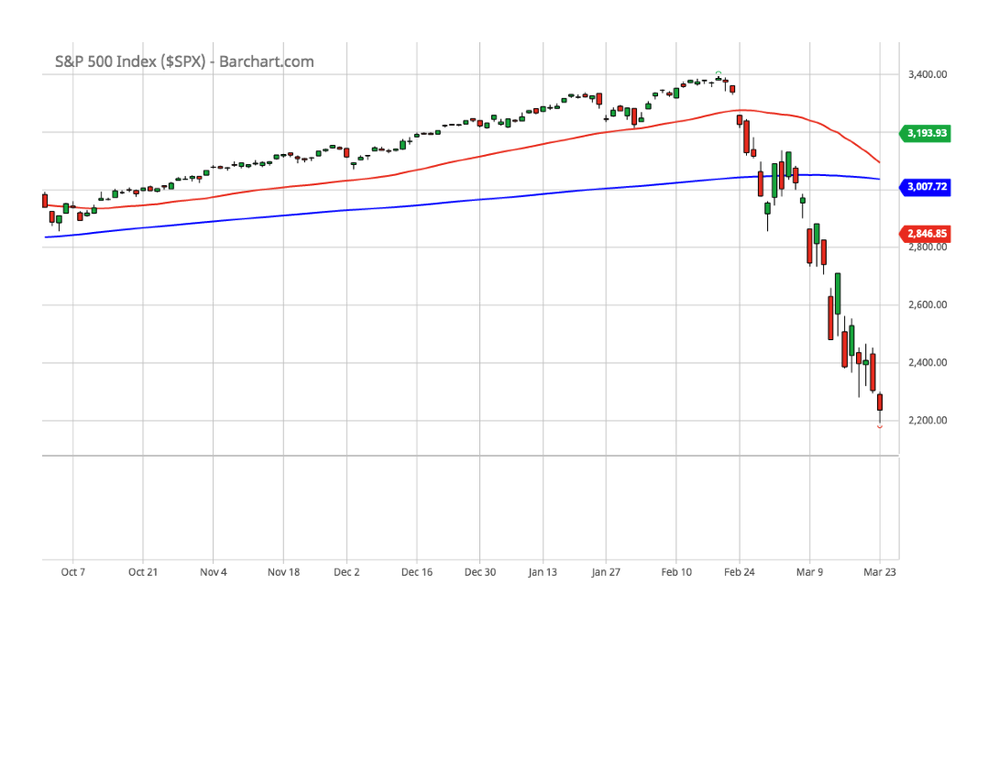
I understand why the stock market fell in March …

Slide 5
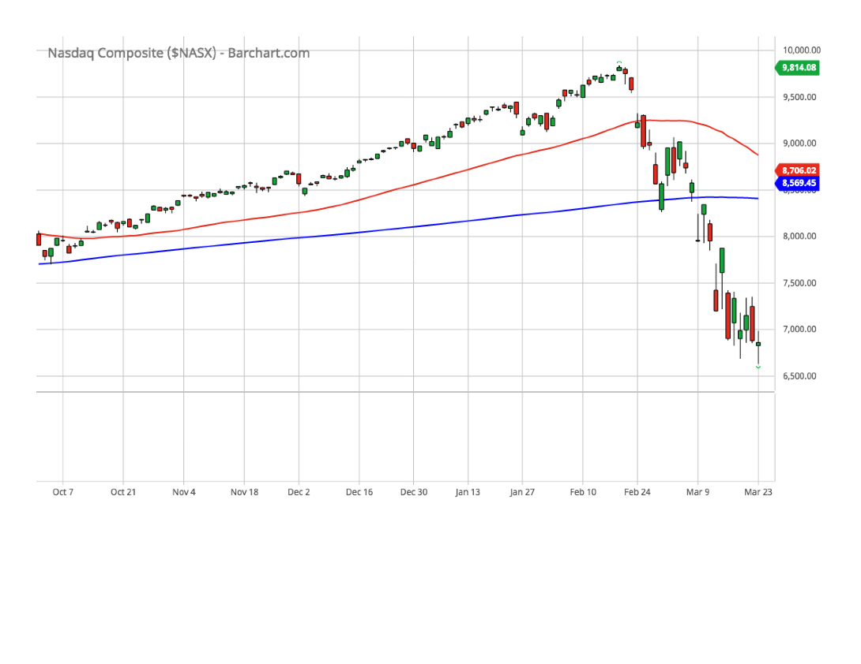
I understand why the stock market fell in March …

Slide 6
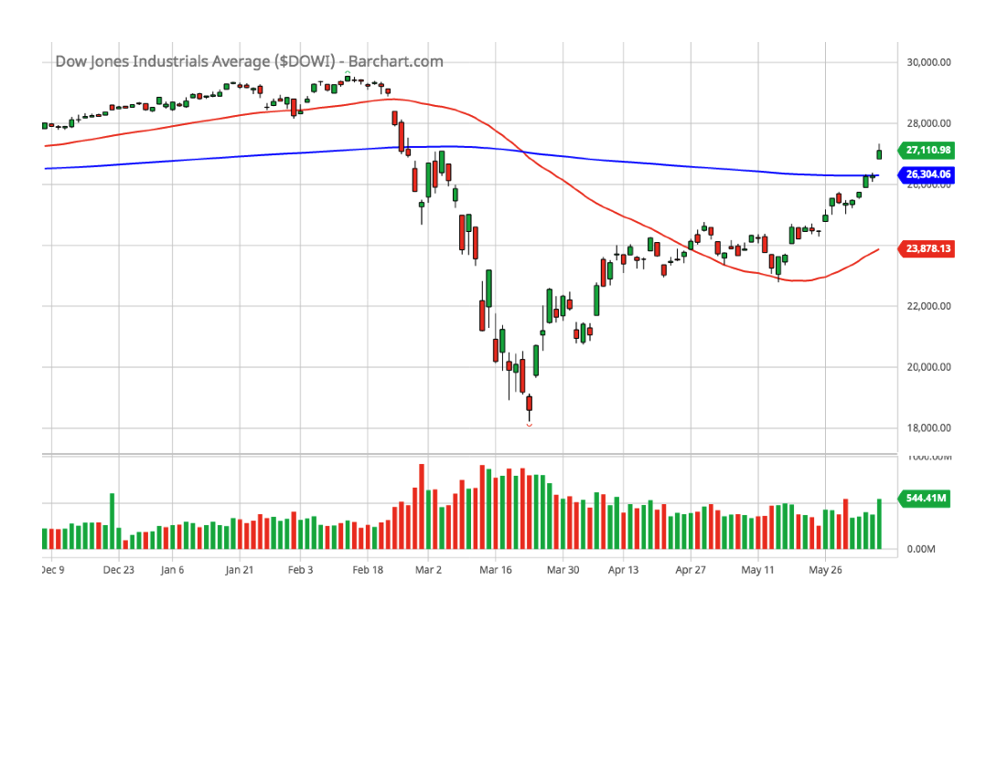
… but why the rise in April, May and June?

Slide 7
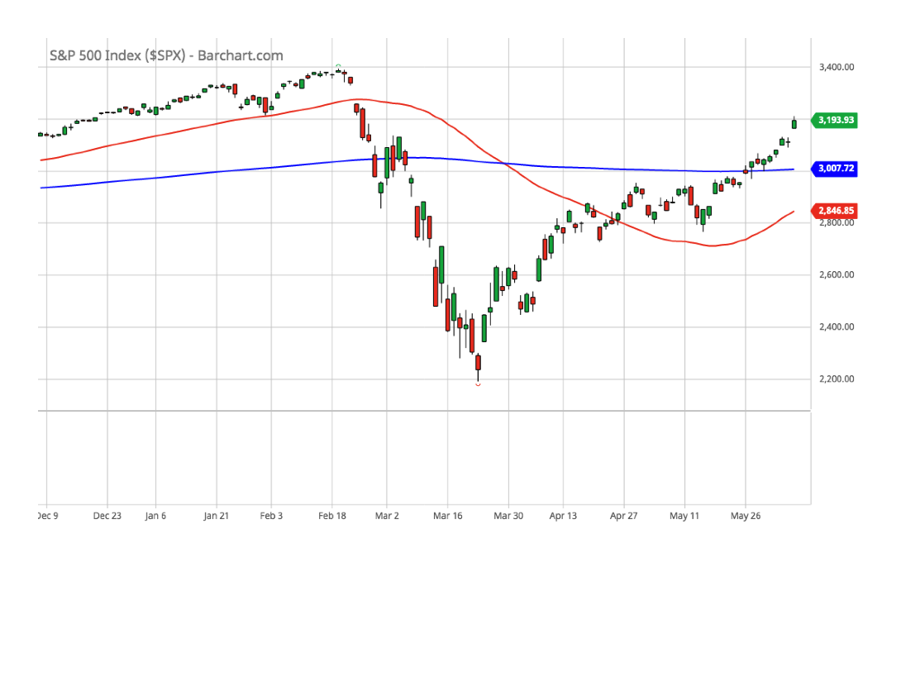
… but why the rise in April, May and June?

Slide 8
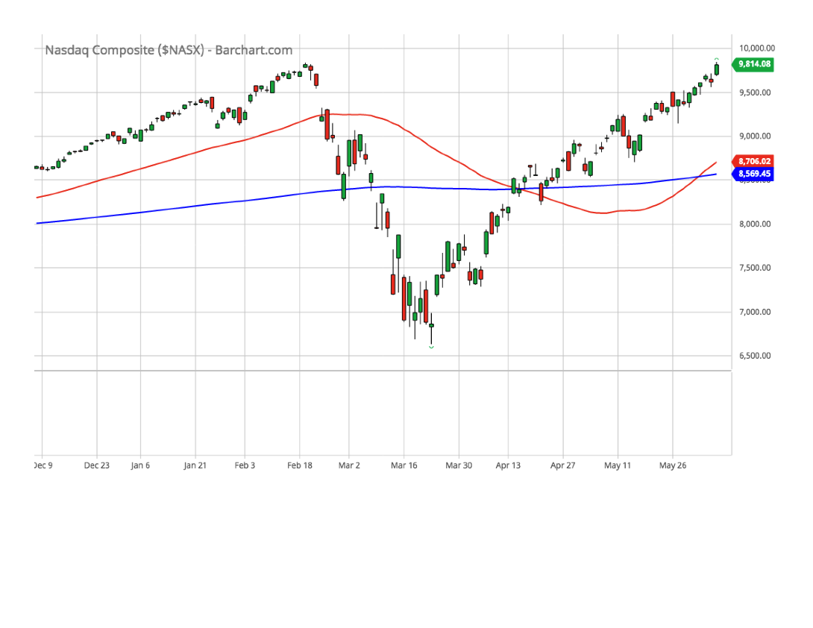
… but why the rise in April, May and June?

Slide 9
Marketplace (April 27, 2020)
Kai Ryssdal, Host of Marketplace
https://en.wikipedia.org/wiki/Kai_Ryssdal
Anat R. Admati
The George G.C. Parker Professor of Finance and Economics
Professor of Economics (by courtesy), School of Humanities and Sciences
Senior Fellow, Stanford Institute for Economic Policy Research
www.gsb.stanford.edu/faculty-research/faculty/anat-r-admati

Slide 10

Marketplace (April 27, 2020)
– the clip

Slide 11
Marketplace (May 7, 2020)
Kai Ryssdal, Host of Marketplace
https://en.wikipedia.org/wiki/Kai_Ryssdal
Stacey Cunningham, President of NYSE Euronext Inc.
https://en.wikipedia.org/wiki/Stacey_Cunningham
Andrea Eisfeldt
Laurence D. and Lori W. Fink Endowed Chair in Finance and Professor of Finance
https://www.anderson.ucla.edu/faculty-and-research/finance/faculty/eisfeldt

Slide 12
Marketplace (May 7, 2020)
– the clip

Slide 13
The Wise Investor Show
(May 31, 2020)
Simon R.B. Hamilton
  Host, Wise Investor Show
  The Wise Investor Group
  Robert W. Baird & Co. Incorporated.
  Managing Director, Portfolio Manager

Slide 14
The Wise Investor Show
(May 31, 2020) – the clip

Slide 15
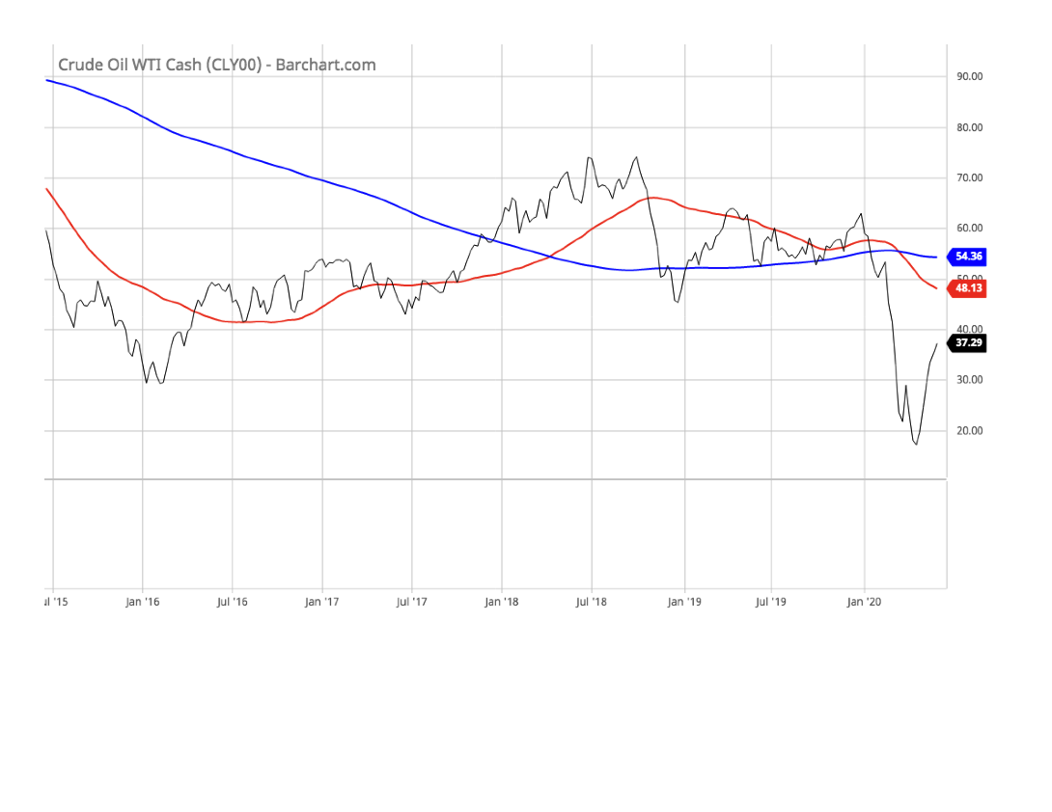
Crude Oil (5y line chart)

Slide 16
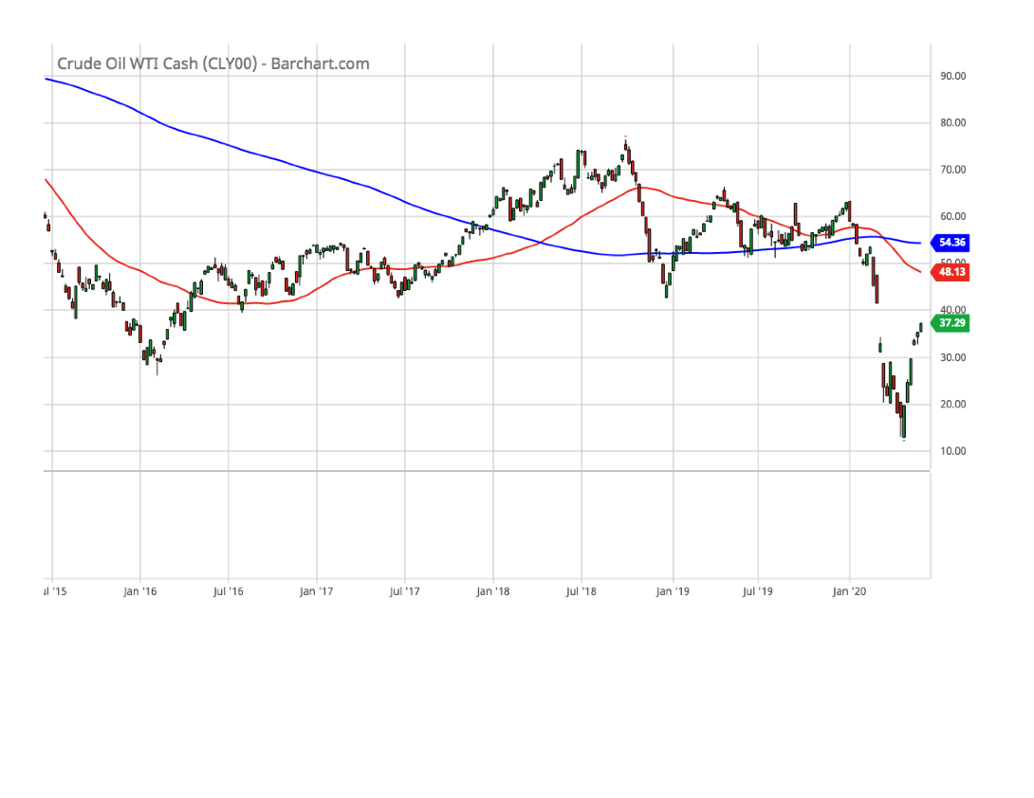
Crude Oil (5y candle chart)

Slide 17
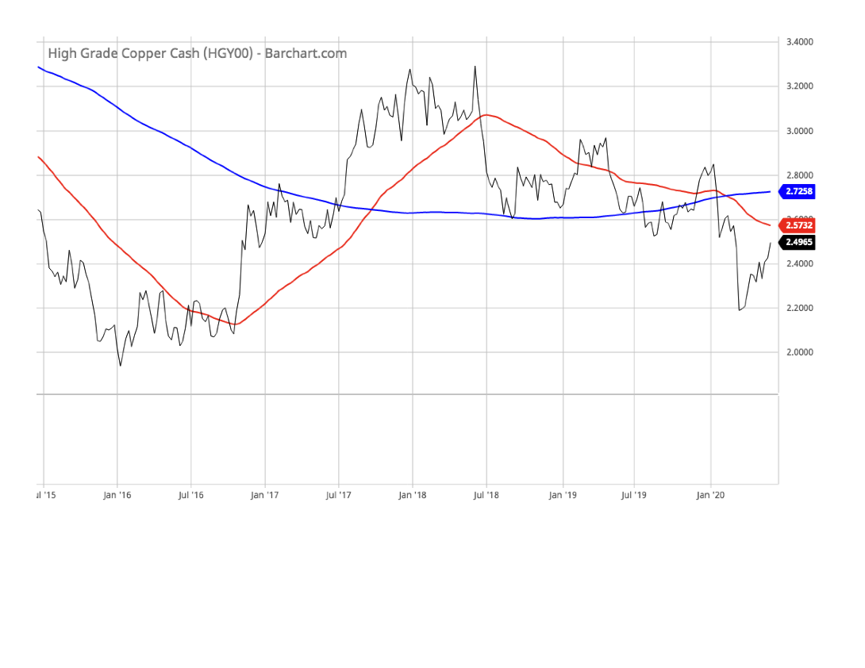
Copper (5y line chart)

Slide 18
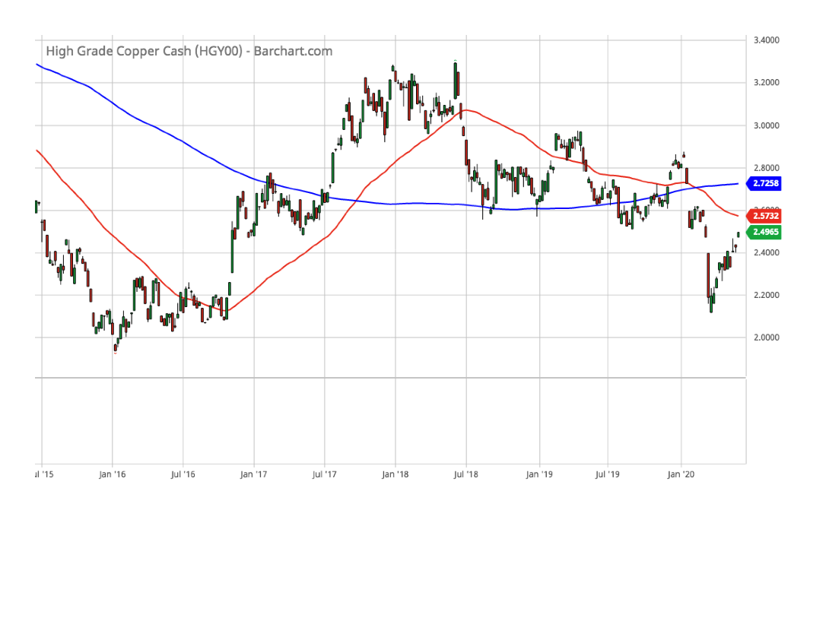
Copper (5y candle chart)

Slide 19
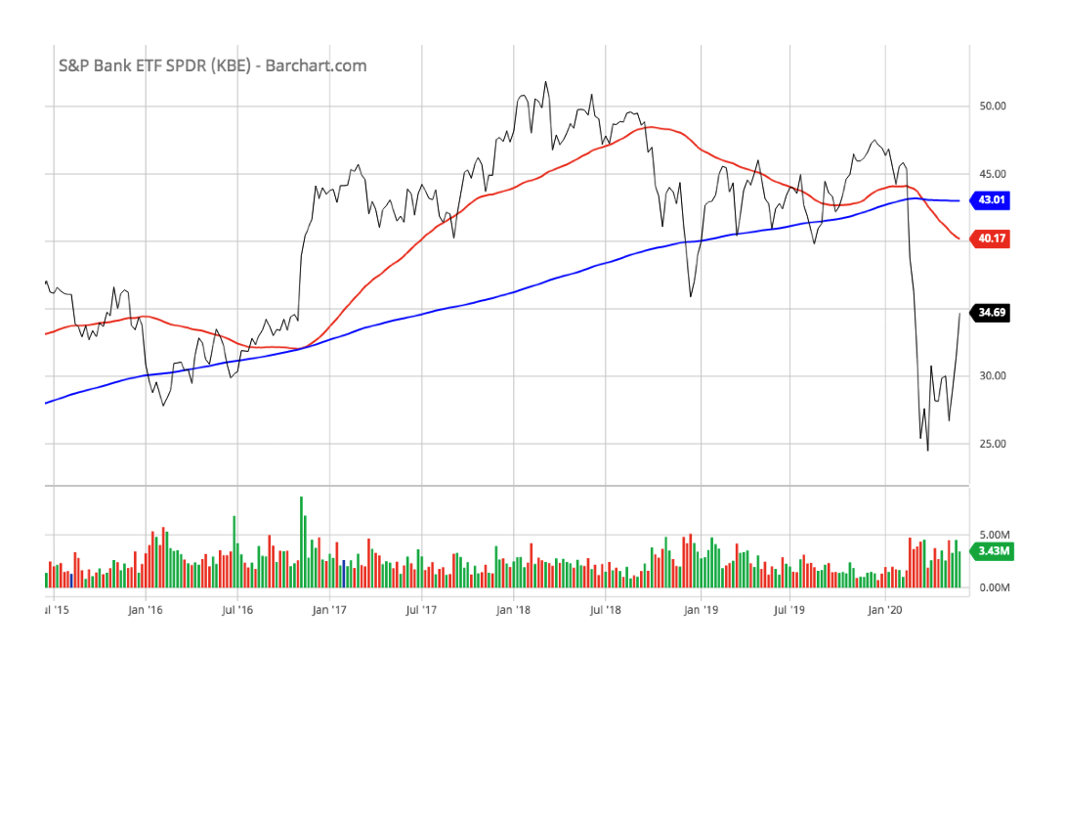
Banks Index (5y line chart)

Slide 20
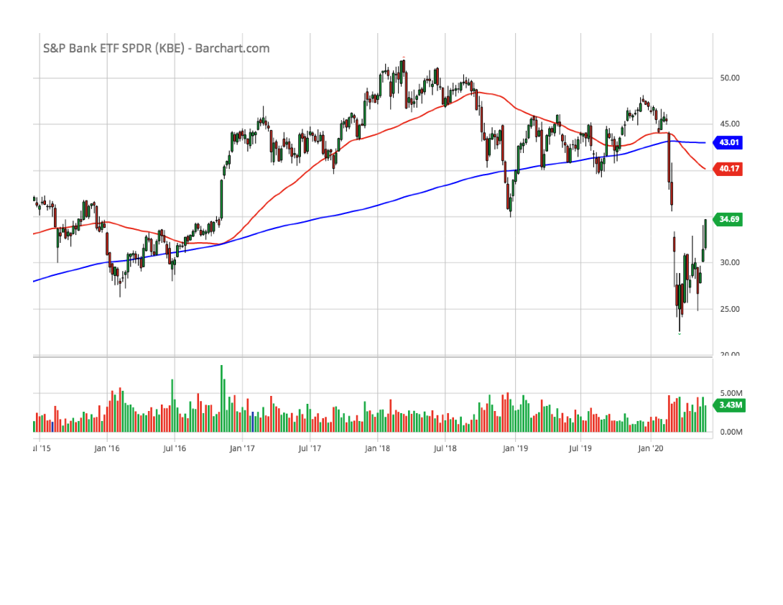
Banks Index (5y candle chart)

Slide 21
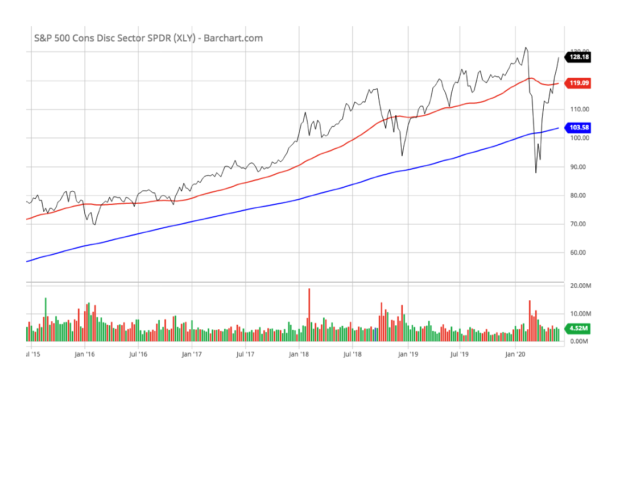
Consumer Discretionary Stocks (XLP) [5y line chart]

Slide 22
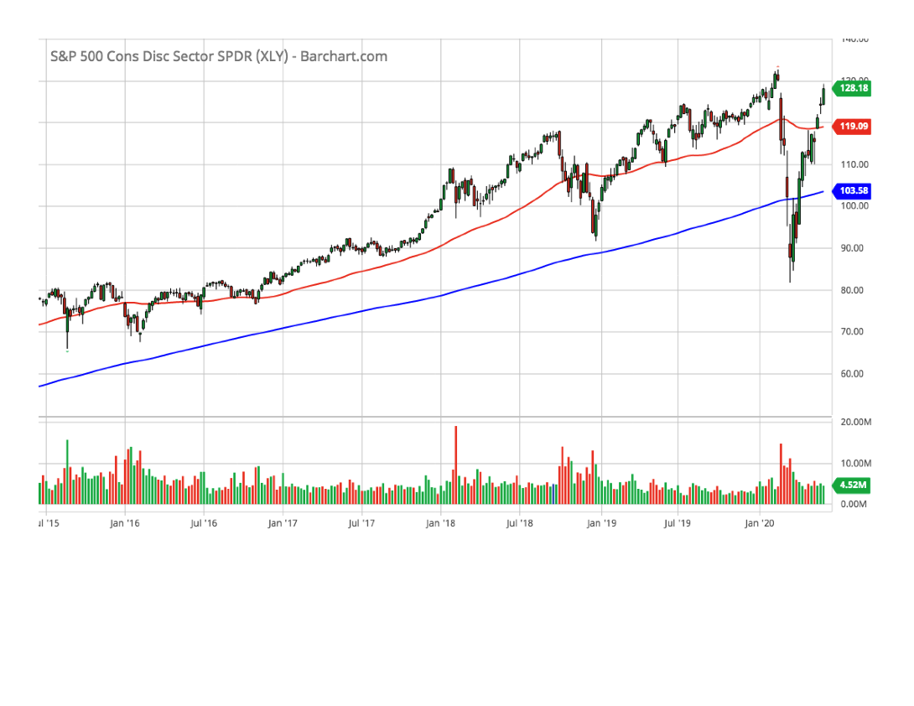
Consumer Discretionary Stocks (XLP) [5y candle chart]

Slide 23
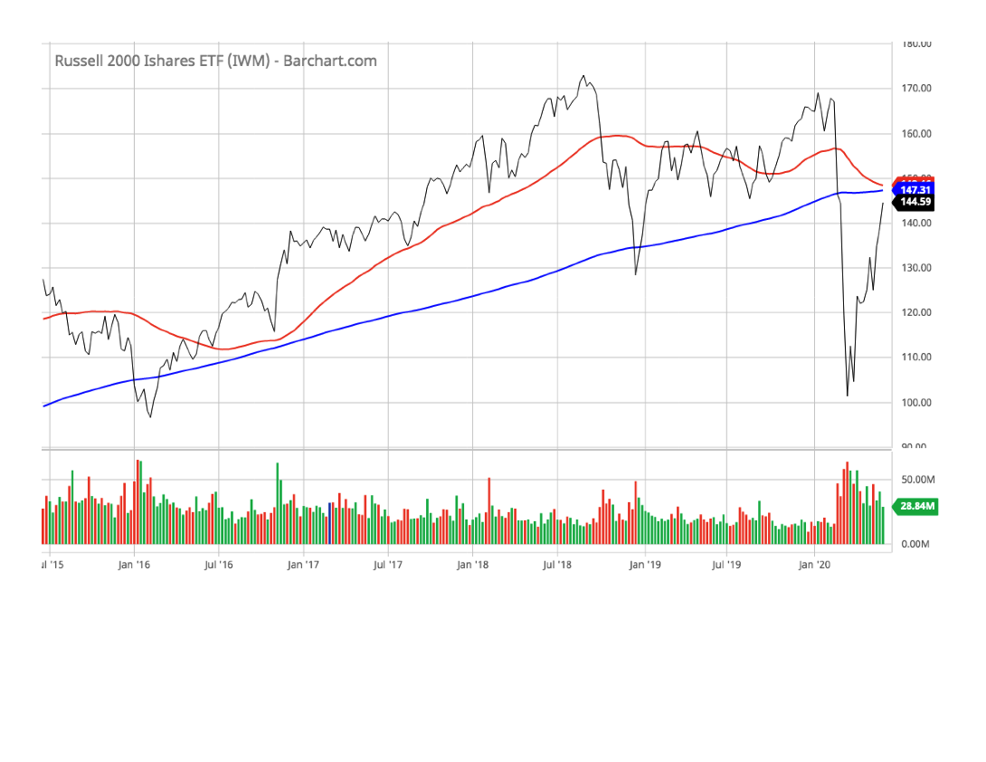
Small Cap Stocks (IWM)
[5y line chart]

Slide 24
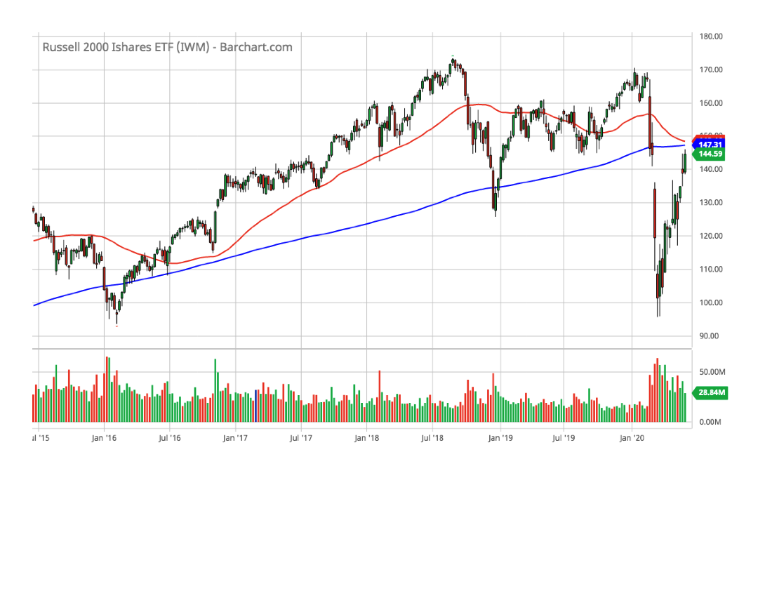
Small Cap Stocks (IWM)
[5y candle chart]

Slide 25
The Future?
… stay tuned.

