Slide 1
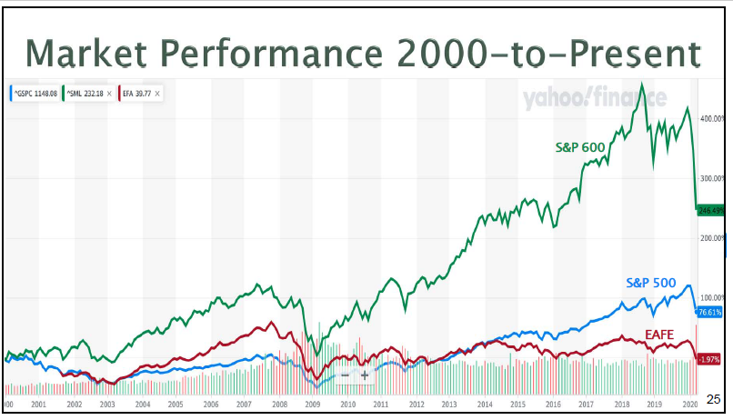
STAY the COURSE: from Doug Gerlach – Investing in Troubled Times

Slide 5
Portfolio Recommendations for Super Sectors- Kathleen Richards, Better Investing
Defensive – 29%
E.g. Consumer Staples, Health Care
Cyclical – 36%
E.g. Consumer Cyclical, Financials, Basic Materials
Sensitive – 35%
E.g. Industrials, Technology

Slide 6
Stay the Course – Advice from Doug Gerlach : Investing in Troubled Times

