Slide 3
Start with a brief description of a company and a very brief overview of its products
or services. Keep this part of the report to 45 seconds or less.
Use the thumbnail description from BI tools as a reference point, but don’t read it to the audi-ence. Use your own words and comfortable vocabulary.

Slide 4
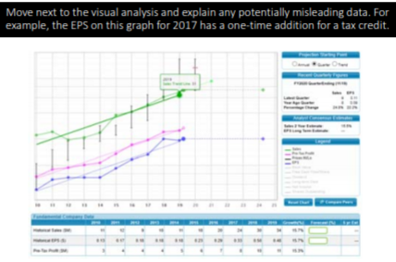
Your company explana-tion should have already included how it makes money. This company introduction should leaddirectly into an additional 30 seconds of how the company will continue tobe profitable. Is it grow-ing stores or geographicfootprint? Is it expandingwithin its historic territory or changing the mix of things it sells or services it provides? These are
the kinds of things you’re looking for to support this concept.

Slide 5
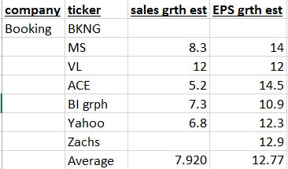
•Your next step is to make some judgment calls based on real data. It’s not the time to report a single set of judgment values from a single source. Use many sources to develop reasonable sales and EPS projections.
•You can find sales and/or earnings projections in many financial sources including the Value Line Report, Morningstar Report, CFRA Report, company investor presentations or earnings reports from its website, one or two reliable internet sources and any proprietary material you can find.
•Refrain from using data based solely on tech- nical indicators. We are fundamental investors and base our judgments mainly on sales, earnings, and profit margins.

Slide 6
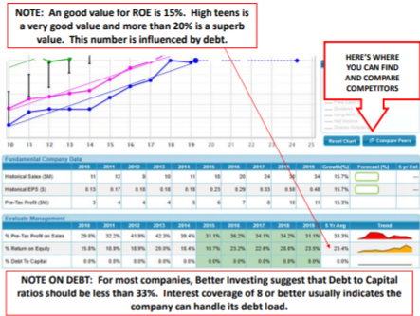
Move next to SSG Evaluate Management section.
•You should be pointing out trends, anomalies and how the company fares compared to our benchmarks.
•If debt seems high, introduce interest coverage. You can easily find the value on the company’s Morningstar report.
•Check out a competitor or two, especially when examining Pre‐Tax Profit on Sales.

Slide 7
You should be about 3 to 3.5 minutes into your presentation by this point.
Move to the second tab and remark about trends in Columns D and E in Section 3.
Also note whether a dividend is being paid and, if so, whether there is a trend in the payout ratio.
Be sure to point out the comparison between the current P/E and the 5‐year average P/E.

Slide 8
Report your P/E judgments and provide your rationale. It’s probably not enough to just say I want to be conservative. You must be reasonable to get an accurate SSG.

Slide 9
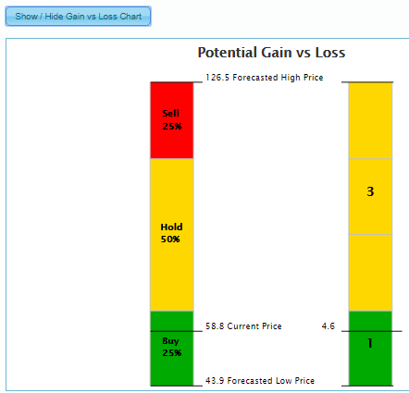
I recommend pressing the button directly below the Zoning section to display this graphic.
IF THINGS HAVE GONE WELL, YOU SHOULD NOW HAVE 15‐ 30 SECONDS TO WRAP UP!

Slide 10
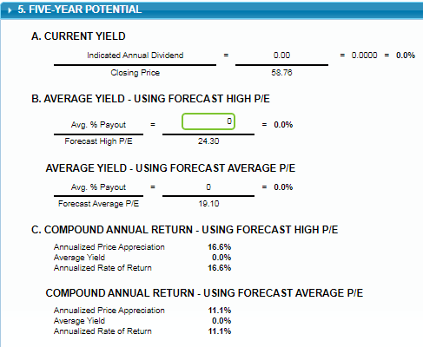
For me, Section 5 is the reason I do an SSG in the first place!
Remark on the current yield if the company pays a dividend. Characterize the return as somewhere between the two reported values. Be sure to characterize the return compared to what you should expect from the size company in the study. I should expect better than 12% from this very small company.

