Slide 1
Using Cash Flow to Assess a Company’s Financial Health
MicNova Education
January 19, 2021
Carol Cuddihy and Gladys Henrikson

Slide 2
DISCLAIMER
The information in this presentation is for educational purposes only and is not intended to be a recommendation to purchase or sell any of the stocks, mutual funds, or other securities that may be referenced. The securities of companies referenced or featured in the seminar materials are for illustrative purposes only and are not to be considered endorsed or recommended for purchase or sale by BetterInvestingTM National Association of Investors Corporation (“BI”). The views expressed are those of the instructors, commentators, guests and participants, as the case may be, and do not necessarily represent those of BetterInvesting. Investors should conduct their own review and analysis of any company of interest before making an investment decision.
Securities discussed may be held by the instructors in their own personal portfolios or in those of their clients. BI presenters and volunteers are held to a strict code of conduct that precludes benefiting financially from educational presentations or public activities via any BetterInvesting programs, events and/or educational sessions in which they participate. Any violation is strictly prohibited and should be reported to the CEO of BetterInvesting or the Director of Chapter Relations.
This presentation may contain images of websites and products or services not endorsed by BetterInvesting. The presenters are not endorsing or promoting the use of these websites, products or services.

Slide 3
Why Study The Financial Statements including Cash Flow?
When we study a new stock, we usually look at the SSG and Analyst Reports. However, the SSG mainly tracks the income statement and provides a debt-to-capital trend.
The SSG alone, especially for young companies, doesn’t provide liquidity data. For that, we need to look at the other financial statements.
Lack of adequate cash is one of the biggest reasons businesses fail.
Cash flow, as well as the Balance Sheet, is as important as earnings in determining if a company is financially healthy and can pay its bills.
If we look at Cash Flow and the Balance Sheet, in addition to the SSG, we can see whether a young company, with high P/E and only recent earnings, might yet be worthy of further study. You’re looking for a company that may be transitioning into the explosive growth stage.

Slide 4
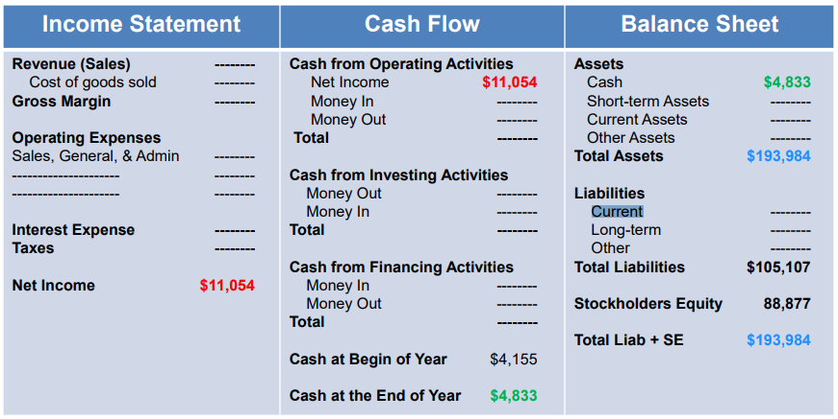
A Company’s Three Financial Statements and Their Relationships

Slide 5
Financial Statements & Key Ratios can all be found on the Better Investing Website, under the SSG Research Tab e.g. Research/ Analysts Estimates /Morningstar Analyst Estimate Demo by Sheryl Patterson
Example, result:

Slide 6
A Closer Look at Cash Flow: Diagram
https://www.wallstreetmojo.com/cash-flow-analysis/

Slide 7
Cash Flow from Operations
Operating Cash Flow
A substantial decrease in cash flow from operations is usually a sign of fundamental difficulties.
Must become positive and should be the largest sources of cash for a company to be sustainable.
For large companies, operating cash flow should only be positive
Make sure the company can sustain its dividends from operations of the business, as opposed to taking on more debt
Free Cash Flow is the bottom line of the Cash Flow Statement (CFS). The net of all forms of cash transactions.
It should be mostly up, can be choppy due to Capital Expenditures (CAPEX).
For the most part we can focus on the trend. But we also need to understand the causes of major shifts and what is behind management thinking.

Slide 8
Investing Activities
Purchase or Sale of assets. Known as CAPEX or Capital Investments/Expenditures
Evaluate the quality of CAPEX (Capital Investments/Expenditures), ask how will it contribute to the company’s future sales growth or profitability?
When a fixed asset is sold, ask why. Is the company trying to raise cash or has the asset’s purpose been realized? Low product demand may force a company to sell manufacturing equipment, generating a positive cash flow but may equally indicate a bleak profit outlook.
Note: The Library’s online edition of Morningstar provides CAPEX activity for each stock it covers,
The Management Discussion or Financial Notes found in the 10-Q or 10-K will describe management’s business proposition.
Financing Activities
Is cash is coming from stock sales or acquiring more debt?
How will cash be used to increase sales and net income?
Is the debt level appropriate for industry?
Financing activities should not be company’s main/sustaining source of positive cash flow

Slide 9
Key Relationships among the Income Statement-Sales and Net Income, the Balance Sheet, and Cash Flow Statement
Growing Together
Sales and Net Income
Net Income and Operational Cash Flow
Inventories with sales and net income (Balance Sheet & Income Statement)
Receivables with sales (Balance Sheet & Income Statement)
Compare Cash Flow from Operations to the company’s net income. If it is consistently higher than the net income, it can safely be assumed that the company’s earnings are of high quality
Some Red Flags
Inventory is growing faster than sales.
Accounts Receivable rise while sales are flattening
Cash Flow from Operations shows lower growth rate than the company’s net income

Slide 10
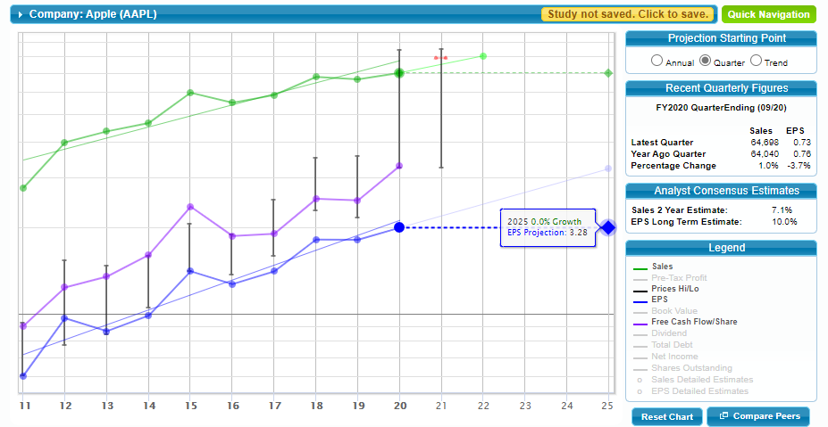
To Illustrate Points on Previous Slide, we’ve graphed, on SSG Plus: Sales, Free Cash Flow/Share, and EPS for Apple
4. Annual Price Bars (Vertical)
1, Sales
Notes:
Sales Line is growing
2) FCF/Share follows Sales
3) EPS follows FCF & Sales 4) Sales, FCF, & EPS follow growing slope of annual stock price bars
2, Free Cash Flow/ Share
3, Earnings/ Share

Slide 11
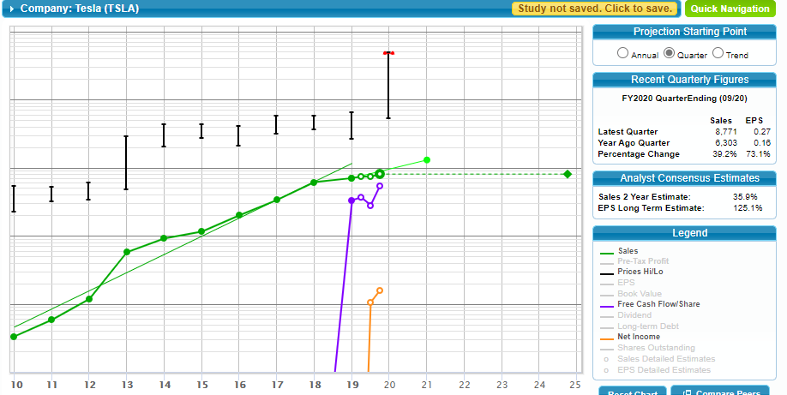
Looking as same information for young company, : Tesla
1. Sales
2. Free Cash Flow/Share
3. EPS
Note extraordinarily high Cash Flow: Check sources
(From Operations or Financing).

Slide 12
Comparing Apple’s Income and Cash Flow Statements (10-K for Fiscal Years ending in Sept.): Note Consistency
Income Statement (Consolidated): Net Income (Year ending)
Cash Flow Statement (Consolidated)
(Cash Generated by Operating Activities OA): Note: Most cash from OA
(Cash Generated/Used by Investing Activities
Cash Generated/Used by Financing Activities
September 2018
September 2019
September 2020
57,256
55.356
59,531
September 2018
September 2019
September 2020
Most cash from Operating Activities
77.434
69,391
80,674
September 2018
September 2019
September 2020
16,066
45,896
(4,289)
September 2018
September 2019
September 2020
(87,876)
(90,976)
(86,820)
Free Cash Flow Calculation (from Morningstar):
Operating Cash Flow (from above):
69,391
80,674
Less Capital Expenditures:
(10,495)
(7,309)
Free Cash Flow:
58,896
73,365

Slide 13
Comparing Tesla’s Income and Cash Flow Statements (Qtrly Data, from Morningstar): See cash from Financing
Income Statement (Consolidated): Net Income (9 Mo ending)
Cash Flow Statement (Consolidated) (9 Mo ending)
(Cash Generated by Operating Activities OA): Note: Most cash from OA
(Cash Generated/Used by Investing Activities
Cash Generated/Used by Financing Activities
September 2019
September 2020
(1,019)
727
September 2019
September 2020
756
2,400
September 2019
September 2020
(486)
(1,039)
September 2019
September 2020
2020 incl 2.9B debt & 5B new stock
118
4,450
Free Cash Flow Calculation (from Morningstar):
Operating Cash Flow (from above):
756
2,400
Less Capital Expenditures:
(410)
(1,026)
Free Cash Flow:
346
1,374

Slide 14
Looking for Key Relationships: (1) Sales (or Net Income) and Receivables
Diagram from Hugh McManus, “The Quality of Earnings,” Manifest Investing Bull Sessions, YouTube, 10/27/2020

Slide 15
Our Example Companies: Net Income (or Sales) vs. Receivables (Note how both track)
September 2019
September 2020
Apple - tracking
Net Income (Income Statement)
Accounts Receivable (Balance Sheet)
Tesla –Growing together
Net Income before taxes
Accounts Receivable
55,356
59,531
22,926
16,120
September 2019
September 2020
(1,019)
727
1,128
1,757

Slide 16
Looking for Key Relationships: (1) Sales (or Net Income) and Inventory
Diagram from Hugh McManus, “The Quality of Earnings,” Manifest Investing Bull Sessions, YouTube, 10/27/2020

Slide 17
Examples: Net Income (or Sales) and Inventory. Note how both track
September 2019
September 2020
Apple
Net Income
Inventory
Tesla
Net Income before taxes
Inventory
55,356
59,531
4,106
4,061
September 2019
September 2020
(1,019)
727
3,581
4,218

Slide 18
Applying a Solvency Ratio (from Balance Sheet) to Assess Company Health: Should be >1
Acid Test (Quick Ratio) – tests immediate ability to cover current liabilities
Formula: Apple Tesla
Cash + 38,016 + 14,531 + Marketable Securities + 52,927 + 0 + Accts Recvble 16,120 1,757 Subtotal/ 107,063/ 16,288/
Current Liabilities = Ratio 105,392 = 1.02 * 13,302 =1.22 *
*Notes: Data available under the “Research” tab for each stock on the BI SSG website; the Morningstar-calculated Quick Ratio numbers are similar but slightly different from those above. Part of the difference between Quick Ratio calculations here and those provided in Morningstar is the timeframe for the financial data: annual vs quarterly Go to: Stock Selection Tools/(stock name)/Research/Financials/Morningstar Financials/Financials or Key Ratios.
One can also find this financial information in the public Library’s online edition of Morningstar

Slide 19
Summary
Cash Flow can be helpful, especially for assessing the health and prospects of new companies, with limited years of Profit.
Cash Flow, by Itself, however, does not provide a full picture of company health.
Very high Cash Flow might indicate under-investment.
Negative Cash Flow could mean a company investing heavily in expanding its market share, which would likely lead to future growth
When analyzing cash flows, it is crucial to compare similar companies to each other in the same industry.
It is important to look at all three financial statements to determine the health of a company.
Income statement – Sales and Net Income
Cash Flow – Net Income vs Actual cash in bank, cash from Operating Activities
Balance sheet – Accounts Receivables, Inventory, CAPEX, debt, and a solvency ratio.

Slide 20
Resources Used for this Presentation and Suggested for Further Research
Ticker Talk, October 26, 2020, by Ken Kavula and Ann Cuneaz
Stock Up, May 3, 2017, “Perform a Financial Checkup Using the Statements of Cash Flow, “ by John Diercks, Director, Central PA Chapter
Book, How to Read a Financial Report, by John A. Tracy and Tage C. Tracy
Manifest Investing, YouTube, Bull Sessions 10/27/2020 (see Hugh McManus slides on Quality of Earnings) Bull Sessions (10/27/2020) - YouTube
Wall Street MOJO - https://www.wallstreetmojo.com/cash-flow-analysis/
https://www.investopedia.com/articles/stocks/07/easycashflow.asp
https://www.investopedia.com/terms/f/freecashflow.asp
TESLA10-K https://www.sec.gov/ix?doc=/Archives/edgar/data/1318605/000156459020047486/tsla-10q_20200930.htm
Apple 10-K https://www.sec.gov/ix?doc=/Archives/edgar/data/320193/000032019320000062/aapl-20200627.htm

