Slide 1
Reading the Charts
Introduction to Technical Analysis: Part 2
Wilbert Nixon, McNoVA; November 9, 2021

Slide 2
Use a Picture.
It’s worth a thousand words.
— Arthur Brisbane,
addressing Syracuse Advertising Men's Club on journalism and publicity (March 1911)

Slide 4
Our Agenda
Trend
Support and Resistance
Technical Indicators
Moving Averages
MACD (Moving Average Convergence Divergence)
RSI (Relative Strength Index)
Stochastics
RSI vs. Stochastics

Slide 5
Q: Why should we invest in stocks?
A: For many investors, it’s because the stocks of many great companies tend to appreciate over time. Over the last hundred years, the prices of these stocks have gone up.

Slide 6
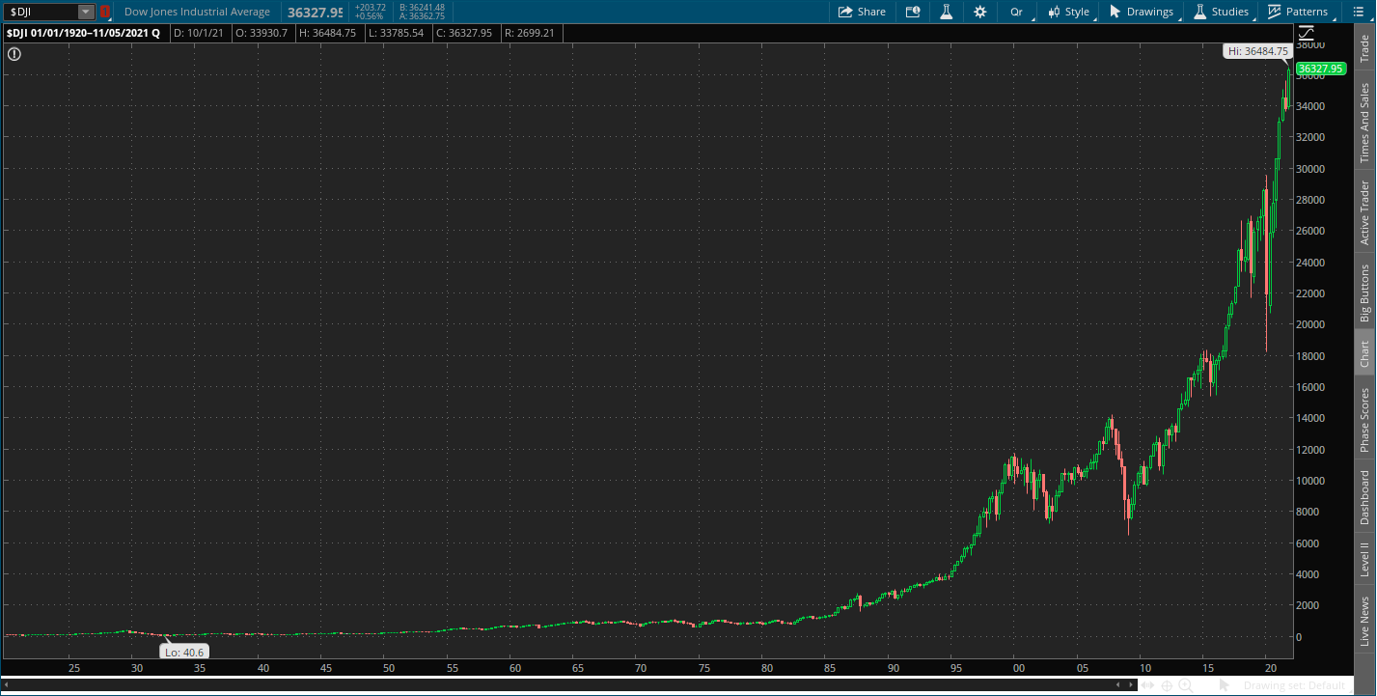

Slide 8
Trend
A trend is the general direction of the price of a market, asset, or metric.
Uptrends are marked by rising data points, such as higher highs and higher lows.
Downtrends are marked by falling data points, such as lower lows and lower highs.
Many investors and traders opt to trade in the same direction as the trend, attempting to profit from a continuation of that trend.
Price action, trendlines, and technical indicators are all tools that can help identify the trend and warn when it is reversing.

Slide 11
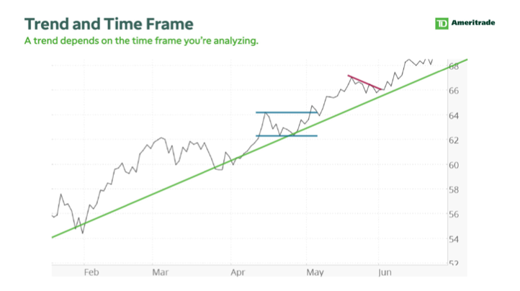

Slide 12
Support and Resistance
Technical analysts use support and resistance levels to identify price points on a chart where the probabilities favor a pause or reversal of a prevailing trend.
Support occurs where a downtrend is expected to pause due to a concentration of demand.
Resistance occurs where an uptrend is expected to pause temporarily, due to a concentration of supply.
Market psychology plays a major role as traders and investors remember the past and react to changing conditions to anticipate future market movement.
Support and resistance areas can be identified on charts using trendlines and moving averages.

Slide 13
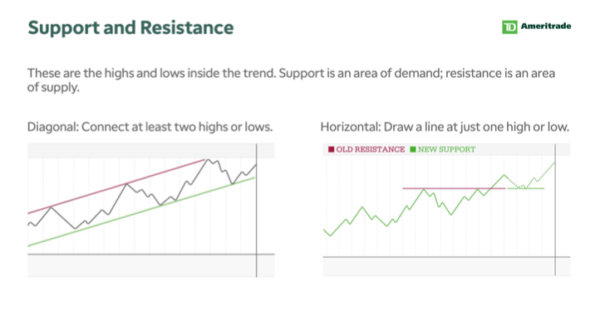

Slide 16
Technical Indicators

Slide 17
Technical Indicators
In general, technical indicators fit into five categories: trend, mean reversion, relative strength, volume, and momentum.
Leading indicators attempt to predict where the price is headed while lagging indicators offer a historical report of background conditions that resulted in the current price being where it is.
Popular technical indicators include simple moving averages (SMAs), exponential moving averages (EMAs), bollinger bands, Relative Strength Index (RSI), stochastics, and on-balance volume (OBV).

Slide 18
Technical Indicators, cont.
Trend indicators (lagging) analyze whether a market is moving up, down, or sideways over time.
Momentum indicators (leading) evaluate the speed of price change over time.
Relative strength indicators (leading) measure oscillations in buying and selling pressure.
Mean reversion indicators (lagging) measure how far a price swing will stretch before a counter impulse triggers a retracement.
Volume indicators (leading or lagging) tally up trades and quantify whether bulls or bear are in control.

Slide 19
Moving Averages
Trend Indicators
50-Day EMA and 200-Day EMA
Moving averages look back at price action over specific time periods, subdividing the total to create a running average that’s updated with each new bar.
The 50- and 200-day exponential moving averages (EMAs) are more responsive versions of their better-known cousins, simple moving averages (SMAs).
In a nutshell, the 50-day EMA is used to measure the average intermediate price of a security, while the 200-day EMA measures the average long term price.

Slide 20
Moving Average Convergence Divergence (MACD)
Momentum Indicators
Moving Average Convergence Divergence (MACD)
Moving average convergence divergence (MACD) indicator, set at 12, 26, 9, gives novice traders a powerful tool to examine rapid price change.
This classic momentum tool measures how fast a particular market is moving while it attempts to pinpoint natural turning points.
Buy or sell signals go off when the histogram reaches a peak and reverses course to pierce through the zero line.
The height or depth of the histogram, as well as the speed of change, all interact to generate a variety of useful market data.

Slide 21
Relative Strength Index (RSI)
Relative Strength Indicators
Relative Strength Index (RSI)
The relative strength index (RSI) is a momentum indicator used in technical analysis that measures the magnitude of recent price changes to evaluate overbought or oversold conditions in the price of a stock or other asset.
The RSI is displayed as an oscillator (a line graph that moves between two extremes) and can have a reading from 0 to 100.
An asset is usually considered overbought when the RSI is above 70% and oversold when it is below 30%.

Slide 22
Stochastics
Relative Strength Indicators
Stochastics
A stochastic oscillator is a momentum indicator comparing a particular closing price of a security to a range of its prices over a certain period of time.
The stochastic oscillator is range-bound, meaning it is always between 0 and 100. This makes it a useful indicator of overbought and oversold conditions.
Traditionally, readings over 80 are considered in the overbought range, and readings under 20 are considered oversold.
However, these are not always indicative of impending reversal; very strong trends can maintain overbought or oversold conditions for an extended period. Instead, traders should look to changes in the stochastic oscillator for clues about future trend shifts.

Slide 23
RSI vs. Stochastic Oscillator
While the relative strength index was designed to measure the speed of price movements, the stochastic oscillator formula works best when the market is trading in consistent ranges.
Generally speaking, RSI is more useful in trending markets, and stochastics are more useful in sideways or choppy markets.

Slide 24
What if the stocks of great companies went down over the last hundred years instead of going up?
How would investors feel?

Slide 26
Fortunately, that’s not our reality.

Slide 27
Resources
Barchart.com
Investopedia.com
investors.com
StockCharts.com
TD Ameritrade Education
ThinkorSwim.com

