Slide 1
Estimating Sales and Earnings with Sheryl’s Template
MicNova Meeting, December 13, 2022 Presentation by Amy Laing

Slide 2
Disclaimer
The information in this presentation is for educational purposes only and is not intended to be a recommendation to purchase or sell any of the stocks, mutual funds, or other securities that may be referenced. The securities of companies referenced or featured in the seminar materials are for illustrative purposes only and are not to be considered endorsed or recommended for purchase or sale by BetterInvestingTM National Association of Investors Corporation (“BI”). The views expressed are those of the instructors, commentators, guests and participants, as the case may be, and do not necessarily represent those of BetterInvesting. Investors should conduct their own review and analysis of any company of interest before making an investment decision.
Securities discussed may be held by the presenters in their own personal portfolios. BI presenters and volunteers are held to a strict code of conduct that precludes benefiting financially from educational presentations or public activities via any BetterInvesting programs, events and/or educational sessions in which they participate. Any violation is strictly prohibited and should be reported to the CEO of BetterInvesting or the Director of Chapter Relations.
This presentation may contain images of websites and products, or services not endorsed by BetterInvesting. The presenter is not endorsing or promoting the use of these websites, products or services.
This session is being recorded for future use.
Notes:
As appropriate for live sessions, remove last line about session being recording.

Slide 3
Outline
Using a Template of Average Analysts’ Estimates to Help Us Form Our Judgements
Locating Analysts’ Estimates Data
Filling in the Template

Slide 4
Analysts’ Estimates Template Advantages
Provides Investors with Averages of Different Analysts’ Projections for
Sales Growth
EPS Growth
Template Tool has a built-in formula to calculate projections

Slide 5
Analysts’ Average Estimates Template: Key data in 1 place

Slide 6
Locating data
Value Line analyst reports, PDF versions, come out at 13 week intervals. The online Value Line version will have current prices and updated data. (Free through Fairfax County Library.)
Morningstar and CFRA reports appear a day or two after a company reports earnings at a quarter's end. One may find them through your broker or through your library’s online collections. Morningstar is carried online by Fairfax and Arlington County Libraries. CFRA is available through the Montgomery Public Library.
Yahoo, Zacks, and Seeking Alpha analysts’ summaries appear in our Better Investing SSG Tool under the “Research” tab, then “Analysts Estimates”

Slide 7
Where to find Value Line Reports

Slide 8
Locating key data on Value Line Report

Slide 9
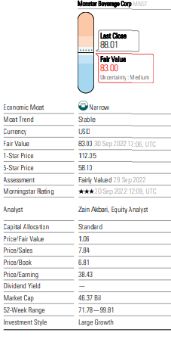
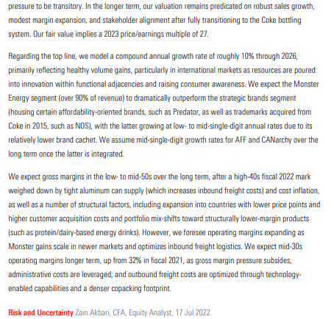
Morningstar Reports Data, report p 3 & p 7/8
101010%%
27 PE
101010%%
10% gwth

Slide 10
CFRA Analyst Report first page

Slide 11
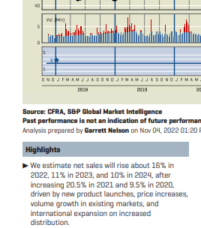
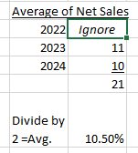
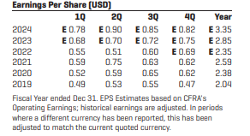
2 yr EPS % from Sheryl Template:

Slide 12
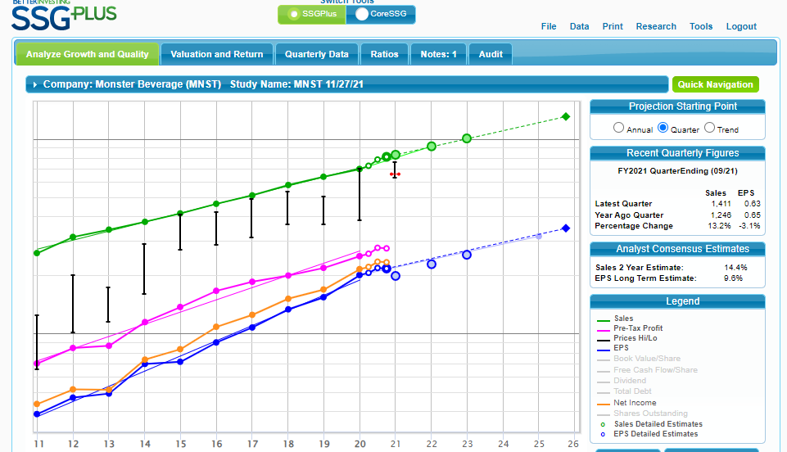
Locating Analysts’ Consensus Estimates on BI SSG

Slide 13
Locating Analysts’Consensus Estimates on BI SSG

Slide 14
BI SSG: Research/Analysts’ Estimates Data (Note: Zacks estimates for 1 year)
See % on Next Slide, from Zack’s Website

Slide 15
Zacks Website EPS estimate for 3-5 years. (located from web search)

Slide 16
Yahoo Finance Analyst Estimates (Note: Yahoo estimates for 1 year)

Slide 17
BI SSG: Seeking Alpha Analysts Estimates (Note: Alpha estimate for 1 year)

Slide 18
Seeking Alpha Analysts Estimates (Note: Alpha estimates for 5 years from website)

Slide 19
Example of Completed Template for Monster Beverage
1
4
2
3

Slide 20
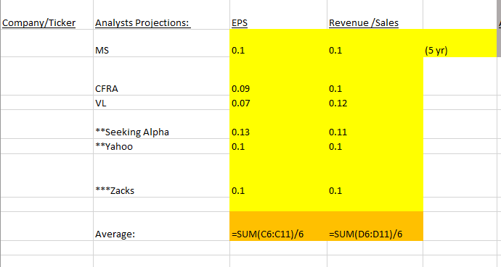
Adjusting the formula in spreadsheet The formula for the average analysts estimates is set for 6 anlaysts. If you use more or less, you will need to adjust the formula in the template.

Slide 21
Missing Information … What to do? Sometimes you won’t be able to locate both the EPS and the Revenue projections from analysts. I recommend keeping both the EPS and revenue projections the same, so simply fill in the cells so that they match or are close.

Slide 22
Conclusion
The average of Analysts' Estimates is a guideline for you to use as you make your own judgements
Easy to see different data in one place
Spreadsheet template is found in Bivio under Public/Education/2022/12 December

