Slide 1
FIRST CUT TIPS and WHAT OTHER CLUBS DO
May 9, 2023
Sheryl Patterson
Model Club of Northern Virginia (MicNOVA)
srap14@gmail.com

Slide 2
Disclaimer
The information in this presentation is for educational purposes only and is not intended to be a recommendation to purchase or sell any of the stocks, mutual funds, or other securities that may be referenced. The securities of companies referenced or featured in the seminar materials are for illustrative purposes only and are not to be considered endorsed or recommended for purchase or sale by BetterInvestingTM National Association of Investors Corporation (“BI”). The views expressed are those of the instructors, commentators, guests and participants, as the case may be, and do not necessarily represent those of BetterInvesting. Investors should conduct their own review and analysis of any company of interest before making an investment decision.
Securities discussed may be held by the presenters in their own personal portfolios. BI presenters and volunteers are held to a strict code of conduct that precludes benefiting financially from educational presentations or public activities via any BetterInvesting programs, events and/or educational sessions in which they participate. Any violation is strictly prohibited and should be reported to the CEO of BetterInvesting or the Director of Chapter Relations.
This presentation may contain images of websites and products, or services not endorsed by BetterInvesting. The presenter is not endorsing or promoting the use of these websites, products or services.
Notes:
As appropriate for live sessions, remove last line about session being recording.

Slide 3
KEY TAKEAWAYS
First Cut
Where to find completed First Cuts and Blank Template
Step by Step Instructions for completing your own First Cut
How to submit a First Cut
What other clubs are doing!
Finding Stock Ideas and filling out Stock idea Template (Stock Study teams)
Presenting ideas from Template to club members
Members voting on ideas to be presented
Rotation of officers
Changing bylaws to better describe duties of each position

Slide 4
Three major financial statements.
A call option gives the holder the right, but not the obligation, to buy the underlying security at the strike price on or before expiration. A call option will therefore become more valuable as the underlying security rises in price (calls have a positive delta).
A long call can be used to speculate on the price of the underlying rising, since it has unlimited upside potential but the maximum loss is the premium (price) paid for the option.
0 seconds of 4 minutes, 10 secondsVolume 75%
Balance Sheet - The balance sheet shows a company's assets (what they own), liabilities (what they owe), and stockholders' equity (or ownership) at a given moment.
Income Statement - The income statement reports the revenue generated from sales, the operating expenses involved in creating that revenue as well as other costs, such as taxes and interest expense on any debt on the balance sheet. The net amount or the bottom line of the income statement is the net income or the profit for the period. Net income is revenue minus all of the costs of doing business.
Cash Flow Statement - The cash flow statement (CFS) measures the cash generated for a period, including all of the transactions added to or subtracted from cash. Cash flow is important because it shows how much cash is available to meet short-term obligations, invest in the company, or pay dividends to shareholders.
In addition to reviewing a company's financial statements themselves, also pay attention to the information provided in the footnotes to the financial statements.

Slide 5
Key Accounting Conventions - Generally accepted accounting principles (GAAP) are used to prepare financial statements. Both methods are legal in the United States, although GAAP is most commonly used. The main difference between the two methods is that GAAP is more "rules-based," while IFRS is more "principles-based." Both have different ways of reporting asset values, depreciation, and inventory, to name a few.
Financial Ratios and Indicators - The absolute numbers in financial statements are of little value for investment analysis unless these numbers are transformed into meaningful relationships to judge a company's financial performance and gauge its financial health. The resulting ratios and indicators must be viewed over extended periods to spot trends. Please be aware that evaluative financial metrics can differ significantly by industry, company size, and stage of development.
Notes to Financial Statements - The financial statement numbers don't provide all of the disclosure required by regulatory authorities. Analysts and investors alike universally agree that a thorough understanding of the notes to financial statements is essential to properly evaluate a company's financial condition and performance. As noted by auditors on financial statements "the accompanying notes are an integral part of these financial statements."

Slide 6
LIQUIDITY RATIOS
Liquidity ratios include the current ratio, quick ratio, cash ratio, and the defensive interval ratio.
Current Ratio – tests the ability of a business to pay its short-term liabilities. It is calculated by dividing total current assets by total current liabilities, using the figures from the most recent balance sheet. The common opinion is that the current ratio for a business should be 2 or higher (although this depends on the type of of industry as in some instances, the current ratio is closer to 1.25.
Quick Ratio - (also referred to as the acid test) is similar to the current ratio except more stringent in that it excludes inventory from current assets. This is because inventory is generally the least liquid current asset as it cannot be quickly sold and typically becomes an account receivable before being converted into cash. On the other hand, if inventory is liquid then the current ratio is a preferred measure of liquidity. Ratios of 1.0 or greater are generally cited as acceptable.

Slide 7
LIQUIDITY RATIOS (CONT.)
Cash Ratio - represents the portion of a firm’s assets held in the most liquid short-term assets that can most easily be used to pay off current obligations in a crisis situation. More specifically, it excludes inventory and receivables as there are no guarantees that these two accounts can quickly be converted to cash. It is not uncommon for companies to have current liabilities in excess of cash and cash equivalents (i.e. a ratio less than 1.0). From a shareholder’s viewpoint, a high ratio may indicate an inefficient use of assets. While creditors rely on the cash ratio to assess margins of safety, it is seldom used by analysts in the fundamental analysis of a company.
Defensive Interval Ratio - (DIR) measures how many days a company can pay its daily expenditures from its existing liquid assets. Daily cash expenditures are calculated by summing all expenditures on the income statement, excluding non-cash expenses and taxes, and dividing by 365. The defensive interval ratio is often seen as a better measure of liquidity because it compares assets to expenses rather than liabilities.

Slide 8
ACTIVITY RATIOS
Activity ratios include inventory turnover, receivables turnover, payables turnover, working capital turnover, fixed asset turnover, total asset turnover, and the cash conversion cycle.
Inventory Turnover - measure of activity (or liquidity) of a firm’s inventory. It shows how efficiently a company is managing its inventory relative to sales. The ratio expresses how many times per year a company theoretically sells out its entire inventory.
A high ratio generally suggests strong sales. If accompanied by slower revenue growth, however, a higher inventory turnover could indicate inadequate inventory levels. A low inventory turnover rate is an indicator of poor sales and excess inventory. One usual suspect is obsolescence problems. Analysts, carefully investigate inventory disclosures to spot any trends in the distribution of raw materials, work-in-progress and finished goods. Significant increases (decreases) in raw materials and/or work-in-progress may indicate that management expects increases (decreases) in demand. When finished goods outpace sales, this could signal increased storage costs, potential write-downs, and less cash available for other purposes.
Companies using LIFO will generally appear to manage their inventory better than equivalent companies using other cost flow assumptions. Inventory turnover can be adjusted to correct for this by subtracting the change in LIFO reserve from the numerator and adding the full LIFO reserve amount to the denominator. Inventory write-downs also positively affect inventory turnover. In some cases it might make sense to add back recent write-down amounts to the denominator. (This same logic applies to other liquidity, activity, and solvency ratios).

Slide 9
ACTIVITY RATIOS (cont.)
Accounts Receivable Turnover evaluates a firm’s effectiveness in extending credit and collecting debts on that credit. It is however only meaningful in relation to a firm’s credit terms. Analysts should be sure to consult the receivables ageing schedule to better understand the underlying reasons for changes in the receivables turnover.
A high receivables turnover ratio reflects a short time lapse between sales and the collection of cash. This generally indicates that the company is efficient at collecting receivables and has a high proportion of quality customers that pay off their debts quickly. It may also suggest that the company is too conservative regarding its extension of credit and is losing sales to competitors as a result.
A low ratio often means that the company has poor collecting processes, a bad credit policy, or customers with financial difficulty. It could also be the result of a disruption in getting the right goods to customers and the customers in turn refusing to pay. The longer it takes a firm to collect on its credit sales, the longer its money is unavailable for other purposes.
The accounts receivable turnover can be translated to days sales outstanding (DSO) by taking the inverse of the turnover and multiplying it by 365. This measures the average number of days that it takes the firm to collect on its credit sales. This number should be less than or equal to the firm’s stated credit terms.

Slide 10
SOLVENCY RATIOS
Solvency ratios include debt-to-assets, debt-to-equity, financial leverage, and interest coverage.
Debt-to-assets ratio (or debt ratio) measures the proportion of a company’s assets that are financed through borrowing. Total debt is the sum of long-term and short-term debt. Higher ratios indicate greater indebtedness and more financial risk. Firms that finance PP&E through operating leases have lower debt-to-asset ratios since such assets are not recorded on the balance sheet. This can be adjusted for by adding the capitalized lease amount to the numerator and denominator of the ratio. Firms using LIFO inventory accounting should also have their reserve amount added to total assets.
Debt-to-equity ratio provides another perspective on a company’s financial leverage. In this case, debt is compared to shareholders’ equity as opposed to assets. Like the debt ratio, a lower ratio indicates that the company is using less leverage. Adjustments can be made for operating leases by adding the capitalized amount to the numerator. The equity-financed portion of the LIFO reserve can also be added to the denominator.
Interest coverage ratio (or times interest earned) measures the number of times a company’s EBIT could cover paying the interest it owes. It therefore represents a firm’s margin of safety in handling its contractual interest payments. Higher ratios indicate that the firm is better able to fulfill its interest obligations, though too little borrowing has the potential of negatively affecting a company’s profitability. Lower interest coverage ratios suggest that debt expense is a burden to the company. Analysts are particularly concerned with the stability of interest coverage ratios when looking at a firm. A value of 3.0 (and preferably closer to 5.0) is often suggested as a reasonable margin while a ratio approaching 2.5 is generally considered a warning sign.

Slide 11
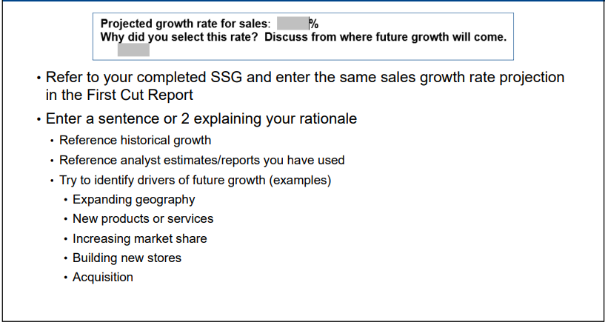
PROFITABILITY Ratios
Profitability Ratios - Profitability ratios are a group of financial metrics that show how well a company generates earnings compared to its associated expenses. However, investors should take care not to make a general comparison. Instead, they will get a better sense of how well a company is doing by comparing ratios of a similar period. For example, comparing the fourth quarter of this year with the same quarter from last year will net a better result.
Return on Equity - Return on equity, or ROE, calculate company's ability to generate income from shareholders' equity or investments. Companies issue shares of stock to raise capital and use the money to invest in the company. The higher the return or ROE, the better the company's performance since it generated more money for each dollar of investment in the company. Return on Equity=Average Shareholders’ Equity/Net Income
Operating Margin - Operating profit margin evaluates the efficiency of a company's core financial performance. Operating income is the revenue generated from a company's core business operations. Although operating margin is the profit from core operations, it doesn't include expenses such as taxes and interest on debt. Operating margin = operating earnings / revenue

Slide 12
MARKET RATIOS
Market ratios include price-to-earnings, price-to-cash flow, price-to-sales, price-to-book, basic EPS, diluted EPS, cash flow per share, EBITDA per share, and dividends per share.
Price-to-Earnings - The P/E ratio is calculated by dividing the market value price per share by the company's earnings per share. Earnings per share (EPS) is the amount of a company's profit allocated to each outstanding share of a company's common stock, serving as an indicator of the company's financial health. The question of what is a good or bad price-to-earnings ratio will necessarily depend on the industry in which the company is operating. Some industries will have higher average price-to-earnings ratios, while others will have lower ratios. For example, in January 2021, publicly traded broadcasting companies had an average trailing P/E ratio of only about 12, compared to more than 60 for software companies. If you want to get a general idea of whether a particular P/E ratio is high or low, you can compare it to the average P/E of the competitors within its industry.
Price-to-Cash Flow - The price-to-cash flow (P/CF) ratio is a stock valuation indicator or multiple that measures the value of a stock's price relative to its operating cash flow per share. The ratio uses operating cash flow (OCF), which adds back non-cash expenses such as depreciation and amortization to net income.
A good price to cash flow ratio is anything below 10. The lower the number, the better the value of the stock. This is because a lower ratio indicates that the company is undervalued with respect to its cash flows.

Slide 13
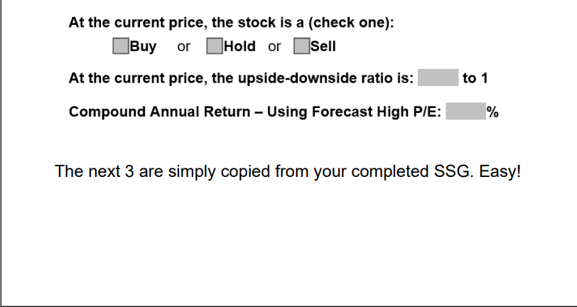
MARKET RATIOS (cont.)
Price-to-Book - Price-to-book value (P/B) is the ratio of the market value of a company's shares (share price) over its book value of equity. The book value of equity, in turn, is the value of a company's assets expressed on the balance sheet. Traditionally, any value under 1.0 is considered desirable for value investors, indicating an undervalued stock may have been identified. However, some value investors may often consider stocks with a less stringent P/B value of less than 3.0 as their benchmark.
Price-to-Sales - The price-to-sales ratio (Price/Sales or P/S) is calculated by taking a company's market capitalization (the number of outstanding shares multiplied by the share price) and divide it by the company's total sales or revenue over the past 12 months. While the ideal ratio depends on the company and industry, the P/S ratio is typically good when the value falls between one and two. A price-to-sales ratio with a value less than one is better.
Price-to-Tangible Book - This is the Current Price divided by the latest annual Tangible Book Value Per Share. Tangible Book Value Per Share is defined as Book Value minus Goodwill and Intangible Assets divided by the Shares Outstanding at the end of the fiscal period. The price-to-book ratio is used by value investors to identify potential investments. P/B ratios under 1.0 are typically considered solid investments by value investors.
Cash Flow per Share - Cash flow per share is the after-tax earnings plus depreciation on a per-share basis that functions as a measure of a firm's financial strength. Many financial analysts place more emphasis on cash flow per share than on earnings per share (EPS). A ratio less than 1 indicates short-term cash flow problems; a ratio greater than 1 indicates good financial health, as it indicates cash flow more than sufficient to meet short-term financial obligations.

Slide 14
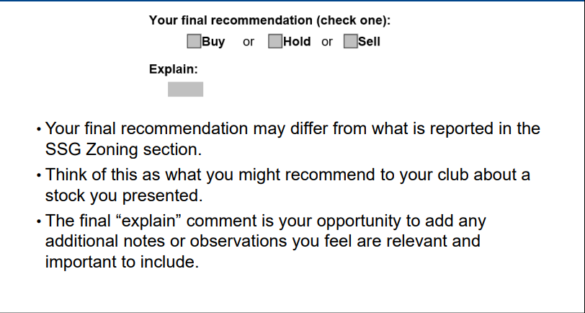
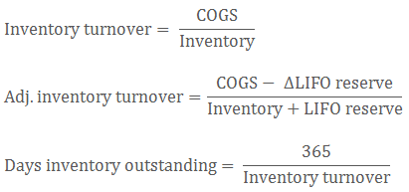
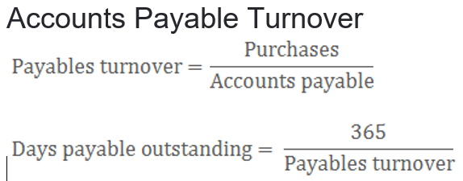
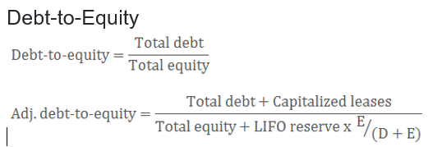
RATIOS (cont.)

Slide 15
RESOURCES
How to read a financial report; Wringing vital signs out of the numbers by John A. Tracy and Tage C. Tracy - 8th edition 2014
Warren Buffett Accounting Book: Reading Financial Statements for Value Investing
by Stig Brodersen – May 2014
Financial Shenanigans, Fourth Edition: How to Detect Accounting Gimmicks and Fraud in Financial Reports
by Howard M. Schilit, Jeremy Perler and Yoni Engelhart - 2018
Financial Statements, Third Edition: A Step-by-Step Guide to Understanding and Creating Financial Reports
by Thomas R. Ittelson – 2020
Using Financial Ratios to Analyze a Company’s Strengths and Weaknesses Matt Cullen-Meyer |01-02-2019 Quick Summary
Investopedia's Glossary of Terms provides you with thousands of definitions and detailed explanations to help you understand terms related to finance, investing, and economics.

Slide 16
WWW.BETTERINVESTING.ORG/CHAPTERS/DC-REGIONAL
What other clubs are doing!
Finding Stock Ideas and filling out Stock idea Template (Stock Study teams)
Presenting ideas from Template to club members
Members voting on ideas to be presented
Rotation of officers
Changing bylaws to better describe duties of each position

Slide 18
WWW.BETTERINVESTING.ORG

