Slide 1
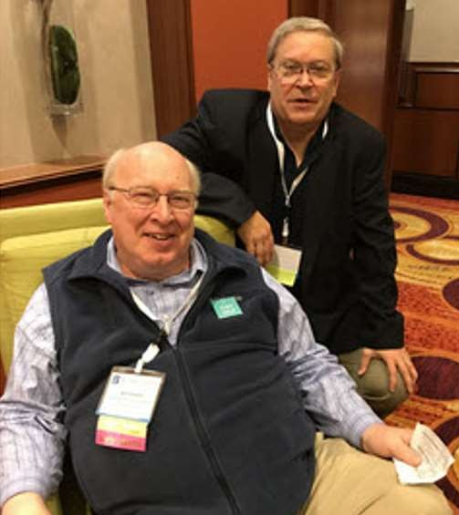
Getting A Start In Investing: Why, What & How?
Featuring Ken Kavula & Mark Robertson
January 3-4, 2024
The Grand Experiment
(Time-Honored Legacy)
Making Reasonable Forecasts (Unleashing Imagination)
Finding Stocks to Study
(Commence Stewardship)

Slide 2
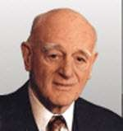
Nicholson’s Gift: Discipline, A Framework
Invest Regularly. “All In”
Buy High-Quality Growth Stocks.
Be Prudent (Shop Patiently and Diligently) Diversify.
“Grand Experiment”
5

Slide 3
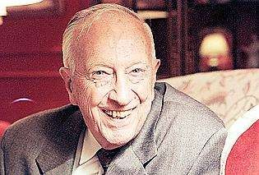
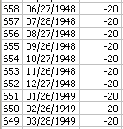
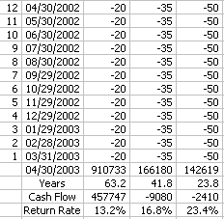
Invest Regularly. $20/month Since February 1948
Tom O’Hara was a founder of the National Association of Investors (NAIC) and its chairman for 50 years. As a member of the Mutual Club of Detroit, he invested $20 a month since 1948 – a sum of $13,160 – while generating a 13.2% annualized return and a personal balance that reached $2,000,000.
13.2% 63.2 years
6

Slide 4
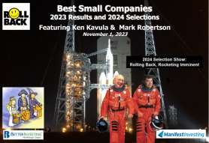
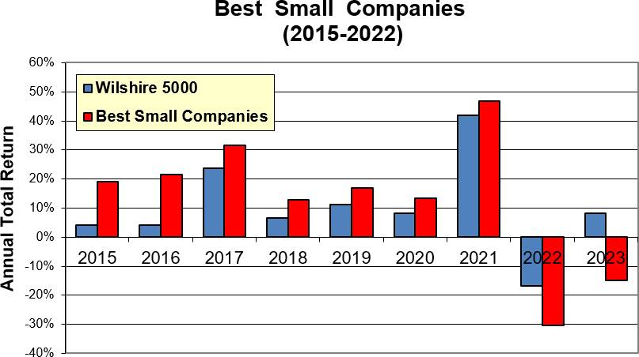
Great Pumpkin Believers. The Best Small Company tracking portfolio has now beaten the Wilshire 5000 in 7-of-9 years. For 2015-2023, the average annualized return is 13.0% versus 10.1% for the total stock market.

Slide 5
“… your great grandfather describes an investment conference where he and your great grandmother had a fascinating discussion with a nice person from a company called Biomet. $2000 invested in Biomet in 1982 was worth nearly $1,000,000 in the late 1990s.”
Consider this: An investor doesn’t “need” the “next Microsoft”.
We need to discover and prudently own time-honored workhorses.
https://www.manifestinvesting.com/articles/201410cover
16

Slide 6
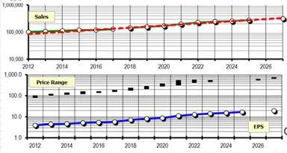
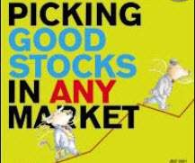
“Buy and Hold High-Quality Growth Companies
for a long as it makes sense to do so…”
We buy excellent companies … not markets.
6

Slide 7
“Be Patient. Diligent. Prudent.”
The only people who think buy-and-hold is dead are short-term thinkers frustrated by their
inability to follow it.” — Morgan Housel, The Motley Fool (2013)
Quality Matters. Maintain the Quality and Projected Returns of your holdings.
Know what you own and why you own it. – Peter Lynch
“Discipline refers to a structured, consistent, and orderly process without rigidity in either concept or method.
Such a process will minimize the impact of human emotions during market peaks and troughs.”
– Benjamin Graham & David Dodd, Security Analysis
“It’s all about growth, historical and expected, and includes an assessment of profitability. How
profitable has the company been? How will it stay profitable? What’s the general growth trend? What’s the average profitability? Compare within industries.
7

Slide 12
Calculating Earnings Per Share

Slide 13
Forecasting Sales

Slide 14
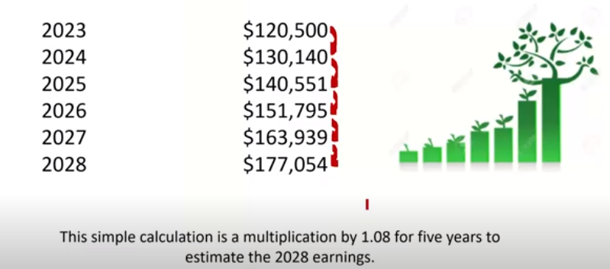
Forecasting Earnings

Slide 16
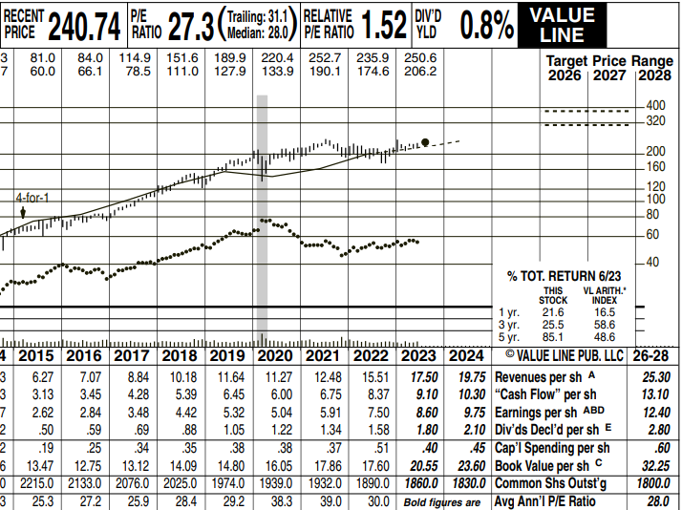
A P/E value at a given moment multiplying by same-time earnings amount will yield a price. Keep it simple and look for data to assist you in your forecast. Value Line gives average P/E values over a reasonable period for the companies they follow. The report also forecasts their ideas about average P/E into the future.

Slide 17
Forecasting 5 Year average P/E and Earnings
We’ve consulted VL for the historical for our company average P/E and found it to be 28, It appears that ‘s also where VL thinks the five year out average P/E will be, so we will use that value to make our forecast.
We will also need an earnings number in the future.
We will assume the share count to stay at 1800 and 2028 earnings to be $21,411.38 assuming 8% growth annually. That will give us a 2028 EPS of $12.40.
P/E X EPS = PRICE
28 X 12.40 = $347.20

Slide 18
The stock is currently trading at $240.74. I am using the most current price that I can find.
Turn the calculation for the percentage annualized growth from $240.74 to $347.20 over to a calculator or a computer.
The Potential Annualized Return would be 21.3%.
This is a greatly simplified version of our methods, but as we explore forecasting and the income statement, keep this in mind.
EARNINGS FOLLOWS SALES AND STOCK PRICE FOLLOWS EARNINGS!

