Slide 1
Using the BI Stock Screener: MicNova Educational Presentation, July 21, 2016 by Gladys Henrikson
A Follow-up to Ty Hughes’s Presentation to MicNova on June 16, 2016

Slide 2
Using the BI Stock Screener: Agenda
Identify Portfolio Objective for Stock Search
Use the BI Stock Screeners & Quick Analysis Tools
Search Two Pre-Defined Screens
Search Two Customized Screens

Slide 3
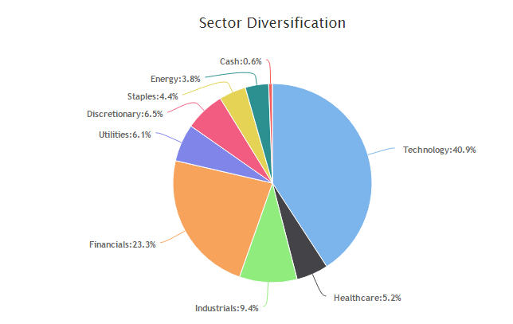
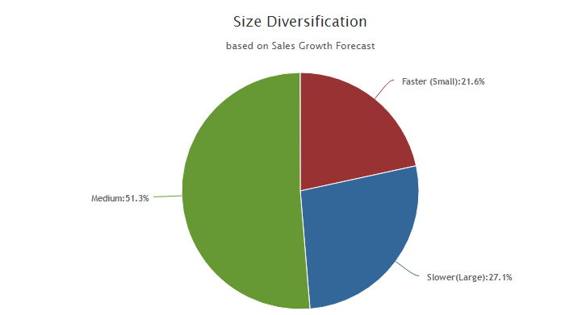
Portfolio Objective for Stock Search: Enhance MicNova Diversification*
Medium
*Find a Company, Small to Medium Size, of Good Value, among Consumer Discretionary (Cyclical) or Consumer Staples (Defensive)

Slide 4
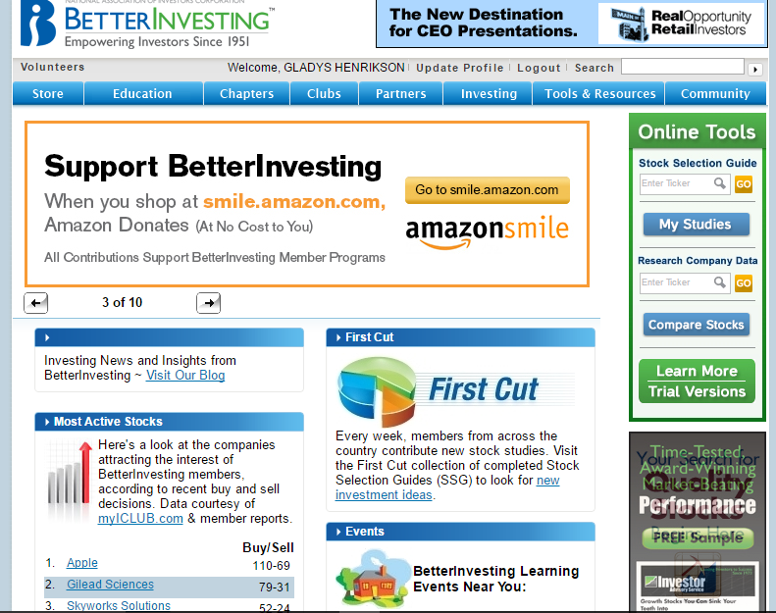
Locate the Better Investing Stock Screeners- from
Home
Page
Click on “My Studies”

Slide 5
Find “Stock Screener” by clicking on Magnifying Glass

Slide 6
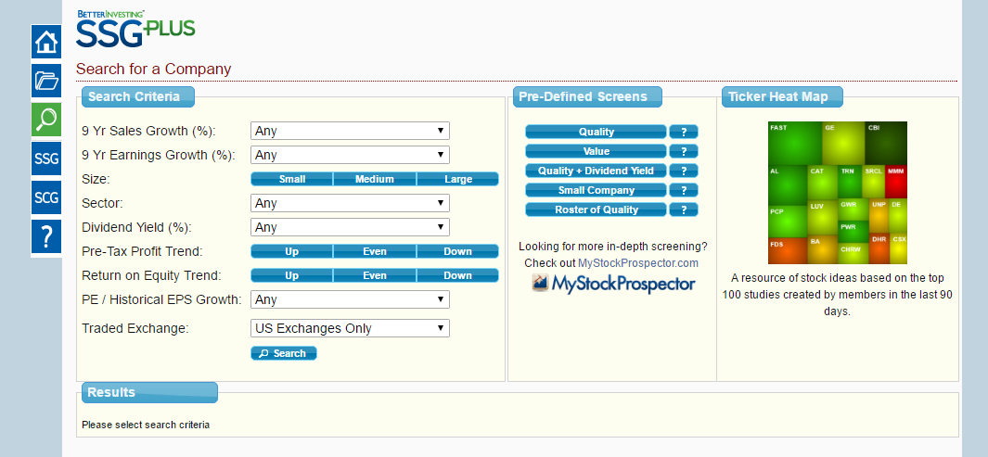
1. Search under “Pre-Defined Screens”, using various criteria (explained under “?”)
1.

Slide 7
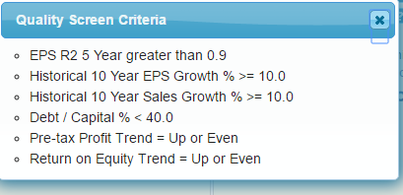
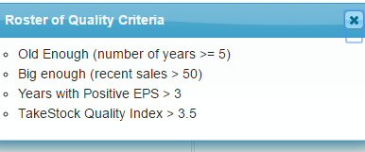
Example (?) : Definitions of two Pre-Defined Screens -“Quality” and “Roster of Quality”

Slide 8
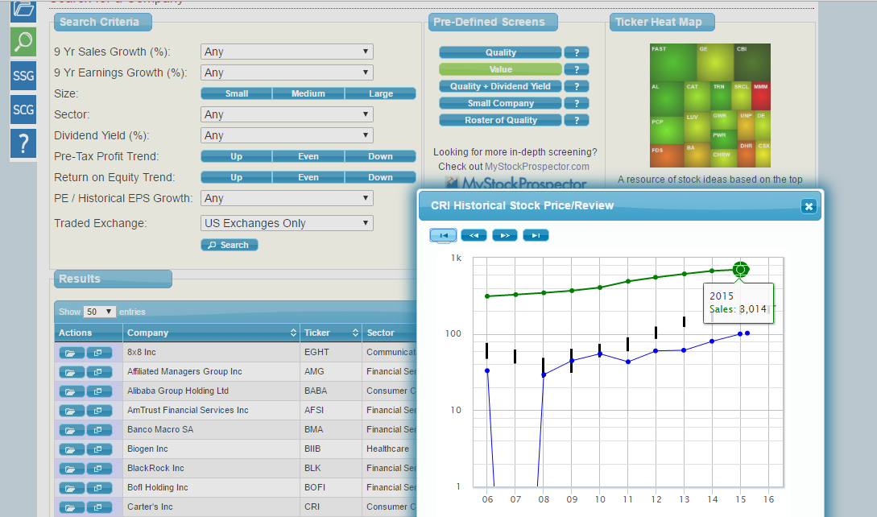
Pre-Defined Screen: “Quality” Companies & Sectors
1
3. Carter’s –
Thumbnail
Financial
Performance
Consumer Discretionary
Sector
2

Slide 9
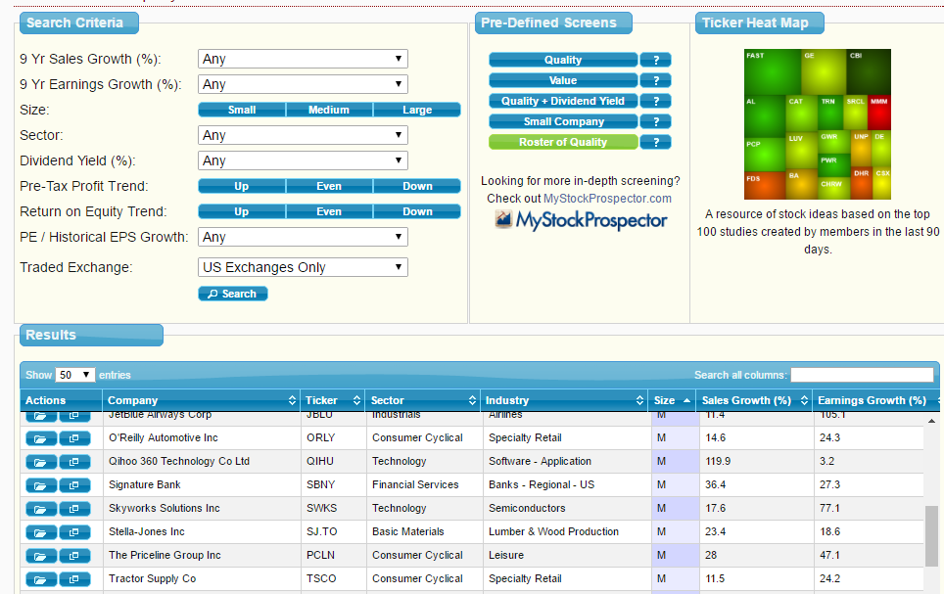
Pre-Defined Screen: Results for “Roster of Quality” (RoQ)
SSG
Thumbnail

Slide 10
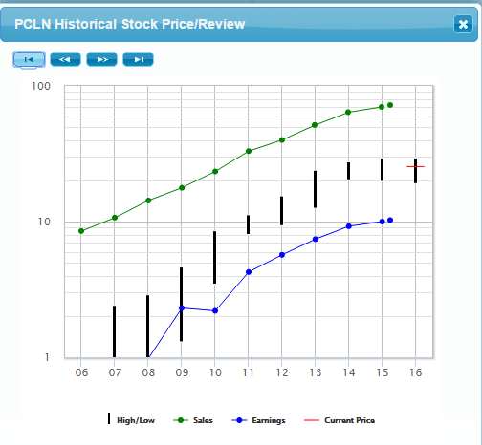
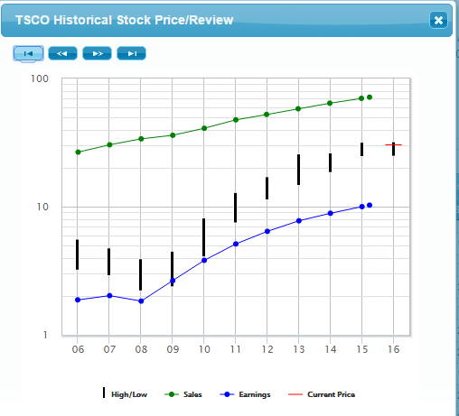
Investigating RoQ Leads: Thumbnails for Priceline & Tractor Supply Co @ 07/05/16
Priceline Closing Price = $1275.
Tractor Supply = $92.

Slide 11
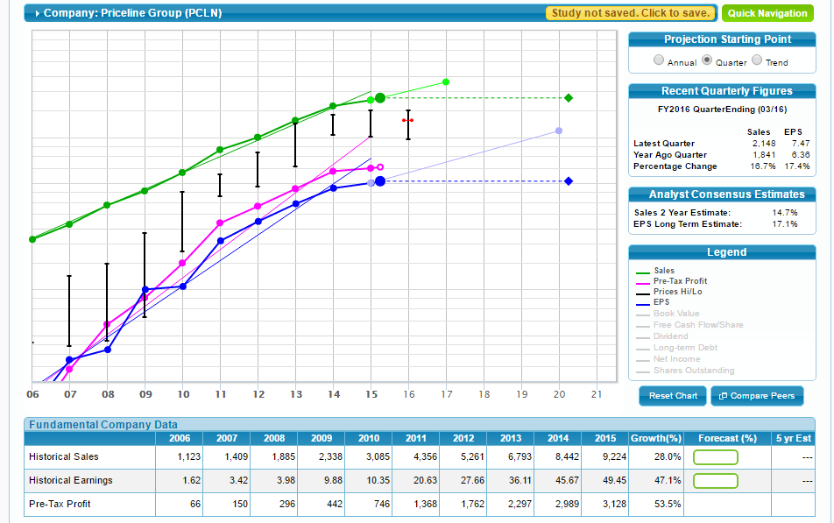
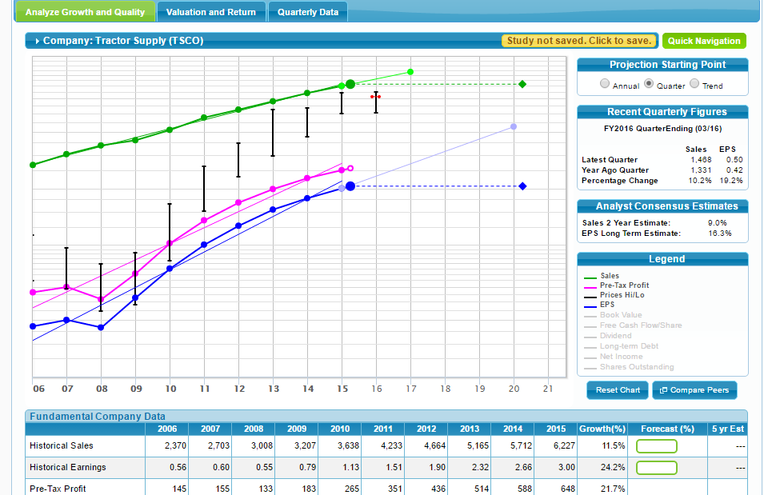
Investigating RoQ Leads, Cont: Prelim SSG, p 1
Est sales: ~15%
EPS: 17%
Est sales: 9%
EPS: 16%
Priceline
Tractor Supply Co.

Slide 12
RoQ: “Research,” “Company Summaries,” Various News/ Analyst Sources
Priceline
Tractor Supply Co.

Slide 13
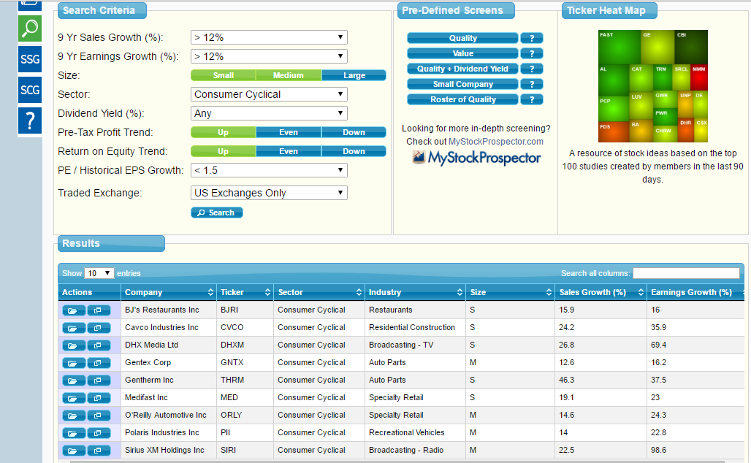
2. Search under Customizable Screens, choose criteria
2.

Slide 14
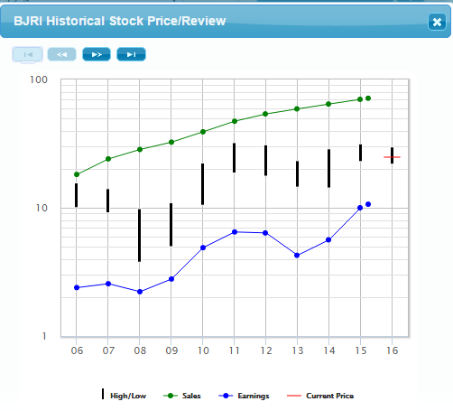
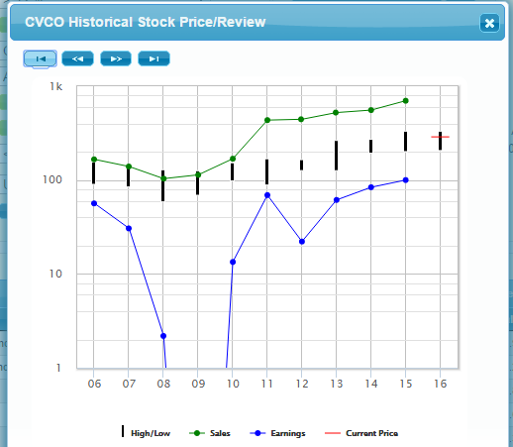
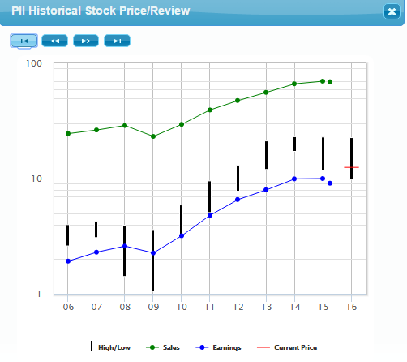
Customizable Screen Results for Consumer Cyclical:
Thumbnails of Companies Identified (more analysis TBD)
BJ’s Restaurants
Cavco (Res. Construction)
Polaris- Rec Vehicles

Slide 15
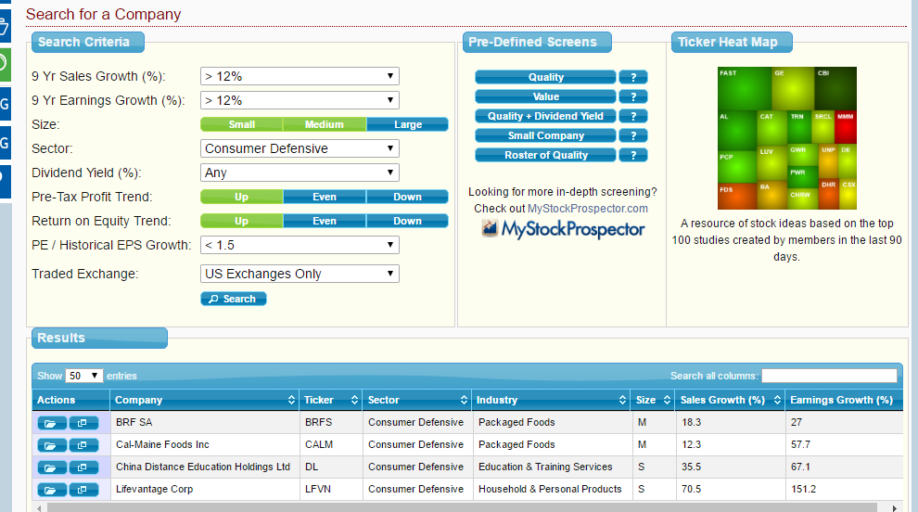
Customizable Screen: 2nd Search -Consumer Defensive: Notes 1=Criteria, 2=Result, 3=Heat Map tool
3
1
2

Slide 16
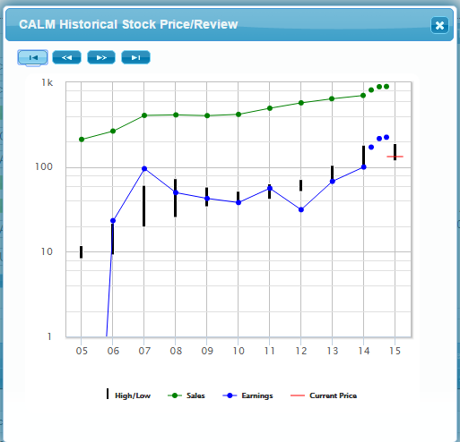
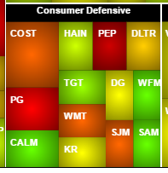
Thumbnail and BI “Heat Map” Estimation of Cal-Maine (CALM) Foods

Slide 17
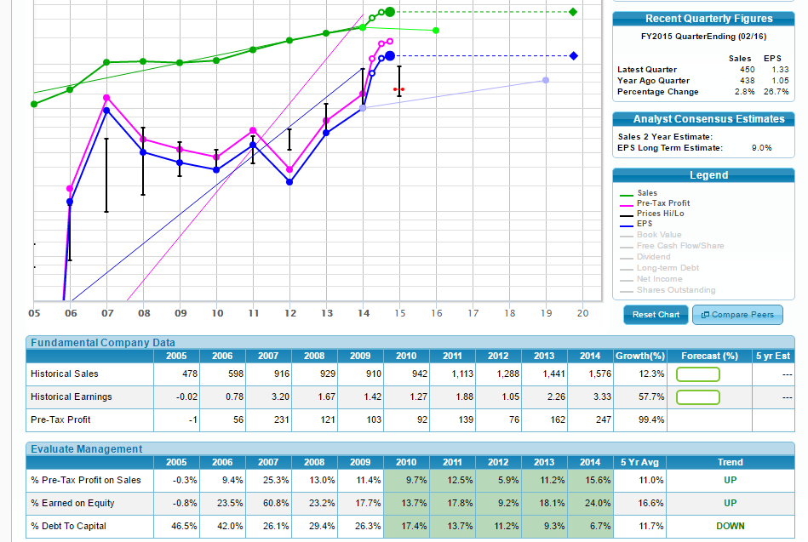
Prelim. SSG, p.1, for Cal-Maine (CALM) Foods

Slide 18
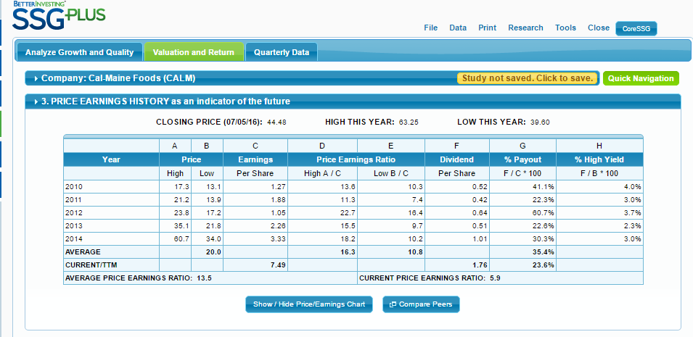
Prelim. SSG, p.2, for Cal-Maine (CALM) Foods
3
1
2

Slide 19
Cal-Maine Foods: Research, Company Summary(& News)
Why Cal-Maine Foods Price Dropped 12% in May (2016)

Slide 20
Conclusion: Using the BI Stock Screener
Two types of Stock Screeners:
Pre-defined screens provide good stock suggestions with clear attributes
Customizable screens allows the user to sort on a number of criteria
Easy initial research: tabs to the left of each stock
A thumbnail sketch of past financial performance
A more in-depth, preliminary, SSG, with research tabs
Happy Searching!
Questions?

