Slide 1
Air Lease (AL)
Young firm specializing in commercial airplane leasing.
Air Lease CEO Steven F. Udvar-Hazy founded industry giant.
International Lease Finance Corp. (ILFC). Later sold to AIG.
Eight of nine executives come from ILFC.
Airlines need newer, more fuel efficient planes to compete,
creating strong, long-lasting demand.
AL Has order book fulfilled through 2015.
Risks: Short operating history, cyclical and complex industry,
higher interest rates and not followed in Value Line.
Projected EPS growth of 18%/year. Consensus FY 2014
EPS of $2.26, forward P/E of 17.

Slide 2
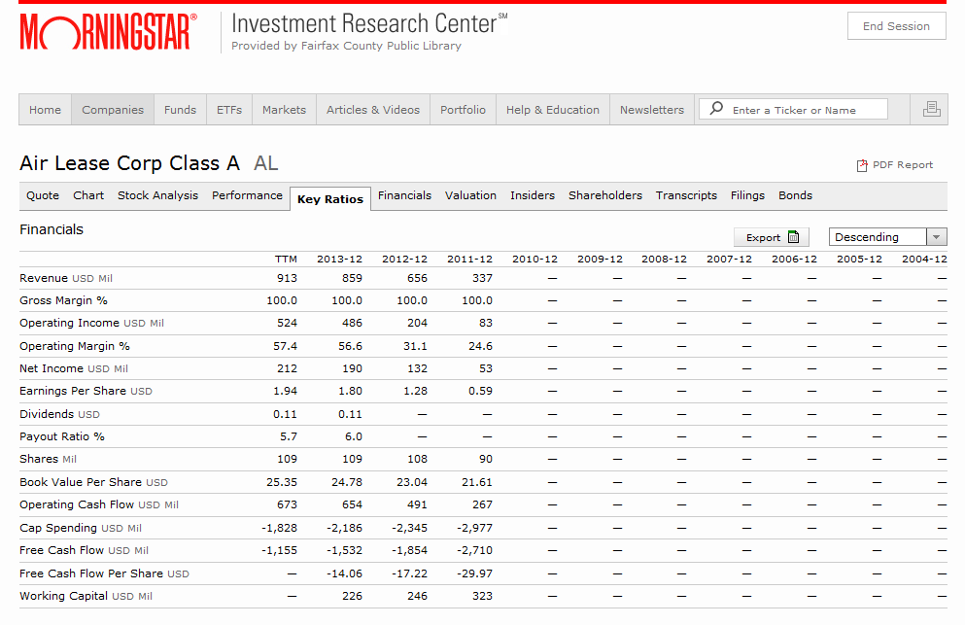

Slide 3
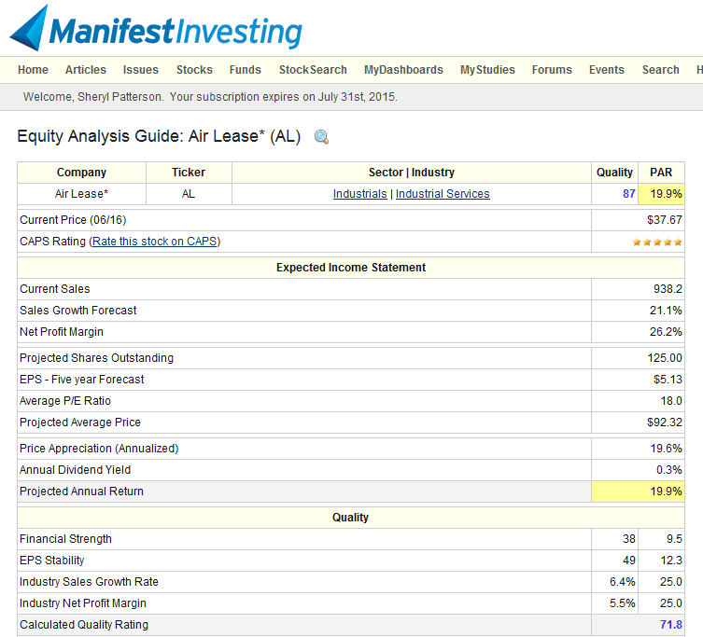

Slide 4
Competitors
AerCap – AER AerCap Holdings N.V., through its subsidiaries, is engaged in leasing,
financing, selling, and managing commercial aircraft and engines primarily in the United
States and Russia. The company provides aircraft asset management and corporate services.
The company operates a fleet of 378 aircraft. AerCap Holdings N.V. was founded in 1995
and is headquartered in Schiphol, the Netherlands. NYSE
2. Aircastle Limited – AYR Aircastle Limited acquires, leases, and sells commercial jet
aircraft to airlines worldwide. The company also makes investments in various aviation
assets, including debt investments secured by commercial jet aircraft. As of December 31,
2013, its aircraft portfolio comprised 162 aircraft that were leased to 64 customers located
In 37 countries. Aircastle Limited was founded in 2004 and is based in Stamford, Connecticut.
3. TAL TAL International Group, Inc., together with its subsidiaries, leases intermodal
transportation equipment and provides maritime container management services worldwide.
TAL International Group, Inc. was founded in 1963 and is headquartered in Purchase,
New York.

