Slide 1

Stericycle – Stock Proposal
Irina Clements
Partner, MICNOVA Director, DC Regional Chapter

Slide 2
Disclaimer
The information in this presentation is for educational purposes only and is not intended to be a recommendation to purchase or sell any of the stocks, mutual funds, or other securities that may be referenced. The securities of companies referenced or featured in the seminar materials are for illustrative purposes only and are not to be considered endorsed or recommended for purchase or sale by BetterInvestingTM National Association of Investors Corporation (“BI”). The views expressed are those of the instructors, commentators, guests and participants, as the case may be, and do not necessarily represent those of BetterInvestingTM. Investors should conduct their own review and analysis of any company of interest before making an investment decision.
Securities discussed may be held by the instructors in their own personal portfolios or in those of their clients. BI presenters and volunteers are held to a strict code of conduct that precludes benefiting financially from educational presentations or public activities via any BetterInvesting programs, events and/or educational sessions in which they participate. Any violation is strictly prohibited and should be reported to the CEO of BetterInvesting or the Director of Chapter Relations.
This presentation may contain images of websites and products or services not endorsed by BetterInvesting. The presenter is not endorsing or promoting the use of these websites, products or services.

Slide 3
Stock Selection: Opening Thoughts
Which Portfolio is the Stock For?
  Model Club or Investment Club
  Personal Portfolio
  Teaching Example
Role in Portfolio
  Size
  Sector/Industry
  Core Holding
  Challenge to Existing Holding
  Pounce Pile (Watchlist)
3
Notes:
On the upper left is the latest data from the Centers for Disease Control on life expectancies for men and women in the United States.
On average, a woman can expect to live to about 81, a man to 78.
On the upper right is a chart from Richard Bolles book, What Color is Your Parachute? For Retirement? In the 1980s a historian at Cambridge University developed the concept of the Four Ages. He knew that the old concept of retirement, retirement at 65, could not fit the new paradigm of retirement, specifically that the healthy vigorous active early part of retirement was not like the frail inactive later part. He developed this map of life. First stage being from birth to 18 or 21, the second stage being from 21 to 50 with the third stage being from 50 ish to about 75 or 80.
In the early years of the Industrial revolution, factory work was quite physical. Most people worked until they could not longer physically do so. The age of 65 as the standard age for retirement was a response to that reality. Most people did not life much longer after retirement. Clearly today, that is no longer true.
The key take away being that during the third stage, people could be developing themselves at the summit of their life, rather than winding down. Hence developing a plan for retirement, life’s next journey.

Slide 4
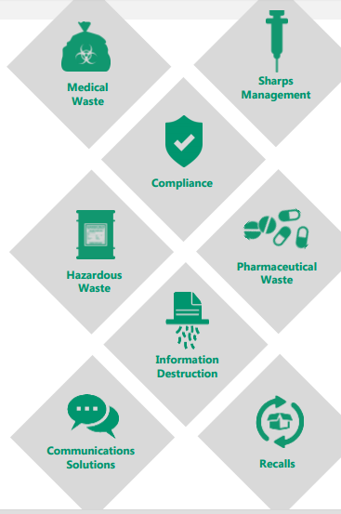
Stericycle (SRCL) - Profile
Stericycle, Inc.
28161 North Keith Drive
Lake Forest, IL 60045
United States - Map
Phone: 847-367-5910
Fax: 847-367-9493
Website: http://www.stericycle.com
Sector: Industrial Goods
Industry: Environmental/
Waste Management
Ticker: SRCL/NASDAQ
4
Notes:
An American depositary receipt (ADR, and sometimes spelled depository) is a negotiable security that represents securities of a non-U.S. company that trades in the U.S. financial markets.^{[1]}
Shares of many non-U.S. companies trade on U.S. stock exchanges through ADRs, which are denominated and pay dividends in U.S. dollars and may be traded like regular shares of stock.^{[2]} ADRs are also traded during U.S. trading hours, through U.S. broker-dealers. They simplify investing in foreign securities by having the depositary bank "manage all custody, currency and local taxes issues".^{[3]}

Slide 5
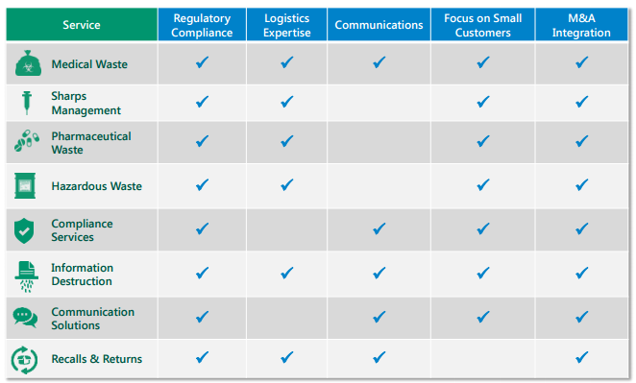
How SRCL Makes Money
Notes:
Complimentary Services that solve complex, highly regulated business challenges
Critical functions with significant potential liability associated with non-compliance
Stringent standards from EPA, DEA, FDA, OSHA, DOT, HIPAA, FACTA and other state, local and international agencies
Focus on healthcare, pharmacy, retail, biotech, manufacturing, professional service industries and governments
EPA, Environmental Protection Agency
Drug Enforcement Agency
Food and Drug Administration
Occupational and Safety Administration
Health Insurance Portability and Protection Act
Department of Transportation
Fair and Accurate Credit Transactions Act
DEA, FDA, OSHA, DOT, HIPAA, FACTA

Slide 6
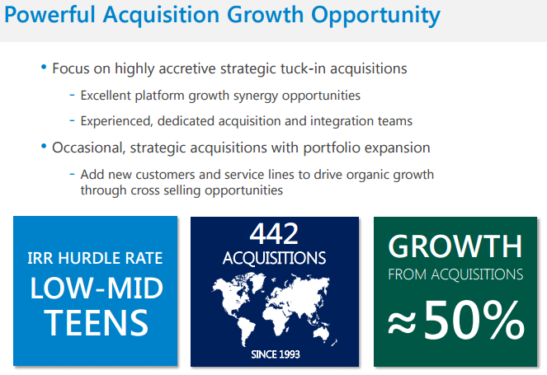
How SRCL Grows
6

Slide 7
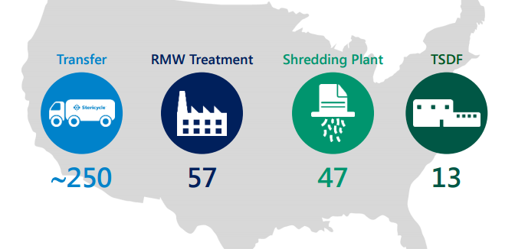
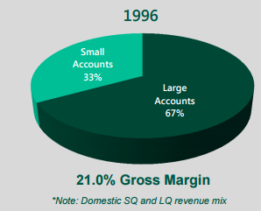
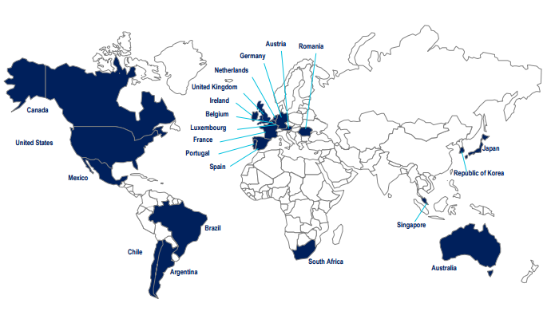
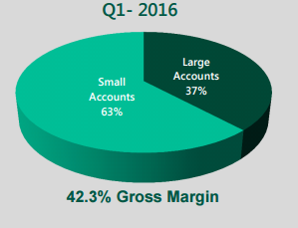
SRCL: US and Global

Slide 8
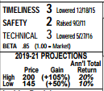



SRCL Opinions: Value Line
Notes:
Stericycle reported disappointing March-period adjusted share earnings of $0.97, versus our estimate of $1.22. The shortfall reflected the absence of expected margin improvement and a higher level of depreciation and amortization charges. Both factors are related, to varying degrees, to the $2.3 billion purchase on October 1st of Shred-It, which provides document destruction services. Anticipated consolidation synergies, which should still be considerable in time, were delayed, and
a percentage basis. On point... We think the recent pullback provides long-term-oriented accounts with an attractive entry point. Positive considerations are solid top-line growth prospects, likely improvement of the current quite healthy operating margin, and this year’s cash flow of about $475 million net of the capital budget. Much of these funds are earmarked for the company’s ongoing acquisition program. It purchased 42 regulated waste-disposal businesses in 2015 for over $100 million. Most of these were in foreign markets. Moreover, operating synergies in regard to Shred-It should soon begin to be realized. In sum, Stericycle stock offers attractive recovery potential to 2019–2021, if our projections of average per-share earnings and cash flow to that period are near the mark. David R. Cohen May 27, 20

Slide 9
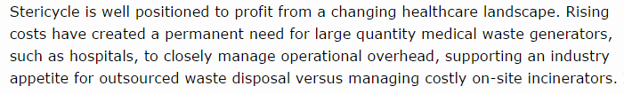
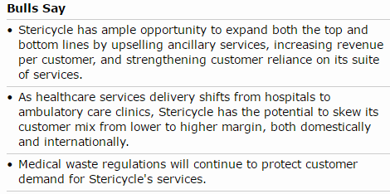
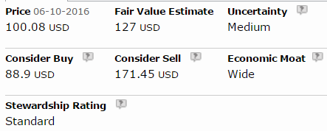
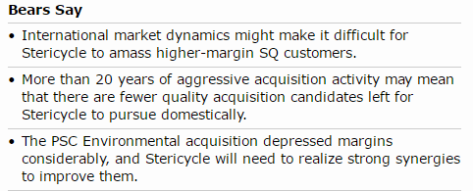
SRCL Opinions: Morningstar
Notes:
Stericycle is well positioned to profit from a changing healthcare landscape. Rising costs have created a permanent need for large quantity medical waste generators, such as hospitals, to closely manage operational overhead, supporting an industry appetite for outsourced waste disposal versus managing costly on-site incinerators. In addition, an aging global population will be an important driver of growth in Stericycle's small-quantity segment, as service delivery and frequency shifts from larger, more expensive hospital operations to smaller acute-care or ambulatory clinics capable of increasing patient throughput. As industry operating budgets adjust in response to these secular trends, Stericycle’s rationale for complementing its core medical waste business with other services useful to healthcare customers increasingly makes sense.
However, in recent years, we’ve seen Stericycle accelerate its evolution from a pure-play medical waste company toward a comprehensive provider of ancillary services targeting regulated industries outside of healthcare. Following the $2.3 billion purchase of Shred-It in 2015 and the $275 million PSC Environmental deal in 2014, we estimate that more than one third of Stericycle’s consolidated sales now come from document destruction and nonmedical hazardous waste management. Adding these compliance-driven services expanded Stericycle’s addressable market far beyond healthcare into the industrial, retail, legal, and financial landscapes; however, we believe the better potential resides in generating incremental revenue streams from Stericycle’s healthcare customers through bundled service adoption. It remains to be seen how Stericycle navigates the competitive landscape in its newest verticals.
Stericycle's international sales have grown at an 18% CAGR over the past five years as the company attempts to replicate its domestic strategy. We expect that slow but
We believe Stericycle has the widest economic moat of all the integrated waste haulers we cover. Its unmatched scale in medical waste disposal was built over time through a series of acquisitions, which secured valuable intangible assets in the forms of medical waste disposal permits and customer relationships much faster than organic development would have allowed. This dense network of collection routes and processing facilities navigates a complicated maze of local, state, and federal EPA regulations that is difficult for competitors to replicate at a similar level of operational and financial efficiency. Since improper handling of medical waste presents an even greater public health risk t

Slide 10
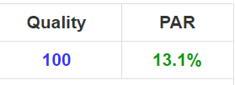
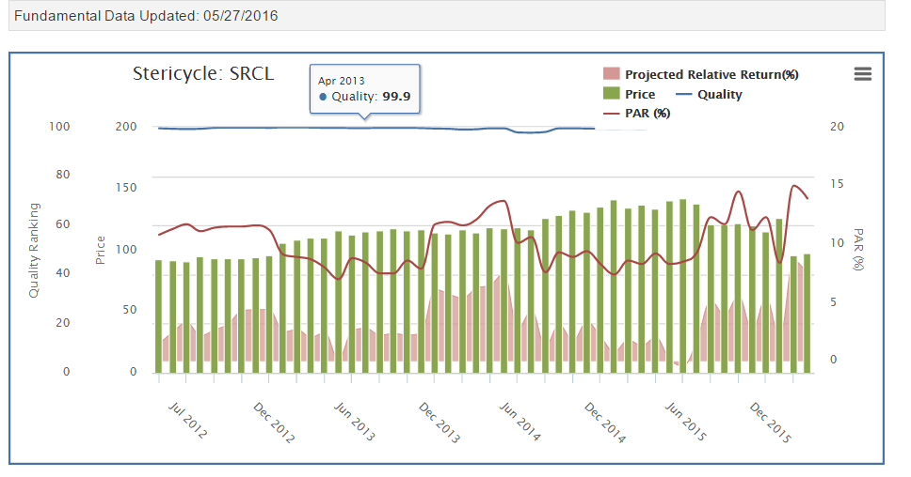
SRCL Opinions: Manifest Investing

Slide 11
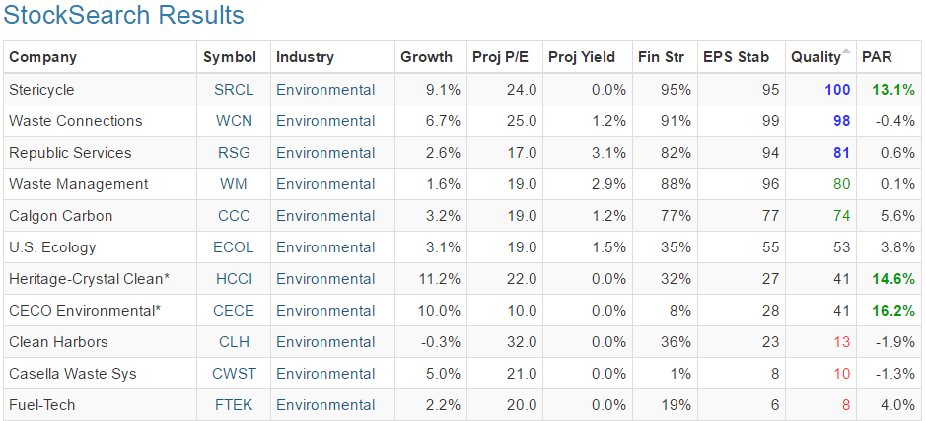
SRCI Competitors

Slide 12
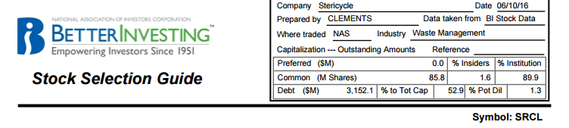
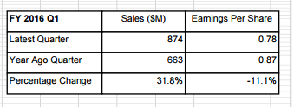
SRCL Stock Selection Guide Header Data/Quarterly Info
12

Slide 13
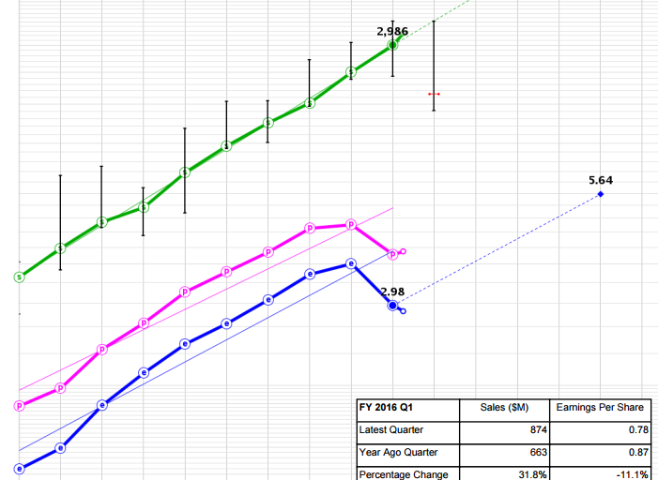
SRCL Stock Selection Guide Part 1 Visual

Slide 14
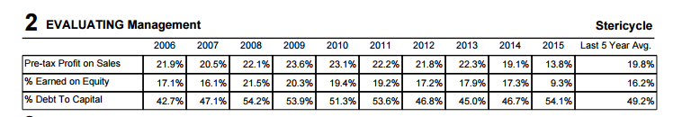
SRCL Stock Selection Guide Management Analysis
14
Notes:
We also believe that TSMC's capital expenditures and expansion plans have been more disciplined in recent years. Hefty expansion plans in the early 2000s led to extremely volatile business conditions, and although the company has made significant manufacturing equipment purchases the past few years, we believe it has done a better job of ensuring that this newfound capacity will be matched with an inflow of customer orders in the years ahead.
TSMC’s corporate governance practices are governed by applicable Taiwan law, specifically, the Company Law and Securities Exchange Law, and also TSMC’s Articles of Incorporation. Also, because TSMC securities are registered with the U.S. Securities and Exchange Commission (“U.S. SEC”) and are listed on the New York Stock Exchange (“NYSE”), TSMC is subject to corporate governance requirements applicable to NYSE-listed foreign private issuers.
Under Section 303A of the NYSE Listed Company Manual, NYSE-listed non-US companies may, in general, follow their home country corporate governance practices in lieu of most of the new NYSE corporate governance requirements. However, all NYSE-listed foreign private issuers must comply with NYSE Sections 303A.06, 303A.11, 303A.12(b) and 303A.12(c).
Item 16G as well as NYSE Section 303A.11 requires that foreign private issuers disclose any significant ways in which their corporate governance practices differ from US companies under NYSE listing standards. A NYSE-listed foreign private issuer is required to provide to its US investors, a brief, general summary of the significant differences, either: (a) on the company website in English, or (b) in its annual report distributed to its US investors. To comply with NYSE Section 303A.11, TSMC has prepared the comparison in the table below.
The most relevant differences between TSMC corporate governance practices and NYSE standards for listed companies are as follows: NYSE Standards for US Companies
under Listed Company Manual
Section 303A TSMC Corporate Practices
NYSE Section 303A.01 requires a
NYSE-listed company to have a majority of independent directors on its board of directors. Taiwan law does not require a board of directors of publicly traded companies to consist of a majority of independent directors. Taiwan law requires public companies meeting certain criteria to have at least two independent directors but no less than one fifth of the total number of directors on its board of directors. In addition, Taiwan law requires public companies to disclose information pertaining to their directors, including their independence status. Please see TSMC’s annual report for the relevant year filed with the Taiwan authorities and the U.S. SEC (both of which are available online at www.tsmc.com) for information on the total number of TSMC directors and directors who would be considered independent under NYSE Section 303A.

Slide 15
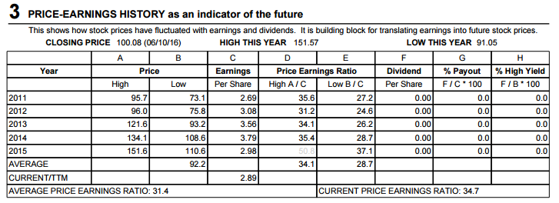
SRCL Stock Selection Guide Part 3 Price Earnings Data
15

Slide 16
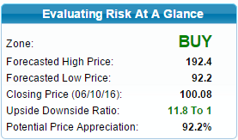
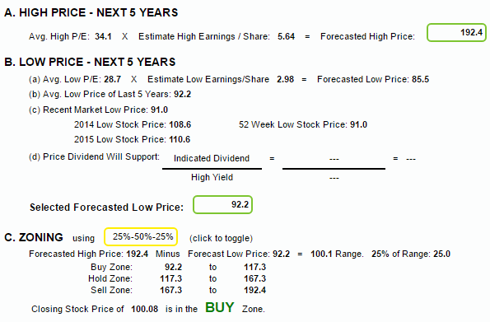
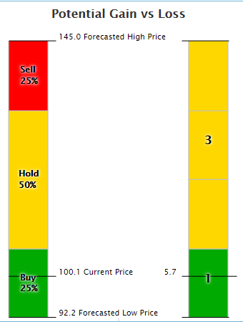
SRCL Stock Selection Guide Part 4 Risk and Reward

Slide 17
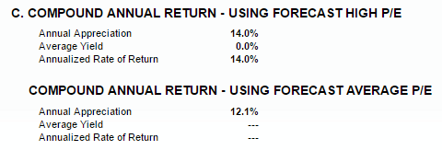
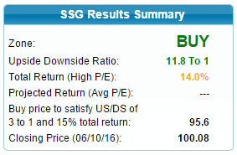
SRCL Stock Selection Guide Total Return Analysis
17

Slide 18
SRCL Conclusion
18

