Slide 1
NYSE: ASR

Slide 2
List of Stocks Selected for further review
Notes:
Need to update table with ASR’s information
Brief statement about the other two stocks having good-looking SSGs but further research revealed serious issues that caused us to exclude them from consideration
How we found out about ASR and why we considered it worthy of consideration

Slide 3
How we chose ASR: Manifest Investing

Slide 4
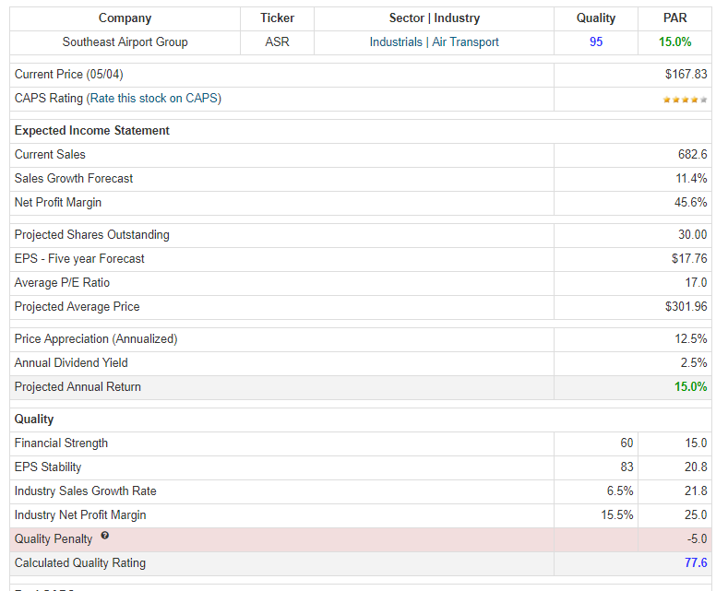
ASR

Slide 5
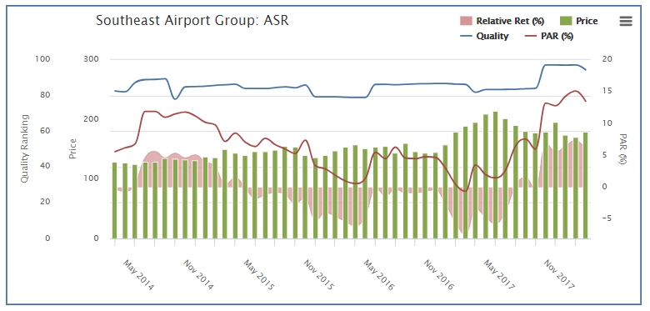
ASR

Slide 6
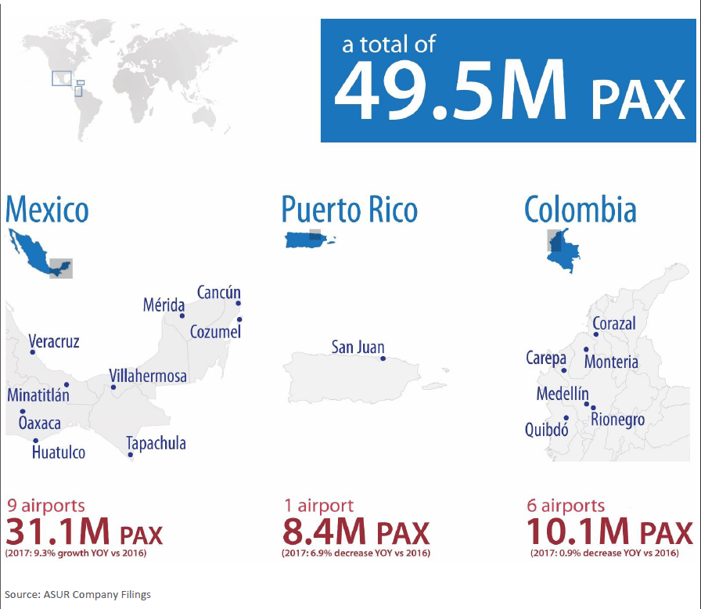
Grupo Aeroportuario del Sureste SA de CV is a holding company, which engages in the operation, maintenance, and development of airports. It operates in Southeast Mexico, Puerto Rico, and Columbia
Notes:
Company Profile and area of operation.

Slide 7
Notes:
Breakdown of revenues
Mexico PAX
Total PAX in ASR’s 9 Mexican airports rose 9.3% in the first quarter (main contributor - Cancun)
Other 8 Mexican airports increased 8.2% over the year-ago period
Mexico revenue
Traffic increased overall but commercial revenue per passenger slipped: 3.2% drop at Mexican airports (traffic grew faster than revenue from non-aeronautical services (duty-free stores, car rentals, retail operations, banking)
Banking and currency exchange services revenue slipped 7.8% year over year

Slide 8
Notes:
Cancun 2nd largest airport in Mexico
Key projects completed (Cancun):
- 2006-2007:Terminal 3 and second runway in CUN
- 2011: Passenger flow separation in CUN
- Terminal building expansion:
• 2014-2016: Terminal 2 & 3 in CUN
• 2014-2017: New Terminal 4 in CUN

Slide 9
Notes:
Cart showing ASR’s ability to recover and grow after major events

Slide 10
Notes:
19.2% decline at the San Juan airport due to impact from Hurricane Maria
Flight levels have returned to normal but fewer passengers are traveling to the area
SJU accounts for over 93% of Puerto Rican passenger traffic
September 21, 2017: Hurricane Maria hits Puerto Rico.

Slide 11
Notes:
Columbia
Traffic in ASR’s newly acquired Colombian airports slipped, declining 5.2%
International traffic soared 19.9%, but that wasn't enough to offset an 8.7% drop in domestic traffic (due to pilot strike at a major carrier)

Slide 12
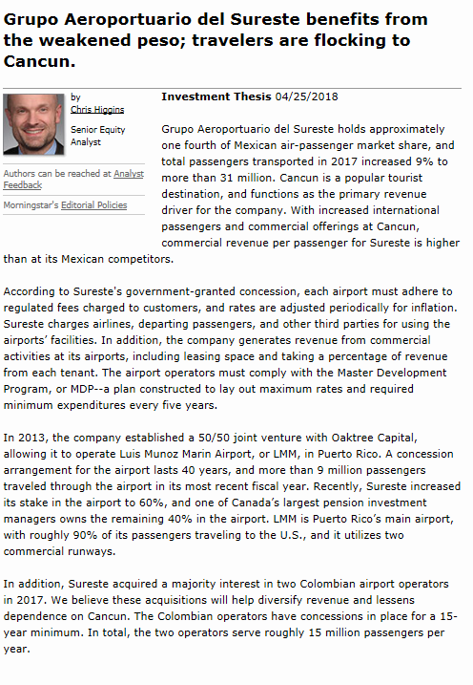
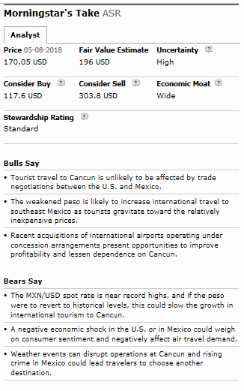

Slide 13
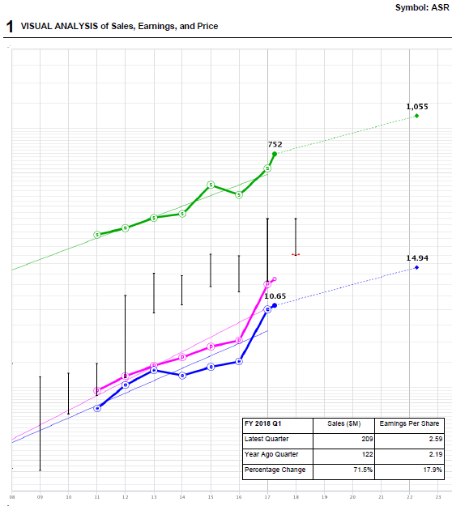
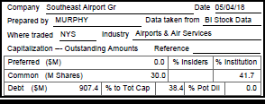
8 9 10 11 12 13 14 15 16 17 18 19 20 21 22 23
Notes:
Place SSG here
Brief summary of why we think it is worthy of consideration by the club. Any caveats or concerns we have that are worthy of note.
Be prepared to respond to queries/concerns from club members, including why 7% or whatever is good enough when we are supposed to be seeking 15%.

Slide 14
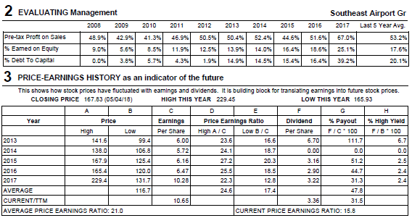

Slide 15
