Slide 2
CFRA - Outlook

Slide 3
Manifest Investing

Slide 4
Value Line

Slide 5
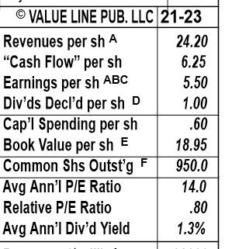
PE – slide

Slide 6
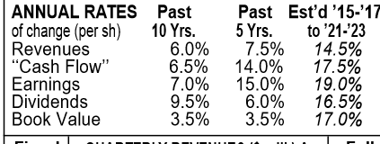
Capital structure Slide

Slide 7
The financial strength –

Slide 8
Stock Selection Guide - Slide

Slide 9
SSG Graph Slide

Slide 10
Using Most recent five Years

Slide 11
Preferred Procedure calculation – Slide

Slide 12
Value line forecast of EPS – Slide

Slide 13
Evaluate Management

Slide 14
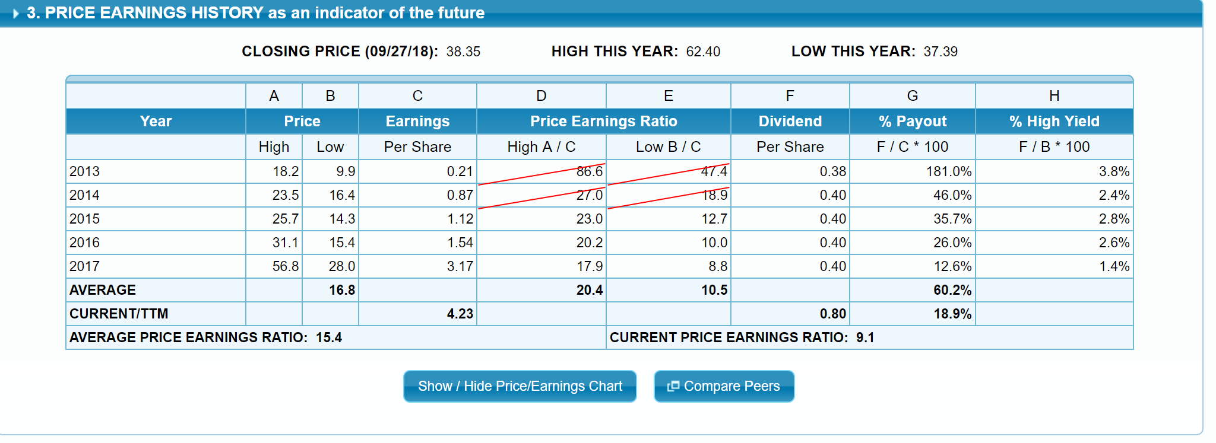
3. Price Earnings History – Slide

Slide 15
4. Evaluating Risk and Reward over the next five years

Slide 16
Determine Low Price - Slide

Slide 17
Evaluating Risk at a Glance slide –

Slide 18
5. Five year potential - Slide

