Slide 1
Western Alliance Bancorp
Notes:
Western Alliance Bancorporation operates as the holding company for Western Alliance Bank that provides various banking products and related services primarily in Arizona, California, and Nevada. The company offers deposit products, including checking accounts, savings accounts, and money market accounts, as well as fixed-rate and fixed maturity certificates of deposit accounts. It also offers commercial and industrial loan products, such as working capital lines of credit, inventory and accounts receivable lines, mortgage warehouse lines, equipment loans and leases, and other commercial loans; commercial real estate loans, which are secured by multi-family residential properties, professional offices, industrial facilities, retail centers, hotels, and other commercial properties; construction and land development loans for single family and multi-family residential projects, industrial/warehouse properties, office buildings, retail centers, medical office facilities, and residential lot developments; and consumer loans. In addition, the company provides other financial services, such as Internet banking, wire transfers, electronic bill payment and presentment, lock box services, courier, and cash management services. Further, it holds certain investment securities, municipal and non-profit loans, and leases; invests primarily in low income housing tax credits and small business investment corporations; and holds certain real estate loans and related securities. As of December 31, 2017, the company operated 38 branch locations and 8 loan production offices. Western Alliance Bancorporation was founded in 1994 and is headquartered in Phoenix, Arizona.

Slide 2
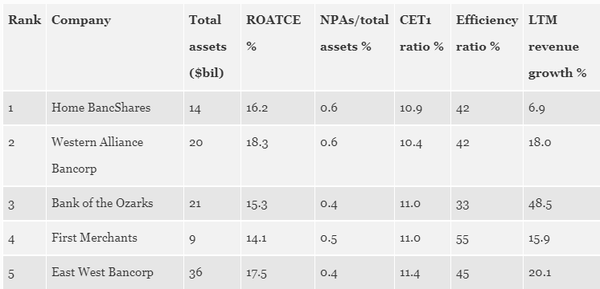
Forbes 2018 Top 5 Ranked Banks
Notes:
Forbes ranked the banks based on 10 metrics related to growth, profitability, capital adequacy and asset quality. Metrics include return on average tangible equity, return on average assets, net interest margin, efficiency ratio and net charge-offs as a percent of total loans. Forbes also factored in nonperforming assets as a percent of assets, CET1 ratio, risk-based capital ratio and reserves as a percent of nonperforming assets. The final component is operating revenue growth.
ROATCE is a measure of how much money a bank makes on the amount of tangible common equity that's on its balance sheet. This measure excludes things like goodwill from the equity calculation and also preferred stock and other forms of capital that aren't common stock. Common Equity Tier 1 capital is the core measure of a bank's financial strength from a regulator's point of view. It is composed of core capital, which consists primarily ofcommon stock and disclosed reserves (or retained earnings), but may also includenon-redeemable non-cumulative preferred stock.

Slide 3
First Merchants

Slide 4
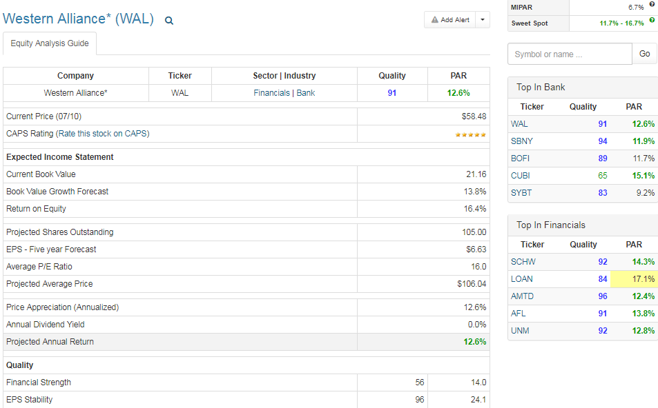

Slide 5
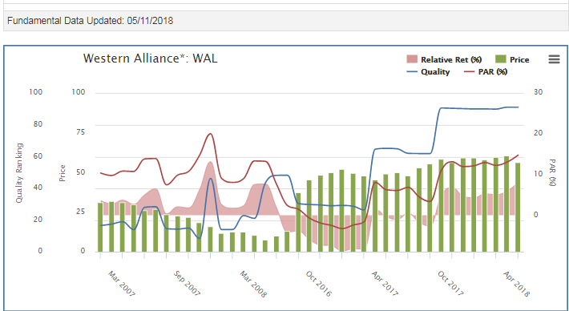

Slide 6
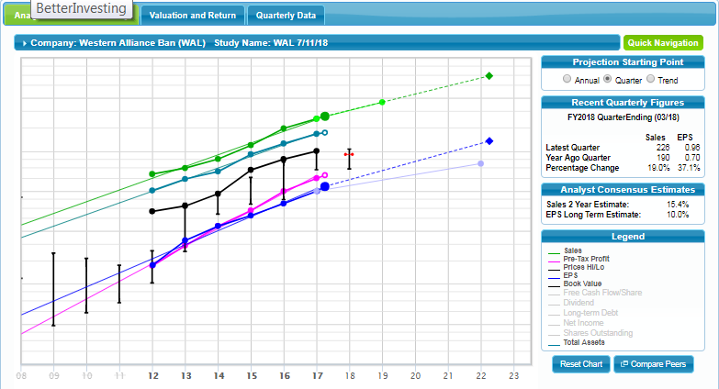

Slide 9
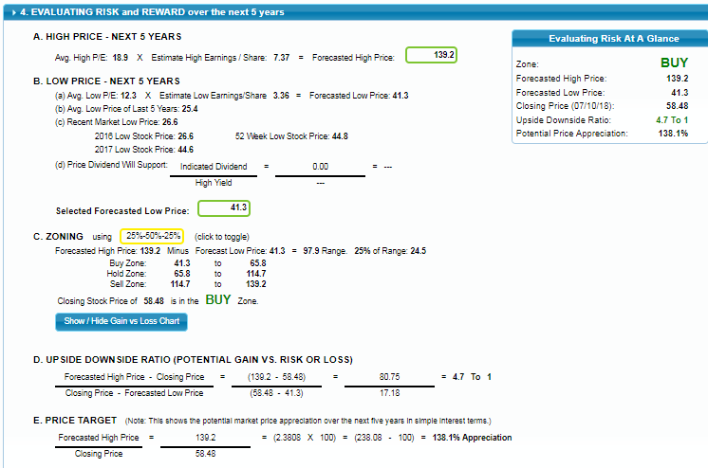

Slide 10
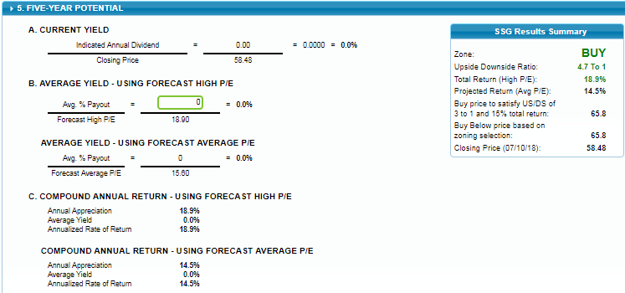

Slide 11
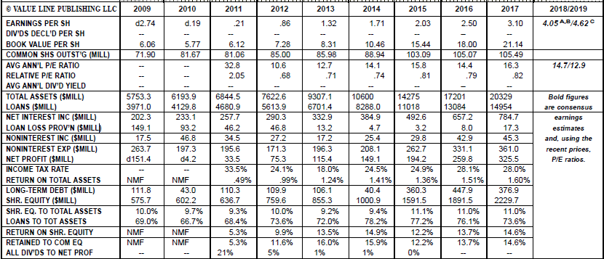

Slide 12
Loan Loss
Loan Loss Characteristics = Loan Loss Provision / Total Loans Outstanding. If less than 1 percent
WAL has extremely low Loan Loss provision

