Slide 1
Corporate Office: 1331 L Street, NW, Washington, DC 20005
November 2019
Presented by
Kent Billmyer

Slide 2
CoStar Group (NAS: CSGP)
CoStar Group is a leading provider of commercial real estate data and marketplace listing platforms. Its data offering contains in-depth analytical information on over 5 million commercial real estate properties related to various subsectors including office, retail, multifamily, healthcare, industrial, self-storage, and data centers. It operates five flagship brands: CoStar Suite, LoopNet, Apartments.com, BizBuySell, and LandsofAmerica with approximately three quarters of its revenue classified as subscription based. The company has also recently expanded its presence in Canada, the United Kingdom, Spain, and France. Sector: Real Estate Industry: Real Estate Services
From BetterInvesting – Company Research

Slide 3
CoStar has four main business lines, CoStar Suite, Commercial Property and Land, Multifamily, and Information Services.
CoStar Suite about 50% of revenue.
This flagship product contains proprietary data that is sold to institutional players such as brokers via annual subscriptions.
Multifamily about 30% of revenue.
This business contains apartment listing platforms such as Apartments.com, ForRent.com, and Apartmentfinder.com among several others.
Commercial Property and Land about 15% of revenue.
The LoopNet Premium Lister, BizBuySell, LandsofAmerica, and other related brands are contained within the commercial property and land business line. Much like the multifamily platforms, CoStar derives its revenue by charging tiered yearly subscription packages in exchange for preferential advertising placement on its platforms.
Information Services less than 10% of revenue
Information services consists of the legacy LoopNet Premium Searcher, CoStar Real Estate Manager, and various other miscellaneous products.
From Morningstar Analysis - Business Strategy and Outlook 02/19/2019

Slide 4
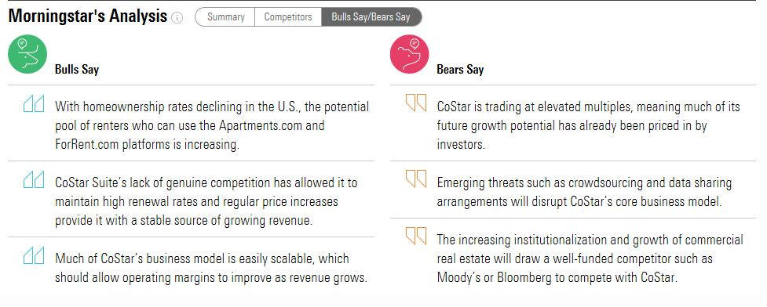
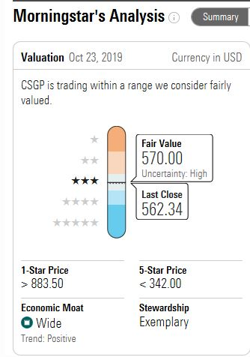
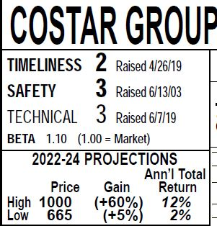
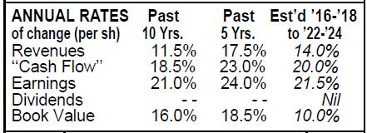

Slide 5
We assign CoStar Group a wide moat rating, with intangible assets, switching costs, and network effects all serving as moat sources.
We view the CoStar Suite business as a borderline monopoly in that it has no true threats in terms of competition.
When the company pursued its acquisition of LoopNet for $860 million in 2011, federal regulators scrutinized it due to antitrust concerns. The acquisition was eventually approved in 2012, but only after CoStar agreed to certain limitations regarding competitive behavior, including a requirement that LoopNet spin off Xceligent, which was CoStar’s only notable competitor. This dynamic was amplified following Xceligent’s declaration of bankruptcy in December 2017. Following this development, the only remaining companies in the space are small startups focused on crowdsourcing data.
we think there is a minor risk that antitrust concerns flare up again. However, absent a headline driving acquisition in the commercial real estate data space, we think the chance that the government will proactively address the issue is low.
Any potential competitor would have to spend years and potentially billions of dollars to replicate CoStar’s data offering.. CoStar benefits from a switching cost moat source given the indispensable nature of its data. As such, the company consistently posts renewal rates above 90%, with the figure typically exceeding 95% for clients who have been customers for five years or longer.
From Morningstar Analysis - Economic Moat 02/19/2019

Slide 6
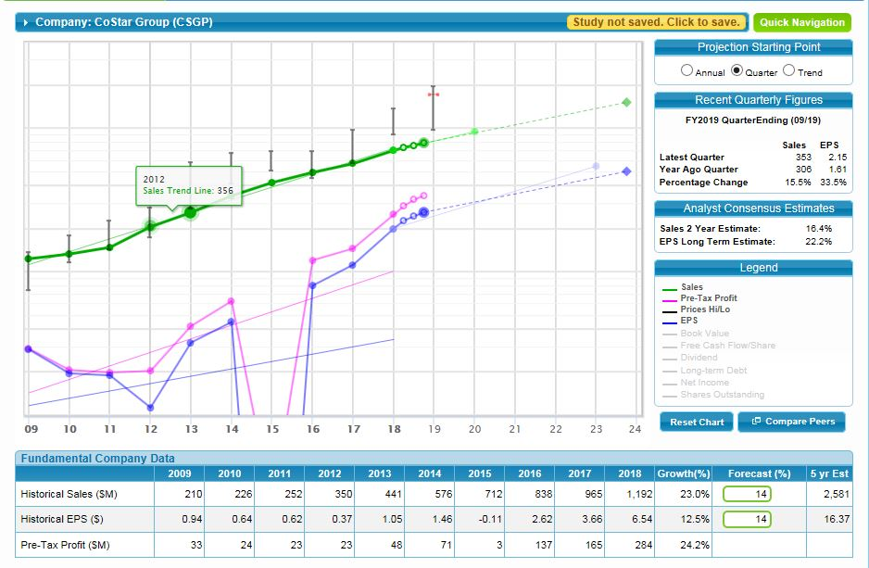

Slide 7
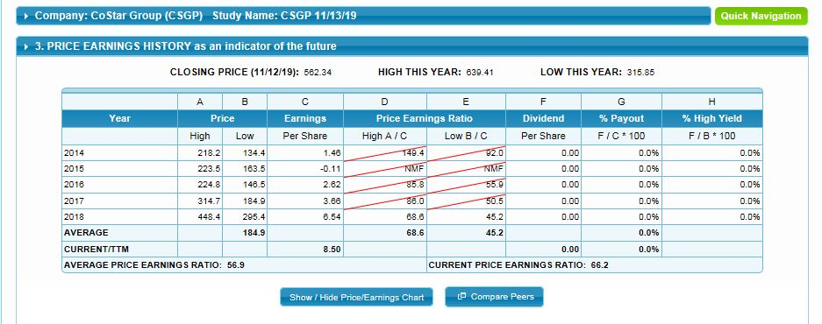

Slide 8
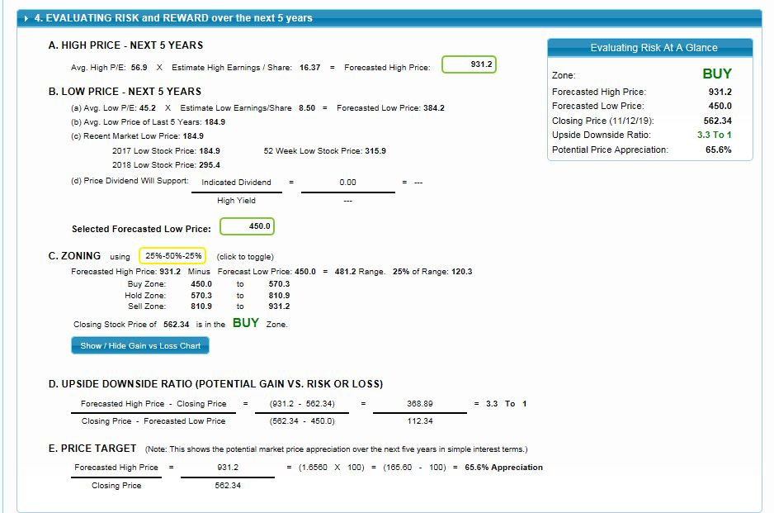

Slide 9
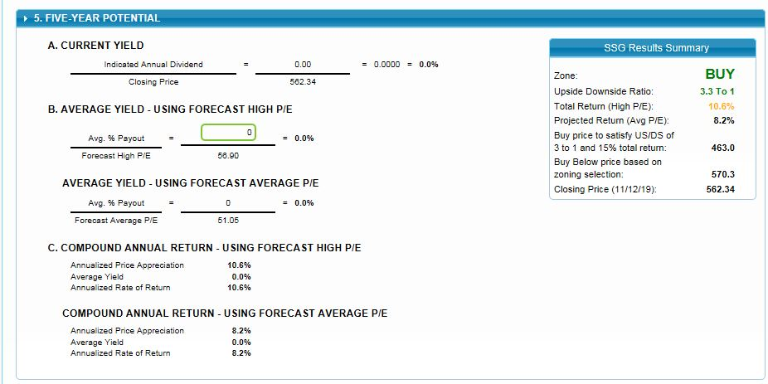

Slide 10
