Slide 1
DC Chapter Directors Talk Stocks Ken Williams – Cirrus Logic Susan Tanoe – Gentex Jo Murphy – Ross Stores Sheryl Patterson – ULTA Beauty
Director, DC Chapter BI
bi_dc_chapter@verizon.net
Notes:
1
Main Title Slide (w/animation)

Slide 2
Disclaimer
The information in this presentation is for educational purposes only and is not intended to be a recommendation to purchase or sell any of the stocks, mutual funds, or other securities that may be referenced. The securities of companies referenced or featured in the seminar materials are for illustrative purposes only and are not to be considered endorsed or recommended for purchase or sale by BetterInvesting™ National Association of Investors Corporation (“BI”) or the National Investors Association, its volunteer advisory board (“NIA”). The views expressed are those of the instructors, commentators, guests and participants, as the case may be, and do not necessarily represent those of BetterInvesting™ or NIA. Investors should conduct their own review and analysis of any company of interest before making an investment decision.
Securities discussed may be held by the instructors in their own personal portfolios or in those of their clients. BI presenters and volunteers are held to a strict code of conduct that precludes benefiting financially from educational presentations or public activities via any BetterInvesting programs, events and/or educational sessions in which they participate. Any violation is strictly prohibited and should be reported to the President of BetterInvesting or the Manager of Volunteer Relations.
Notes:
2

Slide 3
ULTA Beauty Inc (ULTA)
Sheryl Patterson
Director, DC Chapter BI
bi_dc_chapter@verizon.net
srap14@gmail.com
Notes:
3
Main Title Slide (w/animation)

Slide 4
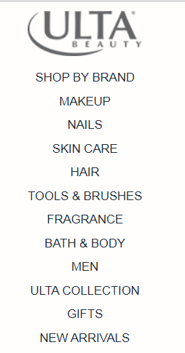

Slide 7
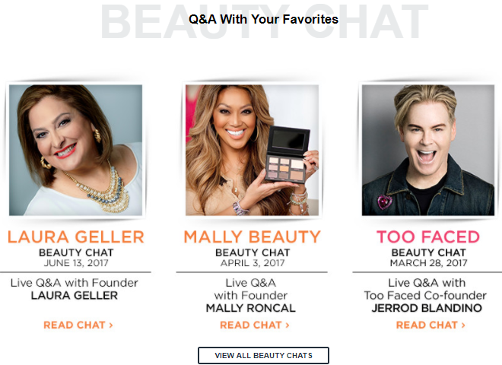

Slide 8
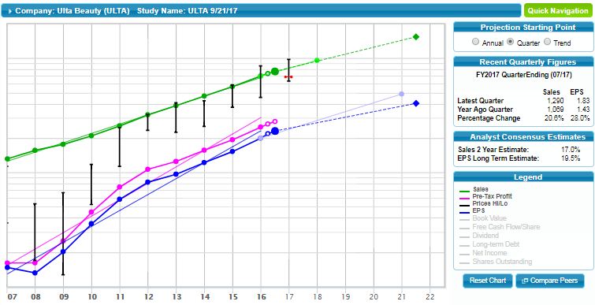

Slide 10
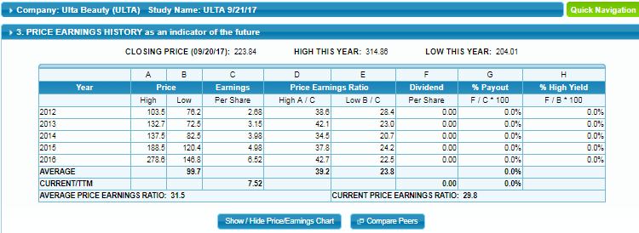

Slide 11
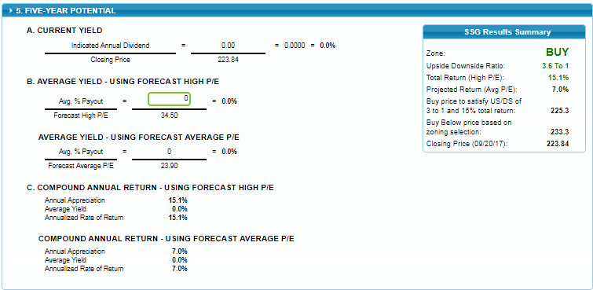

Slide 12
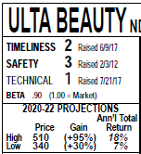
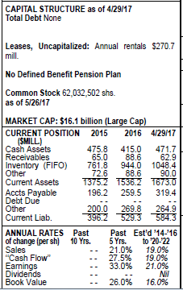
We think that the recent pullback
presents a buying opportunity. Management
upped its comp-sales growth forecast
range by a percentage point at both
ends, to 9% to 11%, and its e-commerce
growth assumption by 25%, to 50%. It also
raised its share-net growth expectation to
a mid-twenties range, from its previous
low-twenties range. All things considered,
we’ve ratcheted up our earnings-per-share
estimate by $0.25 for this year and next, to
$8.25 and $9.95, respectively. We continue
to think that the company’s multichannel
business model, move in to e-commerce,
and rewards program will resonate with
consumers, thereby driving healthy gains
for the foreseeable future.

Slide 13
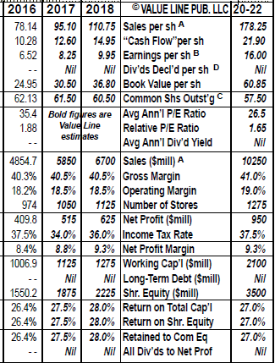

Slide 15
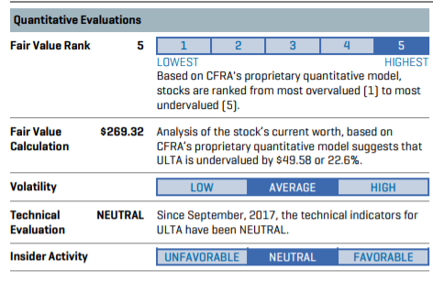

Slide 16
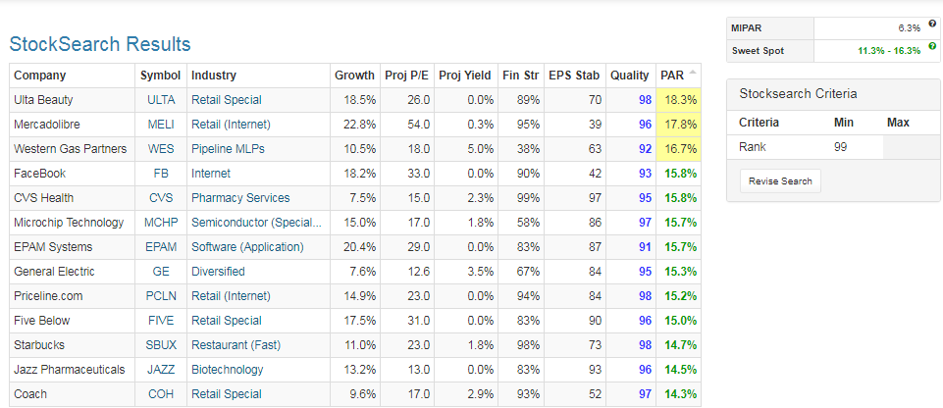
Manifest Ivory Snow Dashboard 9/30/2017

Slide 17
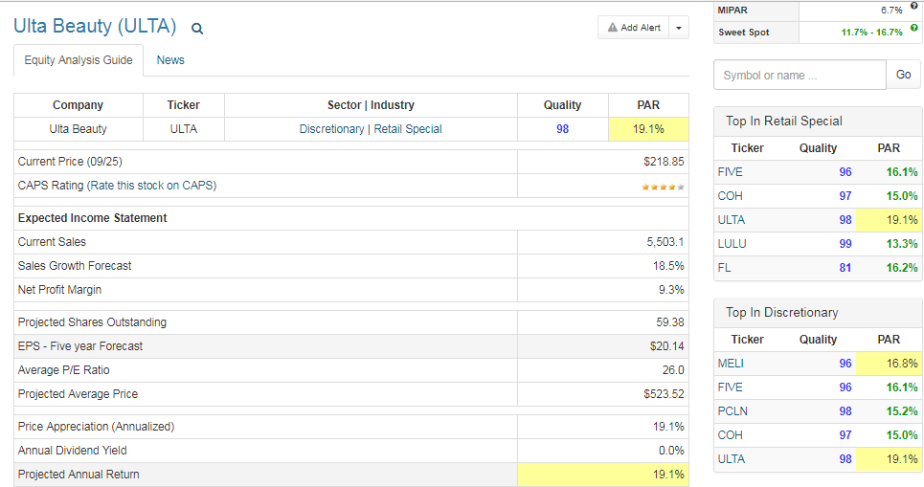

Slide 18
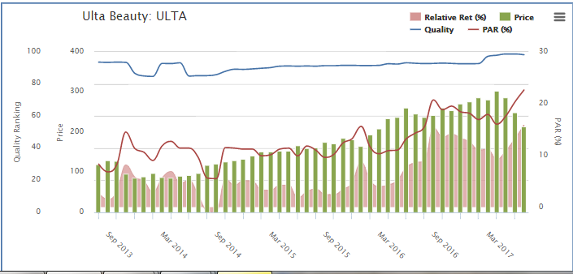

Slide 19
Special Chapter Events
Sat, Oct 21 & 28 – Stock Selection Guide on-site classes; Online & Toolkit software/Judgment and Research Sources – Step by step to preparing your own SSG, Fee: $80 for 2 days; or $50 for 10/21 class and $30 each for sessions two or three on 10/28/17. 10/21/17 class taught by CPA.
Sat Oct 21 – Joint AAII/BI “Morningstar Best Ideas for 2018 and Beyond" with Christine Benz, NOVACC Annandale Campus, 8333 Little River Turnpike (See AAII DC Metro for Info/Prices)
Mon Oct 23 – Library online Resources for analyzing stocks, Rockville Library, 21 Maryland Ave, Rockville, MD, park in Garage A or B for validated parking. 6-9 pm Free
Mon Feb 05 – Next Chapter Webinar – Industry Study by Linda Hunt

Slide 20
Money Matters Book Discussion 2nd Tuesday of each month 7- 8:30pm Oakton Library, 10304 Lynnhaven Place, Oakton

Slide 21
MODEL CLUBS
Model Investment Club of Northern Virginia (MicNOVA)
3rd Thursday of each month (through December 2017) 7 – 9pm (visitors welcome) Dolley Madison Library 1244 Oak Ridge Avenue, McLean, VA
Montgomery County Model Investment Club (MCMC)
3rd Wednesday of each month 7 – 9pm (visitors welcome)
Rockville Library
21 Maryland Avenue, Rockville, MD

Slide 22
On-Line Better Investing Events
Wed Oct 11 - Stock-up webinar, When does GAAP EPS need adjusting. Register at www.betterinvesting.org 8:30-9:45pm Free.
Wed Oct 18 – Ticker Talk Webinar, education shorts. Register at www.betterinvesting.org 8:30-9:30pm Free
Tues Oct 24 - Roundtable webinar, 8:30-9:45pm. E-Mail Natalie Kavula at nkavula1@comcast.net for invite. Free
Tues Nov 07 – First Tuesday – Investing topics with Mark and Ken. Registration https://attendee.gotowebinar.com/register/3870412156204795395 8:30pm
Wed Nov 8 – Stock-up, Classic Stock Study. Register at www.betterinvesting.org 8:30-9:45pm Free for members.

