Slide 1
Notes:
Monster beverage is the leading developer and marketer of that segment of the beverage industry known as Alternative Beverages. According to an Energy Drinks Industry Report, Global energy drink sales reached $49.9 billion in 2014 and is forecasted to reach $84.7 Billion by 2026. Energy drinks are beverages that typically contain taurine, caffeine, vitamins, glucuronolactone, proprietary blends, herbal extracts, and amino acids, which are marketed as products that boost physical stamina and mental alertness. These beverages are formulated both with and without sugar and may or may not be carbonated, thus the product ranges are significantly broad. These products are gaining popularity among athletes, students, service members and even the adult consumers.

Slide 2
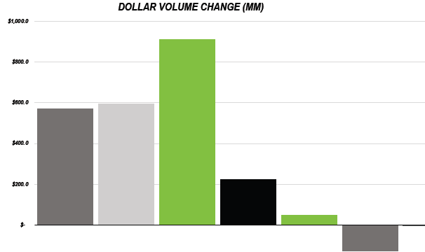
Beverage Landscape (U.S.)
Notes:
Energy drinks are part of the broader soft drink category, which includes carbonated beverages, fruit and vegetable juices, bottled water, sports drinks, beverage concentrates, ready-to-drink tea, and ready-to-drink coffee. Within this industry, consumers have been buying less soda and more energy drinks. Americans today are consuming about the same amount of soda as they were in 1986. Meanwhile, energy drink sales have been growing rapidly, according to the American Beverage Association, the trade association that represents America’s non-alcoholic beverage industry. The markets that will be most important for energy drink growth through 2017 are the United States, China and Brazil, according to market research firm Euromonitor International.

Slide 3
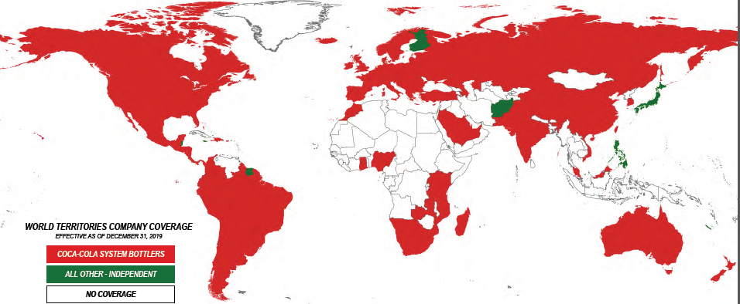
Distribution: Monster Energy Drinks

Slide 5
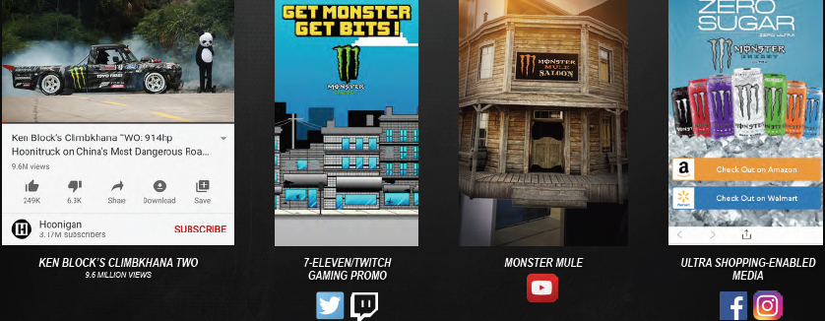
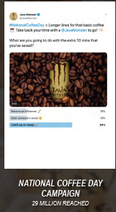
Current and Planned Marketing Strategies

Slide 6
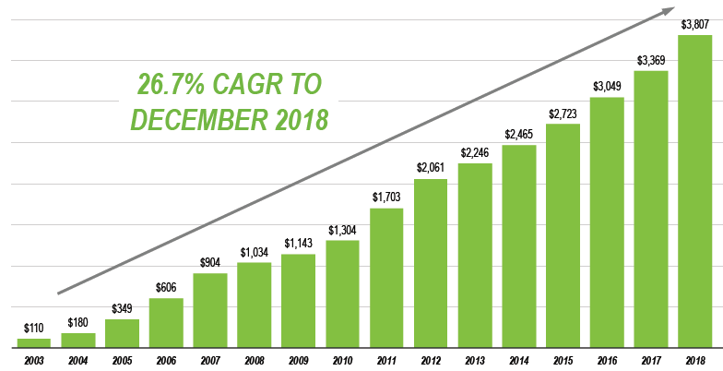
Reported Net Sales ($ in Millions)
Notes:
Since it’s inception in 2002, Monster Beverage has enjoyed consistent growth in Net Sales that resulted in a Compound Annual Growth rate year over year of 26.7% and 27 consecutive years of increased sales since the acquisition of Hansen Beverage Company in 1992.

Slide 8
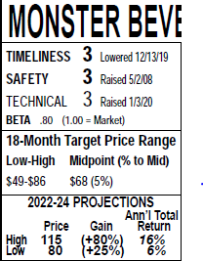
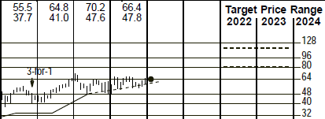

Slide 9
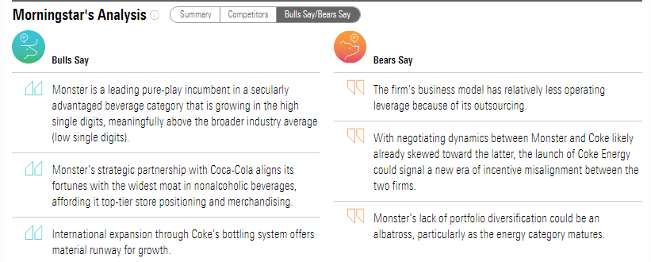

Slide 10
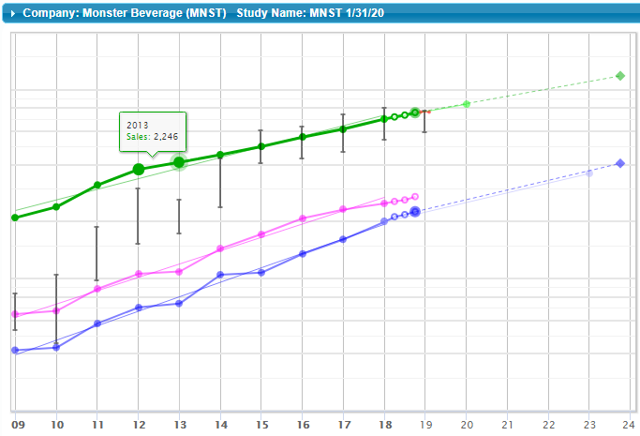
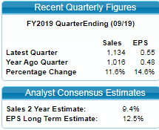

Slide 11
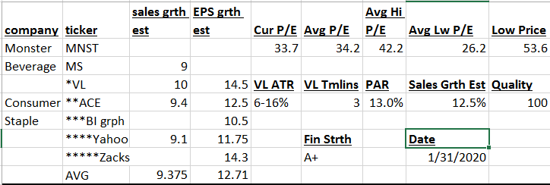
Analyst Estimates
Company Website
Value Line
Notes:
In a previous Ticker Talk, Anne Cunez discussed how one should not depend upon a single point of data to make judgements especially the Sales Growth and Earnings per Share growth estimates. For each stock that I own or study for potential ownership, I developed this spreadsheet to notate different estimates of growth and key ratios to have in one location. For the sales growth, I visit various sites through the SSG Research Tab, and Key sites found at the Library online Research. I will then eliminate any data that I consider an outlier and divide by the number of data points to get an average to consider as my judgement.

Slide 12
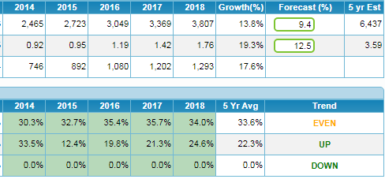

Slide 13
Notes:
The historical 5-year average high P/E for MNST is 46. Over the last few years, the high P/Es have been trending down, and the current P/E is 34. In addition, we forecast future growth to be lower than the historical growth. When growth slows P/Es typically will decline as well. In light of all this, Ken selected 32 and Ann selected 30. We settled on the average of 31 for this SSG.

Slide 15
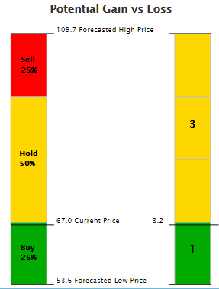
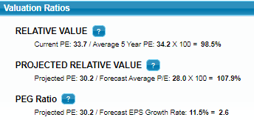

Slide 16
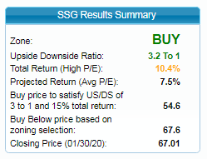
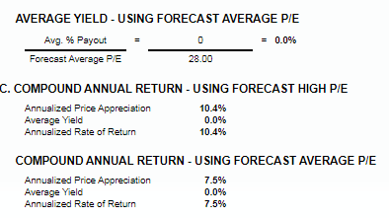

Slide 17
Saturdays, March 21st & 28th – On-site Step by step to preparing your own Stock Selection Guide class; Online Tools; Judgment and Resource Sources. Fee: $80 for 2 days; or $50 for 3/21/20 class and $30 each for software and/or Judgment class on 3/28/20. Northern Virginia Center/Virginia Tech. Register online at www.betterInvesting.org/dcregional
Saturday April 4th – 10:30 AM to 1PM. Money Smart Week: “Financial Empowerment for young adults and their families”. At Alexandria Library, Beatley branch. Free
Thursday April 23rd – 7-9 PM. Jumpstart your savings, At Tysons-Pimmit Library. Free.
Saturday May 2nd – 10:30 AM to 1PM. Honor the Clubs Day, Sharing in the Investment At Arlington Central Library. Free.

