Slide 1
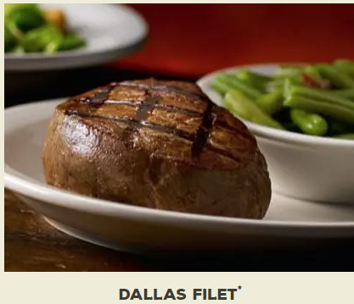
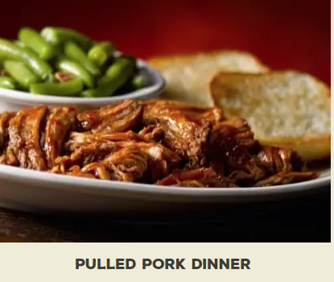
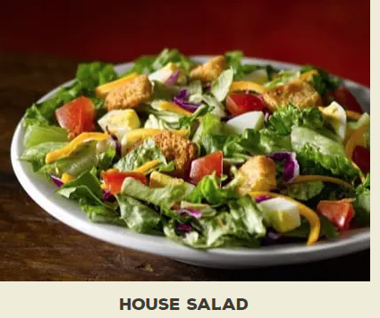

Slide 2
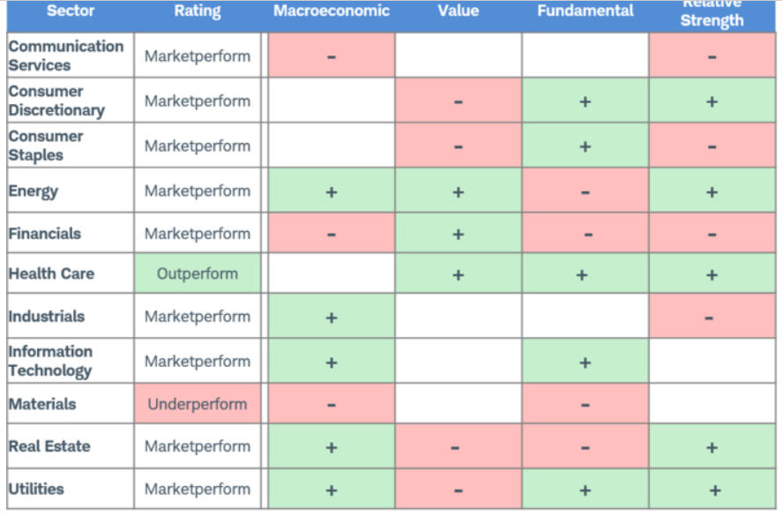
Schwab Sector Performance 2020

Slide 3
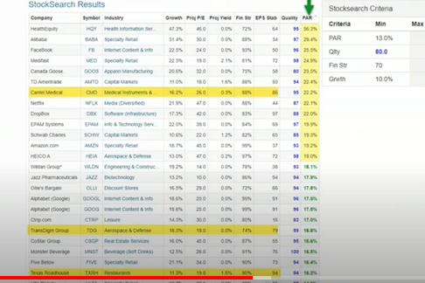
From Manifest Investing Roundtable, October 2019
Note: TXRH PAR 14.2%

Slide 4
Discussed in Q4, October 2019, Manifest RoundTable as a possible buy
Texas Roadhouse, Inc. is a growing restaurant company operating in the casual dining segment.
Founder, Chairman and Chief Executive Officer, W. Kent Taylor, started the business in 1993 with the opening of the first Texas Roadhouse restaurant in Clarksville, Indiana.
Today, the Company operates over 610 restaurants system-wide in 49 states and 10 foreign countries, including 581 Texas Roadhouse restaurants and 28 Bubba’s 33 restaurants.
Their focus: High quality, affordable meals served with friendly service
Customer Quote: “We go to Texas Roadhouse because their steaks are just as good as the high end steak houses and the prices are more affordable.”

Slide 5
Growing Strong (info from fiscal year ended Dec. 31, 2019 MD&A)
2019 opened 22 restaurants
2020 slated to open 30 new restaurants
December 2019 signed franchise and/or development agreements in the Middle East, Taiwan, Philippines, Mexico, China and South Korea. Now have 28 international restaurants
February, 2020 pays quarterly dividend of .36 per share of common stock
Dec, 2019 $160.4 Million remains authorized for stock repurchase

Slide 6
TXRH Compared to Competitors (Merrill Edge, 4-25-20)

Slide 7
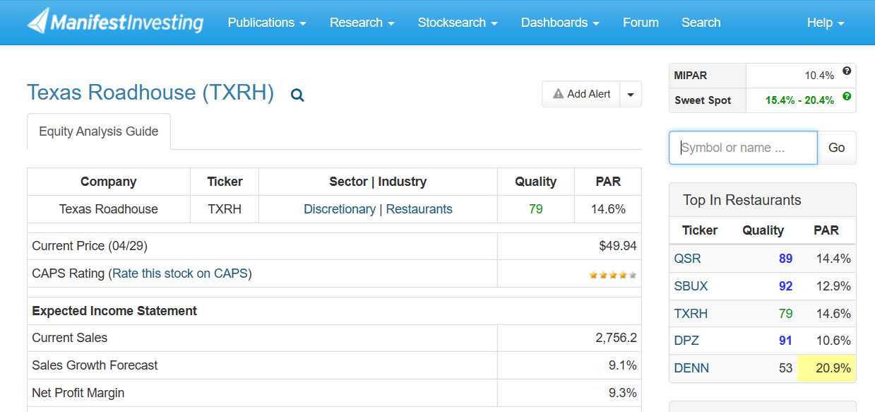

Slide 8
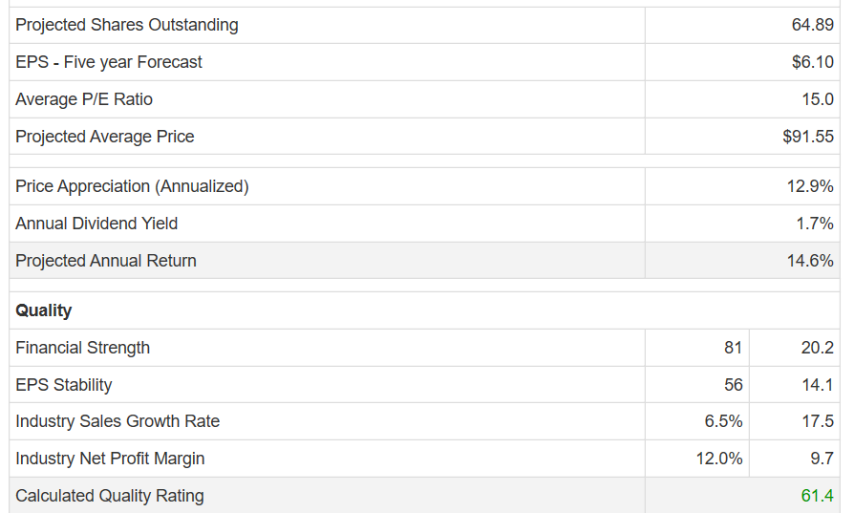
Manifest Investing Assessment of TXRH, cont.

Slide 9
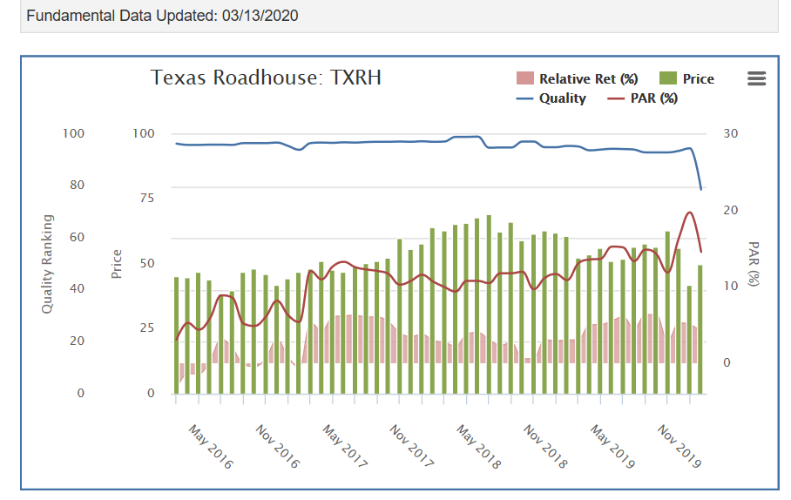
TXRH Quality and PAR – From Manifest Investing
See Quality Line

Slide 10
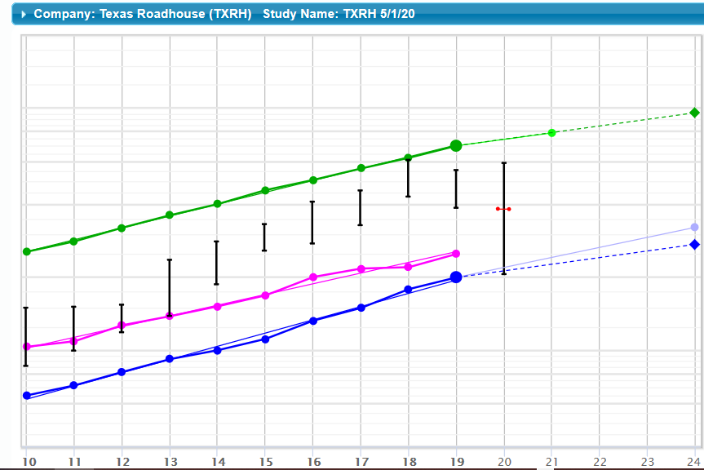
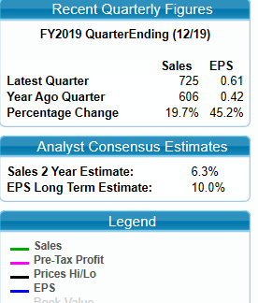
My Analysis of TXRH: 1st page of SSG (5/1/20)

Slide 11
My Sales & Earnings Judgements in these years of Pandemic & Recovery (2020+)
Analysts Estimates for Sales Growth:
Value Line = 4.5% over 5 yrs
Analysts’ Consensus = 6.3% next two years,
Manifest Investing =9.1%
I chose estimate close to Analysts’ Consensus.
Note: Debt = New Lease Accounting

Slide 12
My P/E Judgements reflecting falling P/E ratios, due to Shuttered Restaurants serving only Take-Out (Eliminated all but Current High and Low P/Es. Note Average PE at 23.4 and Current P/E at 19.1)

Slide 13
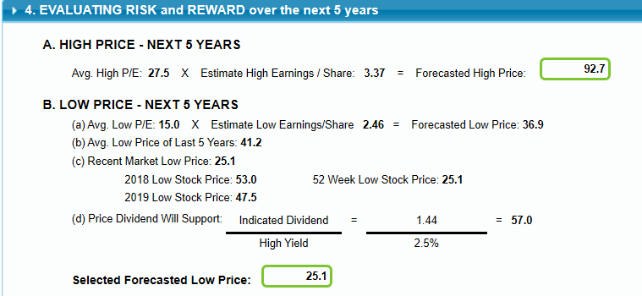
Forecast-ing High and Low Stock Price

Slide 14
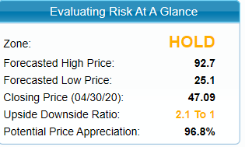
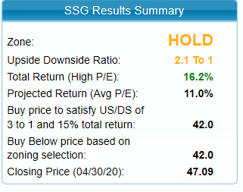

Slide 15
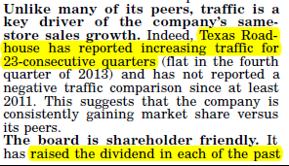
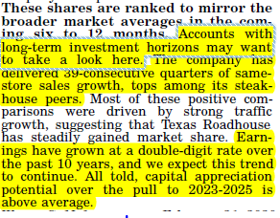
Value Line

Slide 16
Overall: Some Analysts’ Assessments of TXRH
Morning Star
3 year revenue growth (was) 11.45 percent
3 year Income growth (was) 14.70 percent
ValueLine
Timeliness upgraded to “2”; Safety = “3”; Financial strength = B++ ; predictability of earnings is 95
Yahoo Finance
11 percent return (before pandemic)

Slide 17
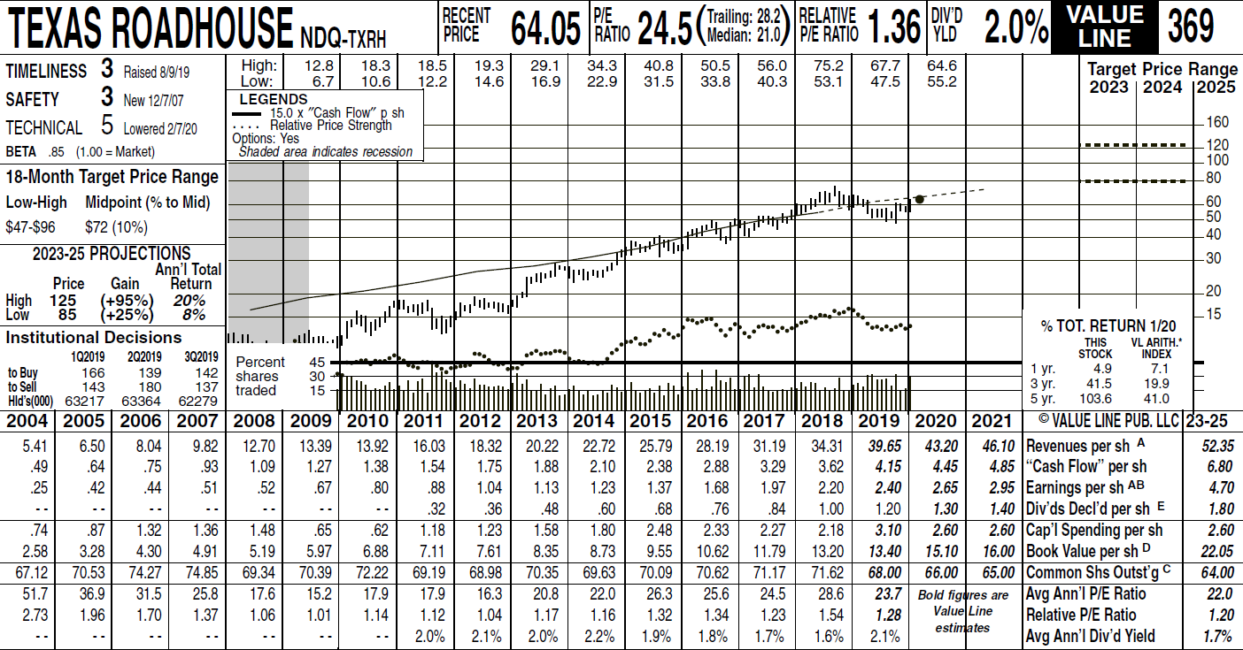
Value Line

Slide 18
Conclusion: Add to Watch List
Best-of-breed in midsize company, restaurant industry
Value Line feels it is positioned to survive the pandemic
Good cash flow, double digit growth
Solid Fundaments For the long term investor

