Slide 1
Presentation to MicNova March 11, 2020 by Gladys Henrikson

Slide 2
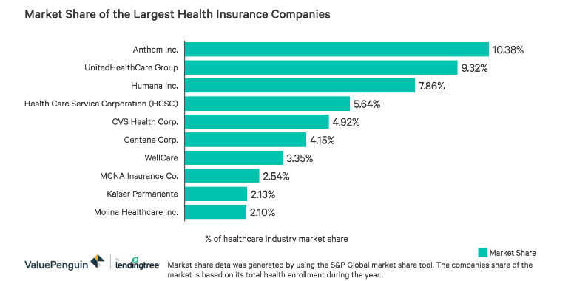
Landscape of Health Insurance Co. in 2020 Information from “Largest Health Insurance Companies in 2020,” pub online by Value Penguin, Feb 7, 2020. Analyst, Sterling Price.

Slide 3
Top 5 largest health insurance companies by membership Information from “Largest Health Insurance Companies in 2020,” ValuePenguin,
UnitedHealthcare Group - 48.9 million members
Anthem - 40.8 million members
Aetna (Acquired by CVS) - 22.1 million members
Cigna - 17.0 million members
Humana (stopped offering individual policies as of 2017)- 16.6 million members

Slide 4
Value Line Industry Assessment: “Industry Overview: Medical Services,”2020 Education Article
Value Line categorizes United Health Care in the Medical Services Industry, while CVS Health is in the Pharmacy Benefits Industry. (In March, 2020, VL rated both companies similarly: A++ Financial Strength, but Timeliness & Safety = “1” for UNH and “2” for CVS)
“Medical Services stocks are a conservative strategy: revenue and earnings growth rates are steady but rarely spectacular.” Ahead, revenues are sure to expand, but health expenditures need to be closely managed.
Medical Services’ 3 Key Components: Hospitals, Insurers/Health Maintenance Organizations (UNH area. Medical Cost Ratio = a crucial metric; UNH = an industry leader, helped by data analytics), and Clinical laboratories. Cash flow is vital to success; companies, incl. UNH, turning to mergers & acquisitions to gain economies of scale; alternatively, pursuing joint ventures.
Influences: Federal legislation – especially related to Medicare and Medicaid funding; Physician Retention; Domestic population demographics – growth of aging population, more international travel and exposure to diseases.

Slide 5
2020+ Health Care Outlook by Some Analysts
Fidelity, 12/2019: “Managed care is one of the health care sector's long-term winners, backed in part by the strong fundamentals and attractive business models of the industry's leaders…US health care is moving to an integrated care delivery model”
Schwab Sector Views, 03/2020: “Coronavirus Changes Our Views.” The Health Care Sector is now the only sector Schwab now rates as “Outperform.”

Slide 6
UNH Business Segments
1. Unitedhealthcare – Health Benefits Management (52% of profits)
State Medicaid & Community Programs
Employer-sponsored and Individual Benefits
Medicare & Retirement Benefits (fast-growing market)
Global – Health Benefits & Services in over 130 Countries
2. Optum – Health Services and Information Platform (48% of profits)
Optumhealth - Population Health Management and Health Care Delivery (expanding provider network)
Optuminsight - Health Care Analytics, Information and Technology (per CFRA - robust demand, in age of personalized medicine, etc.)
OptumRx - Pharmacy Care Services

Slide 7
* UNH Projections, as of Dec 2019
Umbrella Organization

Slide 8
Unitedhealth Group Projects 2.5% Enrollment Growth: from 49M to 50M

Slide 9
UNH Projections from Dec 2019 Investors’ Presentation
~8% growth
~11% growth

Slide 10
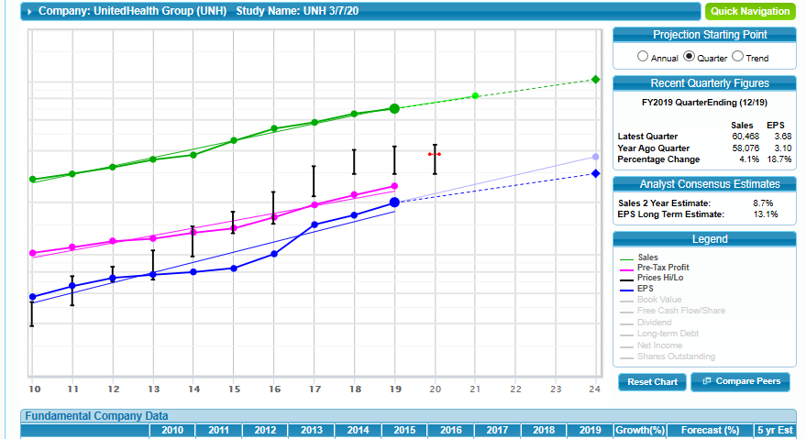
UNH is a Large Co, $274 B/yr

Slide 11
Historical Data & Judgements on UNH SSG
Acid Tests & Vein
1.
2.
3.
5.
4.

Slide 12
6.
7

Slide 13
8. Compare Peers to UNH EPS Growth

Slide 14
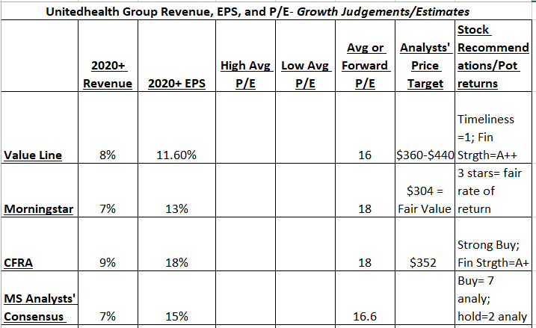
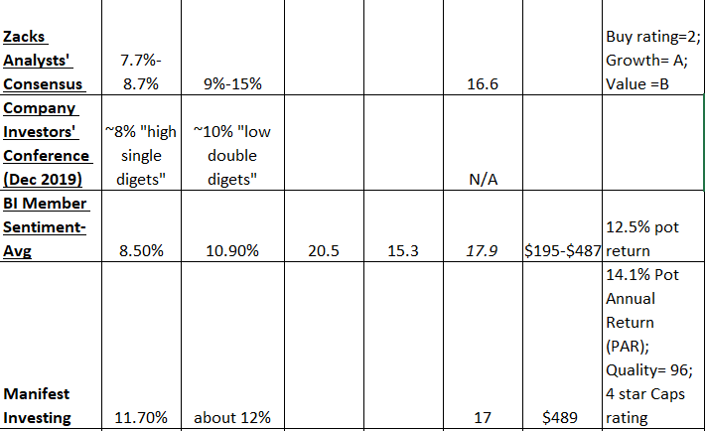
9. Determine Analysts’ Assessments of
Current UNH Stock:
Quality & Fin Strength
Ratings: Buy/Hold/Sell
Sales Gwth ~ 8%/yr
EPS Gwth ~ 11%/yr
Health Care = growing sector

Slide 15
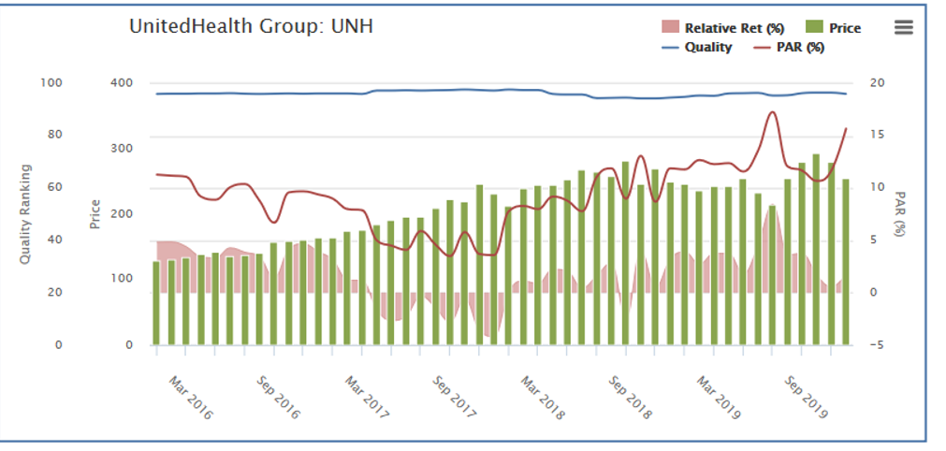
9. Cont: Manifest Investing Chart of UNH Shows “Buy”
Consistently Hi Quality Line
PAR above green price bars

Slide 16
Group Worksheet: Evaluating UNH, using “BI Acid Tests”
Yes, >8 %
1. Does Sales Growth Meet Standards for Large Co (5-7%/yr)?________ Are sales growing, even, declining?______________
2. Does EPS growth match or exceed sales growth percent?__________ 3. Is Pre-Tax Profit on Sales even or increasing?_________
4. Is debt/capital under 33% or within industry standards?__________
5. Is Return on Equity = or > than 15%?____________
6. Is Current P/E above or below Average P/E?___________
7. Do last 4 Qtrs of Data in Sales & Earnings maintain growth rate?_______
8. How does UNH compare to Peers in Earnings?_________
9. How do Analysts Rate UNH: Buy, Hold, Sell?_______________
Growing
Exceeds >10%
Even
Within Industry
Greater; > 20%
Slightly Above
Yes, >8 %
Greater
Buy

Slide 17
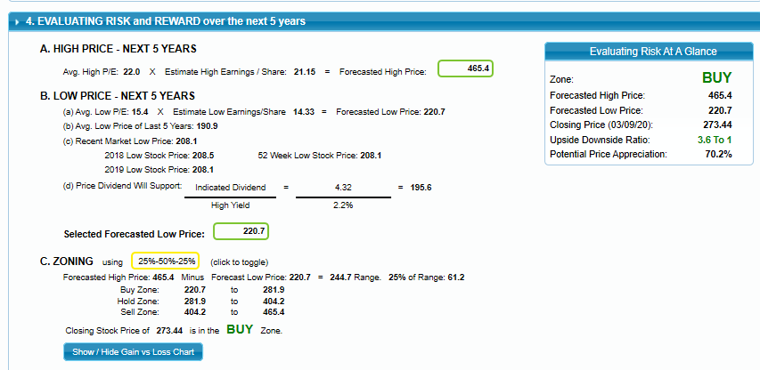
10. Make Judgements about UNH’s return

Slide 18
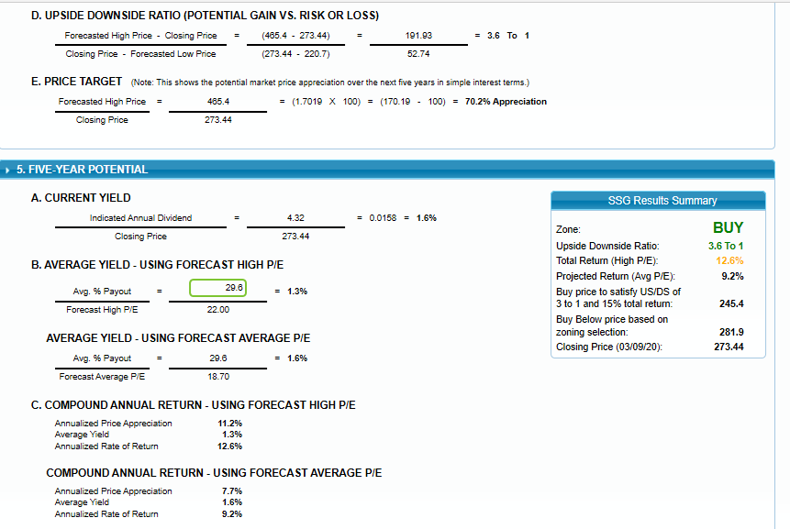

Slide 19
MicNova Decision for Mar 11 2020:
Do We Add UNH to Watch List?

