Slide 1
Stock Presentation
Wilbert Nixon, McNoVA
-- September 21, 2021

Slide 2
“During the gold rush, its a good time to be in the pick and shovel business”
–- Mark Twain
“Nothing creates profit quite like global conflict.”
–- White Rose (Mr. Robot)

Slide 3
Facebook (FB)
Facebook is the world’s largest online social network, with 2.5 billion monthly active users. Users engage with each other in different ways, exchanging messages and sharing news events, photos, and videos.
On the video side, the firm is in the process of building a library of premium content and monetizing it via ads or subscription revenue. Facebook refers to this as Facebook Watch.

Slide 4
Facebook (FB)
The firm’s ecosystem consists mainly of the Facebook app, Instagram, Messenger, WhatsApp, and many features surrounding these products. Users can access Facebook on mobile devices and desktops.
Advertising revenue represents more than 90% of the firm’s total revenue, with 50% coming from the U.S. and Canada and 25% from Europe. With gross margins above 80%, Facebook operates at a 30%-plus margin.

Slide 5
4 Reasons Facebook (FB) is a Compelling Buy
A Dynamic Business Model
A “cash cow” with growth
An aggressive stock buyback
A stock that’s on sale

Slide 6
4 Reasons:
Dynamic Business Model
FB started as a simple social media network in the early 2000s, but founder and CEO Mark Zuckerberg has been active in positioning the company for future growth.
FB predicted the importance of images to social media, buying Instagram for $1 billion in 2012, in what is commonly looked back on as one of the "steals" of corporate history, now that Instagram boasts more than 1 billion users.

Slide 7
4 Reasons:
Dynamic Business Model
FB later bought WhatsApp in 2014 in a deal worth $16 billion in cash and stock; the WhatsApp platform now has more than 2 billion users and is the world's most popular mobile messenger.
FB has also leaned into augmented reality (AR) and virtual reality (VR), buying VR hardware company Oculus in 2014 for $2 billion, and recently announcing a new team to develop Facebook's "Metaverse" business.

Slide 8
4 Reasons:
“Cash Cow” with Growth
These, among other strategic acquisitions have created value for FB over time via both user growth and monetization. FB makes the vast majority of its revenue from advertising, so by growing users and generating increasingly more revenue from them, it's a two-sided way to grow revenue.
FB's total number of daily users has grown 20% over the past two years, to 1.9 billion. FB is increasing its average revenue per user (ARPU) at the same time, hitting $10.12 per user in 2021's second quarter, a 43% increase year-over-year.
With more users generating more revenue, FB's overall revenue growth is impressive. In its Q2 2021, FB did $29 billion in revenue, a 56% increase over 2020.

Slide 9
4 Reasons:
Aggressive Stock Buyback
FB is very profitable, generating lots of cash as revenue grows larger. It converted $8.5 billion, or 29% of its revenue, into free cash flow (FCF) in Q2; FCF is the cash remaining after spending what it needs to run the business.
Rather than pay a dividend, FB is buying back its own stock, increasing the value of the remaining shares because its profits are split between a smaller number of shares. The result is an increase in earnings per share (EPS), which typically drives the stock price higher over time.
FB bought back $7.1 billion of its stock during 2021 Q2, and its total number of shares outstanding has decreased to 2.877 billion from 2.921 billion at the end of 2018. The company has $64 billion on its balance sheet in cash and securities, so investors should look for the buybacks to continue.

Slide 10
4 Reasons:
The Stock is on Sale
FB is a huge company, trading at a market cap of $1.05 trillion. The company is expected to earn $14.08 per share for the full year of 2021, which values the stock at a price-to-earnings ratio of 26.
Hitting its estimates would mean a 40% increase in EPS from 2020, and that's an impressive jump for a company of such size. Analysts are also expecting double-digit growth in 2022, so the current valuation seems very reasonable.

Slide 11
4 Reasons:
The Stock is on Sale
One aspect of FB that's difficult to account for in its valuation is the company's versatility. With all of that cash on its balance sheet and a forward-thinking management team, it's hard to put a number on the potential value that FB can create in the future that isn't obvious today.
We can only look at what Facebook currently is. Still, the company's ability to create new business segments through acquisitions or innovating is something that investors should keep in mind, especially given Zuckerberg's enthusiasm for the Metaverse.

Slide 12
4 Reasons:
Still Room to Grow
Big technology companies rule the world, and FB is one of a select few in the trillion-dollar market cap club. But don't be fooled; the business continues to grow, makes a ton of money, and returns value to shareholders through share buybacks and strategic moves that create long-term value in the company.
There is a lot to like in FB, despite the controversies (or perhaps because of them), which makes it a compelling investment idea today.

Slide 13
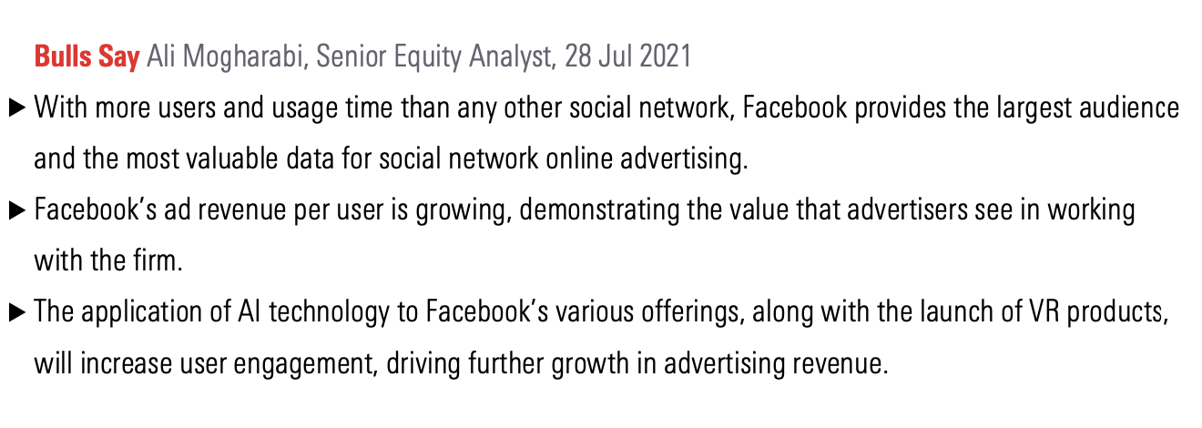
FB Bulls Say

Slide 14
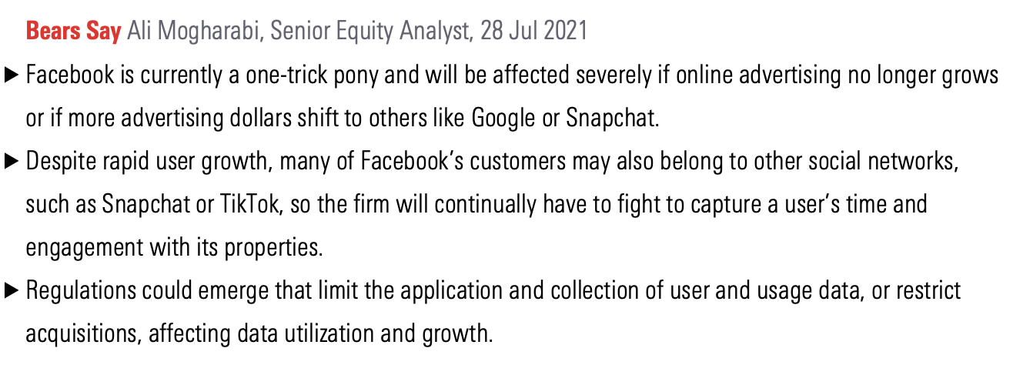
FB Bears Say

Slide 15
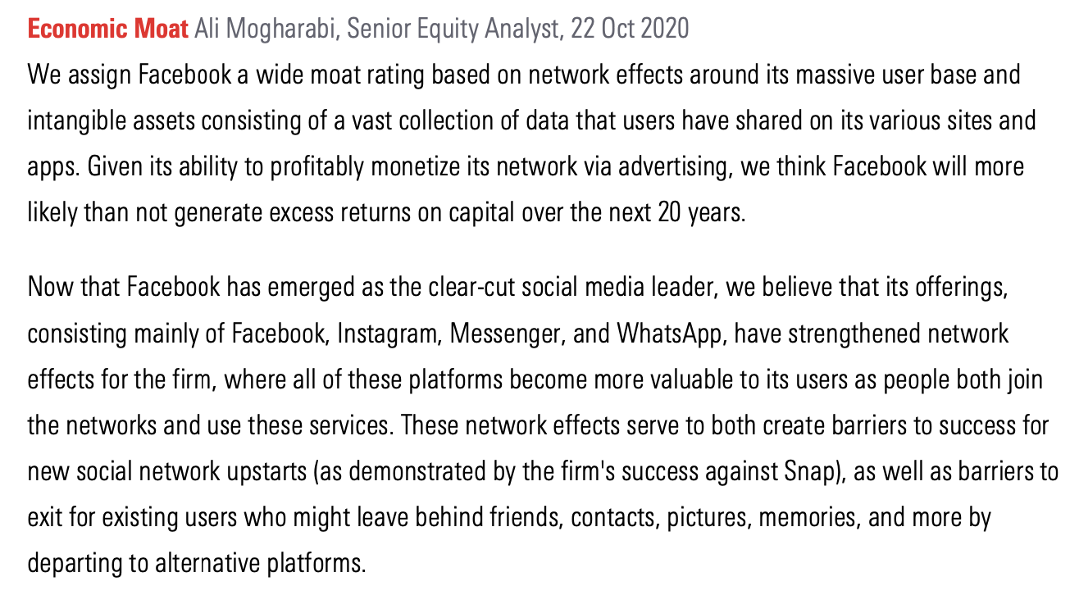
FB Economic Moat Analysis

Slide 16
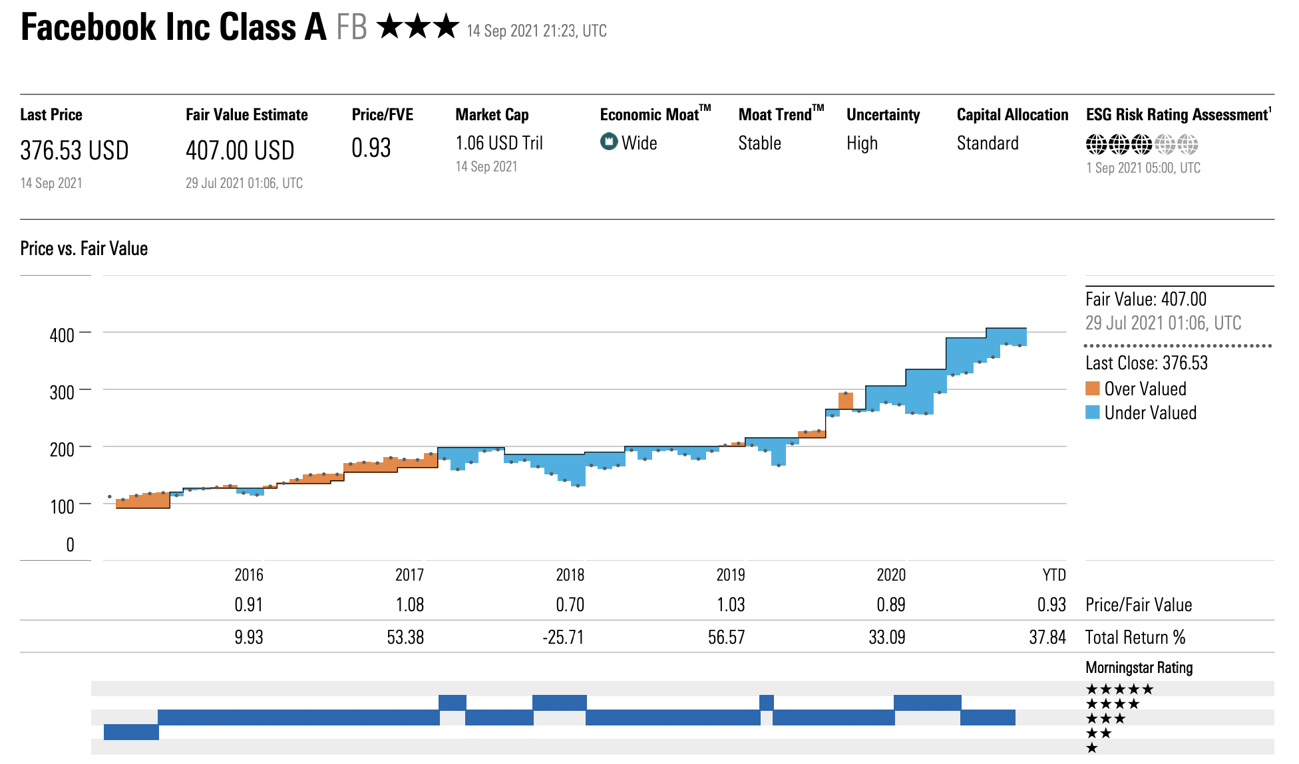
FB Price vs. Fair Value chart

Slide 17
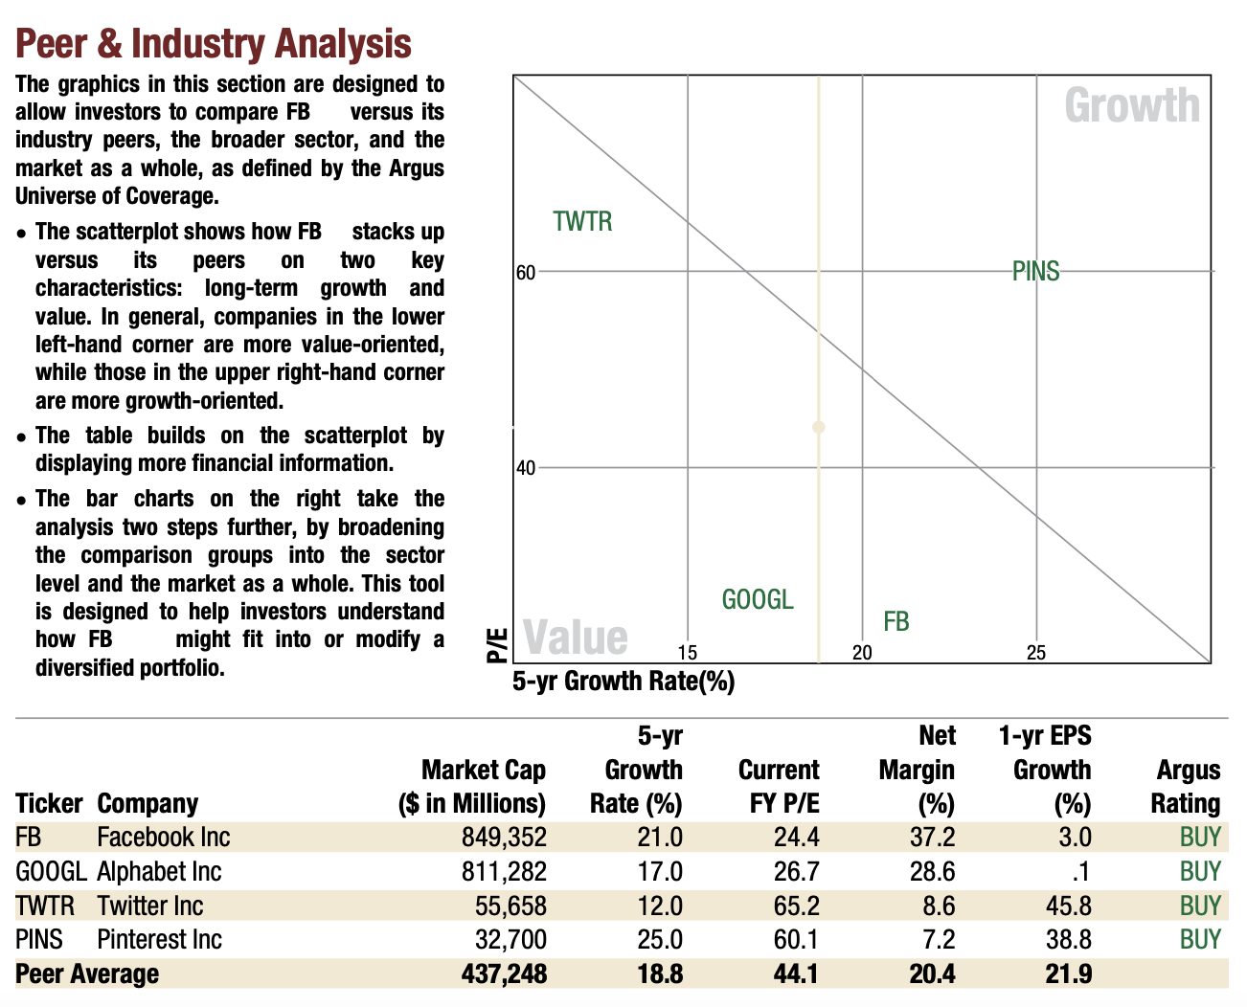
FB Peer & Industry Analysis chart

Slide 18
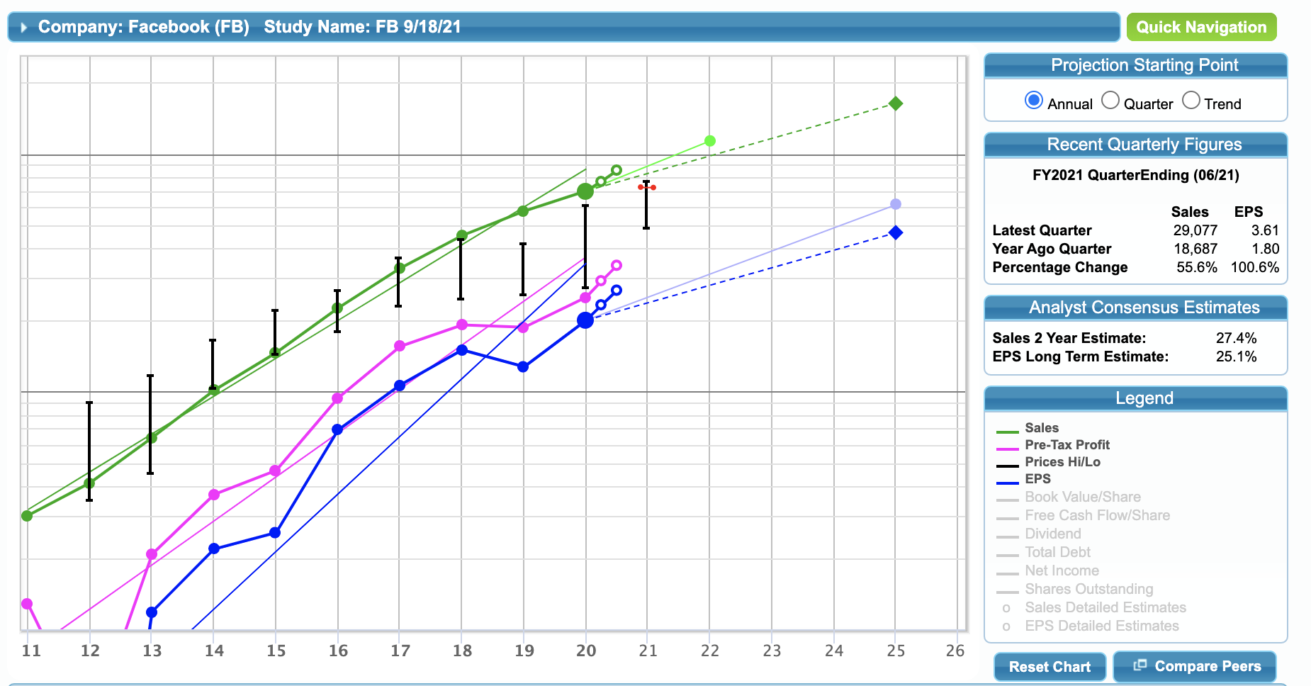
SSG chart

Slide 19
SSG Fundamental & Management Data

Slide 20
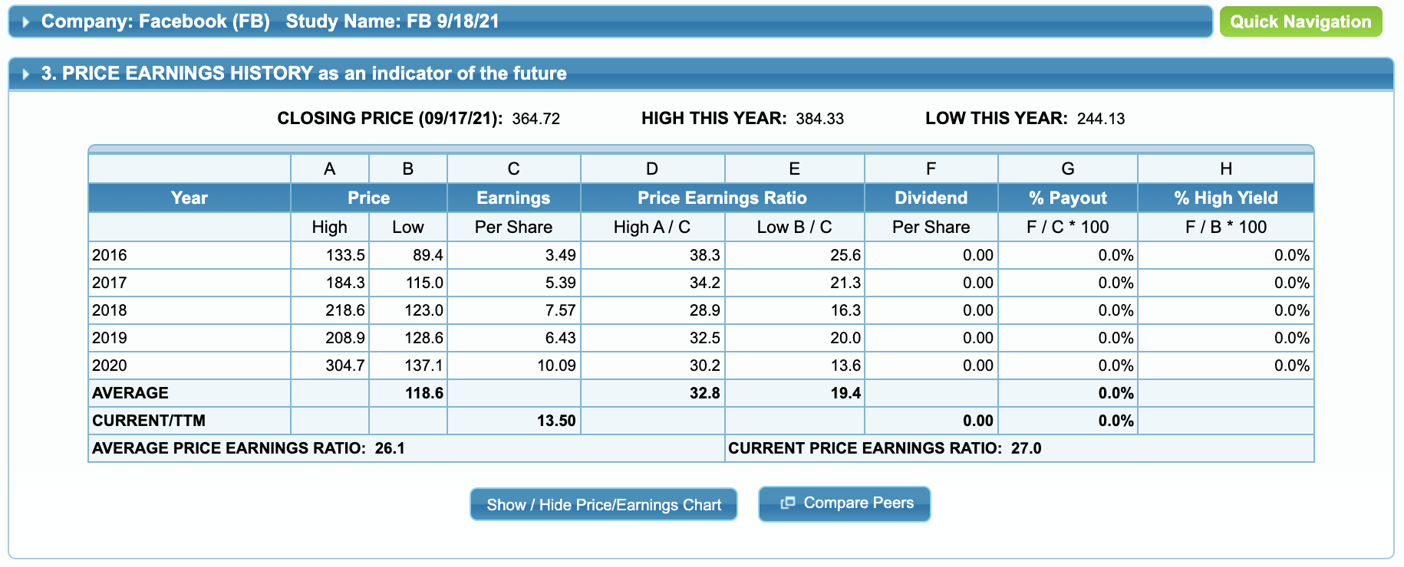
SSG Price Earnings History

Slide 21
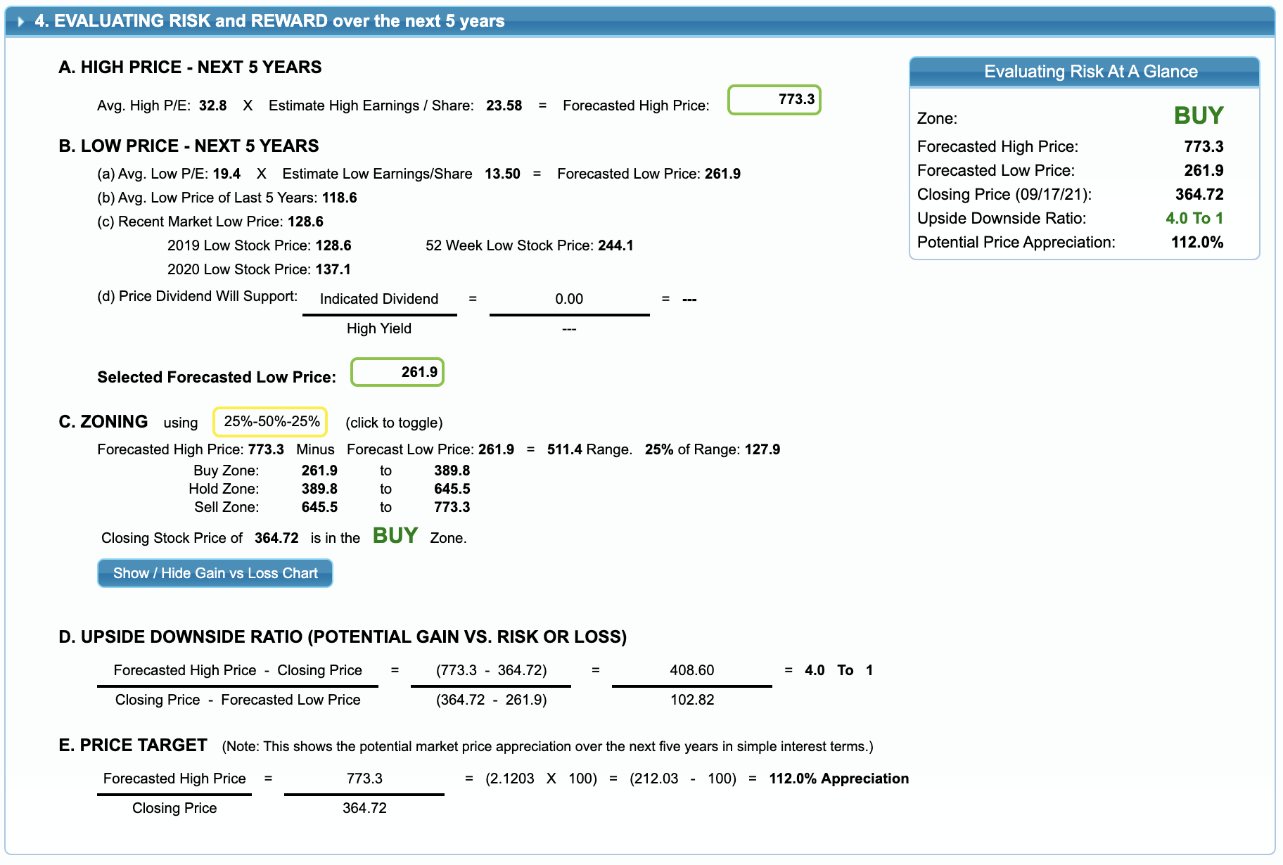
SSG Risk and Reward (next 5 years)

Slide 22
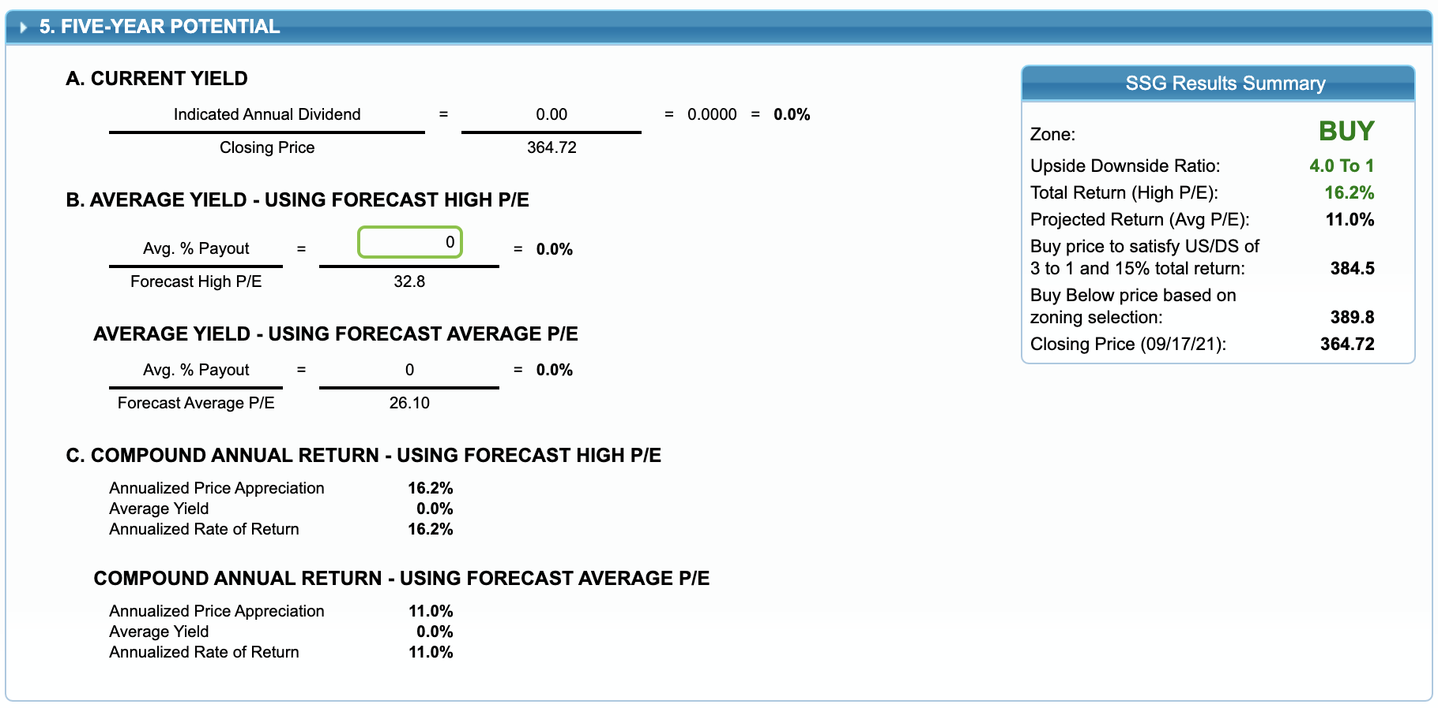
SSG 5-year potential

Slide 23
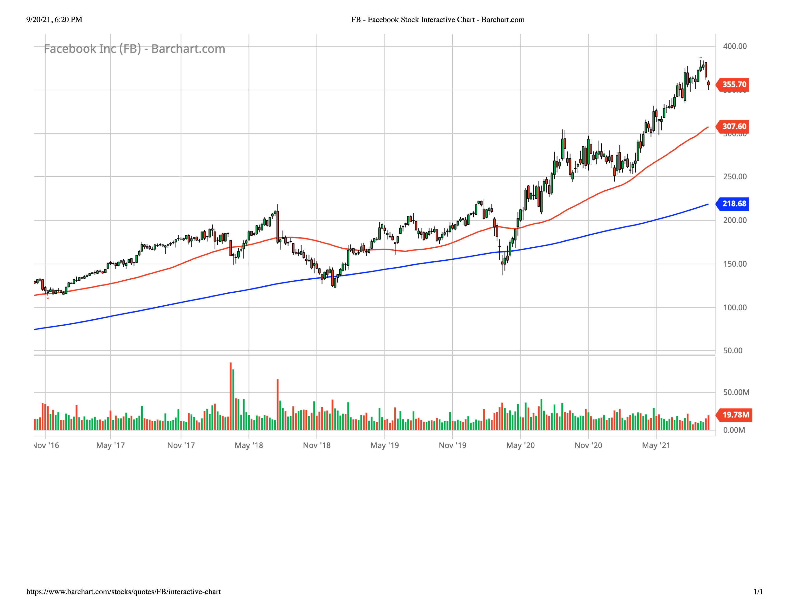
FB 5-year price chart

