Slide 1
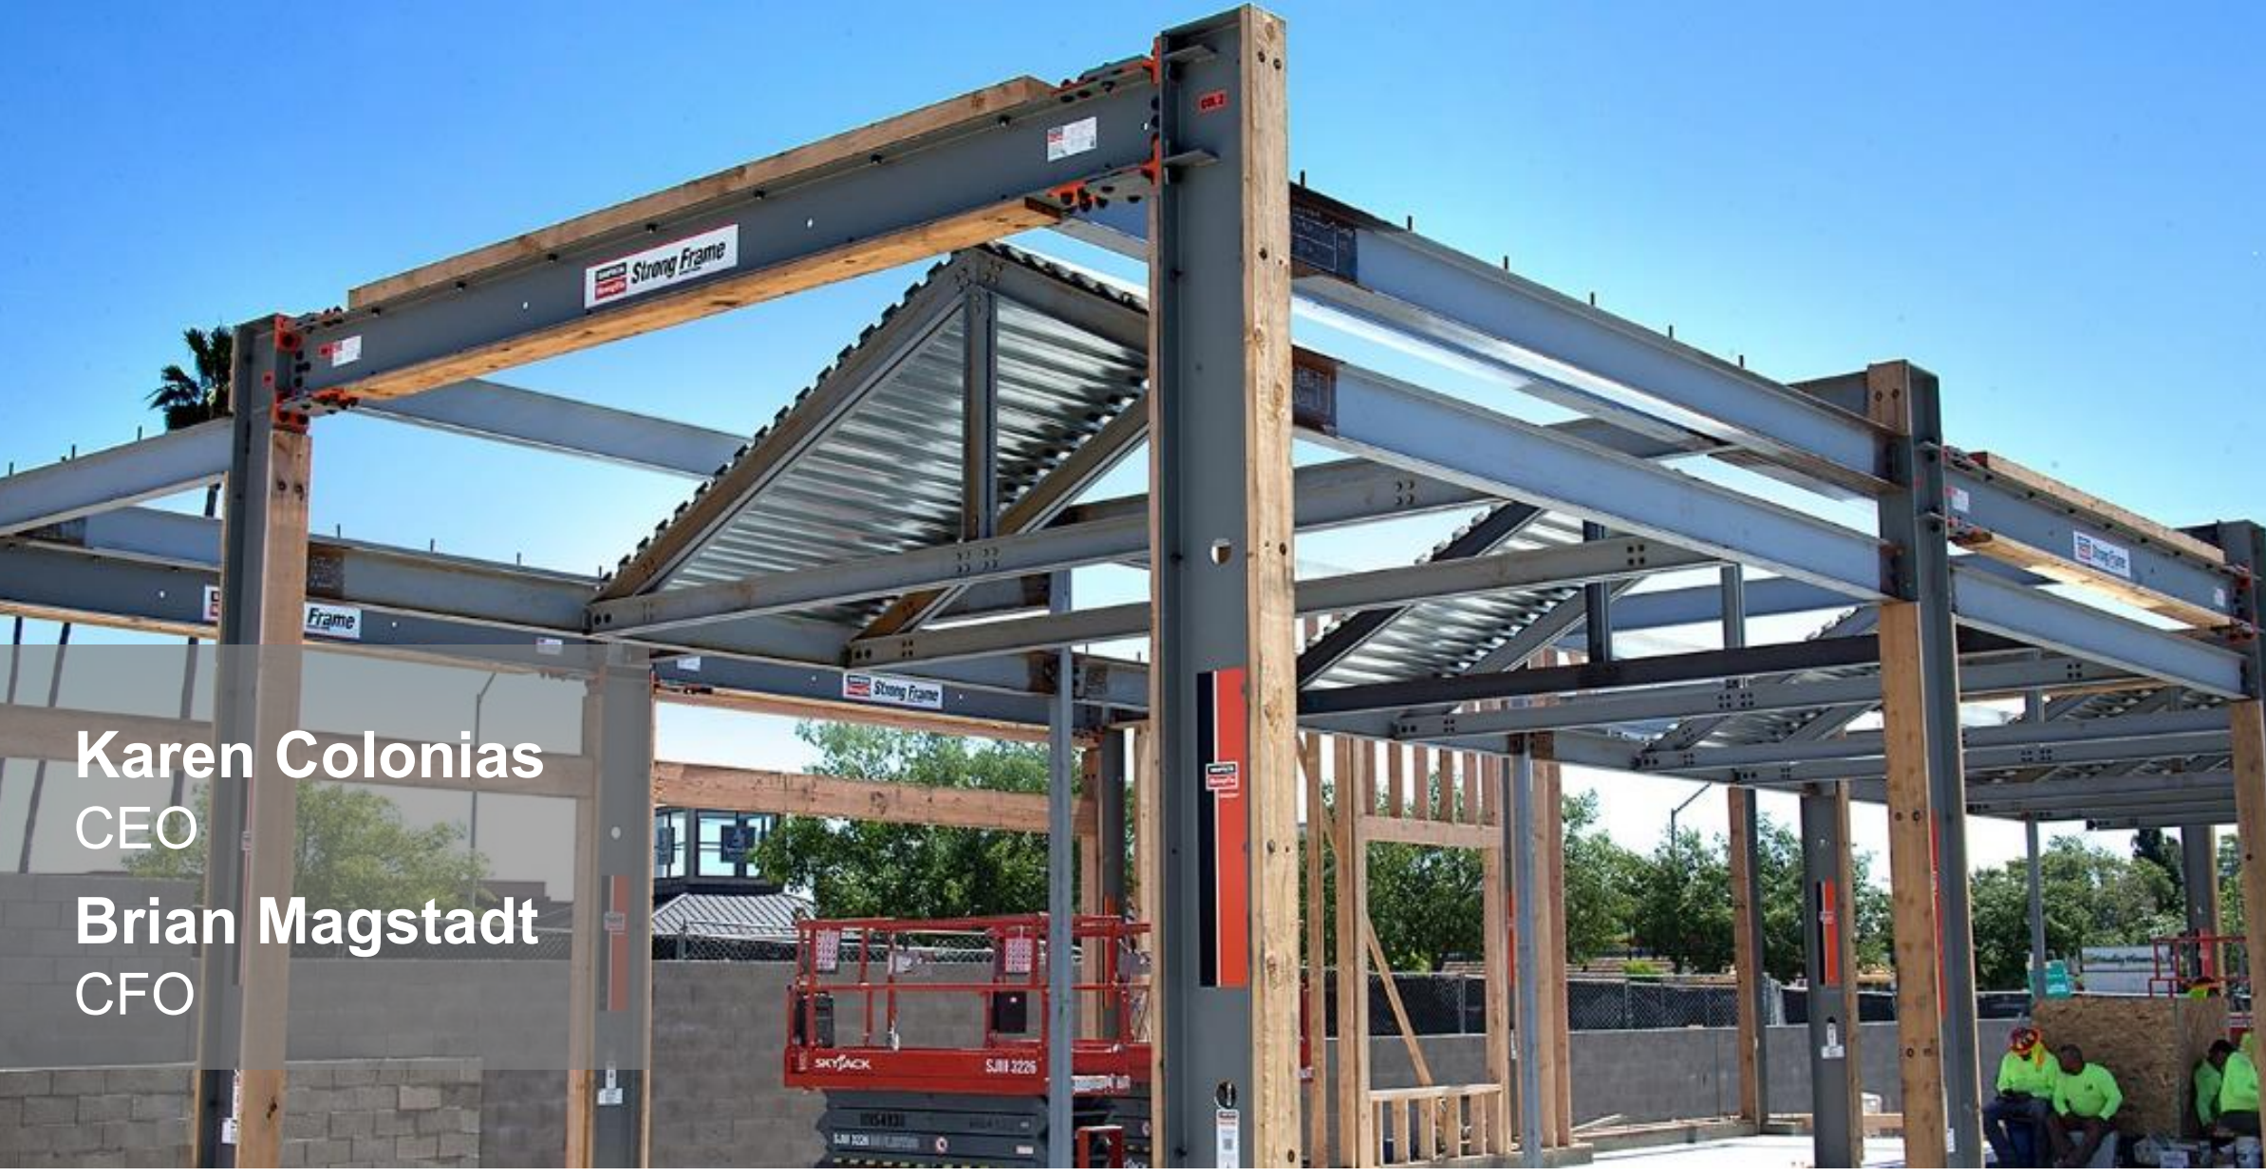
Maskey Krishnarao
DC Regional Chapter, MicNOVA
Simpson Manufacturing Co. (NYSE: SSD)
Ticker Heat Map
Notes:
Simpson Manufacturing Company produces wood production products. The company offers connectors, truss plates, fastening systems, fasteners, prefabricated lateral systems, concrete construction products, adhesives, mechanical anchors, carbide drill bits, powdered-actuated tools and fiber reinforced materials. Simpson Manufacturing markets its products to the residential, light industry and commercial construction markets as well as the remodeling and do-it-yourself markets. The largest end market is the United States. Simson Manufacturing is a medium size company with building products and equipment industry and Industrials sector. It is also a global company dealing with 60 countries.

Slide 2
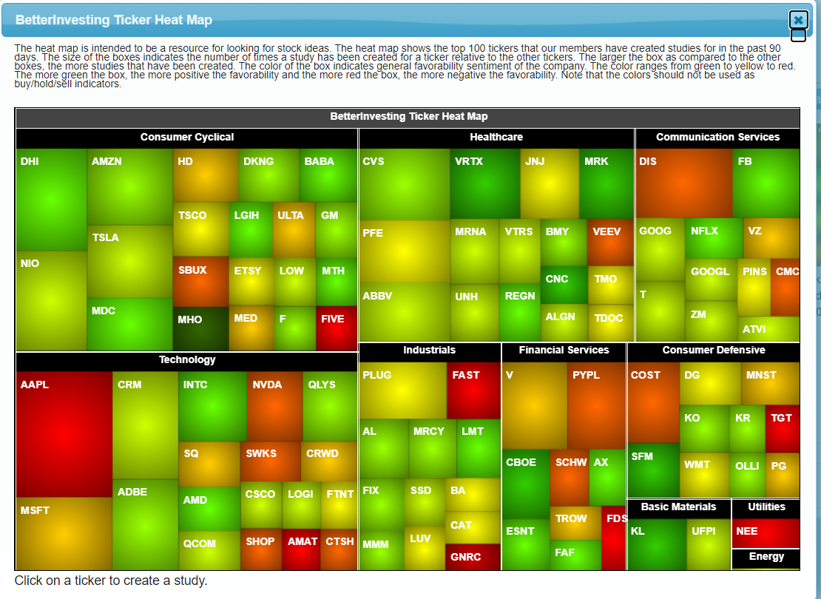
How Did I Find SSD?

Slide 3
WWW.BETTERINVESTING.ORG
Notes:
Simpson has spent the last 60 years providing the highest quality structural building solutions with a strong foundation of customer service, product innovation, and industry leadership, supporting the process of building safer, stronger structures. Simpson differentiates from its competitors accross operating segments by designing and marketing end-to-end construction product systems. Simpson promoses aa culture of employee ownership that value the contributions of every employee.

Slide 4
WWW.BETTERINVESTING.ORG
Notes:
Simpson has returned 74% of cash flow from operations returned to stockholders since 2017 through a combination of dividends and common stock buy backs.

Slide 5
Product Applications
WWW.BETTERINVESTING.ORG
Notes:
Products Applications Include Single family homes, DIY: Decks, Multi family Homes, Outdoor Accents and Hardware.

Slide 6
Six Key End Markets
WWW.BETTERINVESTING.ORG
Notes:
Six Key end markets Light Framed Construction,

Slide 7
Competitive Advantages
WWW.BETTERINVESTING.ORG

Slide 8
Strong Business Drives Stockholder Value
WWW.BETTERINVESTING.ORG
Notes:
Year over year growth in both earnings per share and Dividends per share since 2010

Slide 9
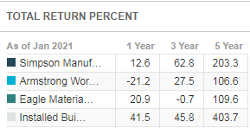
Value Line – Peer Comparison
WWW.BETTERINVESTING.ORG
Notes:
Long-term business prospects are encouraging and should rapidly accelerate once the global health crisis is in the rearview mirror. Simpson’s European operations hold plenty of promise, as pent-up demand ought to surge in conjunction with recovering global economies. In the U.S., attractive mortgage rates, robust suburban homebuilding, and a resilient renovation market are apt to keep volumes moving in the right direction. Lastly, strategic bolt-on acquisitions should nicely supplement organic growth. s. Acquired S&P Clever in Jan. 2012 and Automatic Stamping, LLC and Fox Industries in Dec. 2011. Simpson’s top line also benefited from the return of home improvement giant Lowe’s as a customer.0, interested buy-and-hold subscribers would be wise to keep this one on their watchlists should the price decline further

Slide 10
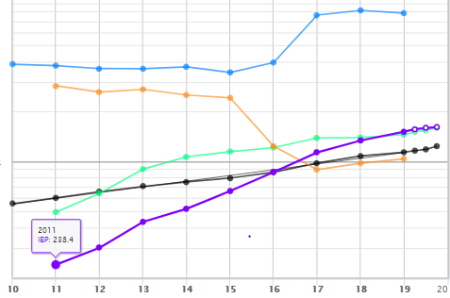
WWW.BETTERINVESTING.ORG
SALES
Notes:
Historical sales growth is the first of four indicators BetterInvesting uses to identify well managed growth companies. It is desirable to invest in companies whose sales growth is strong and consistent and generally growing faster than the overall economy and inflation combined. *SSD (black Line) is up and straight and in the last year has increased by 17.5 percent which is greater than any of it’s peers and the industry average of 10 percent.

Slide 11
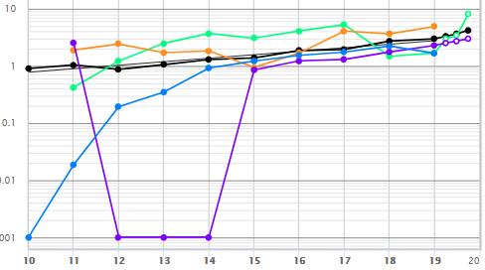
WWW.BETTERINVESTING.ORG
EPS
Notes:
Historical earnings per share (EPS) growth is the second indicator BetterInvesting uses to identify well managed growth companies. It is desirable to invest in companies whose EPS growth rate is strong and consistent and generally growing faster than the overall economy and inflation combined. The SSD line is up and straight and the latest year ago quarter data is higher than it’s peers

Slide 12
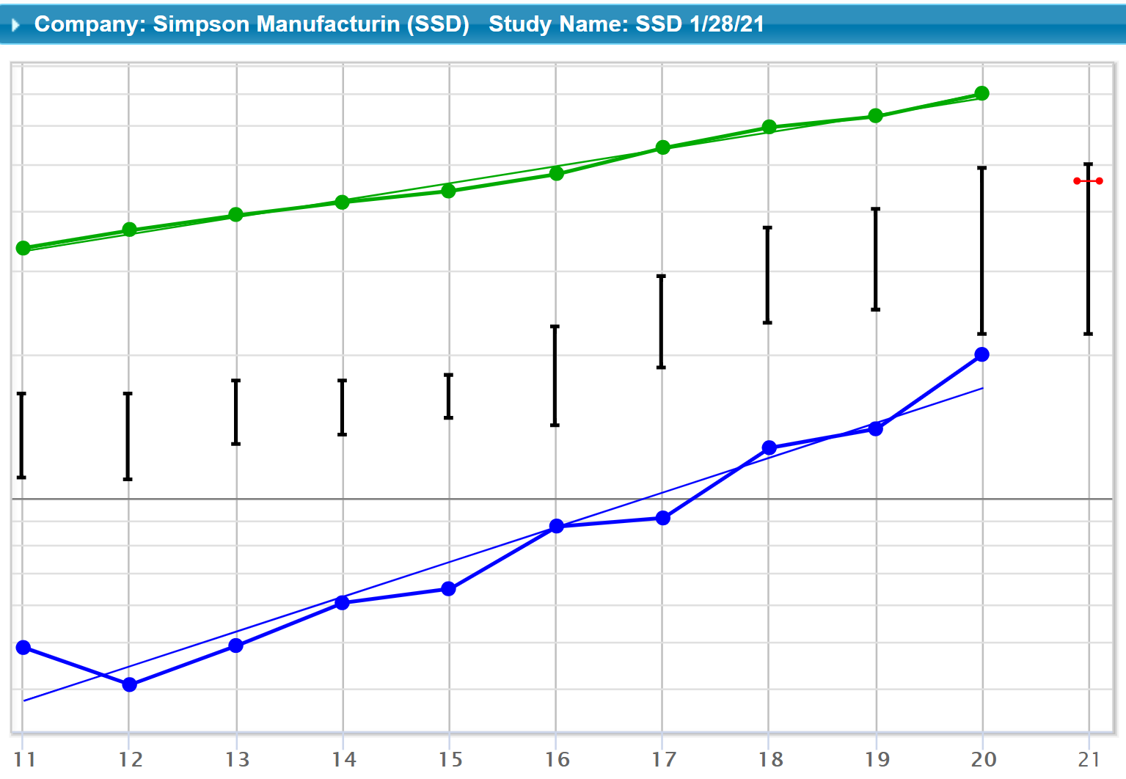
WWW.BETTERINVESTING.ORG
Notes:
You've reviewed the company's historical sales and earnings growth. Both should be growing 1. Faster than the economy and inflation combined 2. Faster than competitors 3. Consistently If these conditions have been met then check that EPS is growing in line with sales. The graph demonstrates that this is so.

Slide 13
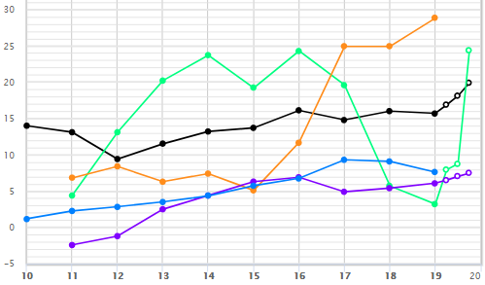
WWW.BETTERINVESTING.ORG
Notes:
% Pre-tax Profit on Sales is the third indicator BetterInvesting uses to identify well managed growth companies. A good percent pre-tax profit margin shows a company is well managed. It is desirable to invest in companies whose percent pre-tax profit is increasing or at least staying the same. Examining the most recent five year average helps us determine this. Is the 5 year average percentage of pre-tax profit on sales increasing or at least staying the same? Is the percentage of profit consistent over time?
Does this company deserve further study? Compare your candidate company to

Slide 14
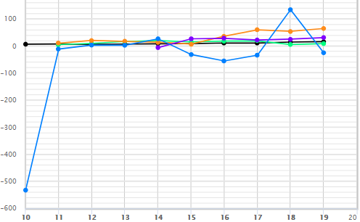
WWW.BETTERINVESTING.ORG
Notes:
% Return on Equity (ROE) is the fourth indicator BetterInvesting uses to identify well managed growth companies. It tells how effectively company management is using the shareholders' money to make a profit. It is desirable to invest in companies whose ROE percentage is increasing or at least staying the same. An exception is when a company is paying off debt, which is covered in the next section.
Is the percentage of ROE increasing or at least staying the same? Is the percentage of ROE consistent over time? Does this company deserve further study?

Slide 15
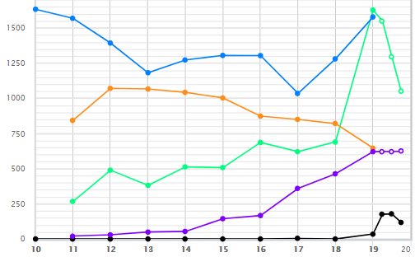
WWW.BETTERINVESTING.ORG
Notes:
One indicator of management skill is how debt is employed. Most companies borrow money to help them reach their goals. Companies go into debt to buy equipment, real estate, and many other things. Some industries use debt more than others. Borrowing some money can be very good because it helps the company do things it could not afford to do on an all cash basis. Borrowing too much money can be very bad because it increases risk in two ways: 1. Debt increases the risk to common shareholders because the company must pay the claims from debt and preferred stockholders before common shareholders receive anything. 2. High levels of debt are risky for a company because it has to pay its debt obligations whether it's doing well or not. If the company runs short of money during a recession, the debt obligations could force the company to go out of business. Check: Is the total debt increasing or decreasing? Review the company web site and official reports to understand the reasons for significant changes in total debt. Look at Total Debt and % Debt to Capital together to understand how the company is managing debt.

Slide 16
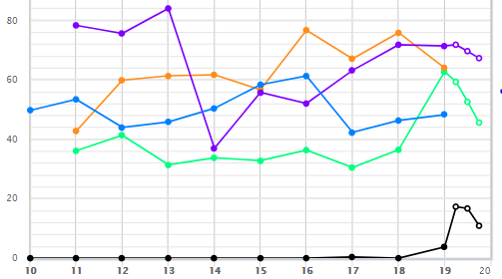
WWW.BETTERINVESTING.ORG
Notes:
One indicator of management skill is how debt is employed. Look at Total Debt and % Debt to Capital together to understand how the company is managing debt. The percent of total debt to capital helps you understand whether company management is using debt conservatively or liberally. The ratio enables you to make valuable comparisons between the company you are studying, peer companies and the industry. Some industries such as banks, financial institutions, and utilities typically operate using higher levels of debt. Some successful companies in other industries have proven that they can carry high debt over many years. Younger companies often have relatively higher levels of debt, but because they are young they don't have a track record that shows they can manage it well over many years. This adds considerable risk as an investment. Check: Is percent of Debt to Capital increasing or decreasing markedly? Review the company web site and official documents to understand the reasons for changes in debt levels (company expansion, acquisitions, divestiture, etc.)
Is the company on a "spending spree" financed by debt?
Is the company borrowing enough to help it stay competitive? Compare to: Historical trends, Peer Group, Industry averages

Slide 17
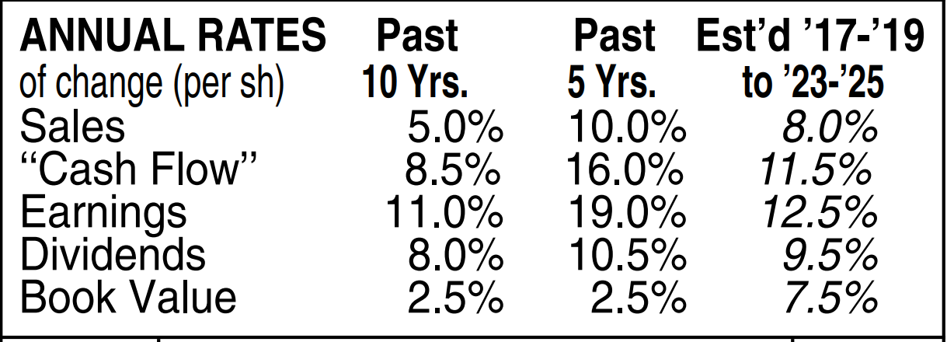
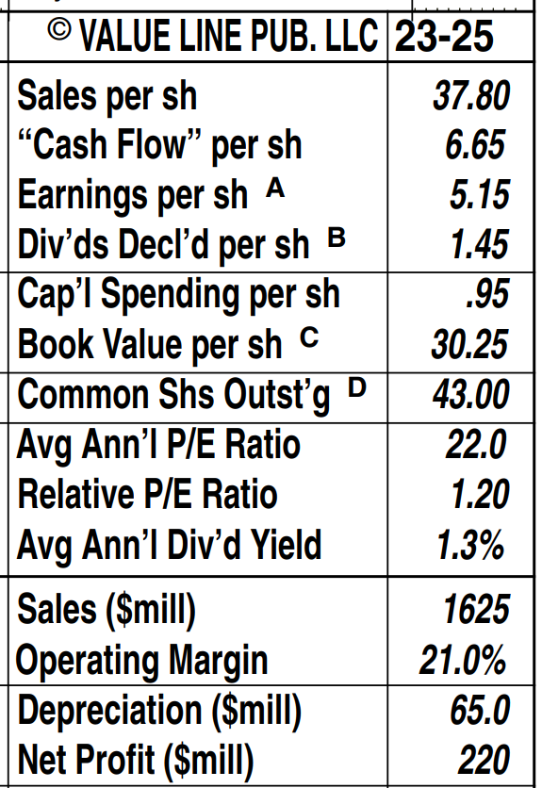
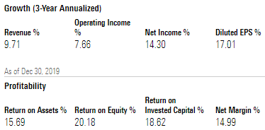
WWW.BETTERINVESTING.ORG
Value Line
Notes:
My judgements are based on Value Line, Morningstar and Manifest Investing estimates

Slide 18
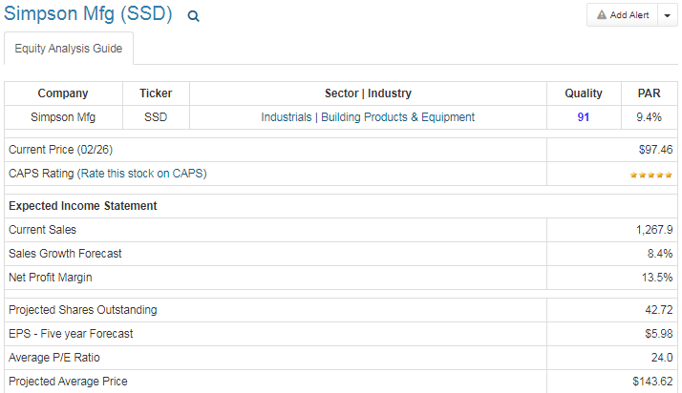
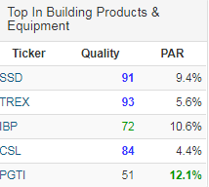
WWW.BETTERINVESTING.ORG
Notes:
Manifest Investing Growth estimes sales sales at 8.4% and EPS to $5.98.

Slide 19
Growth Estimates from VL and Manifest Investing
WWW.BETTERINVESTING.ORG
Sales estimated Range is 8% which results to (MIL) $1,833 from my and EPS at 12% is $7.05 from my SSG Visual Analysis.
Value line forecasts sales at 8% and EPS at 12% while Manifest investing forecasts sales at 8%.
5-year AVE High P/E I chose is 27.9 and low P/E is 19.0.
High Price using estimated high P/E (27.9 X 7.05) is $196.8 and using the low P/E with low EPS from 2020 (19.0 X $4.27) is $81.1.

Slide 20
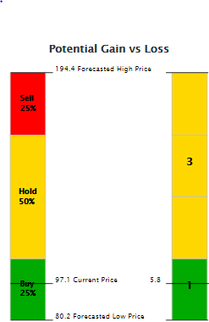
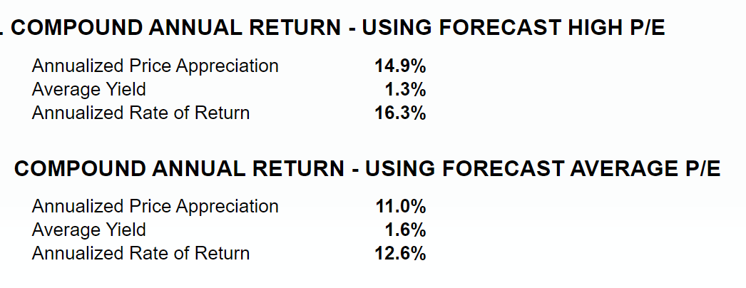
WWW.BETTERINVESTING.ORG
Notes:
Even though well considered, forecasts are not certain. By comparing the current price to 1. Your forecast high price and 2. Your forecast low price you determine your potential gain and potential loss. It is desirable to invest in companies offering a potential gain at least three times the potential loss.
Compounded Return is the projected annual price appreciation plus the projected average annual yield. The Price Appreciation is the increase in the price of the stock, assuming you sold the stock at its projected high price. The Yield is the projected average annual return on the price, paid as a dividend. Yield is calculated by dividing the dividend by the purchase price of the stock. If the company performs as well as you expect, and you sell the stock at the forecast high price, this will be your financial return.

Slide 21
SSD Conclusion
SSD is a medium sized steady growth company.
SSD is a well managed company.
SSD is “fairly priced” trading near its 5 Yr. Ave PE.
SSD is a worthy candidate to the purchase.
SSD is a BUY up to $108.8

