Slide 1
Taiwan Semiconductor manufacturing co.
(TSM)

Slide 2
The big three chip-making companies:
TSMC (Taiwan)
Samsung (Korea)
Intel (US)

Slide 3
Other chip-making companies:
Advanced Micro Devices (AMD)
Texas Instruments
Skyworks Solutions

Slide 4
TSMC
Taiwan Semiconductor Manufacturing Company, or TSMC, is the world's largest dedicated chip foundry, with over 58% market share in 2020 per Gartner. TSMC was founded in 1987 as a joint venture of Philips, the government of Taiwan, and private investors. It went public as an ADR in the U.S. in 1997. TSMC's scale and high-quality technology allow the firm to generate solid operating margins, even in the highly competitive foundry business. Furthermore, the shift to the fabless business model has created tailwinds for TSMC. The foundry leader has an illustrious customer base, including Apple, Nvidia and Qualcomm, and Chinese companies like Huawei Technologies, that looks to apply cutting-edge process technologies to its semiconductor designs.

Slide 5
DEFINITIONS
Nanometer or nm --- The term 3 nanometer (3 nm) or 5 nanometer (5nm has no relation to any actual physical feature of the transistors. It is a commercial or marketing term used by the chip fabrication industry to refer to a new, improved generation of silicon semiconductor chips in terms of increased transistor density, increased speed, and reduced power consumption.
Fabless company – A fabless company is one that develops and holds intellectual property while outsourcing the fabrication of its hardware, e.g., Qualcomm.
Capex – Capital expenditures.
HPC – High Performance Computing.
IoT – Internet of Things - The Internet of Things, or IoT, refers to the billions of physical devices around the world that are now connected to the internet, all collecting and sharing data.
AI – Artificial Intelligence

Slide 6
Bottom line up front
TSMC produces the world’s most advanced microchips for artificial intelligence, 5G, cloud computing, and electric vehicles.
TSMC is likely to maintain that technological and production lead over the next five years.
The market’s insatiable demand for new semiconductor chips will drive TSMC’s growth.
TSMC has returned an annualized 29% over the past decade.

Slide 7
FINANCIALS
TSMC announced consolidated revenue of NT$372.15 billion, net income of NT$134.36 billion, and diluted earnings per share of NT$5.18 (US$0.93 per ADR unit) for the second quarter ended June 30, 2021. Year-over-year, second quarter revenue increased 19.8% while net income and diluted EPS both increased 11.2%. Compared to first quarter 2021, second quarter results represented a 2.7% increase in revenue and a 3.8% decrease in net income.
In US dollars, second quarter revenue was $13.29 billion, which increased 28.0% year-over-year and increased 2.9% from the previous quarter.
In the second quarter, shipments of 5-nanometer accounted for 18% of total wafer revenue; 7-nanometer accounted for 31%. Advanced technologies, defined as 7-nanometer and more advanced technologies, accounted for 49% of total wafer revenue. “
Second quarter business was mainly driven by continued strength in HPC and Automotive-related demand, Moving into third quarter 2021, TSMC expects business to be supported by strong demand for 5nm and 7nm technologies, driven by four growth platforms, which are smartphone, HPC, IoT, and Automotive-related applications.
Based on the company’s current business outlook, management expects the overall performance for third quarter 2021 to be as follows:
Revenue is expected to be between US$14.6 billion and US$14.9 billion;
Gross profit margin is expected to be between 49.5% and 51.5%;
Operating profit margin is expected to be between 38.5% and 40.5%.

Slide 8
financial future
TSMC started mass producing 5nm chips in the second quarter 2020. (Samsung started producing 5nm chips shortly thereafter, but its chips are not as dense [that is, fewer transistors] as TSMC’s chips. Intel, no. 3, planned to launch its 7nm chips in late 2021, but that has been put off until 2023.
TSMC plans to start mass-producing even smaller 3nm chips in the second half of 2022, and production is entirely booked through 2024.
It’s already started development of 2nm chips with mass production starting in 2026. TSMC has hinted at developing 1nm chips.
To meet demand and maintain its lead, TSMC plans to increase its capex from $17.2 billion in 2020 to $30 billion in 2021, and collectively spending about $100 billion over the next three years. Neither Samsung’s nor Intel’s capex plans are quite as extensive.
TSMC is considering expanding its foundry operations into three other countries: Japan, Germany (Dresden), and the U.S. (two in Arizona).

Slide 9
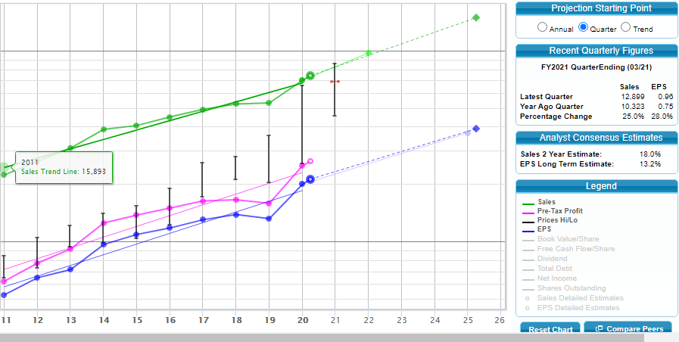

Slide 12
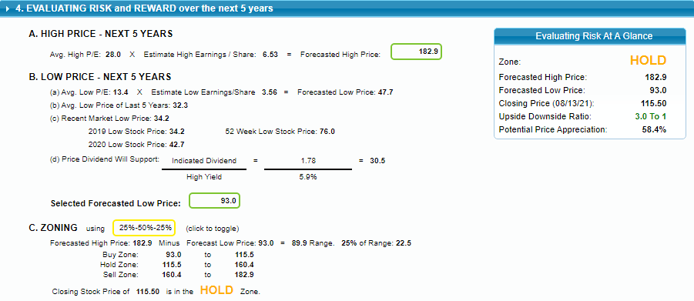

Slide 13
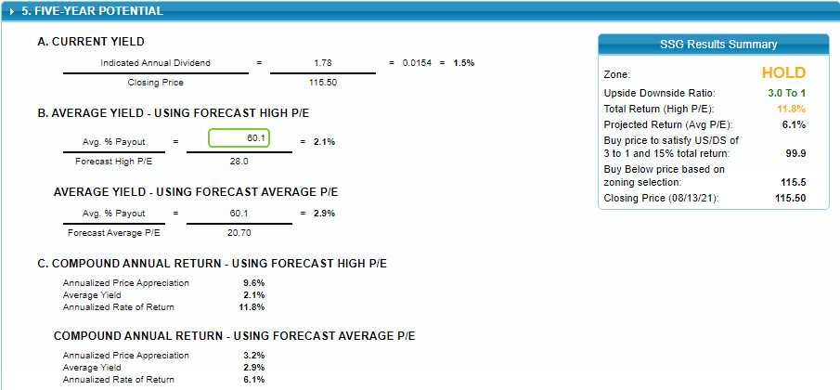

Slide 14
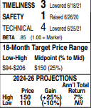
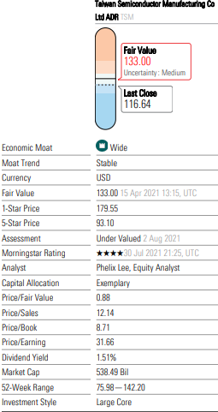
“The company’s immense size and balance sheet strength give it a leg up on the competition and should enable it to withstand an industry downturn better than most. Increased economies of scale should also provide a boost to the bottom line during more prosperous times.”

Slide 15
“Positive structural demand trend involving 5G, IoT, and AI, together with short supply of high-end chip capacity, should lift TSMC’s pricing power and keep its plant utilization rate high at least until 2022.”

Slide 16
Bulls Say
Bears Say
TSMC should consistently earn higher gross margins than competitors thanks to its economies of scale and premium pricing justified by cutting-edge process technologies.
TSMC wins when customers compete to offer the most advanced processing systems using the latest process technologies.
TSMC will benefit from more semiconductor firms embracing the fabless business model.
Although TSMC is the foundry leader, each generation of process technology matures and commoditizes quickly, forcing the company to deal with pricing pressure.
TSMC’s planned Arizona factory is not enough to rekindle a U.S.-based supply chain to support its operations.
Samsung has significantly improved its foundry offerings and is now arguably on a par with TSMC. SMIC and other state-supported Chinese foundries also lurk as potential threats.

