Slide 1
Maskey Krishnarao
Possible Corporate Image
DC CHAPTER, MICNOVA
METROPOLITAN Commercial BANK (MCB)
MCB BANK WAS SELECTED USING PROSPECTOR SOFTWARE
Notes:
Good evening everyone. I am Maskey member of the model investment club of Northern Virginia. I found this bank using Prospector software.
Most investors do not want to analyze banks or insurance companies because their financial statements contain unfamiliar terminology and data and so they tend to keep away from this sector.

Slide 2
BUSINESS OF THE BANK
WWW.BETTERINVESTING.ORG
Metropolitan Bank Holding Corp. is a bank holding company that operates through its wholly owned subsidiary metropolitan Commercial bank, a new York state chartered bank. The Bank was founded in 1999.
CEO & President Mark R. DeFazio
99 Park Ave, New York, NY 10016. Tel 212 669-0600
Notes:
As of January 21, 2021, MCB operated in six locations in Manhattan and Brooklyn, as well as Great Neck, Long Island. The company was founded in 1999 and is headquartered in New York, New York.

Slide 3
WWW.BETTERINVESTING.ORG
Notes:
The company offers checking, savings, term deposit, and money market accounts, as well as certificates of deposit. It also provides lending products, including commercial, construction, multifamily, and one-to four-family real estate loans, as well as commercial and industrial loans; trade finance, letter of credit, term loans, working capital lines of credit; commercial mortgages; and consumer loans.
In addition, the company offers cash management services, as well as online and mobile banking, ACH, remote deposit capture, and debit card services.

Slide 4
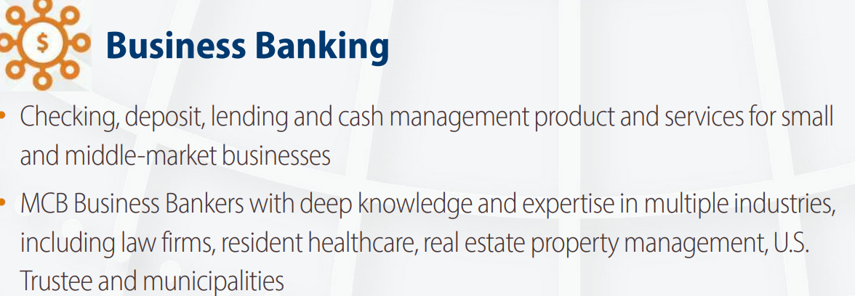
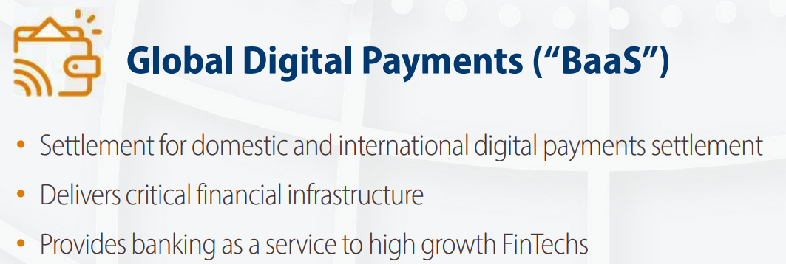
WWW.BETTERINVESTING.ORG
Notes:
MCB offers corporate cash management and retail banking services and, through its Global Payments group, provides banking as a service to its fintech partners, which includes serving as an issuing bank for third-party managed debit card programs nationwide and other financial infrastructure, including cash management and custodian deposit services.

Slide 5
Growth Rates
Notes:
Loans have grown from 2015 to 2021 with a 6 year percentage increase of 355%
Deposits have grown 2015 to 2021, with a 6 year percentage increase of 740%
Revenues have grown 2015 to 2021. with a 6 year percentage increase of 466%
Net Income has grown from 2015 to 2021 with a 6 year Percentage increase of 1400%

Slide 6
Performance
Notes:
Metropolitan Commercial Bank has performed quite well since it IPO presentation. Shareholders have done well with the stock performance share price growing by more than 200%. As compared to the Nasdaq Regional Banking Index (KRX). In all 3 categories of Revenue, Earnings and tangible book value, MCB has also dominated.

Slide 7
Loan Growth
Notes:
Net loans (a measure of revenue growth for banks)have grown from $11 Million in 1999 to 3.6 Billion in 2021 and deposits have grown from $10 Million in 1999 to $6.4 Billion in 2021.

Slide 8
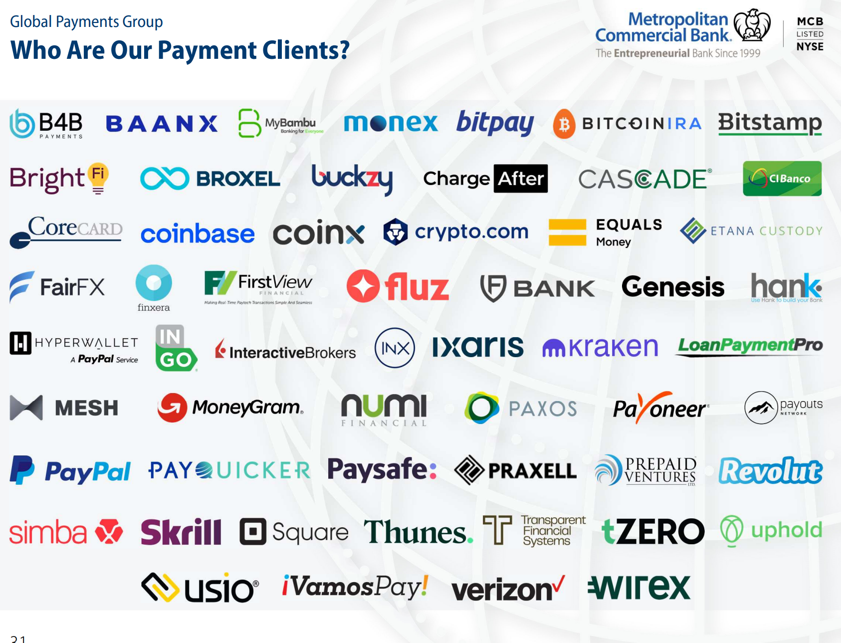
Global Payments group
Notes:
MCB has many Global digital payment clients. Some of them are mega corporations such as Verizon and PayPal with the remaining being mid-size and small.

Slide 9
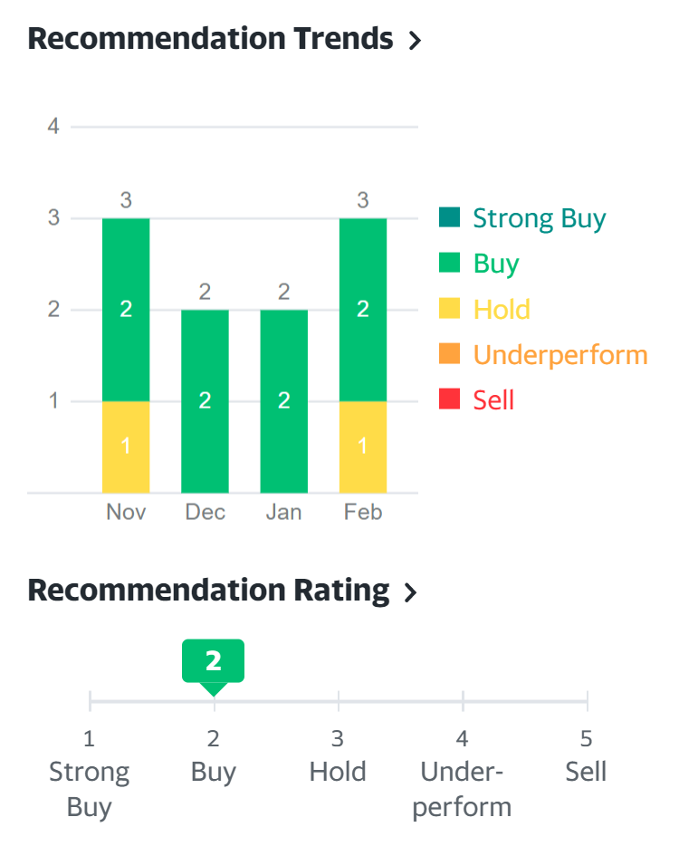
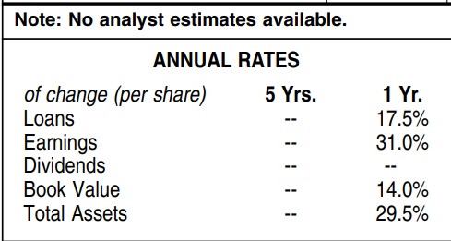
Yahoo Finance / Value Line
Notes:
The shareholder’s return for the past three years has been 245%. Yahoo finance and CFRA both recommend a strong buy rating for this company.
From Value line analyst estimates for loans is 17.5%, EPS is 31% and total Assets is 29.5%..

Slide 10
Notes:
CFRA forecasts a total return increase for three years out at 41.5% and recommends a buy rating for this company. They compare that increase to a peer total return of 8.7% and an S&P 500 total return of 19.9% for that same period.

Slide 11
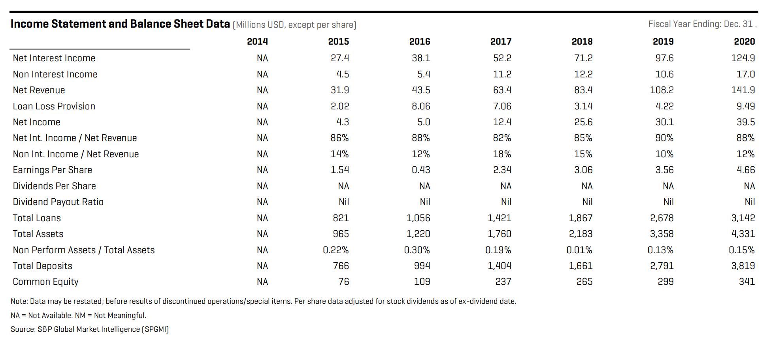
Morning Star
Notes:
Net revenues (a key factor in demonstrating whether a company has real growth) shows consistent growth from 2015 to 2021. Total loans and total assets also demonstrate real growth.
The only negative data maybe the Loan Loss Provision. Potential investors need to be wary and watch that number as it should only be at or below 1%.
This would be an excellent question for the investor relations person as to the amounts for the net loan to calculate the Loan Loss expense ratio?

Slide 12
Definition of SSG Terms
Notes:
The revenues for a bank is Net interest income + Non Interest income.
Net interest income is the difference between a bank's revenue generated from the interest earned on assets such as loans, mortgages and securities over the interest paid out on the institution's deposits.
Non-interest income is bank and creditor income derived primarily from fees including deposit and transaction fees, insufficient funds (NSF) fees, annual fees, monthly account service charges, inactivity fees, check and deposit slip fees, and so on.
For banks, the efficiency ratio is non-interest expenses/revenue. This shows how well the bank's managers control their overhead (or "back office") expenses.
Loan Loss Provision:-Banks and credit unions are in the business of lending money to individuals, families and businesses. But not every loan is repaid in full; in fact, many banks lend to risky borrowers by charging high interest rates. To stabilize earnings and remain solvent in bad times, banks estimate losses and seek to hold enough capital to absorb future write-offs.
If the charge off is less than 1% the bank is efficiently run.

Slide 13
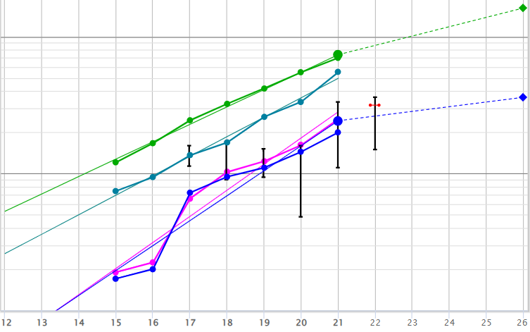
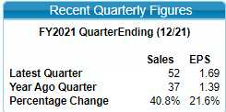
SSG+ Fundamental Company Data
Notes:
Historically the Bank has done very well for the past six years, sales have grown by 34% and Historical Total assets has grown by 39%. The FY21 quarter ending percentage change for sales is 40.8% and EPS is 21.8%.
I used a sales forecast of 17% from Value line and Yahoo Finance and I used the preferred procedure to get 8.2% for EPS. For the past five years, all of the above lines are up, straight, and parallel.

Slide 14
SSG+ Evaluate Management
Notes:
Pretax profit on sales for the past five years is 42.5% and the return on equity to share holders around 13%. The Management is doing quite well in controlling the expenses and making profits to its shareholders.
The % of debt to capital is declining. Banks Normally carry a large debt because their job is lending money to others to make money.
ROAA – Management’s ability to control Expenses and Maximize Earnings from assets. Value line lists it as “Return on Assets”.
Good Banks maintain ROAA > 1.25% and Best Banks have ROAA > 1.5%. MCB has a 5 year average of 1.05%, but the trend is increasing.

Slide 15
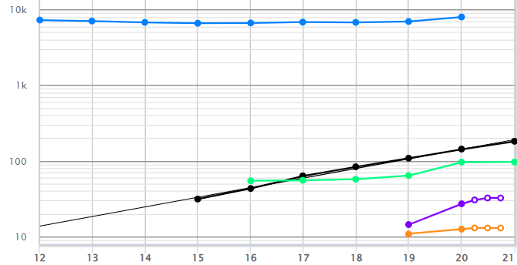
SSG Core Sales Peer Comparison
Notes:
I compared MCB to its peers – Due to short history and lack of data for Generations Bancorp and Affinity Bancshares, I eliminated these companies from further study.
MCB has kept up with it’s closest peer in all categories with revenue growth rates of 34% for the year and 41.8% for the quarter.

Slide 16
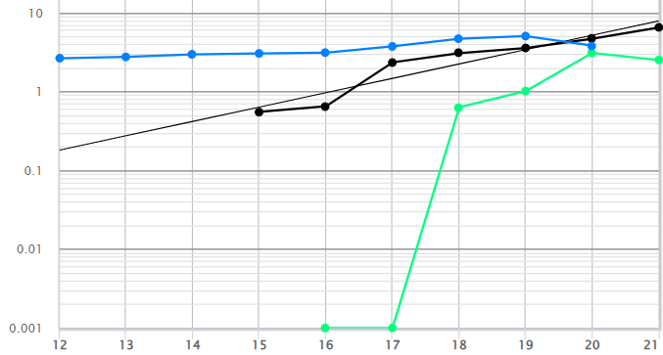
SSG Core EPS Peer Comparison
Notes:
Judging from the graph we see MCB has EPS growth better than MYFW and Industry Average. MCB has growth rate of 52.1% for EPS, while FYFW EPS is negative until 2018, spiked very high in 2019 and 2020 and then lower in 2021 due to inconsistent ups and downs. MCB quarterly growth rate of 21.6% higher than MYFW which has negative -62.3%.

Slide 17
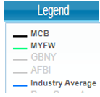
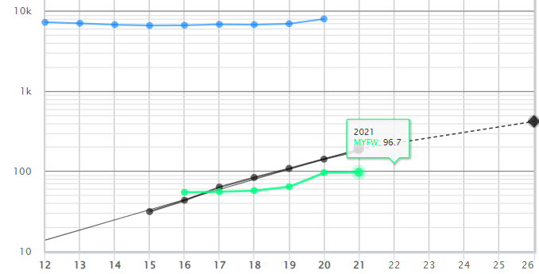
SSG Core Forecast Sales
Notes:
MCB Has better sales growth forecasts compared to MYFW and the industry average.

Slide 18
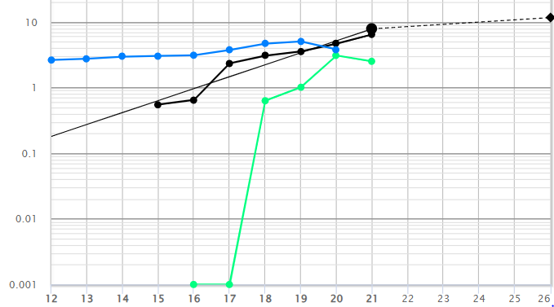
SSG Core Forecast Earnings
Notes:
Looking at the graph MCB has straight up and parallel line compared to MYFW which has inconsistent growth and Industry Average which is almost parallel to MCB. MCB has always had consistent growth.

Slide 19
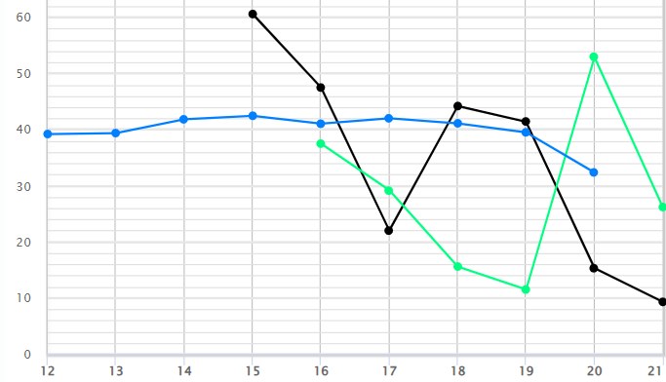
% of Debt to Capital
Notes:
% of debt to capital is declining compared to MYFW and industry average for the last five years. MCB has managed to control their debt at lower numbers, while increasing their number of loans, deposits, and other fees.

Slide 20
Price Earnings History
Notes:
Normally Banks have a low P/E compared to other industries/sectors.
MCB - Historical high P/E is lower than its peer and the industry Averages.
The same with the Low p/e. MCB high p/e is 16.2 compared to MYFW 17.6 and Industry avg of 16.3.

Slide 21
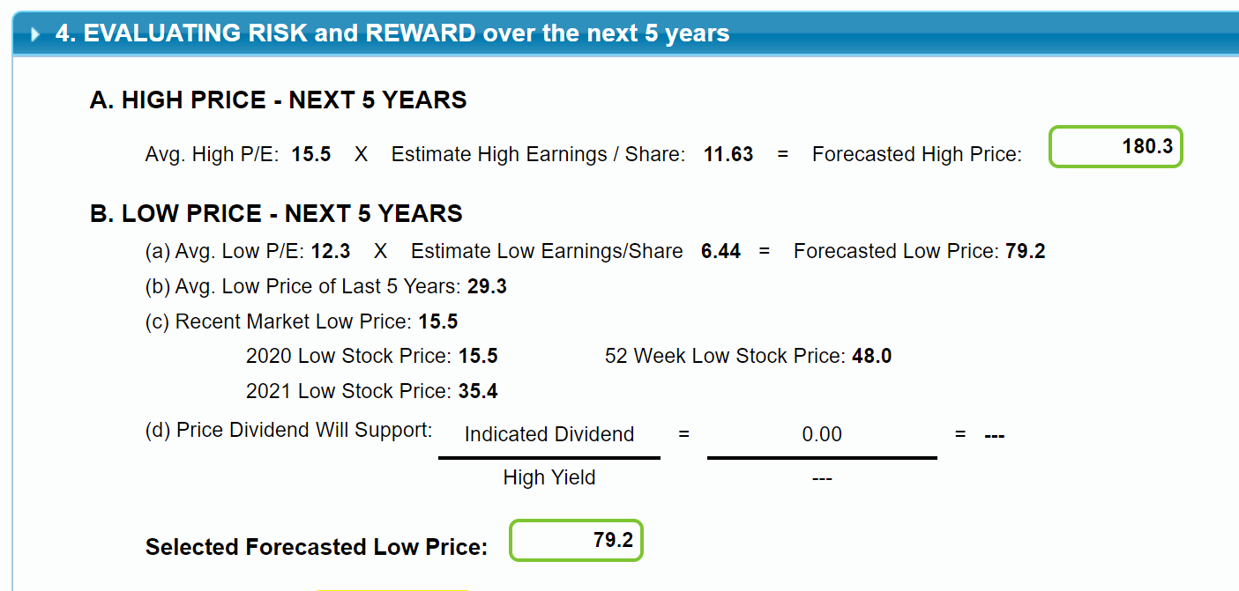
Evaluating Risk and Reward
Notes:
I chose five year avg high p/e of 15.5 and a low p/e of 12.3 to come out with a high price of $180.30 and a low price of $79.20, which comes out to be 70% of the current price (giving me a buffer in case the market drops 30% which it may in current turbulent national and global event).

Slide 22
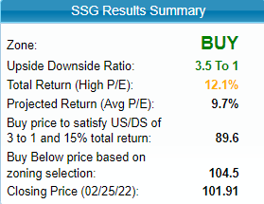
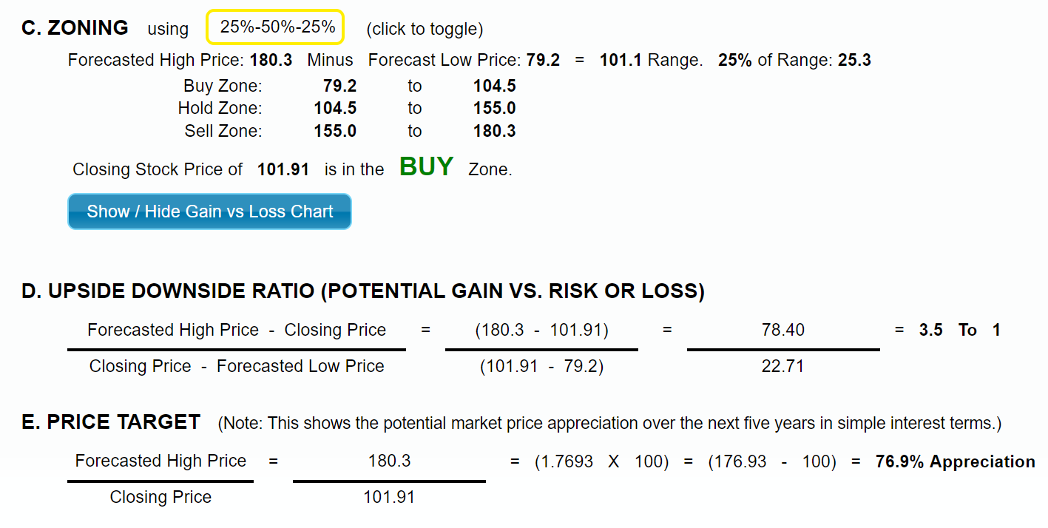
Zoning / Upside – Downside Ratio
Notes:
The price as of 02/27/22 was $101.91. It has us/ds ratio of 3.5 to 1 and to get 15% total return on your investment one must buy at below $89.60.

Slide 23
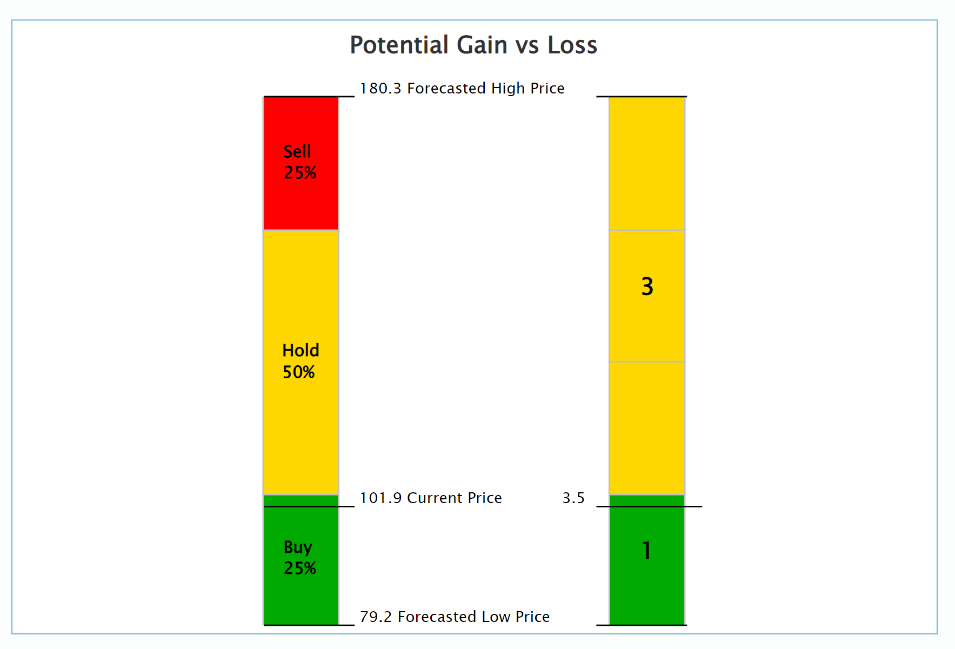
Zoning / Upside – Downside Ratio
Notes:
Graph shows the US/DS Ratio. Within the zones, MCB at it’s current price is near the top of the buy zone. Look for dips in the price to achieve totals returns of 15%.

Slide 24
Conclusion
MCB is a small sized, and growth company.
MCB is a well managed company.
MCB is trading within the buy range.
MCB is a worthy candidate to add to your watch list for further study.
MCB is a BUY up to $89.06 (buy price to satisfy US/DS of 3 to 1 and 15% Total Return).
Notes:
Read slide

