Slide 1
Jo Murphy
June 14, 2022
Houlihan Lokey (NYSE: HLI)
BI First Cut Stock Reports
Four First Cuts in 2021
Manifest Investing Round Table 4/26/2022

Slide 2
Disclaimer

Slide 3
HLI Overview
Founded: 1972 Public: 2015
Headquarters: Los Angeles, CA
Regional Headquarters: U.S., Europe, Asia, Australia
Revenue Breakdown: Corporate Financings 53%, Restructurings 35%, and Advisory Services 12%
Growth by acquisitions: most recent GCA Japan-based investment bank giving it a footprint in Asia-Pacific region.
Ownership: Officers & Directors 77.8%
Debt: Nil (per 4/23/2022 VL) 8% CFRA

Slide 4
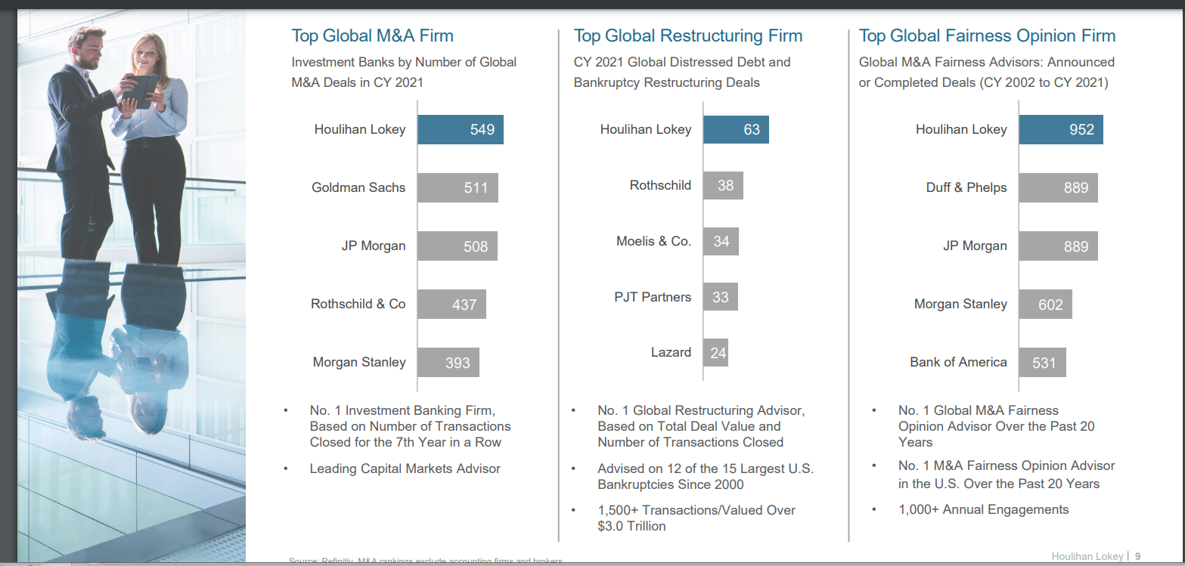
What They Do

Slide 5
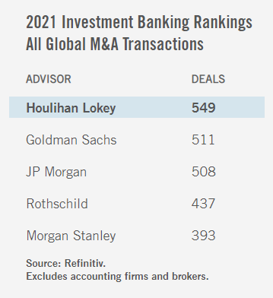
What They Do
Ranks #1 for the last 7 years in the U.S.

Slide 6
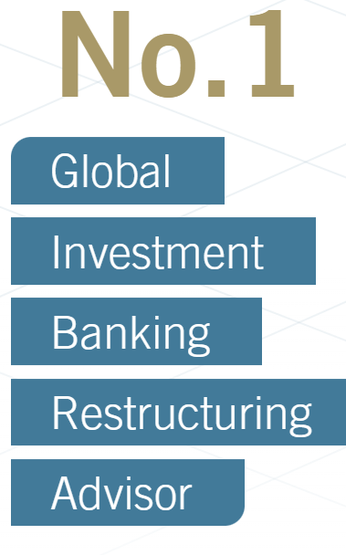
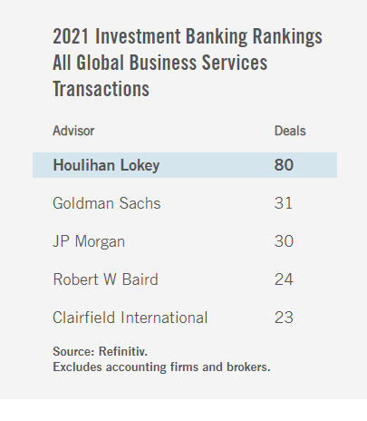
What They Do
For the past 8 years
Notes:
Advised on 12 of the15 largest U.S. bankruptcies since 2000.

Slide 7
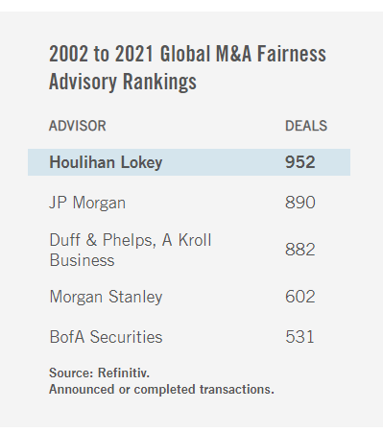
What They Do

Slide 8
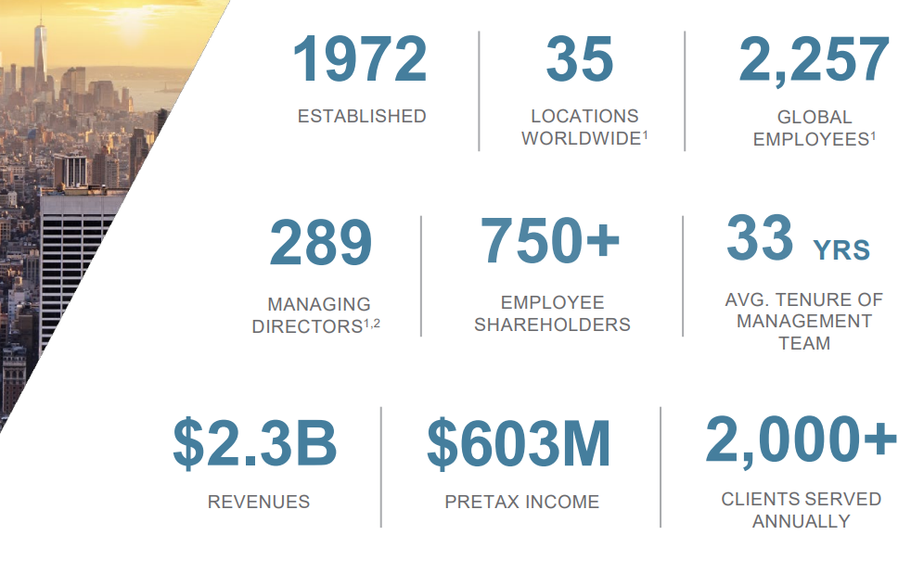
Summary Statistics

Slide 9
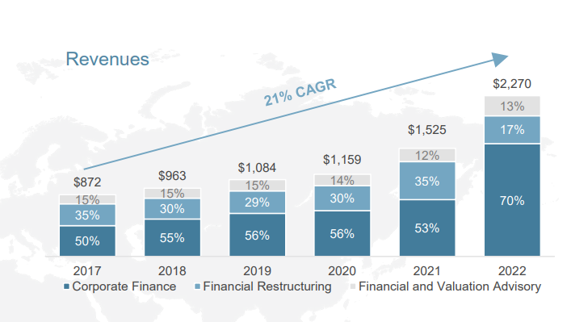
Strong Financial Performance

Slide 10
Strong Financial Performance

Slide 11
Governance

Slide 12
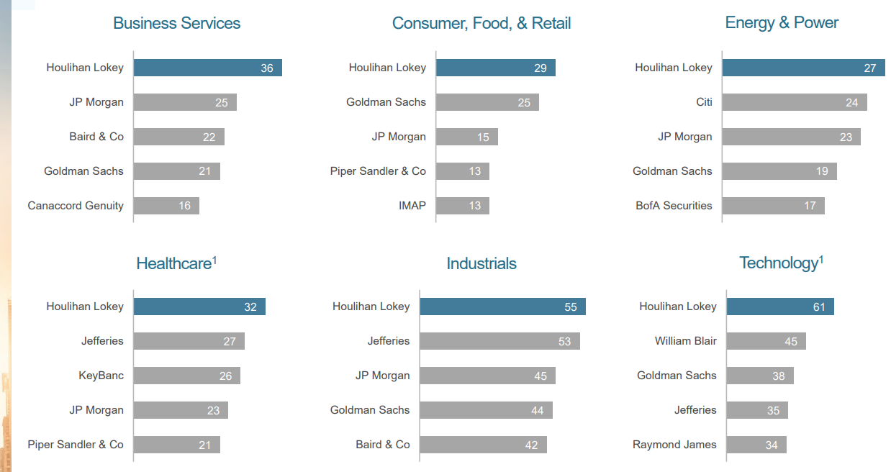
Diversified Industries

Slide 13
Diversified client base

Slide 14
Where is the growth?

Slide 16
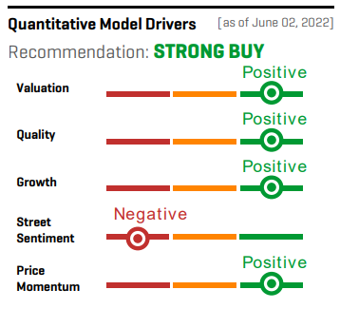
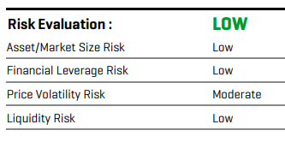
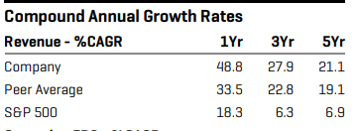
Analyst Coverage

Slide 17
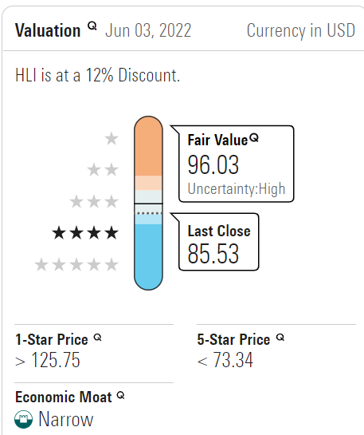
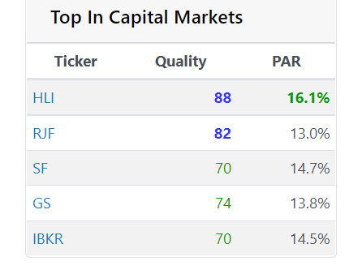
Manifest Investing

Slide 18
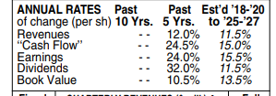
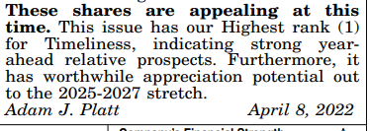
Value Line Projections
The purchase of GCA brought a Japan-based investment bank with a technology-industry focus into the fold. After the acquisition, the company stands out as the most active M&A advisor in the technology arena. Furthermore, Houlihan now has a substantial footprint in the Asia/Pacific region, which management has indicated will be a target for future investments. Before the GCA acquisition, the company has made a number of substantial acquisitions in Europe, where Houlihan now stands out as one of the largest M&A advisors.

Slide 19
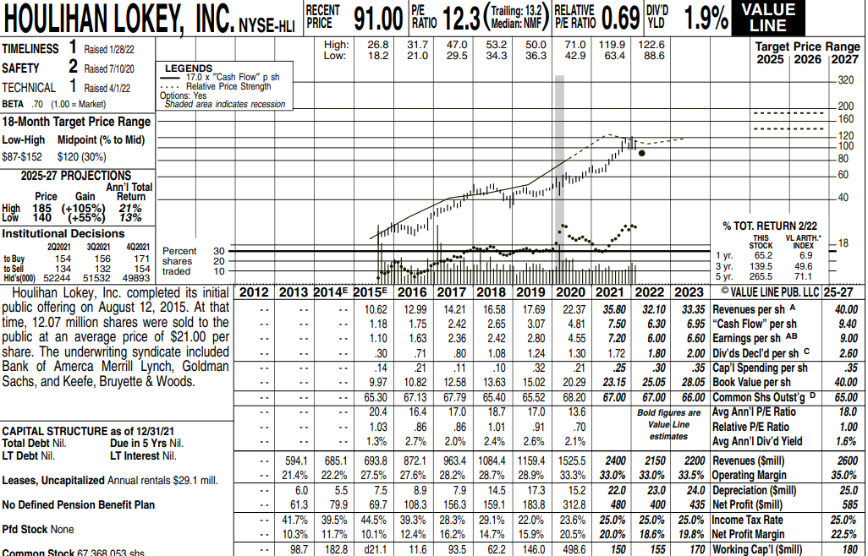
Triple Play?
PE Expansion
Depressed price
Rising earnings
Notes:
Depressed Price: High price in 2021: $122.6 Low: 88.6 Today’s $85.91 and undervalued for the past 5 years while earnings have been steadily increasing.
Room for PE expansion : Current PE of 12.3, and expected average PE of 18 (VL)
Net Margin expansion: 2021”s $18.6 expected 22.5 in 5 in five years.

Slide 20
Value Line updates
Rank & rating changes:4
4/29/22 - Technical rank down
5/6/22 - Technical rank down
5/6/22 - Timeliness TM rank down
6/3/22 - Timeliness TM rank down

Slide 21
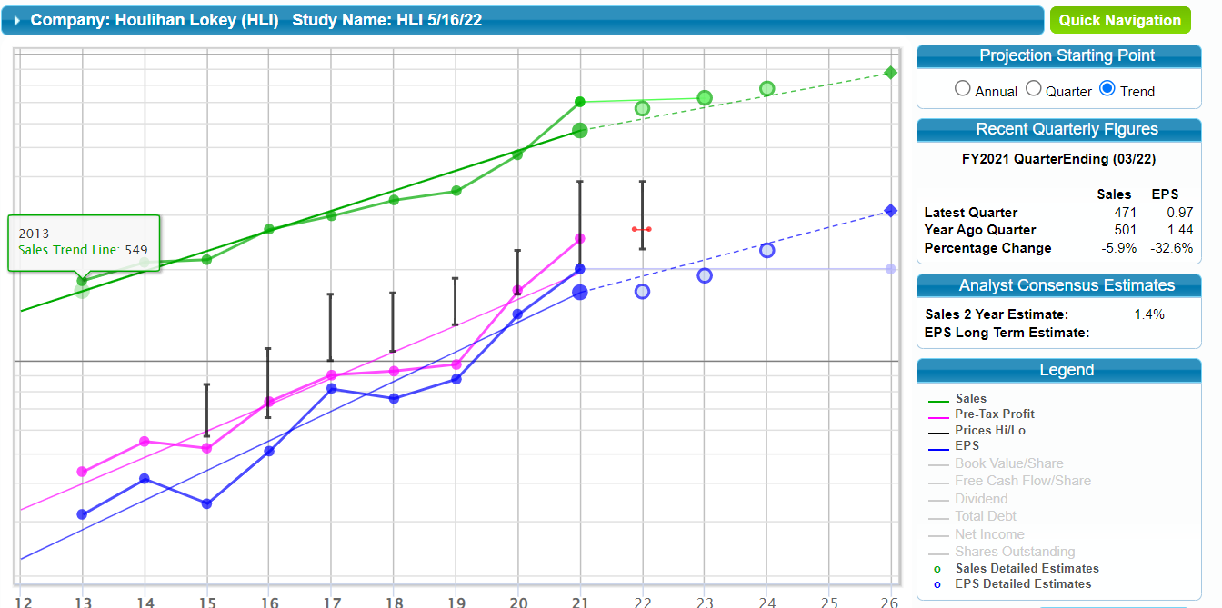
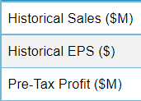

Slide 22
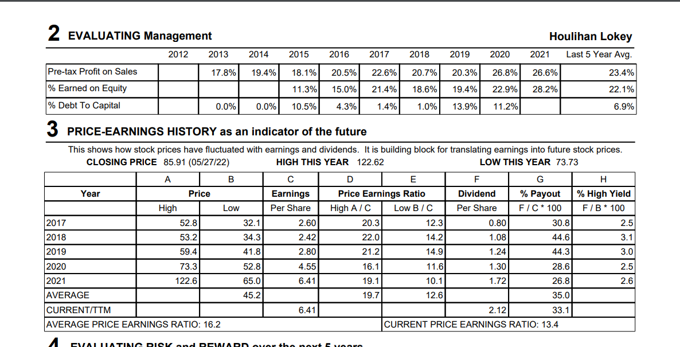

Slide 23
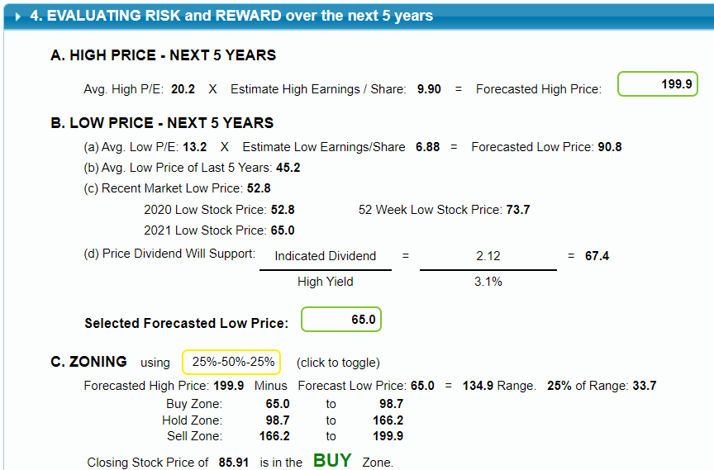

Slide 24
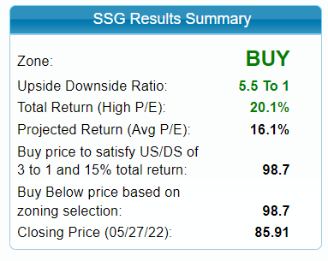

Slide 25
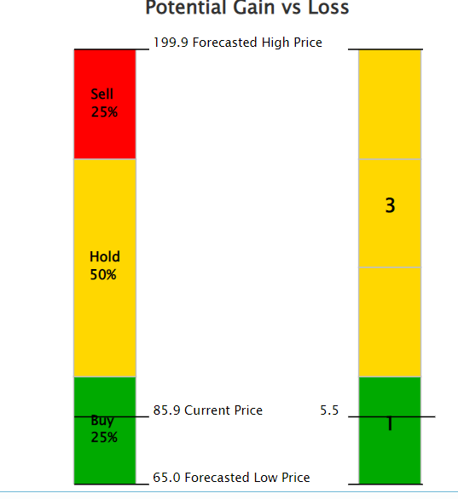
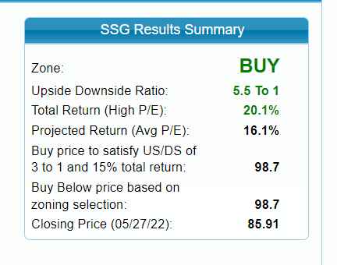

Slide 26
Houlihan Lokey Conclusion
HLI is a medium-sized rather mature company that is still growing
It is well-managed and profitable
It is on sale now below its average PE and below Morningstar’s FV of $96
It is a worthy candidate for further study and possible purchase.

