Slide 1
FactSet Research (FDS)
Stock Study
By Jo Murphy
June 2023

Slide 2
Sector: Financial Services
Size: Medium 1.9 Billion
Industry: Data and Stock Exchanges
FactSet Research Systems Inc., a financial data and analytics company, provides integrated financial information and analytical applications to the investment community in the Americas (64%), Europe, the Middle East, Africa (26%), and the Asia Pacific (10%).
The company delivers insight and information through the workflow solutions of research (38-40%), analytics and trading (32%), content and technology solutions (24%), and wealth.
It serves portfolio managers, investment banks, asset managers, wealth advisors, corporate clients, and other financial services entities.
FactSet Research Systems Inc. was founded in 1978 and is headquartered in Norwalk, Connecticut. Went public 1996, and was added to the S&P 500 in 2021.

Slide 4
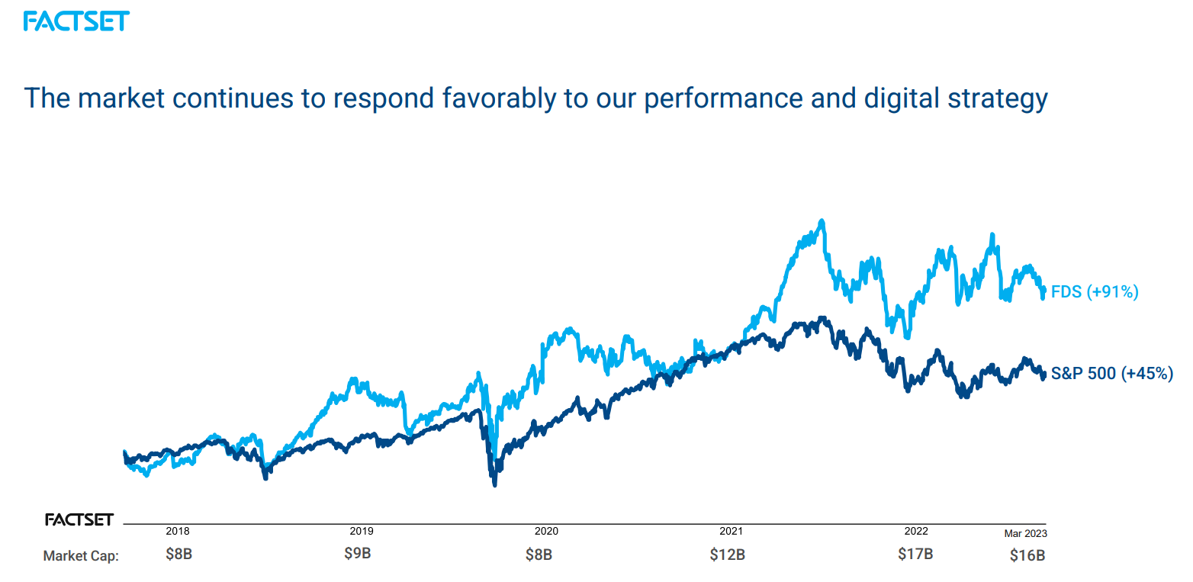

Slide 5
* ASV = Annual Subscription Value

Slide 6
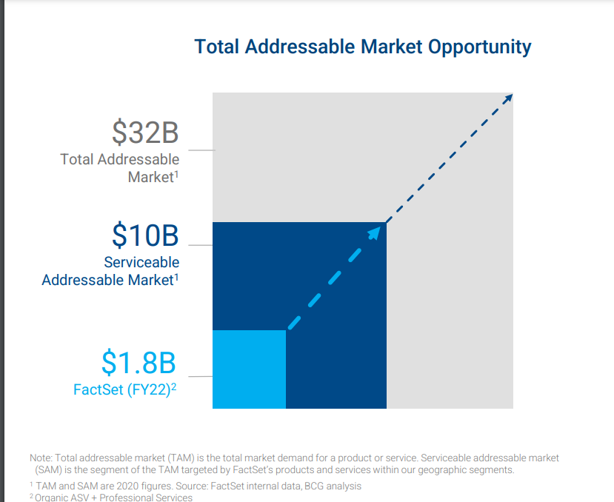
Competitors
Bloomberg 33% market share
Refinitiv (Reuters) 20%
S&P Global 6%
Factset 4-5%
Subscriptions
Bloomberg Work Station = $27,000
Refinitiv $22 ,000 but some stripped down
S&P Global $2500 to $13,000
Factset Annual $12,000
Narrow Moat
High switching costs pose entry barrier
Excellent track record through tough economic times.
Costs have a large variable component

Slide 7
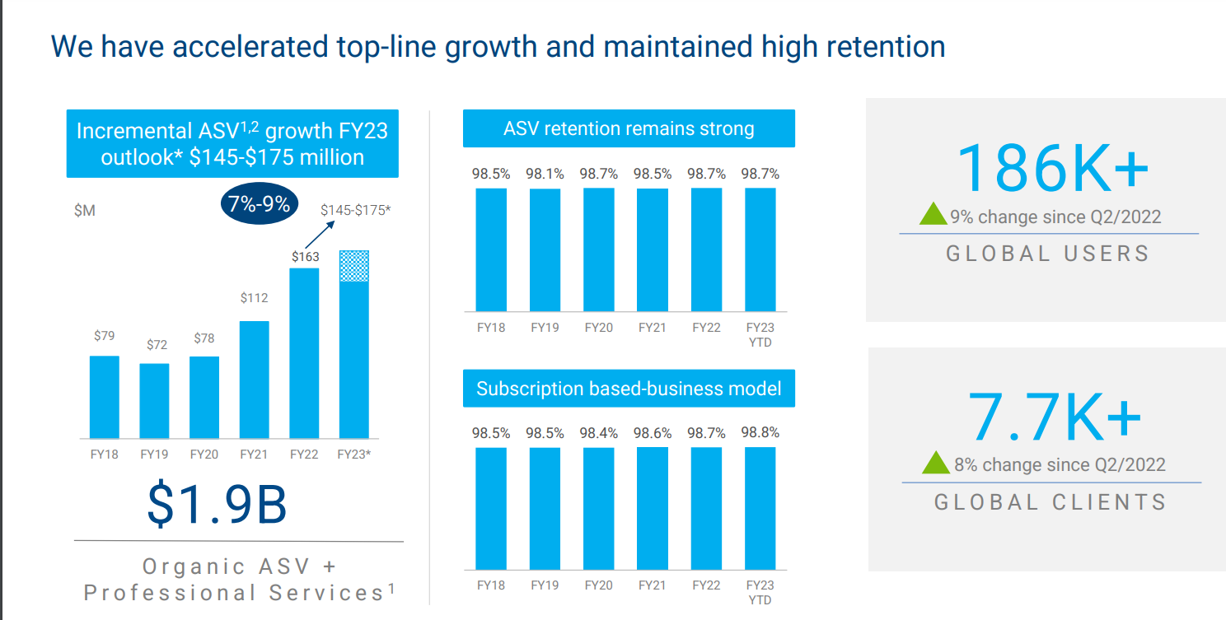
* ASV = Annual Subscription Value

Slide 8
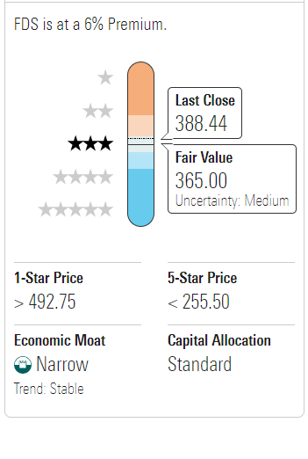
Value Line (5/19/2023)
Morningstar
CFRA
Company’s Financial Strength A+
Stock’s Price Stability 85
Price Growth Persistence 90
Earnings Predictability 100
Buy ****
Fair Value = $353
Over-valued by 9.02%
12-month target = $454.
2026-28 Projections

Slide 9
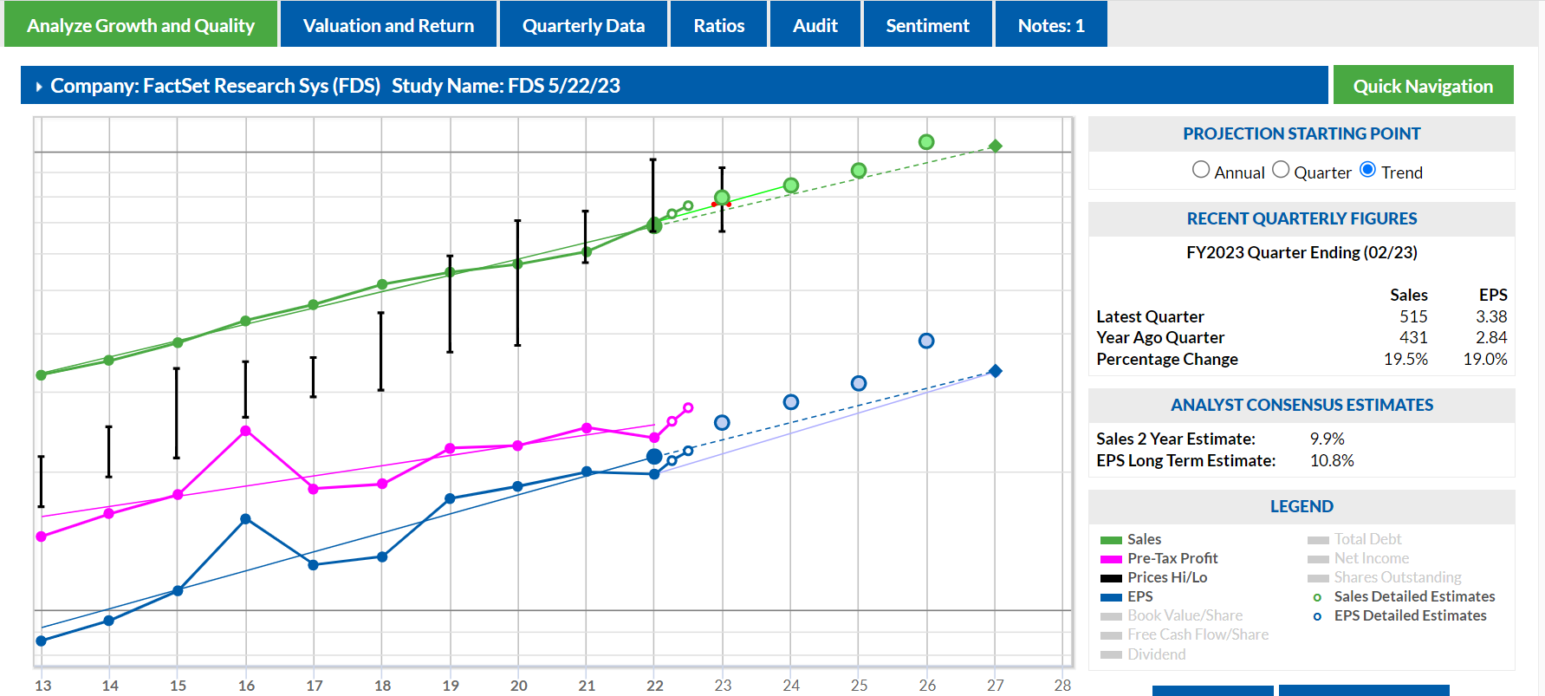

Slide 10
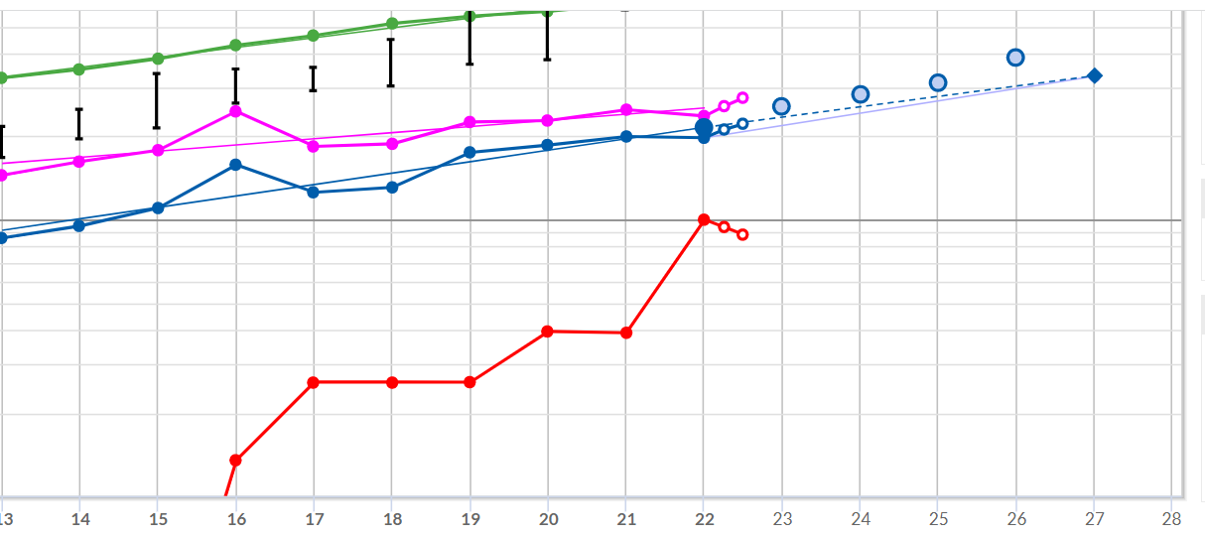
Bought CUSIP 2022 from S&P
Debt
52% of Capital, but 10.7 x interest coverage, and paying off

Slide 11
My growth projections

Slide 12
Evaluating Management
Barbed Wire Fence?

Slide 14
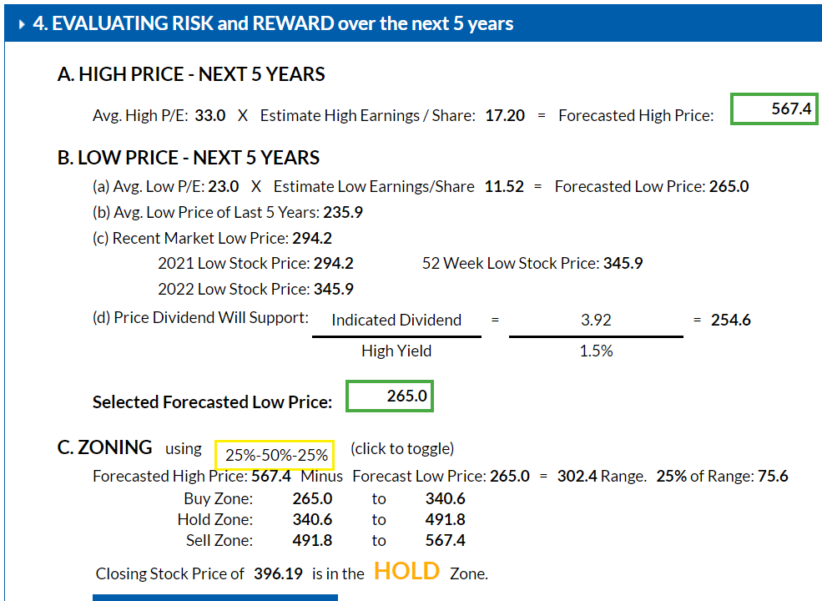
VL High Price 690
Low price 565

Slide 15
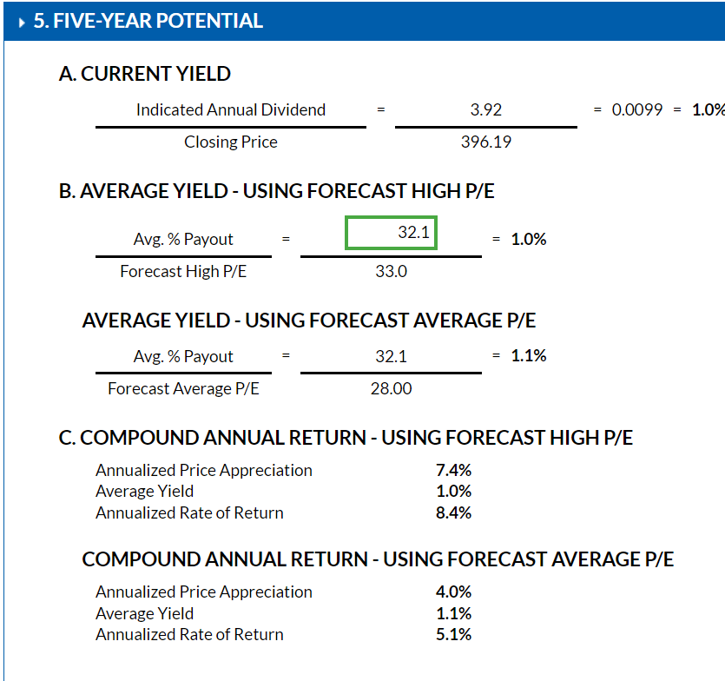
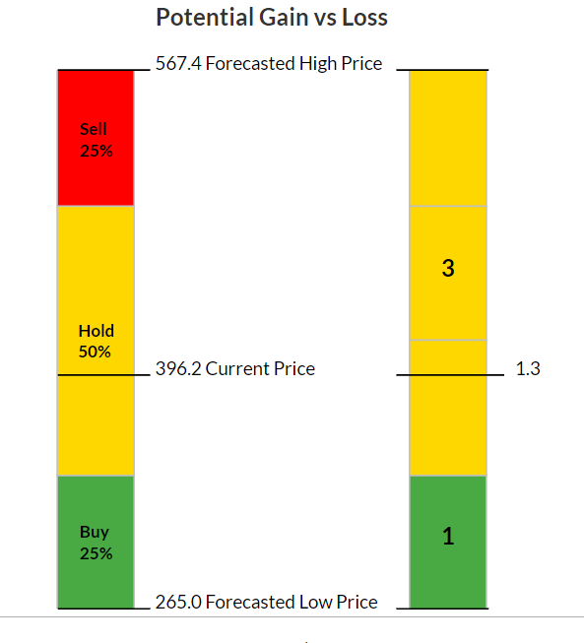

Slide 16
Conclusion
FDS is medium size mature steady-eddy company
Has grown sales annually for 42 years
Dividend increased annually since 2007
EPS increased annually for 26 years
Narrow moat from switching costs
Currently overpriced
Morningstar analyst thinks it could be bought by larger company with ample finances
Suggest watch for buying opportunity if interested.

