Slide 1
Cummins
MicNova Model Club
Patrick Smith
10-10-23

Slide 3
Worlds largest diesel engine manufacture
Publicly traded since 1947
60,000+ employees
In a 190 countries
45% International sales
$33.64 billion Capitalization

Slide 4
Cummins has 5 Business Segments
Engines 39%
Power System 18%
Components 35%
Distribution 32%
Accelera (New Power)
1%
a business segment focused on making components and integration of batteries, hydrogen fuel cells, electronic axles, traction drive and hydrogen-making electrolyzers.

Slide 6
Manufactures Diesel, Gasoline, Gas, Hydrogen and Electric Engines
48 to 715 horsepower and 2.8 to 91 liters
RVs
Buses
Generators
light-duty automotives
Heavy-duty and medium-duty commercial trucks

Slide 10
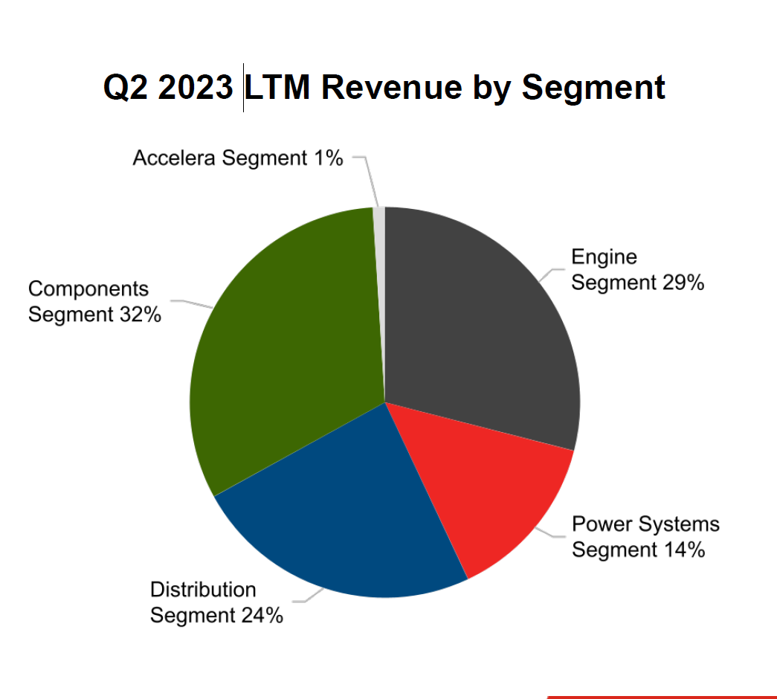

Slide 11
“At some point the low-carbon thing becomes the main thing. And [diesel] becomes the niche business,”
“I think diesel engines will be around for our kids’ full adult lives. But it will move from the main thing to a place that it operates in some places.”
Tom Linebarger,
Cummins’ executive chairman and retired CEO
12/2021

Slide 13
Carbon Capture Transition

Slide 14
Carbon Capture Transition

Slide 16
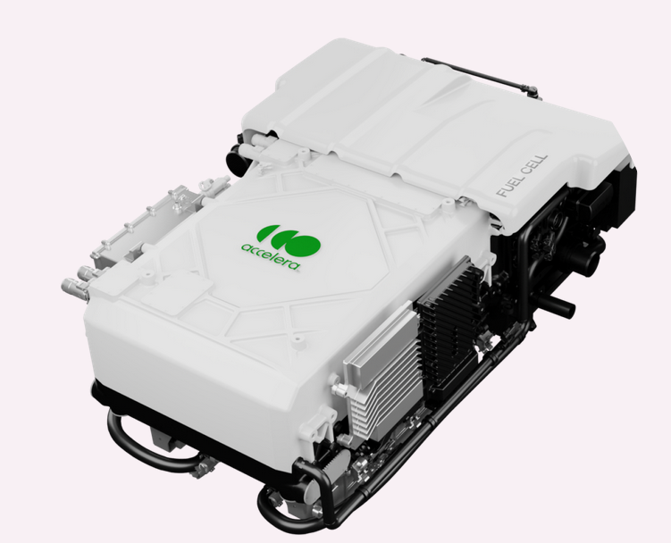

Slide 17
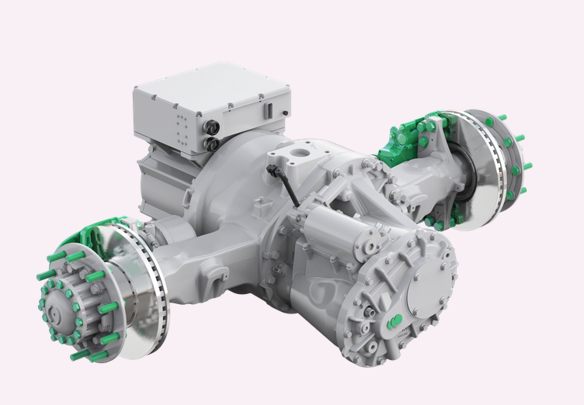

Slide 20
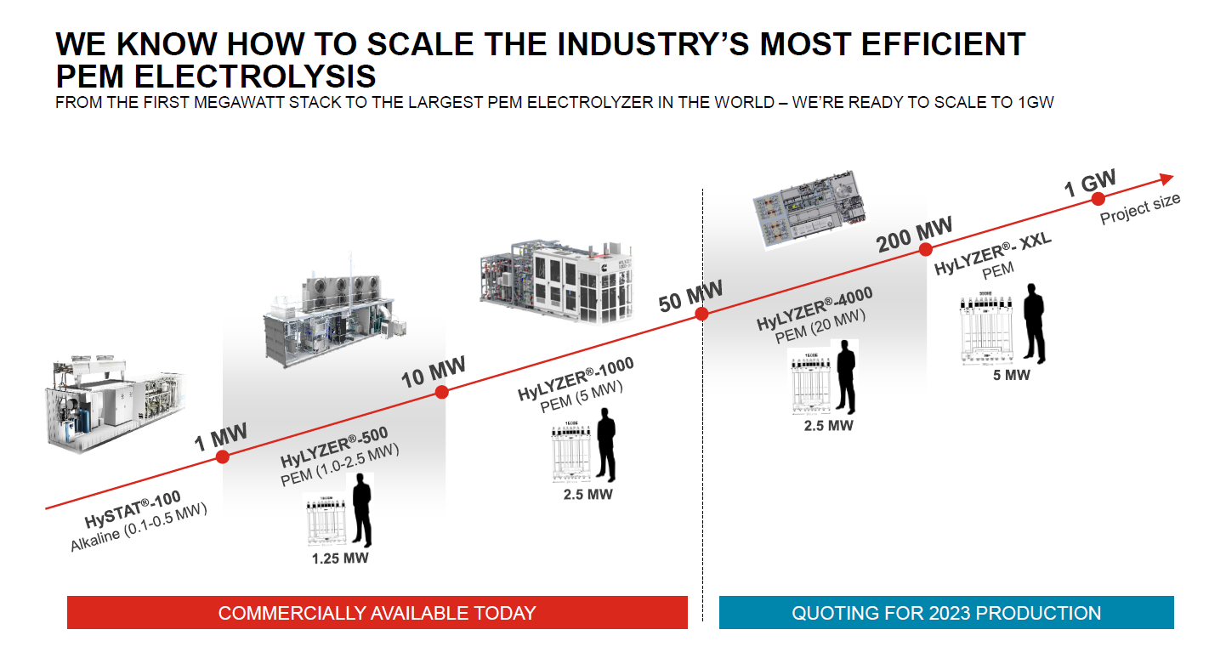

Slide 21
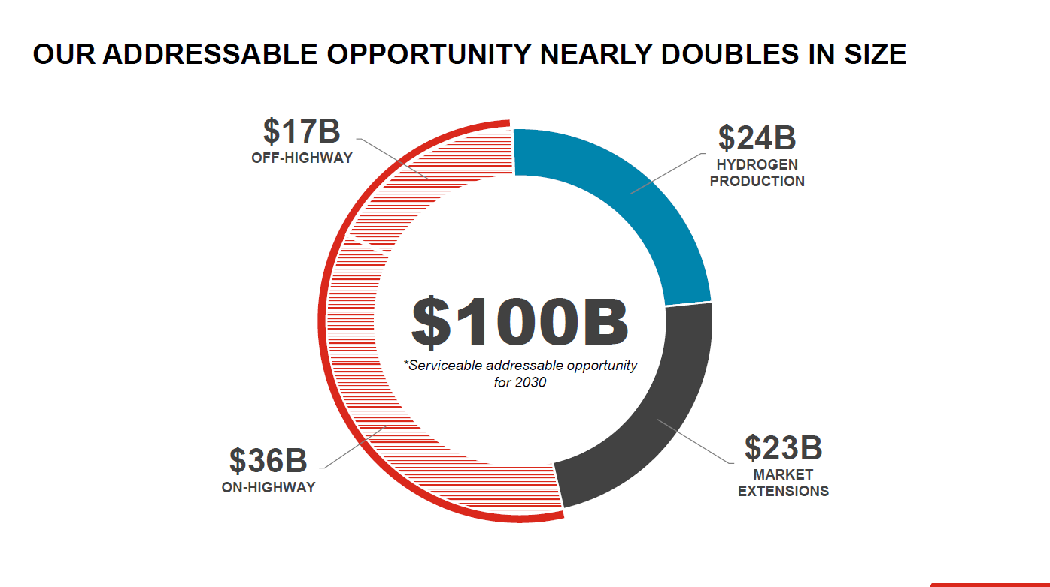

Slide 22
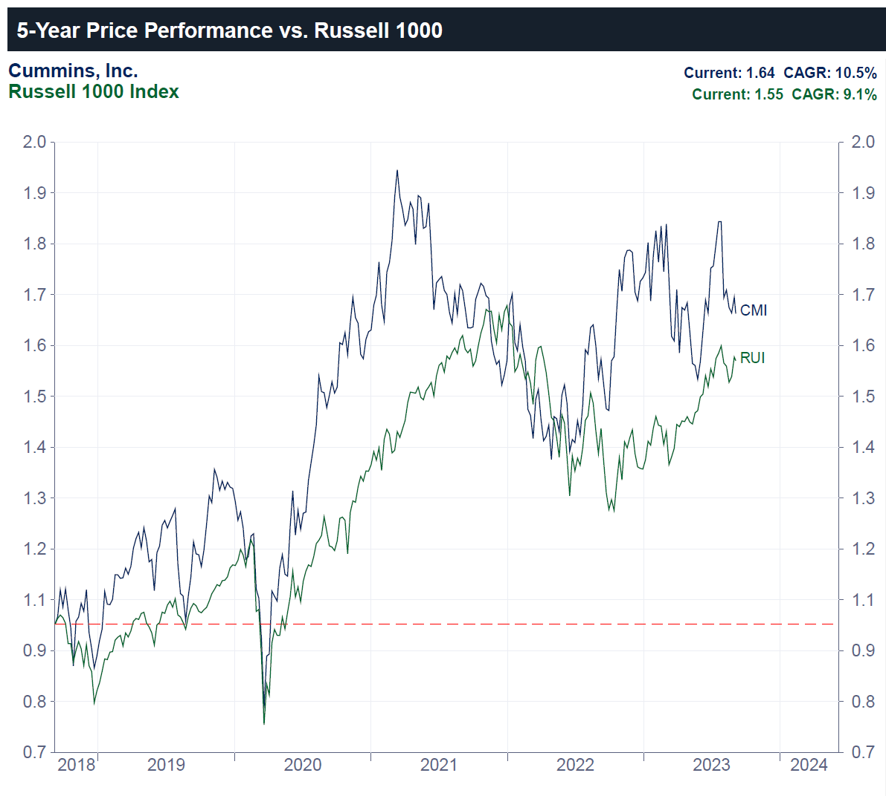

Slide 24
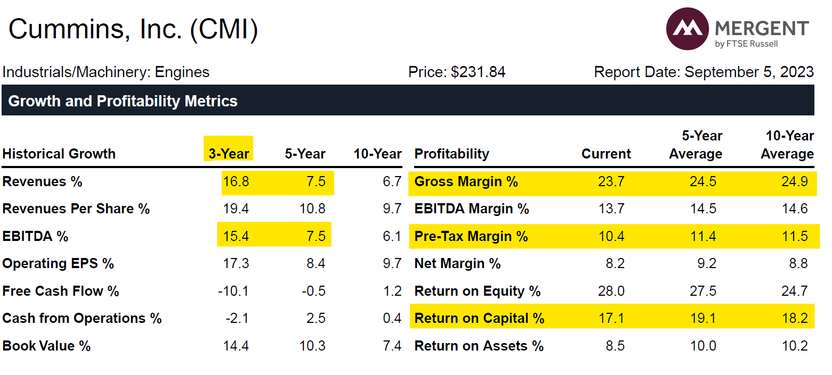

Slide 26
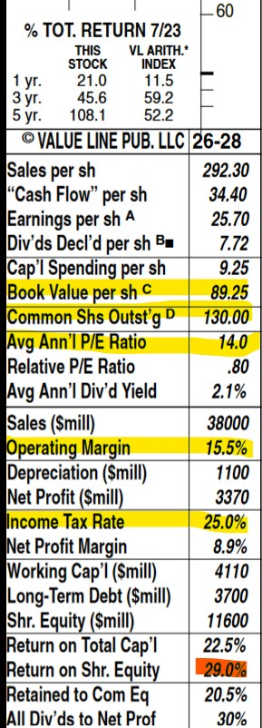
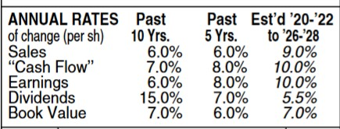
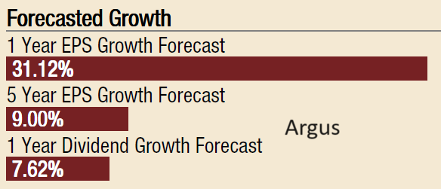

Slide 27
5yr Revenue 2028
Lo=38,000
Hi=42,000

Slide 28
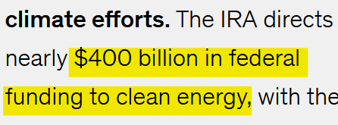

Slide 29
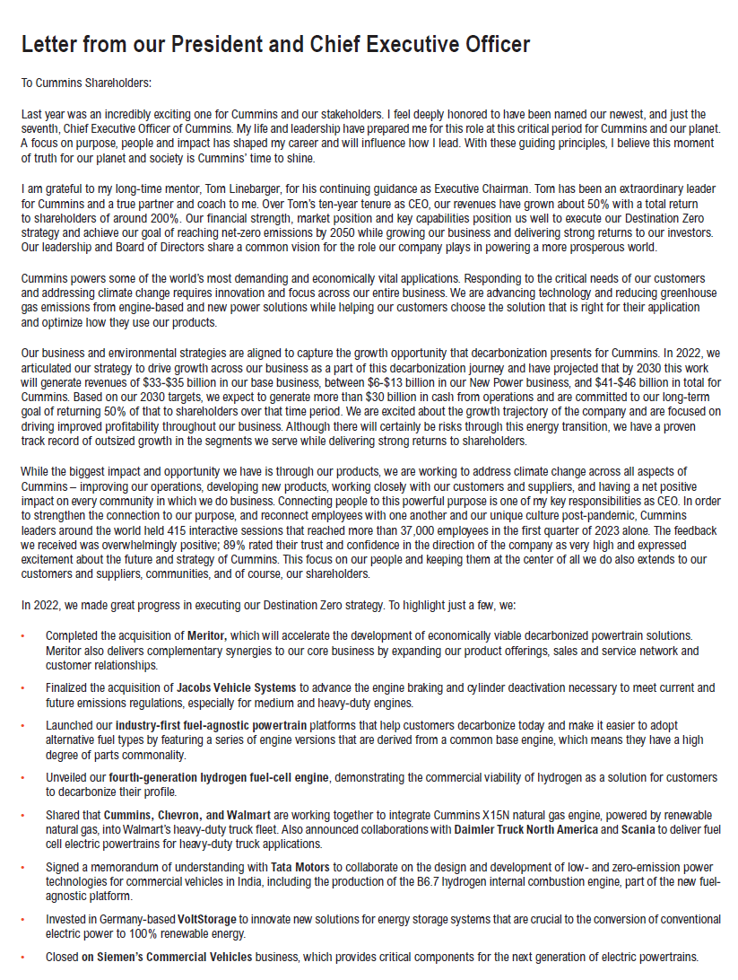

Slide 30
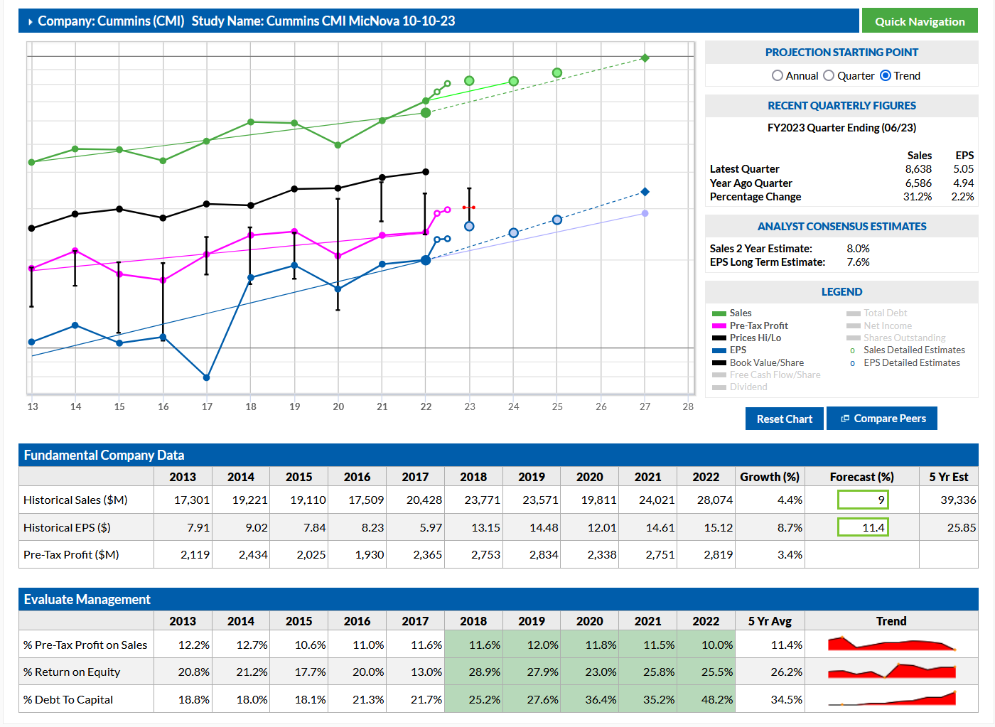

Slide 31
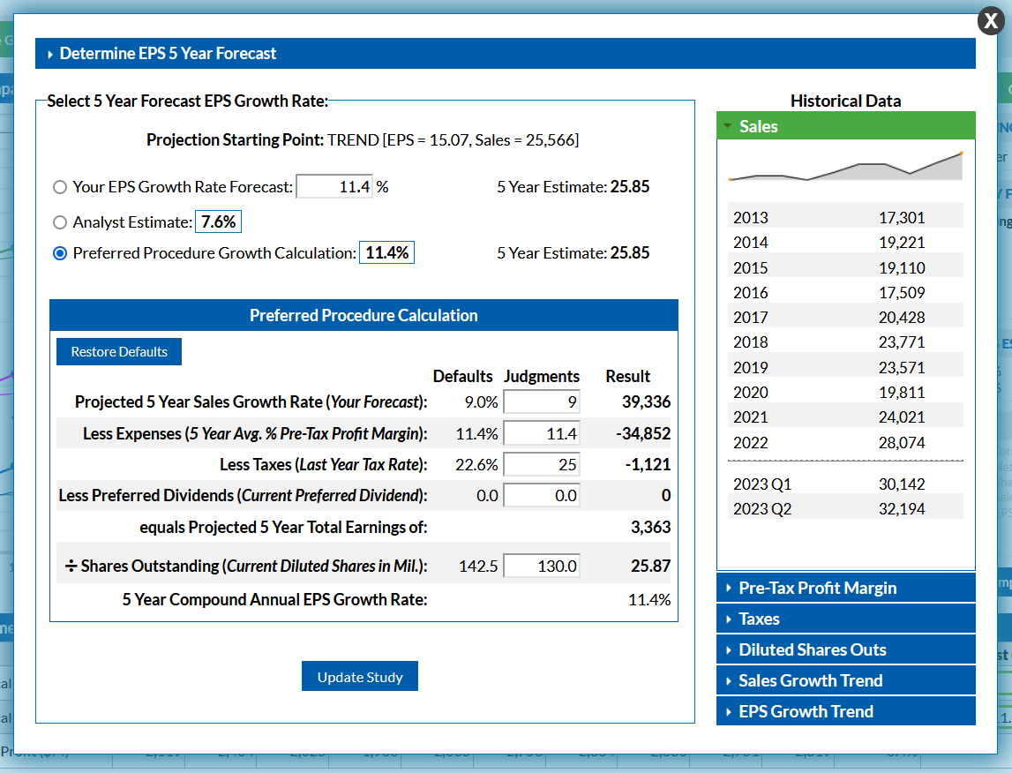

Slide 32
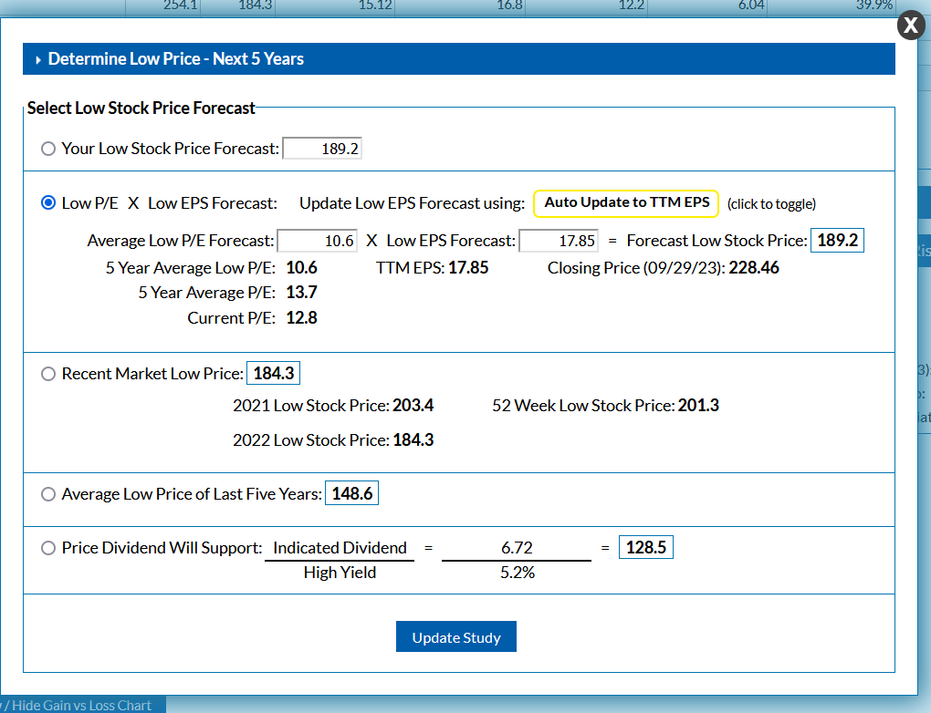
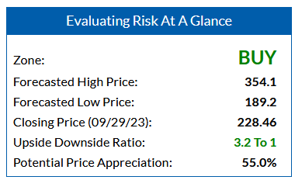
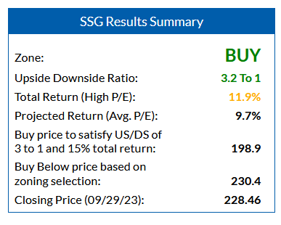
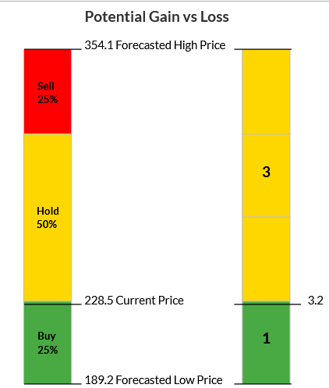
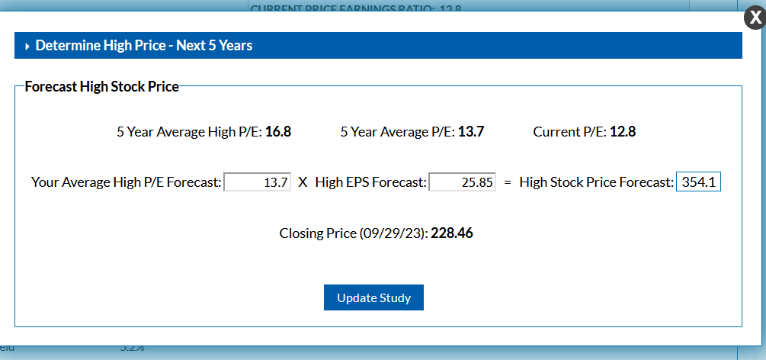

Slide 33
?

