Slide 1
DC Chapter The Model Investment Club of Northern Virginia
New Stock Presentation, March 12, 2024
Prepared by Andrew Ober
Addus Home Care (Nasdaq: ADUS)

Slide 2
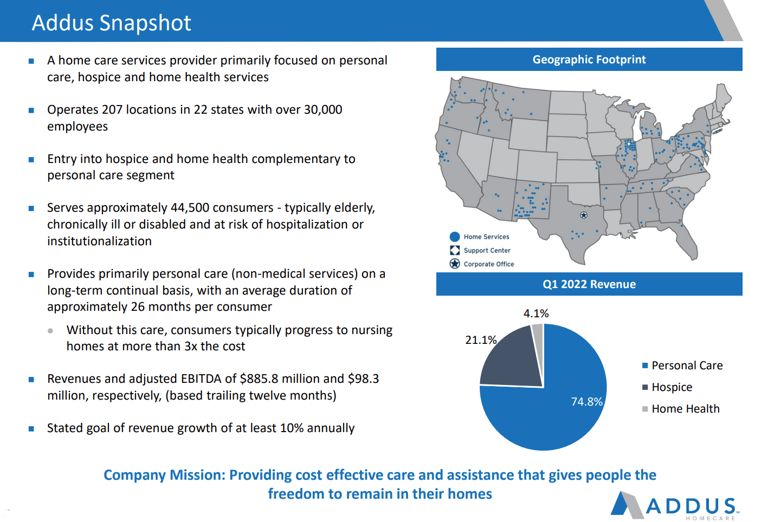

Slide 4
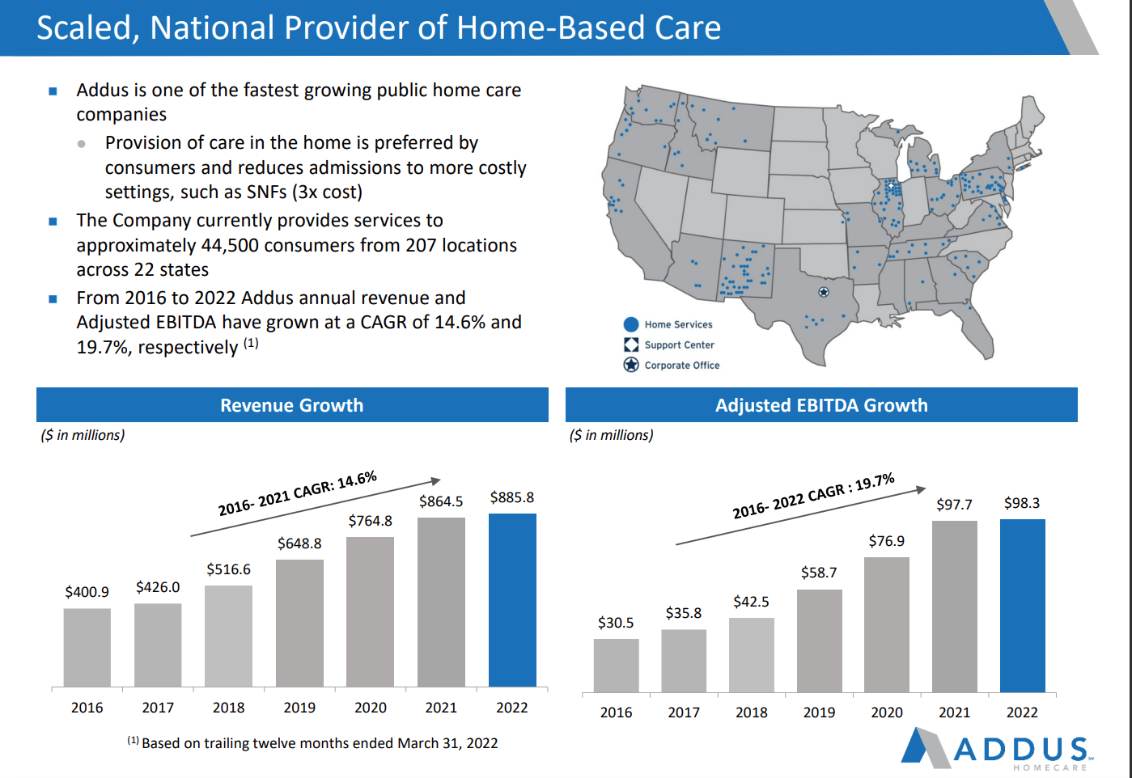

Slide 5
Addus Financial Summary
Revenues increased 11.3% from $951.1$M (2022) to $1.06 $B (2023)
Net income increased 35.8% from $46.0 $M (2022) to $62.5 $M (2023)
Earnings per share increased 34.9% from $2.84 (2022) to $3.83 (2023)
*With Care Staff acquisition in 2023, Personal Care expanded to Florida
** With Journey Care acquisition in 2022, Hospice expanded to Illinois
**/*** With Tennessee Quality Care acquisition in 2023, Hospice and Home Health care expanded to Tennessee
 | $M
Personal Care* | 794.8 | 75.0%
Hospice** | 207.3 | 19.6%
Home Health *** | 56.9 | 5.4%
Total Revenue | 1,059 | 100%

Slide 7
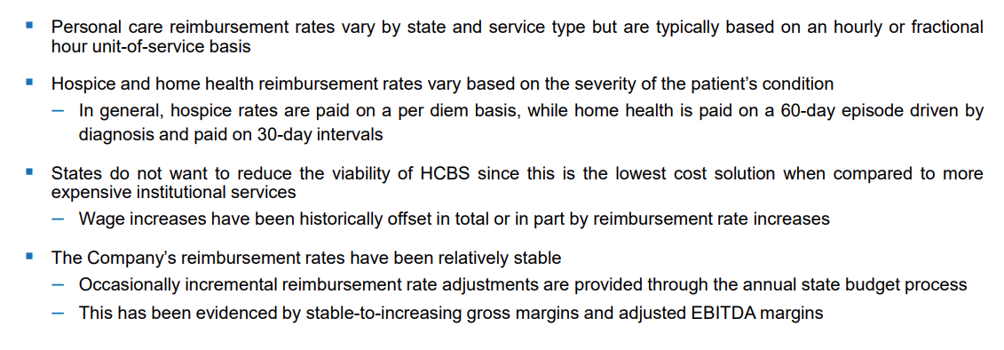
Reimbursement

Slide 8
Reimbursement - Challenges
Centers for Medicare and Medicaid Services (CMS) are proposing new Medicaid Access rules
The proposed rule change would require 80% of Medicaid Payments to go toward Worker Compensation (as opposed to expenses or profit)
CMS did not address payment rates to home care providers
Addus leadership stated they are more optimistic now than last year when the rule was initially proposed and think it will have a longer phase in period, and possibly lower than 80%
Addus expects a ruling in April 2024
The company also reiterated that if the rules are finalized as proposed, they would be subject to legal challenges from one or more states

Slide 9
Organic Growth
Population over 65 is growing
Adding clinical services where Addus provides personal care services
Cross sell from personal care to hospice care to retain all patients in one system
Personal Care services more cost effective and preferred for patients and families
Medicare Advantage opportunity
Acquisitions
Most growth will come from acquisitions in a fragmented market comprised of 11,000 home health agencies representing robust consolidation and scaling opportunities
Industry consolidation presents lower cost settings driven by regulatory and operating requirements

Slide 10
+ Apple Home Healthcare (late 2022) Illinois
+ Tennessee Quality Care (2023)

Slide 12
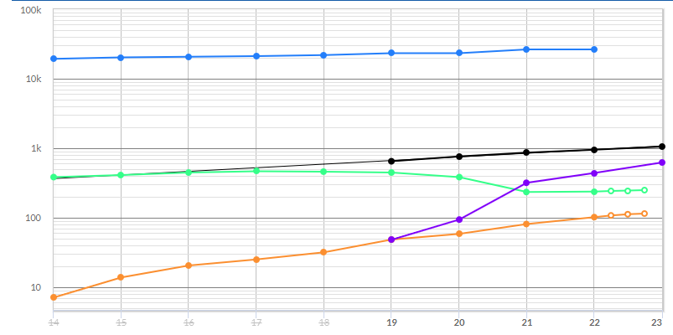
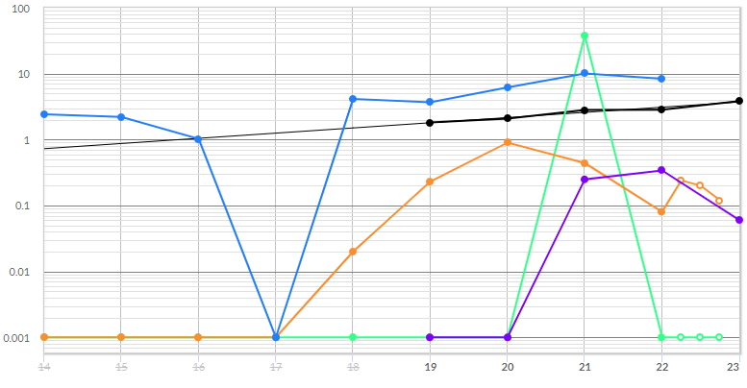
Addus - Historical Sales and Earnings per Share (SSG Core)

Slide 13
Addus vs. Peers (SSG Core )

Slide 14
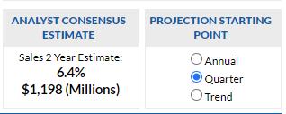
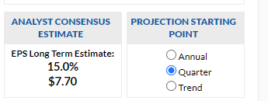
Addus – Analyst Forecasts and Judgements
 | SSG Analyst Consensus | Yahoo | CFRA | Argus | Avg | Judgement
Sales % | 6.4 | 6.8 | 6.7 | 10 | 7.5 | 8
EPS % | 15 | 19 | 17.3 | 13 | 16.1 | 13
Sales B $$ | 1.2 | 1.17 | 1.17 | 1.2 | 1.18
EPS $$ | 7.7 | 5.01 | 5 | 5 | 5.68

Slide 15
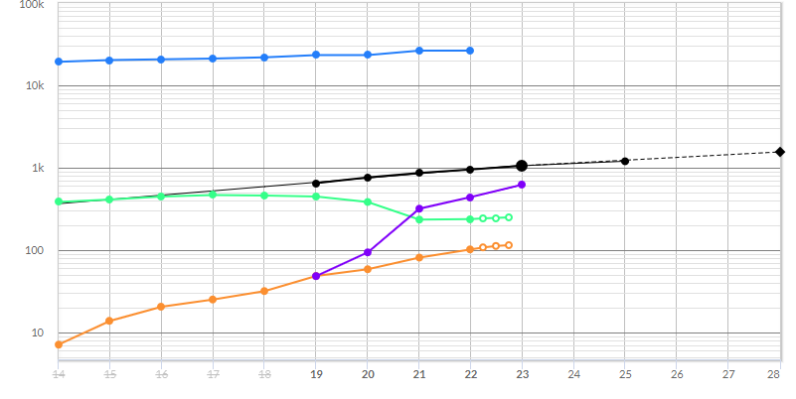
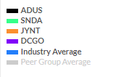
Addus - Sales Forecast (SSG Core)

Slide 16
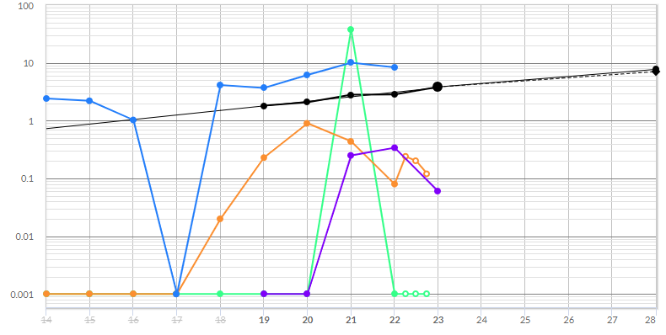
Addus - EPS Forecast (SSG Core )

Slide 17
Addus - High P/E (SSG Core)

Slide 18
Addus - Low P/E (SSG Core)

Slide 19
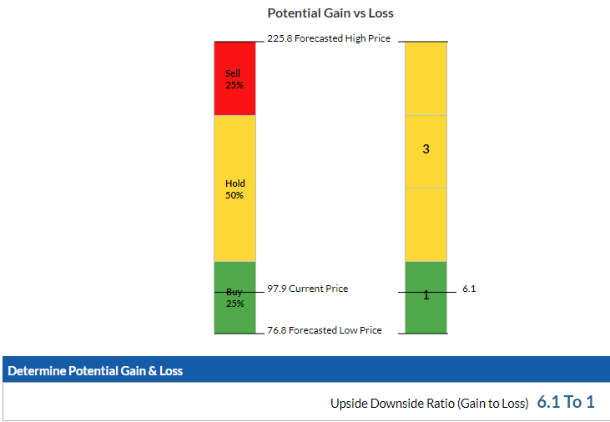
Addus

Slide 20
Conclusion – Addus Home Care
Addus Home Care is a small Mid-Cap company with a market cap of $1.5B
ADUS long term growth is driven by increasing services and through acquisitions
ADUS is a well managed company that has consistently increased sales, earnings, and kept debt low while acquiring other companies
ADUS current PE is 26.7 and is trading below its 5-year average PE (34.9)
Addus at $97.90 is a Buy price at 6.1 to 1 (SSG Buy Zone has ADUS a BUY up to $114)
ADUS could be a worthy candidate for purchase

