Slide 1
Dividend Stocks
Can they give us the growth we want?

Slide 2
Beating the s&P with dividends
How to build a superior portfolio of dividend yielding stocks
By
Peter O’Shea
And
Jonathan Worrall

Slide 3
Historical performance of dividend stocks
1926 – 2005 Dividends contributed almost 40% of the average annual return of stocks on the S&P Index
Since 1926 nearly half of the 10.3% annual stock market return has come from dividends and dividend reinvestment

Slide 4
advantages of dividend stocks
Less volatile—bought for long-term
Tend to be more mature companies--make sure they are not on downward slope
Easy value calculation--Predictable cash flow
Imposes financial discipline on management
Dividend stocks attract investors
Long-term winners tend to be stocks with above average yields and relatively low payout ratios
Notes:
The dividend comes from what is left after the company pays off expenses from profits. A dividend may be issued at the discretion of management—usually paid quarterly. This distribution of a portion of a company's earnings is decided by the board of directors, and given to a class of its shareholders. The amount of a dividend is quoted in the amount each share receives or in other words dividends per share. Dividends may be in the form of cash, stock, or property. Most secure and stable companies offer dividends to their stockholders. Their share prices might not move much, but the dividend attempts to make up for this.
Some argue that dividends provide the most shareholder value, but this is not necessarily true. From a tax standpoint, share repurchases are superior to dividends when the valuation is increased. Long-term capital gains have a lower rate than dividends, usually.
Motley Fool sets a $1 billion minimum for market cap when looking for dividend stocks. That weeds out small stocks likely to get tossed around by the market's waves. Next, they set a minimum yield of 2.5% in order to be sure the dividend can be sustained. Only stocks whose dividend is higher than 80% of free cash flow (which gives a minimum cushion of 20%, are selected. Sometimes more is advised. They have a newsletter for dividend companies “Income Investor.”
Large companies (Blue Chip) generally give dividends of 2% to 5% of value of stock.
Historically, dividends on companies in the S&P500 have risen 6% a year. At this time the options market is pricing in very little growth over the next two years and about 2% after that. (WSJ 4-21-08)

Slide 5
Considerations when evaluating a dividend stock
Historical performance of dividend (consistency and growth)
Yield (High is not always better; watch out for company using debt to finance)
Payout ratio ((30-50% considered moderate)
Ability of company to continue paying dividends (Fundamental Analysis)
Taxes (Rate for dividends vs. bonds)
Notes:
In 1982 the dividend yield on the S&P 500 Index reached 6.7%. Over the following 16 years, the dividend yield declined to just a percentage value of 1.4% during 1998, because stock prices increased faster than dividend payments from earnings, and public company earnings increased slower than stock prices. During the 20th century, the highest growth rates for earnings and dividends over any 30-year period were 6.3% annually for dividends, and 7.8% for earnings

Slide 6
NEVER BUY THE STOCK JUST FOR THE DIVIDEND
Consistent sales and earnings growth
Good management
Best in industry
Competitive advantage
Well-funded pension plans
Strong free-cash flow (double dividend payment)
Low debt/equity

Slide 7
Considerations when evaluating Valuation
“Dividends still don’t lie: the truth about investing in blue chip stocks and winning in the stock market”
By Kelley Wright
Editor, Investment Quality Trends

Slide 8
Criteria for “blue chip stocks”
Dividend increase at least 5 times over 12 yrs
S&P Quality is in “A” category
At least 5 million shares outstanding
At least 80 institutional investors
At least 25 years uninterrupted dividends
Earnings have improved in at least 7 of last 12 years.
This criteria eliminates 98% of the roughly 15,000 publicly traded stocks (275 companies)

Slide 9
“Profile of value”
Valuation is determined by historical low and high yields.
At least 12 years of data.
Average the top three years and the low three years for dividend yields.
Prices are undervalued or overvalued when they are within 10% range of historic levels.
Caution: markets are a reflection of the thoughts, opinions, and emotions of millions of investors

Slide 10
Rising/Falling trends
Rising 10% off undervalued base, stock enters into a rising trend.
This is called the holding area.
When price reaches level within 10% of the historically low yield calculation, it is considered overvalued.
Trend for overall market must also be considered—bulls or bears in control.
Values can be found in any market, however.

Slide 11
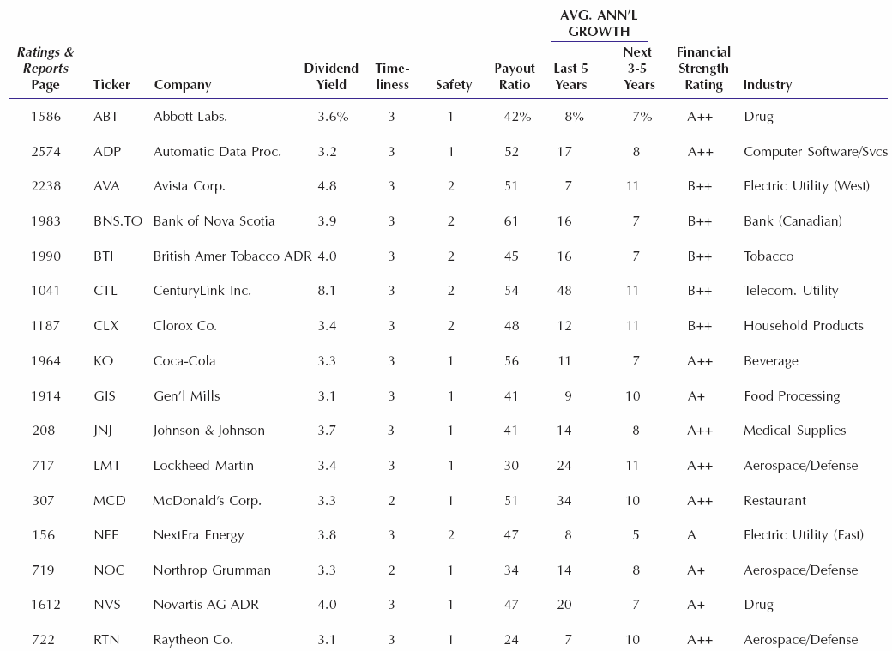
Value Line dividend stocks 8-6-10

