Slide 1
BASIC STOCK PRESENTATIONS 101
Cincinnati Model Investment Club (CinMIC)
Mar 19, 2016
Rich Alden

Slide 2
Introduction
Checklist for stock presentations
Assumes the presenter has done a screen or selected a stock by some other means
Assumes a working knowledge of Better Investing website as well as Value Line, Morningstar, S&P NetAdvantage and other sources
Minimum requirements, other sources welcome

Slide 3
Guidelines
Nominal 30 minute presentation
Allow questions only to clarify a point, hold judgement questions until the end
Use recent screen captures to illustrate a point, not live data
Suggested pacing as follows:

Slide 4
Set the Stage (3 mins)
How and why did you pick this stock to study?
What Sector and Industry trends make this an attractive candidate to study?
Is this a new stock or a review of a current holding?

Slide 5
Company Profile (3 mins)
Introduce the company: What do they do – industry, products, services
Who are their peers?
Are they in a niche? How are they better?
Little explanation needed if the products/services are well known or obvious but explain any companies that are diverse or have a unique approach.

Slide 6
Sources and Background Data (3 mins)
Data sources: What do Value Line, Morningstar, and Manifest Investing say about the company?
Does it have high quality management?
Is there a moat? What is it and how wide is it?

Slide 7
Stock Selection Guide (15 mins)
First tab: Analyze growth, stability, quality
Use the Notes feature to record all of your decisions
Are sales, pretax profits, earnings, stock price lines up, straight, and parallel?
Explain deviations – economic conditions, bought a company, sold a product line, wrote down an asset or goodwill?
If you ignore certain years or make other adjustments, why?

Slide 8
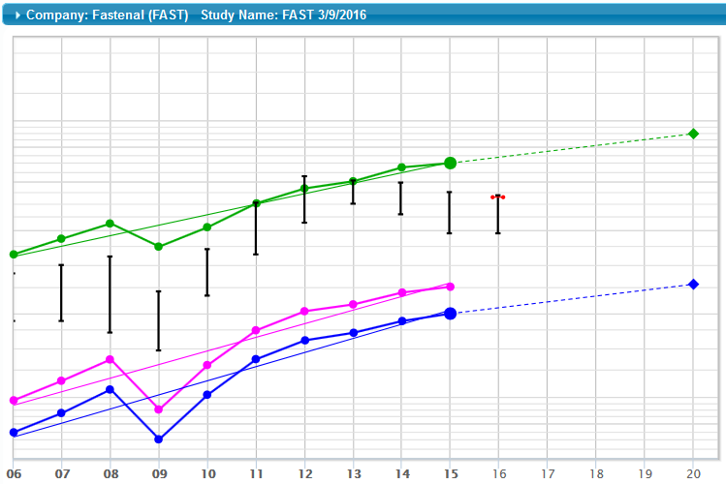
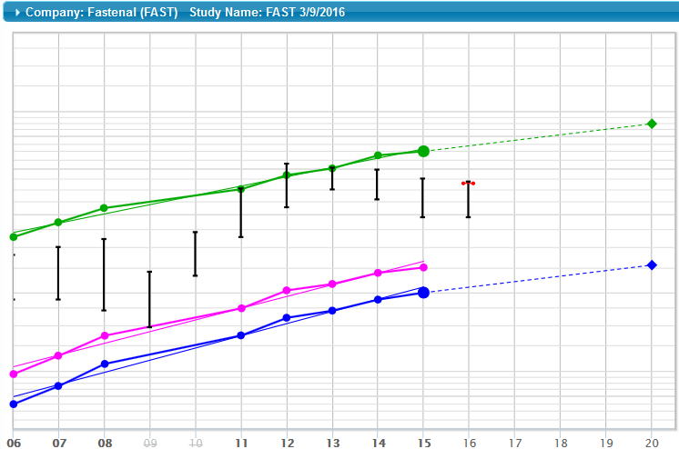
Sales, Pre-tax profit, EPS, Stock Price
Deleting years may not change the outlook much but don’t make so many changes the essential pattern is lost.

Slide 9
SSG cont’d
Sales growth projection – explain your criteria, sources, and judgement .
Are you using the of the latest fiscal year or most recent quarter?
Where will the future growth in sales/earnings come from – organic growth, acquisitions, share buybacks, improved margins, reduced overhead?

Slide 10
SSG cont’d
Earnings growth projection – explain your criteria, sources, and judgement
Consider the impact of US currency on sales and earnings – exchange rates, import/export rates
If management favors non-GAAP numbers, why?
Where will the future EPS growth come from – increased sales, improved pre-tax profit, share buyback, etc.?

Slide 11
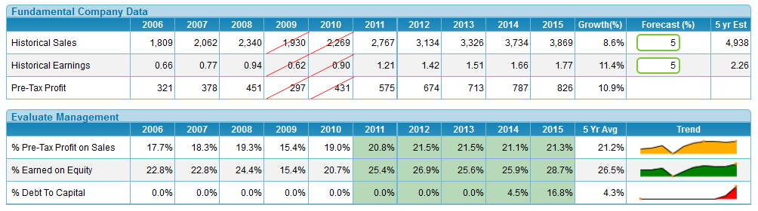
SSG cont’d
Review historical Pretax Profit, Return on Equity, and Percent Debt to Capital – use visuals
Discuss trends, explain deviations from the norm
Do they show a well-mannered company?

Slide 12
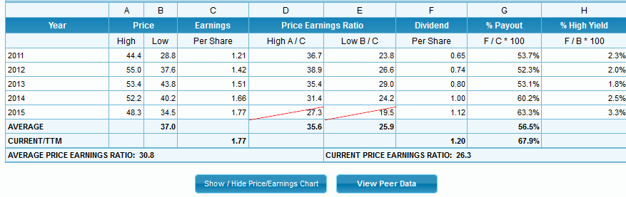
SSG cont’d
Second tab: Valuation and Return
What is the historical PE trend? Select outliers in Sect 3, if any

Slide 13
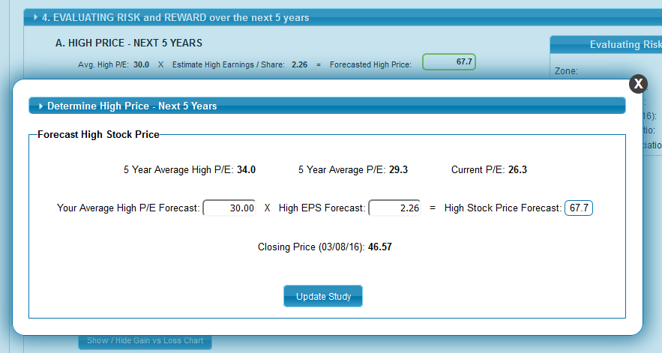
SSG cont’d
Explain your High Price selection in Sect 4A if not based on historical high PE

Slide 14
SSG cont’d
Explain method used in selecting Low Price in Sect 4B
Show comparative peer data on Percent Pre-tax Profit (PTP), Return on Equity (ROE), Percent Debt, and PE
Review quarterly data – are they consistent with your judgements for sales and earnings forecasts?
Using the SSG+ Research tab, Value Line, and Morningstar data, what are the analysts’ estimates for sales and earnings growth?
What are their buy/sell recommendations and/or target prices?

Slide 15
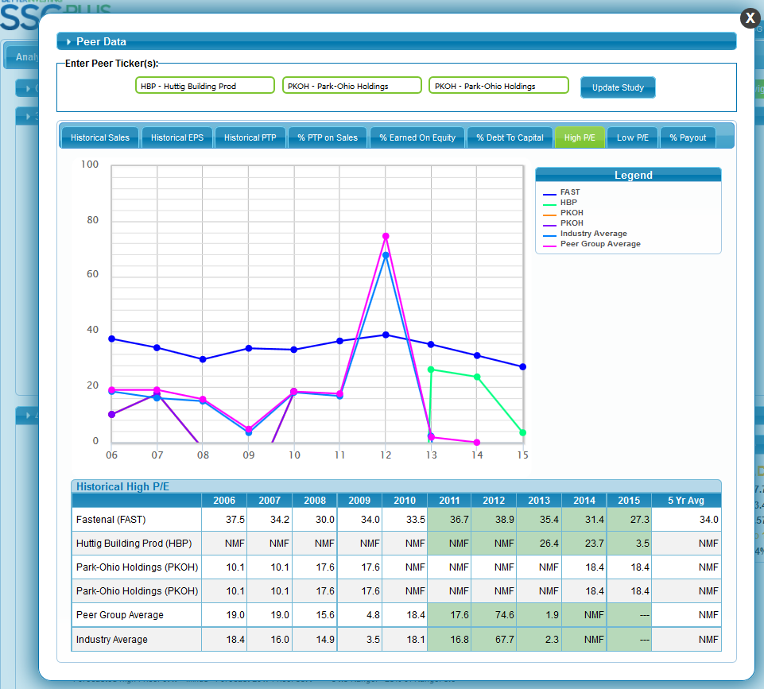

Slide 16
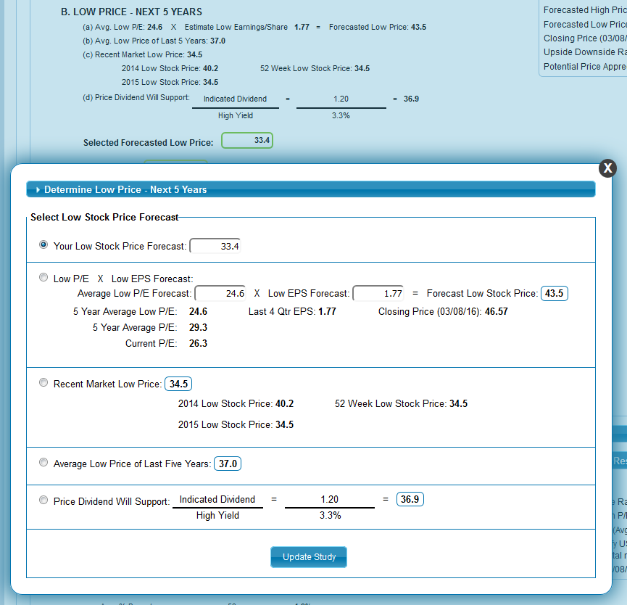

Slide 17

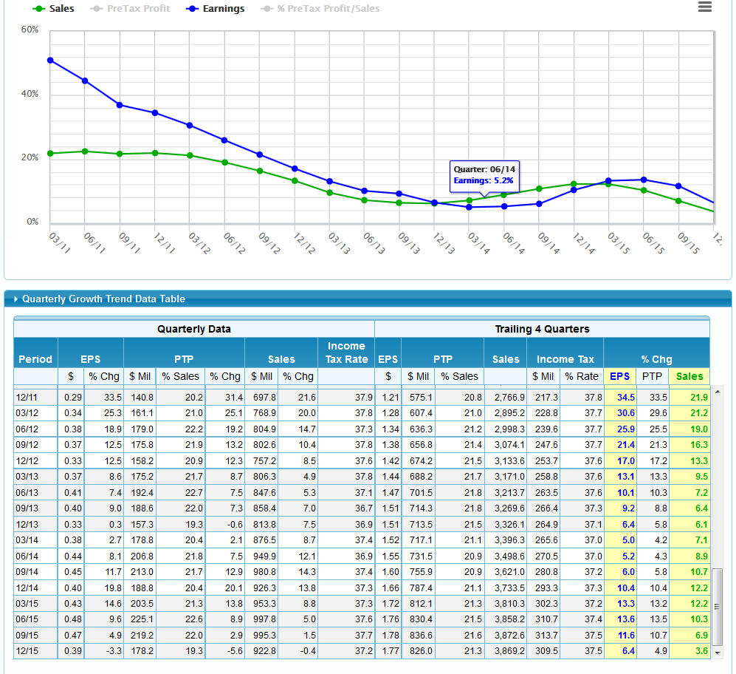
Research\Analyst Estimates
MarketWatch Analyst Estimates
Morningstar Analyst Consensus Estimates
NASDAQ Analyst Summary
Reuters Analyst Consensus Estimates
Yahoo Analyst Estimates
Zacks Detailed Estimates

Slide 18
SSG cont’d
Note the Upside/Downside Ratio in Sect 4D – is it reasonable or should the judgement be reviewed?
Review the Five Year Potential in Sect 5 only if dividends are a substantial part of the evaluation
If so, discuss the dividend history, payout ratio, and prospects for continuation

Slide 19
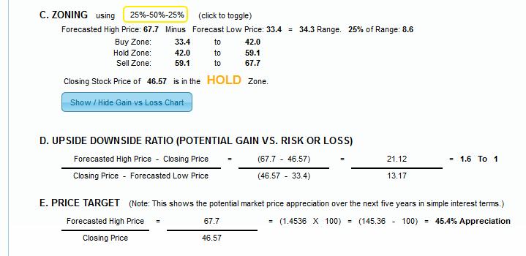
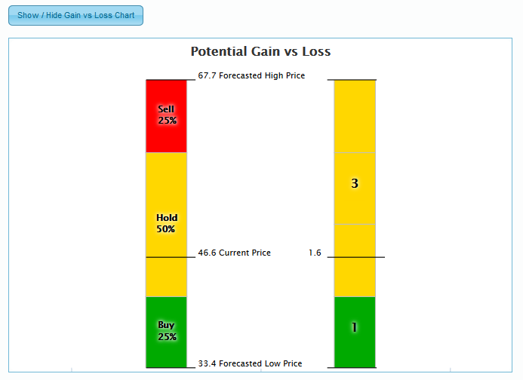

Slide 20
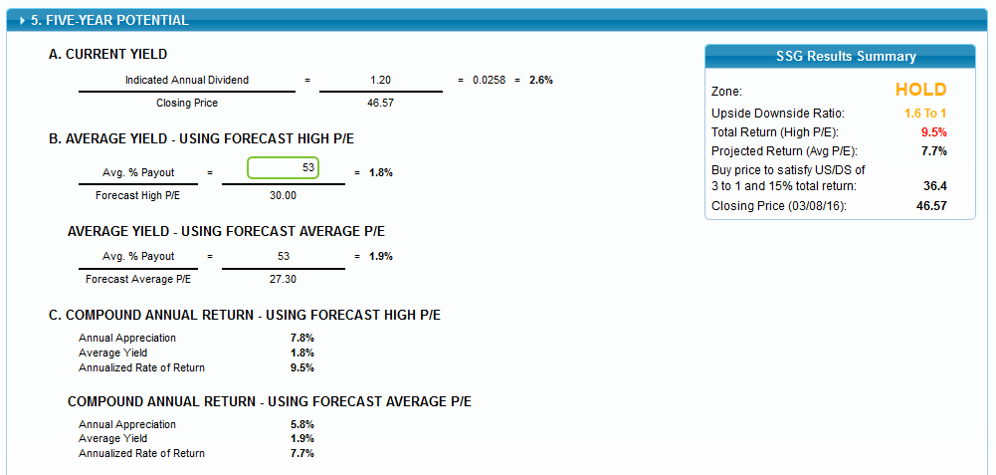

Slide 21
Wrap It Up
Summarize your impression of the stock: Buy, sell, put it on the watch list? Not a motion, just your opinion as a wrap-up.

Slide 22
Discussion (6 or more mins)
Have more data available than you actually present
Expect to have your decisions challenged – everyone has their own opinion

Slide 23
QUESTIONS?

