Slide 1
P/E’s for Beginners or
P/E Refresher
Created by Gretchen Hurt
Edited by Craig Jacobsen

Slide 2
P/E’s For Beginners
PRICE
EARNINGS
P/E
Created by Gretchen Hurt
Amendments by Craig Jacobsen

Slide 3
P/E Refresher
PRICE
EARNINGS
P/E
Created by Gretchen Hurt
Amendments by Craig Jacobsen
3

Slide 4
What We Will Cover
What is a P/E
Why P/E’s are important
What the P/E tells us
Different types of P/E’s
Impact on price one might pay for a stock

Slide 5
What is a P/E?
Price to Earnings Ratio is called P/E.
P/E stands for Price divided by Earnings.
The price to earnings ratio , or P/E, is a number.
PRICE
EARNINGS
P/E

Slide 6
What Is A P/E?
When we take one number, such as the price of a stock and divide it by another number, such as the earnings for that stock we get a number which is called a ratio.

Slide 7
P/E Terminology
P/E ratio $100 Price/$5 Earnings = 20 P/E
20 times earnings
Multiple of 20
Valuation
Years to recoup investment

Slide 8
What Is A P/E?
The price to earnings ratio (P/E) is a simple easy way to compare the current price of a stock with the current earnings.
The price of the stock is changing constantly but the earnings only change four times a year.

Slide 9
P/E’s
In the same way that we compare today’s price of a gallon of gas with the price in previous days, weeks, and months to determine if the current price of gas is high or low, we can compare today’s P/E for a stock with earlier P/E’s for that same company to help us decide on a “good” price to pay.

Slide 10
What Is A P/E?
People who learn how to buy those earnings when they are on sale will be the successful investors.
The P/E is the tool we use to help us determine if those earnings are on sale, are a fair price right now, or are over-valued.

Slide 11
Why we Look at P/E’s
In the history of the American Stock market only one item has ever been found to have a correlation to the price of a stock.
That item is earnings.

Slide 12
Why We Look at P/E’s
When the earnings of a company go up, the price of the stock will go up…….eventually.
When the earnings of a company go down, the price of the stock goes down….almost immediately.

Slide 13
Why We Look at P/E’s
Because there is this correlation, we need to have a way to compare today’s price with the current earnings to see if the price is growing the same rate as the earnings, faster than the earnings, or slower than the earnings.

Slide 14
Why We look at P/E’s
Our goal is to buy stocks when they are on sale.
One tool we use to help us do this is the P/E.

Slide 15
P/E Tells Us How Investors Value a Company’s Stock
Do you always buy the smallest box of cereal because it is cheapest?
  Price per Ounce vs. Price per Box
  In groceries we look at dollars to purchase an ounce of product.
  When buying stock in a company we look at the number of dollars it takes to buy one dollar of earnings.

Slide 16
P/E Tells Us How Investors Value a Company’s Stock
--And what about the nutritional value of each cereal?
--And what about the quality of those earnings?

Slide 17
Price per share/Earnings per share =P/E Ratio

Slide 18
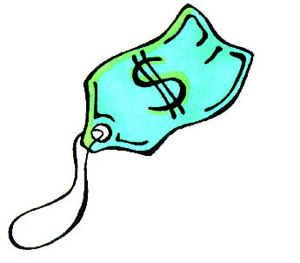
Example
If the price of a stock is $30 a share and the company has earnings of $1.50 they would have a P/E of 20.
30 divided by 1.50 equals 20.

Slide 19
P/E’s
The P/E ratio tells us what Investors are currently willing to pay for $1 of the company’s earnings.
In the previous example, investors are paying $20 for every one dollar of earnings. (20 times earnings) (Multiple of 20).

Slide 20
P/E’s
Is 20 a good P/E?
By itself the P/E ratio tells us very little.
We need to compare that P/E with P/E’s that investors have paid for the company’s earnings in the past.
And compare to other companies in the same industry.

Slide 21
P/E’s
To determine a “good” P/E for a company, compare today’s P/E with the average P/E for that company.
When you are going to buy stock in a company you always want to know today’s P/E and the average P/E so that you will know if you are paying too much or getting a bargain.

Slide 22

Where to Find Today’s P/E
Find the current P/E in the financial section of the newspaper or on the internet.
Or calculate it yourself from Yahoo! Or similar sites.

Slide 23
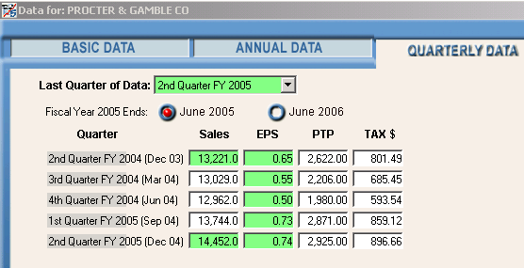
Where To Find the Earnings
All the NAIC software packages have the quarterly earnings listed in the quarterly data.

Slide 24
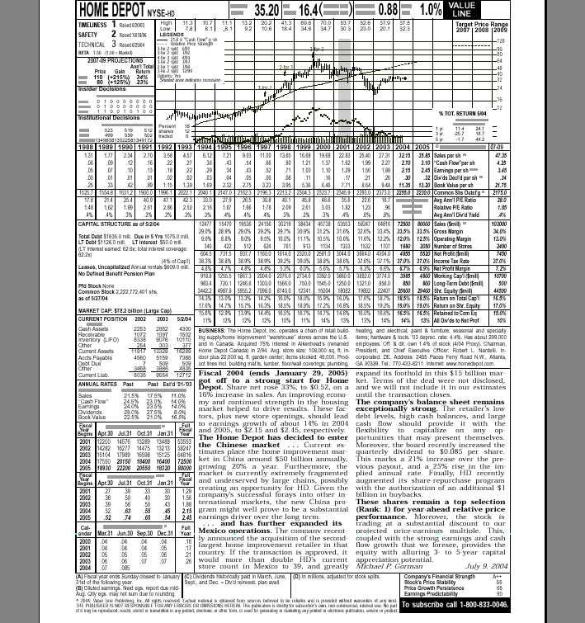
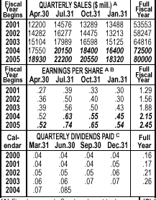
Where To Find the Earnings
Quarterly Earnings are found on the Value Line Sheet on the lower left side.

Slide 25
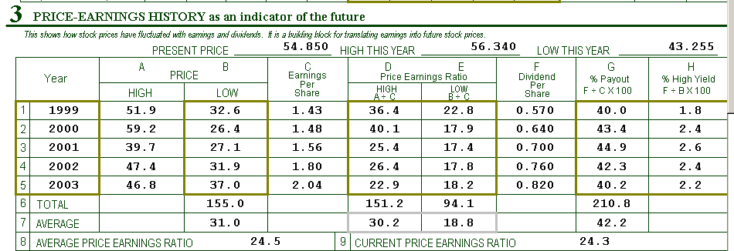
Where to Find the Average P/E
You can find the average P/E on the lower left hand side of Section 3 of your SSG (Stock Selection Guide) or on Page 2 of the Stock Check List.

Slide 26
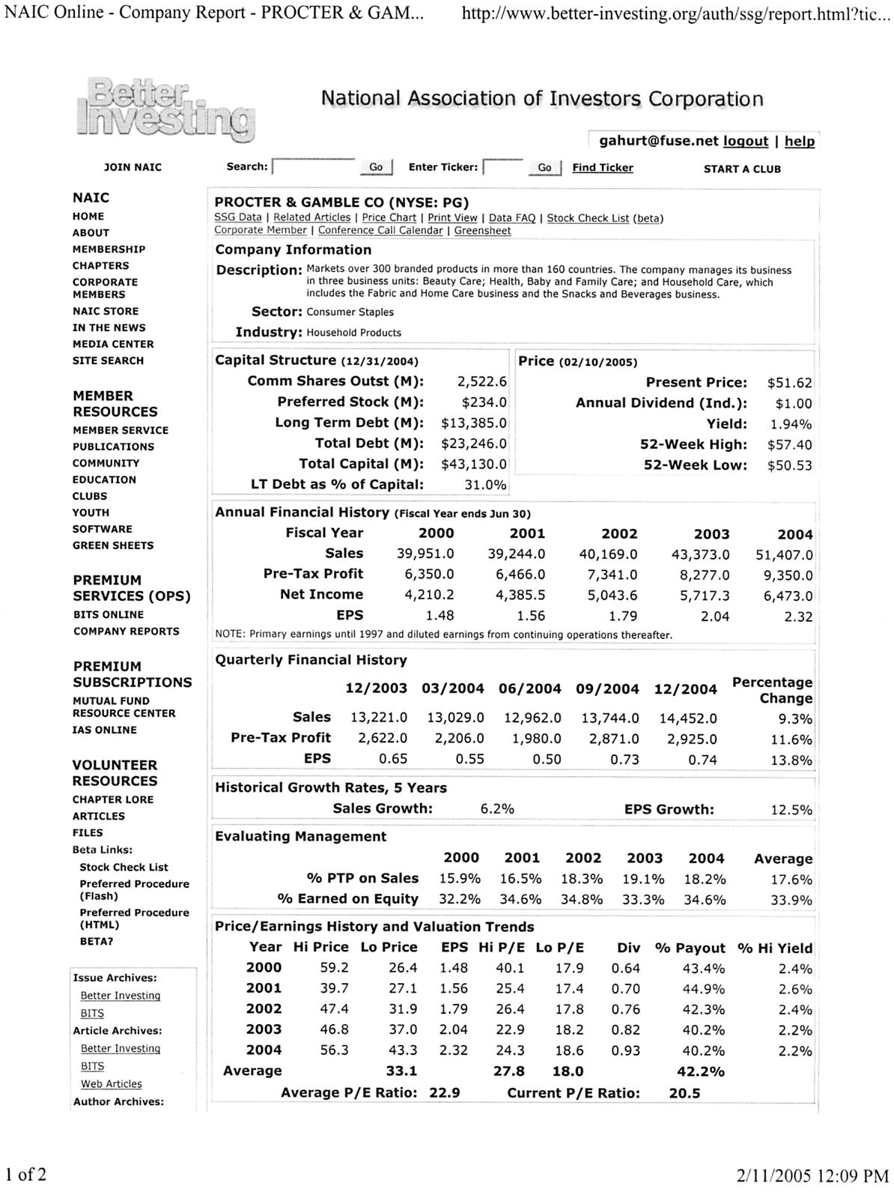
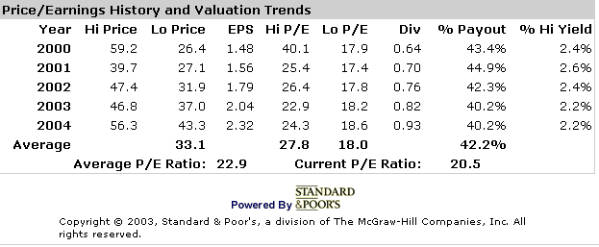
Where to Find the Average P/E
The average P/E and current P/E are found on the company report at better-investing.org.

Slide 27
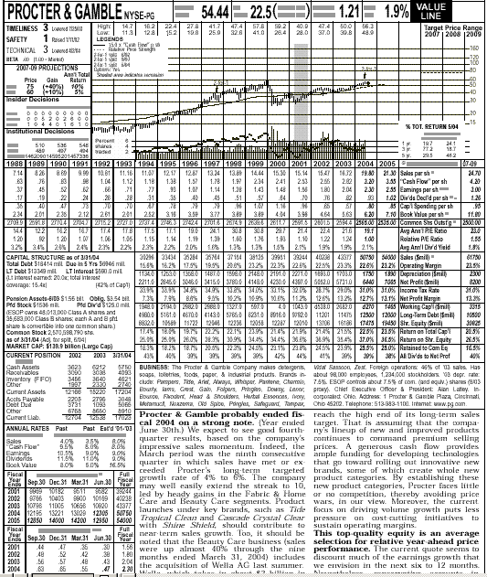
Where to Find the Average P/E
The Median P/E at the top of a Value Line sheet is the average P/E for that company for the past ten years with some adjustments made for outliers.

Slide 28
What does this P/E Ratio tell us?
Comparing today’s P/E with the average P/E tells us if today’s price is a bargain or if we are paying a premium for this stock. (Or the company may have a problem).
If today’s P/E is below the average P/E, the stock may be on sale.
If today’s P/E is above the average P/E the stock may be overpriced.

Slide 29
Different Kinds of P/E’s
There are several different kinds of P/Es.
The most common P/Es are:
  Trailing P/E
  Forward looking P/E
  Average P/E
  Signature P/E

Slide 30
Trailing P/E
NAIC members generally use the trailing P/E because it is the most conservative P/E.
The Trailing P/E takes the current price and divides that price by the total of the last four quarters of earnings.

Slide 31
Trailing P/E
The P/E in the financial section of the newspaper and on the internet is usually the trailing P/E.
The trailing P/E will tell you how many dollars you will be spending for each dollar of earnings from the total of the last four quarters of earnings.

Slide 32
On February 10th the price of a share of P & G was $51.50.
The last four quarters of earnings were .55 + .50 + .73 + .74 for a total of $2.52.
The trailing P/E was $51.50 divided by $2.52 or 20.5

Slide 33
Forward Looking P/E
The forward looking P/E shows us what we would be paying for next four projected quarters of earnings.
We use the projected earnings from our Stock Selection Guide or the analysts’ projections.

Slide 34
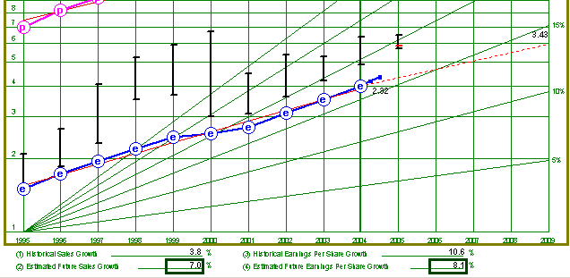
Forward Looking P/E
8.1%
Our projected earnings growth is 8%, which means our earnings next year (4 quarters in the future) will be $2.70.
The price is still $51.50 so the forward looking P/E would be 19.

Slide 35
Forward Looking P/E
Forward looking P/Es are always lower than current P/Es because the future earnings will be higher and today’s price stays the same.
Forward looking P/Es are not conservative numbers so be cautious about using them.

Slide 36
Forward Looking P/E
When might you use a forward looking P/E?
  If you are looking at a fast growing company whose price and earnings are growing rapidly, and you are confident this growth will continue, compare the forward looking P/E to the average P/E.
  If the forward looking P/E is also above the average P/E, you know the stock is way over priced.

Slide 37
The Average P/E
The average P/E tells us how much people have been willing to pay on average for a company’s earnings during the past five years.
This P/E is found on your SSG.

Slide 38
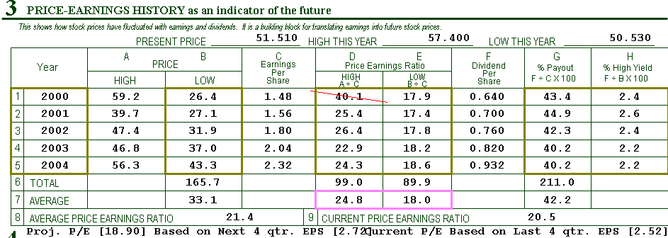
Average P/E
Average P/E 21.4
Trailing P/E 20.5
When the trailing P/E is close to the average P/E we know that today’s price is a good price to pay.
If the trailing P/E is below the average P/E we know the stock is on sale.

Slide 39
Signature P/E
A signature P/E is similar to the average P/E found on the SSG.
A signature P/E looks at the P/E multiples over a longer period of time (10 years rather than five) and calculates the median P/E rather than the average P/E.
The signature P/E is often close to the average P/E.

Slide 40
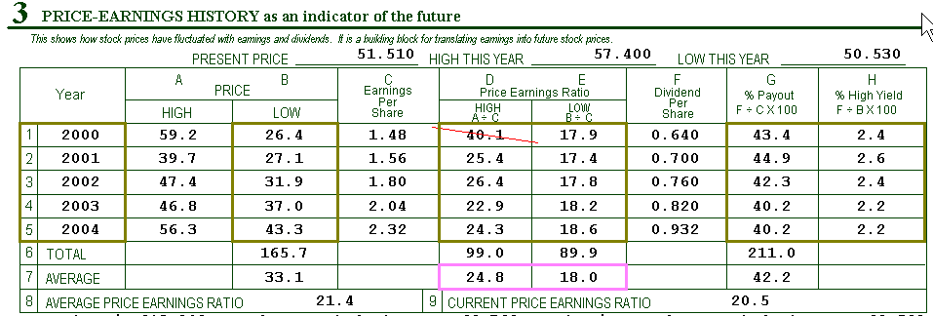
Average P/E for Procter & Gamble
21.4 is the average P/E for Procter & Gamble. It is calculated by adding the average high P/E and the average low P/E for the last five years and dividing by 2.

Slide 41
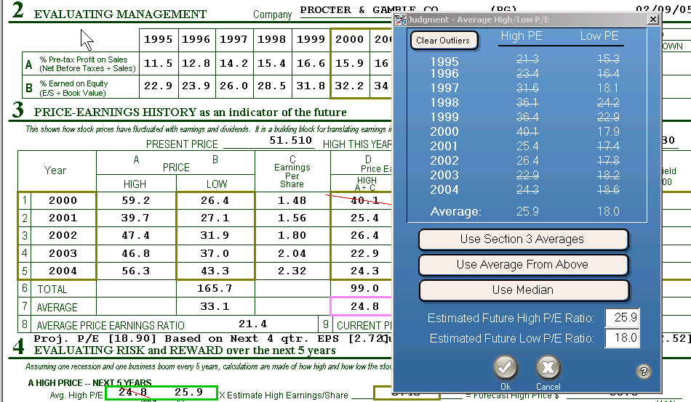
Signature P/E for Procter & Gamble
Toolkit will calculate a Signature P/E when you select the “Use Median” bar.

Slide 42
When To Look At Signature P/E
You might want to look at the Signature P/E if there are a lot of outliers (P/E’s that are too high or too low) in Section 3 of the SSG.
In our P & G example we only removed one P/E in Section 3 so the Average P/E and the Signature P/E are very close.

Slide 43
Why Some Stocks Have Higher P/E’s
Investors will pay more for the stock in company’s with the following characteristics:
  Consistent earnings growth.
  Earnings that are growing rapidly

Slide 44
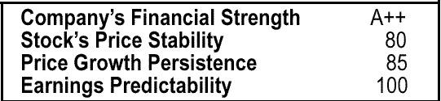
Check the Financial box in the lower right-hand corner of the Value Line page. Companies with high Earnings Predictability and with high Price Growth Persistence will always command higher prices for their earnings than those with low numbers.

Slide 45
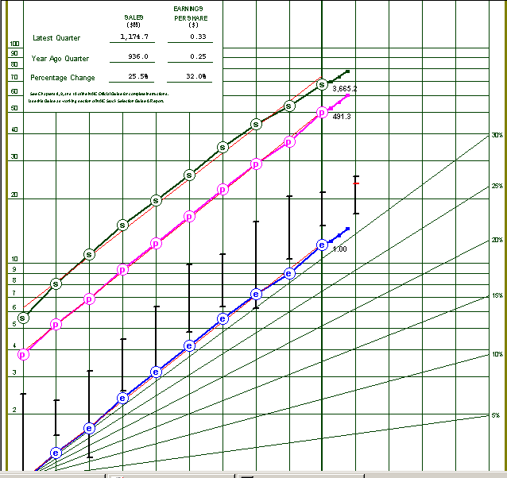
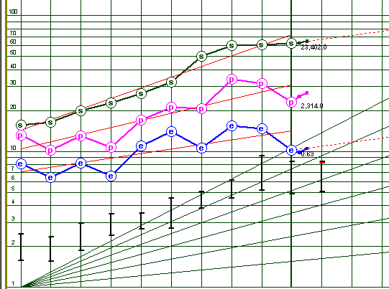
Company A
Company B
Companies with graphs like Company A will always have higher P/E’s than companies with slow or erratic earnings growth like Company B.

Slide 46
High and Low PE Ratios
Education Segment
Cincinnati Investment Model Club

Slide 47
Average High and Low PE’s
Computed from high and low prices for the last five years.
In normal times, these are good ratios to use for projected High and Low PE’s.
Last five years have not been normal
  “Irrational Exuberance”
Can try marking some PE ratios as “outliers”, but this may not suffice.

Slide 48
Projected High and Low PE’s
Projected High PE is used to project a high price over the next five years (4A):
  (High Price) = (Projected High PE) times (Projected EPS).
Projected Low PE is used to project a low price over the next five years (4Ba):
  (Low Price) = (Projected Low PE) times (Current EPS).
Do not need to use average high and low PE’s for projected high and low PE’s.

Slide 49
Projected High and Low PE’s
So what happens when our selected P/E ratios are too high?
Or too low?

Slide 50
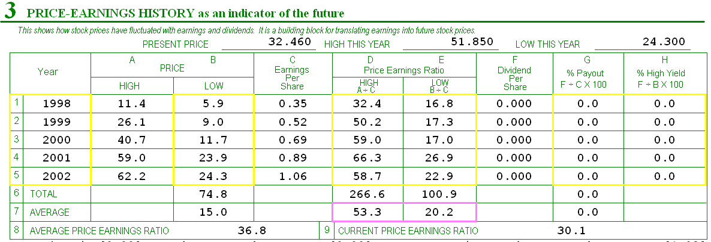
Section 3 for Resmed
Lately, EPS growth has been about 20%.
Are any of the high PE’s for the last five years reasonable?
Are any of the low PE’s for the last five years reasonable?

Slide 51
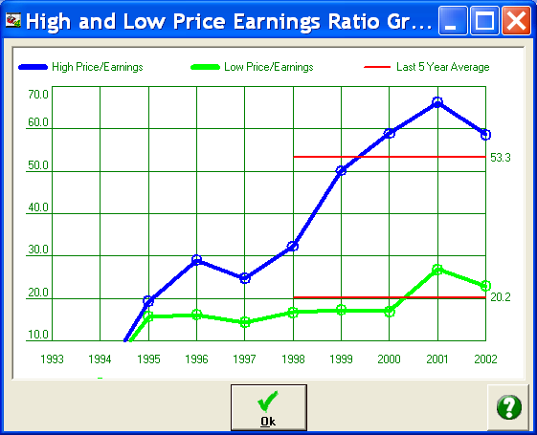
PE Graph for Resmed
Looks like all of the last five high PE’s were “irrational exuberance”.

Slide 52
Using Average High PE
If projected EPS is $2.64 (20% growth rate)
And we use average high PE of 53.3
We get a projected high price of $140.71

Slide 53
Using Projected High PE
If projected EPS is $2.64 (20% growth rate)
And we use projected high PE of 25.0
We get a projected high price of $66.00
Compare this to $140.71
Which is more realistic?

Slide 54
Using Average Low PE
Current TTM EPS is $1.08
And we use average low PE of 20.2
We get a projected low price of $21.82

Slide 55
Using Projected Low PE
Current TTM EPS is $1.08
And we use projected low PE of 17.0
We get a projected low price of $7.56
Compare this to $21.82
Which is more realistic?

Slide 56
Impact on Price Zones
Projected EPS = $2.64 Current Price = $32.46
TTM EPS = $1.08 33:33:33 Zoning

Slide 57
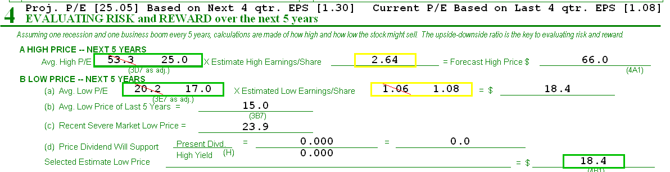
Use Your Own Projected PE Ratios

Slide 58
Judgment
What will the average high and low PE’s be for the next five years?
  Same as the last five years?
  Based on your projected growth rate and PEG?
  Based on the first five years?
  Based on your best guess?
  Market P/Es???

Slide 59
S & P 500 P/E Ratio

Slide 60
If you use P/E’s to help buy stocks when the price is a bargain, then you will have a greater chance of being a successful investor.
If you don’t use P/E’s you may well be a poor investor.

