Slide 1


Booking Holdings, Inc. (BKNG)
April 20, 2019 / Cincinnati Model Investment Club
Richard Alden
Member of BetterInvesting.org / dedicated to Investment Education
Presiding Partner, Cincinnati Model Investment Club

Slide 2
Disclaimer
The information in this presentation is for educational purposes only and is not intended to be a recommendation to purchase or sell any of the stocks, mutual funds, or other securities that may be referenced. The securities of companies referenced or featured in the seminar materials are for illustrative purposes only and are not to be considered endorsed or recommended for purchase or sale by BetterInvesting™ National Association of Investors Corporation (“BI”) or the National Investors Association, or the OKI Chapter Board. The views expressed are those of the instructors and do not necessarily represent those of BetterInvesting™, or OKI. Investors should conduct their own review and analysis of any company of interest before making an investment decision.
Notes:
House cleaning on legal issues

Slide 3
Booking Selection Process
CinMIC Pre-Screened Stocks to Study
Better Investing SSG
Manifest Investing March 2019 Round Table
Manifest Investing Dashboard
Ann Cuneaz First Cut Aug 14, 2018
Investor Advisory Service - April 2019

Slide 4
Booking Selection Process
CinMIC Pre-Screened Stocks to Study
3/23/2019
Company | Symbol | Shares | Price | Value | % of Total | Growth | Proj P/E | Proj Yield | Fin Str | EPS Stab | Qlty | PAR
EPAM Systems | EPAM | 0.64 | $164.26 | $105.29 | 3.50% | 20.00% | 35 | 0.00% | 85% | 78 | 98 | 14.80%
Simulations Plus* | SLP | 5.1 | $20.11 | $102.60 | 3.40% | 15.40% | 35 | 1.20% | 75% | 87 | 96 | 14.30%
II-VI | IIVI | 2.37 | $36.47 | $86.28 | 2.80% | 13.90% | 16 | 0.40% | 51% | 65 | 85 | 17.20%
Booking | BKNG | 0.05 | $1,721.59 | $88.56 | 2.90% | 13.80% | 19 | 0.00% | 95% | 94 | 100 | 16.40%
ASGN | ASGN | 1.6 | $61.82 | $98.66 | 3.20% | 13.80% | 20 | 0.00% | 31% | 65 | 83 | 15.50%
Air Lease* | AL | 2.34 | $32.68 | $76.57 | 2.50% | 13.60% | 8 | 0.70% | 59% | 84 | 98 | 18.10%
Alphabet (Google) | GOOG | 0.09 | $1,205.50 | $110.15 | 3.60% | 12.90% | 24 | 0.00% | 98% | 90 | 95 | 12.40%
HEICO Corp | HEI | 1.1 | $91.93 | $101.51 | 3.30% | 12.90% | 34 | 0.20% | 88% | 70 | 99 | 9.50%
Schwab Charles | SCHW | 1.98 | $41.80 | $82.67 | 2.70% | 12.70% | 24 | 0.80% | 82% | 71 | 85 | 16.80%
Bank OZK* | OZK | 2.61 | $27.79 | $72.64 | 2.40% | 12.20% | 11 | 1.50% | 33% | 31 | 50 | 17.60%

Slide 5
Booking Selection Process
CinMIC Pre-Screened Stocks to Study

Slide 6
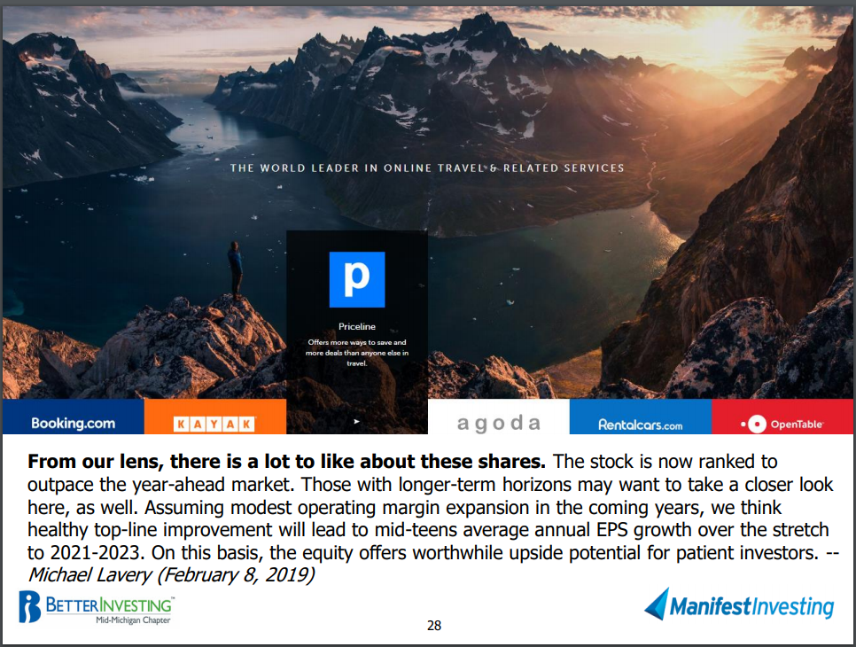
From Manifest Investing March Roundtable

Slide 7
Booking Holdings Profile
Booking is the world’s largest online travel agency by revenue, offering booking services for hotel and vacation rooms, airline tickets, rental cars, restaurant reservations, cruises, experiences, and other vacation packages. The company operates a number of branded travel booking sites, including Priceline.com, Booking.com, Agoda, OpenTable, and Rentalcars.com, and has expanded into travel media with the acquisitions of KAYAK and Momondo. Transaction fees for online bookings account for the bulk of revenue and profits.

Slide 8
Booking Holdings Profile
Booking Holdings is the world’s leading provider of online travel & related services, provided to consumers and local partners in over 220 countries through six primary brands.
Almost exclusively on-line. The company collects customers’ requests and matches them against a proprietary database of seller inventory.
Incorporated 1998, Priceline.com pre-existed
Headquarters in Norwalk, CT. 24,500 employees globally
Does not pay a dividend, reinvests in expansion of the business
Fiscal Year closes Dec 31

Slide 9
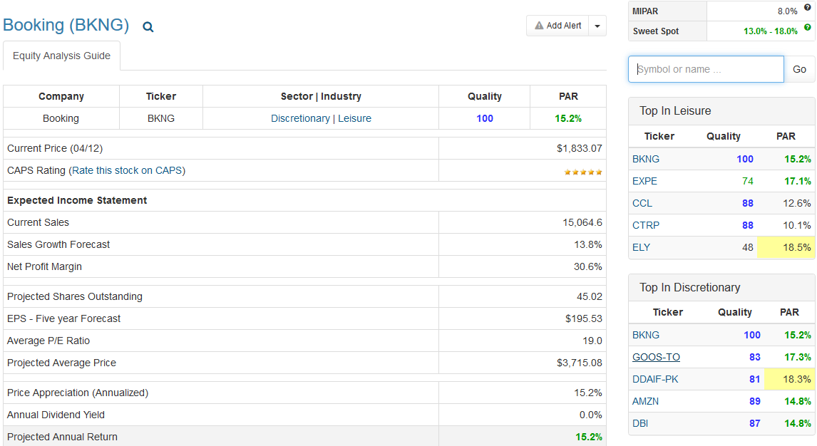
Manifest Investing

Slide 10
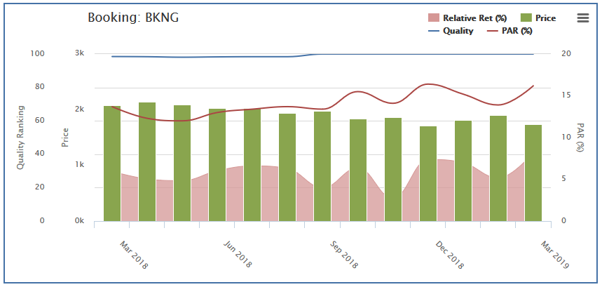
Manifest Investing

Slide 11
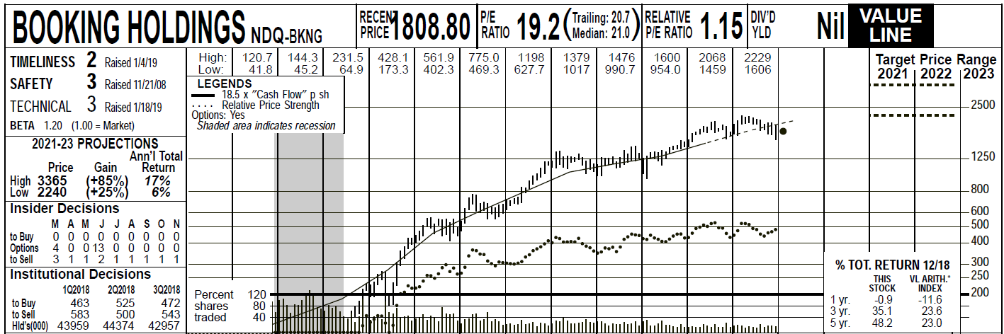
Value Line
From the Feb 8, 2019 Value Line report:

Slide 12
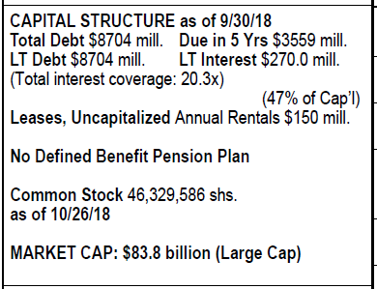
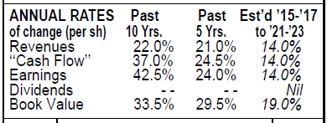
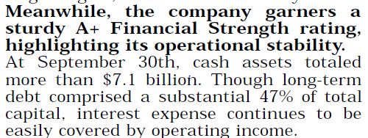

Value Line
From the Feb 8, 2019 Value Line report:

Slide 13
Morningstar
From the April 15, 2019 report:
Classified as Large Growth, four star rating
Exemplary Stewardship, Narrow Moat
Classified as Consumer Cyclical / Leisure
This is a Cyclical stock, expect financial performance fluctuations with general economic conditions
With a large international presence, expect currency fluctuations to affect profitability – Euro, Brexit activity

Slide 14
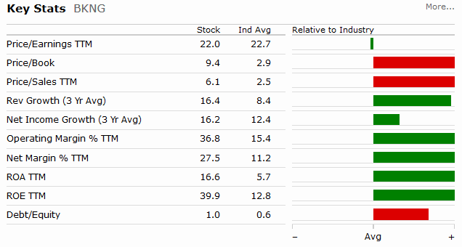
Morningstar

Slide 15
Morningstar
Comments:
Superior position in China, leadership position in maturing European market (near 50%)
Growth through the Asia Pacific region and additional acquisitions
Well ahead of Expedia and TripAdvisor in a fragmented market
Potential competition from Amazon, Google, Facebook
Mobile is 50% of the business and growing
European economy is entering a maturing phase and cooling economically

Slide 16
Investor’s Advisory Service
Comments:
BKNG expects 2019 non-GAAP constant currency EPS growth to be in the low-double digits
Adjusting for currency, growth rate could be in the high single digits, resulting in an EPS of $95, or a PE of about 18
Weak Euro is expected to shave 6% from reported growth, late Easter will move revenue from 1Q to 2Q.
Improvements expected in alternative accommodations, payments platform

Slide 17
SSG Notes
Guidelines: predominantly Value Line and Ann Cuneaz’ analysis
Adjusted FY2017 data for TCJA per First Cut report
Selected growth rate is above ACE but below MI and other sources
Used Preferred Procedure - adjusted tax rate, shares outstanding
Used Value Line as reality checks on high and low price decisions
Looks like a BUY with a nice U/D ratio
Switch to on-line SSG

