Slide 1
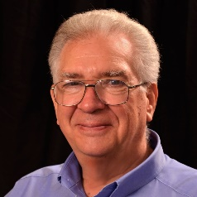

Under 50 Investing
Observations from the Other Side of the Hill
Presented by:
Richard Alden, Presiding Partner
Cincinnati Model Investment Club (CinMIC)
November 21, 2020
Very Old Photo
NON-PROFIT VOLUNTEER BASED MEMBER DRIVEN

Slide 2
BetterInvesting is non-profit, volunteer based and member driven.
The information contained in this presentation is for education and information purposes only, and does not constitute professional advice. The information provided is subjective and you should always do your own research before making decisions. While reasonable efforts are made to include accurate and up-to-date information, the creator makes no warranties or representations of any kind concerning the accuracy, timeliness or suitability of the information provided for any purpose. Validity of the content is not guaranteed and you are strongly urged to consult a professional or other authority in the appropriate field before acting on any of the content.
DISCLAIMER
NON-PROFIT VOLUNTEER BASED MEMBER DRIVEN

Slide 3
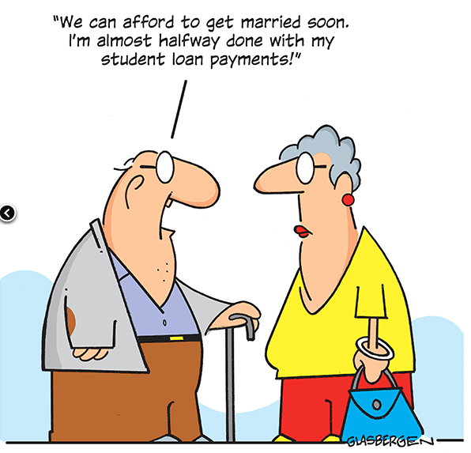
Over 50?
NON-PROFIT VOLUNTEER BASED MEMBER DRIVEN

Slide 4

Fundamentals
Most BI members acquired their current assets through methodical saving and informed investing
HOWEVER . . .
Children and grandchildren need to develop saving/investing habit early to get the benefits of time and compound interest.
Younger generations may have only one or two income streams, e.g., earned income, credit cards, trust funds
Very easy to go into debt without thinking much about it – credit cards, student loans, easy credit on major/minor purchases
NON-PROFIT VOLUNTEER BASED MEMBER DRIVEN

Slide 5
Fundamentals, cont’d.
Auto deposit and bill pay can lead to loss of focus on budgeting and spending habits
Electronic accounts are just numbers, not tangible currency like cash in hand
The youthful brain favors instant gratification, on-line portals take advantage of that
Studies of the very young show that most would take an immediate small reward vs. larger reward for waiting
We want what we want and we want it now! Apps make it happen with the tap of a finger
NON-PROFIT VOLUNTEER BASED MEMBER DRIVEN

Slide 6
Demographics
Gen Z (7-22 yr old)
  Just getting started, needs a car, may not have investable resources
Gen Y Millenials (23-38 yr old)
  Likely employed, starting a family, trying to buy a house, student loans, not thinking too much about retirement yet
Gen X (39-54 Yr old)
  Peak career years – raising a family but should be investing for retirement
Boomer (56-74 yr old)
  Last ditch effort to invest for retirement
NON-PROFIT VOLUNTEER BASED MEMBER DRIVEN

Slide 7
Investing Instruments
Mutual funds
Exchange-traded Funds, Index Funds
Individual stocks
401(k)
Appreciating assets, e.g., a home
NON-PROFIT VOLUNTEER BASED MEMBER DRIVEN

Slide 8
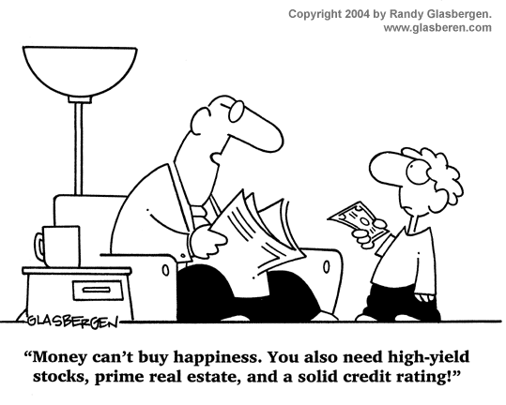
Considerations
NON-PROFIT VOLUNTEER BASED MEMBER DRIVEN

Slide 9
Considerations
Risk vs. reward
Diversification of investments
Steady investing strategy – dollar cost averaging
Have an objective and a plan to get there
Experience is the best teacher – best to experience a small loss early on
Small portfolios don’t warrant professional advice
Traditional vs. on-line investing
Social networks of like-minded individuals can reinforce good habits
NON-PROFIT VOLUNTEER BASED MEMBER DRIVEN

Slide 10
Recent News
Better Investing, November, 2020 issue, on Robinhood:
  Friendly interface, free share of stock when joining
  Encourages premium services, more profitable options trading, frequent and short term trading
  Little encouragement for research, offers cannabis and cryptocurrency stocks
  Social investing can lead to pump-and-dump schemes
  Has worked well in a bull market but long-term investors better tolerate economic cycles
NON-PROFIT VOLUNTEER BASED MEMBER DRIVEN

Slide 11
Recent News, cont’d.
The Economist, Oct 24, 2020 issue:
  Young investors stand to inherit considerable wealth from Boomers
  Robo-advisors make it easy to invest in index funds that have a positive social and environmental impact
  Morgan Stanley bought Solium, Goldman Sachs bought United Capital
  Big financial firms have to change how they appeal to young investors if they are to stay in business
NON-PROFIT VOLUNTEER BASED MEMBER DRIVEN

Slide 12






Traditional Investing Portals
Charles Schwab
TD Ameritrade (Schwab)
Fidelity
J P Morgan Chase
Merrill Edge (Bank of America)
T Rowe Price
Vanguard
NON-PROFIT VOLUNTEER BASED MEMBER DRIVEN

Slide 13




Popular Online Portals
Robinhood - https://robinhood.com/us/en/
Acorns - https://www.acorns.com/invest/
Stash - https://www.stash.com/
Sofi - https://www.sofi.com/invest/
E*Trade - https://us.etrade.com/home
NON-PROFIT VOLUNTEER BASED MEMBER DRIVEN

Slide 14
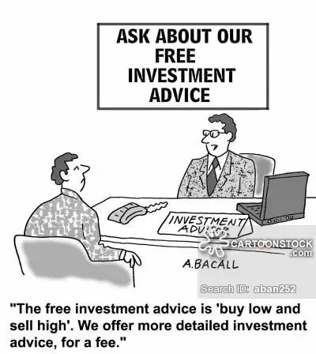
Online Investing
NON-PROFIT VOLUNTEER BASED MEMBER DRIVEN

Slide 15
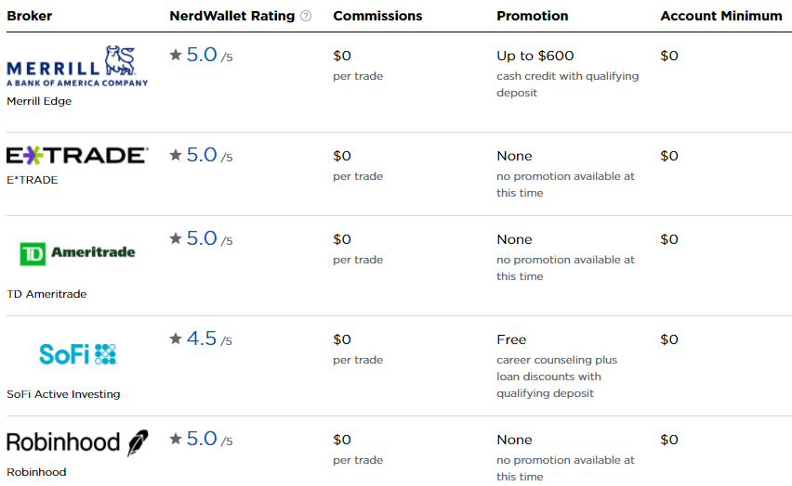
Nerdwallet Ratings
https://www.nerdwallet.com/best/investing/investment-apps
NON-PROFIT VOLUNTEER BASED MEMBER DRIVEN

Slide 16
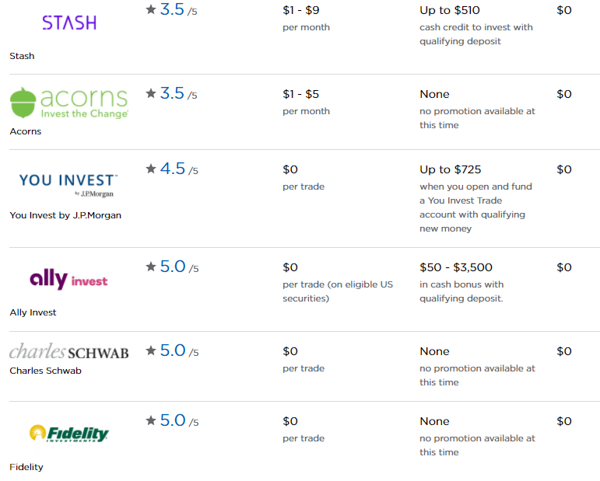
Nerdwallet Ratings, cont’d.
NON-PROFIT VOLUNTEER BASED MEMBER DRIVEN

Slide 17
Common Investing Features
Not all portals have these but some do:
Mix of stocks, funds, ETFs
Monitor/trade on your phone
No trading fee
Fractional shares
Low/no minimum investment
Online banking and ATM access
Incentives – cash or stock
Robo advice
Automatic additional deposits
Cryptocurrency
NON-PROFIT VOLUNTEER BASED MEMBER DRIVEN

Slide 18
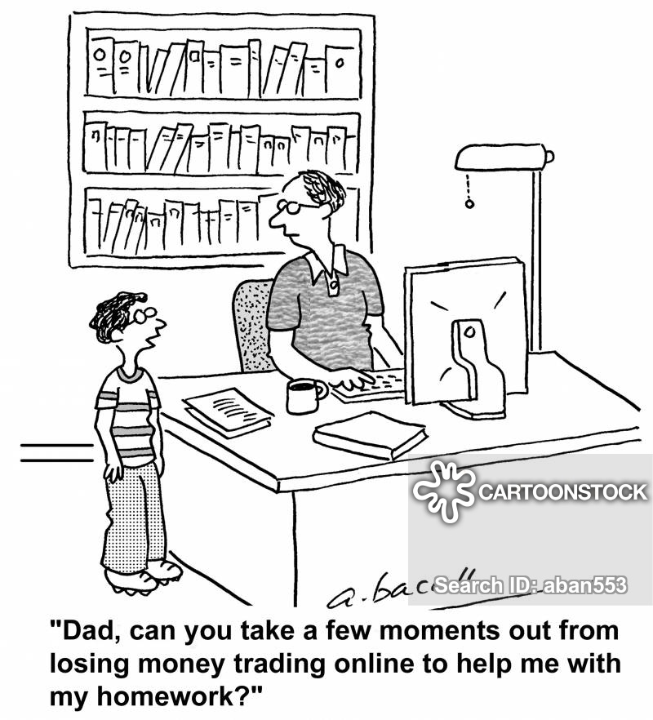
Modern Investing
NON-PROFIT VOLUNTEER BASED MEMBER DRIVEN

Slide 19
Rewards
Online portals and user-friendly apps can be gateway to lifelong investing
Traditional brokerages, e.g., Schwab, Merrill, have caught up and provide a transition for growing portfolios
Younger investors live on their cell phones, on-line investing fits their lifestyle
Social media can spread the word if used properly
NON-PROFIT VOLUNTEER BASED MEMBER DRIVEN

Slide 20
Risks
Ease of use and up to the minute information can be rewarding, if not addictive – game-like
Trading sites make money by using your money – grouping lots, churning
Smaller portals may experience more frequent outages or security breaches; online fraud is rampant
A large gain or loss can distort investing reality, a bit like gambling. https://internationalbanker.com/brokerage/robinhood-and-the-ethical-issues-facing-fintech/
NON-PROFIT VOLUNTEER BASED MEMBER DRIVEN

Slide 21
Thoughts / Opinions
The author is not a financial professional but offers these retrospective observations on personal finance.
NON-PROFIT VOLUNTEER BASED MEMBER DRIVEN

Slide 22
Thoughts / Opinions
Follow a 50/30/20 rule for needs / wants / savings & debt reduction - Nerdwallet
Try to have 6 mo. to a year of cash available in case of adversity
Beware of bright shiny objects – products and sites that overstimulate the pleasure centers of the brain
Buy something only after you have analyzed its benefit and value to you, not the seller
NON-PROFIT VOLUNTEER BASED MEMBER DRIVEN

Slide 23
Thoughts / Opinions, cont’d.
  Don’t be ‘sold’; salespeople and on-line sites only make money when they tempt you buy something
  Pause/reconsider 24 hrs before clicking or signing on significant purchases
  Try to never borrow to purchase a depreciating asset, except your primary residence
  Consider value vs. status – a Chevy gets you there as well as a Porsche
NON-PROFIT VOLUNTEER BASED MEMBER DRIVEN

Slide 24
Thoughts / Opinions, cont’d.
  Postpone buying a residence until you are sure your job will not require frequent relocation.
  Some people should not own a residence unless they are committed to caring for it – lifestyle, investment, etc.
  Never charge more on a credit card than you can pay off every month
  Objectively research future career prospects before taking on student debt - a trade career / apprentice program may provide a good career with less debt
NON-PROFIT VOLUNTEER BASED MEMBER DRIVEN

Slide 25
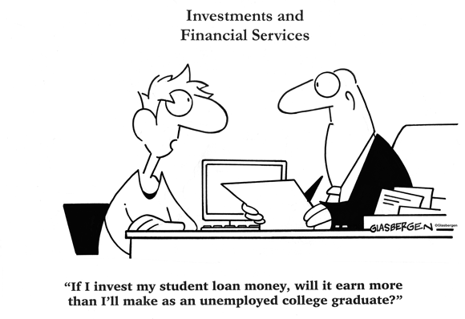
Student Loan Debt
NON-PROFIT VOLUNTEER BASED MEMBER DRIVEN

Slide 26
Closing Thought
Good Judgment Depends Mostly on Experience and Experience Usually Comes from Poor Judgment
NON-PROFIT VOLUNTEER BASED MEMBER DRIVEN

Slide 27


QUESTIONS? COMMENTS?
Share BetterInvesting materials
with your family and friends!
BetterInvesting.org/InvestBetter
Keep track of what’s going on in your OKI Tri-State Chapter:
www.betterinvesting.org/okitri
NON-PROFIT VOLUNTEER BASED MEMBER DRIVEN

