Slide 1
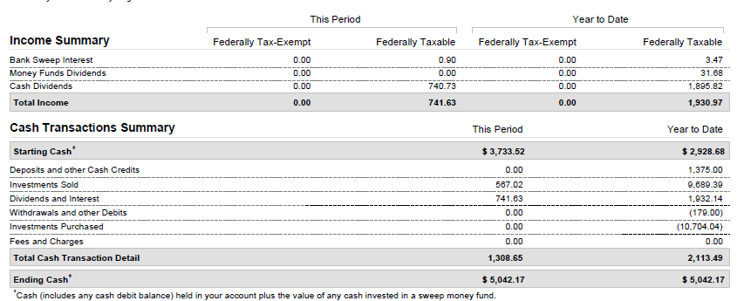
Off by 487.50, Cash in Lieu was 79.52
487.50 + 79.52 = 567.02
OK

Slide 2
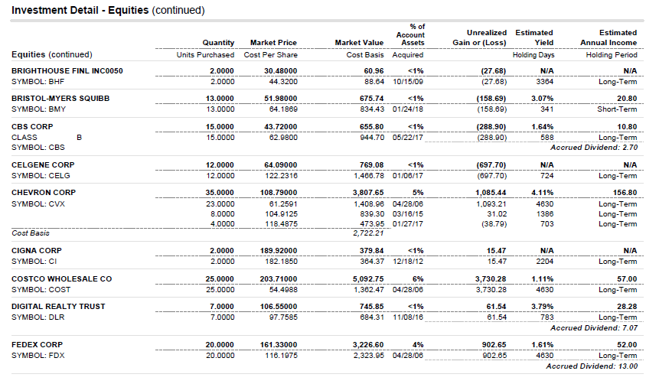
Shows I now own 2 shares of cigna,
Purchased at $364.37/share and on 12/31/18 valued at$379.84/share

Slide 3
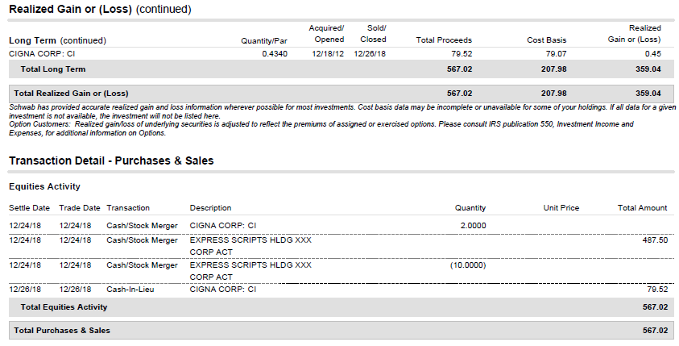
I am missing this $487.50, next page shows how I entered this merger in bivio

Slide 4
