Slide 1
Vertex Pharmaceuticals Incorporated
Ticker: (VRTX)
Exchange: Nasdaq
Sector: Healthcare
Industry: Biotechnology
By: Jonathan Timmes
Chapter: DC Regional
Club: MicNOVA

Slide 2
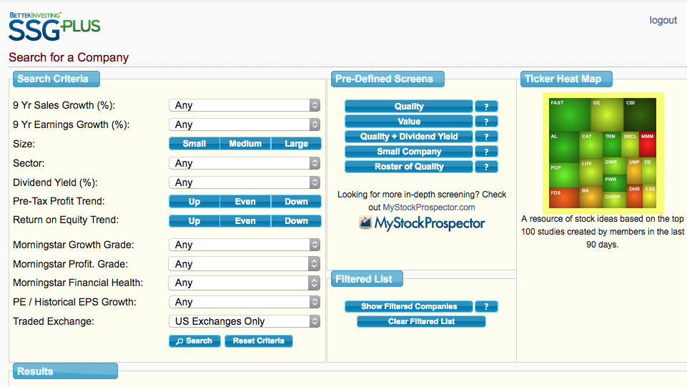
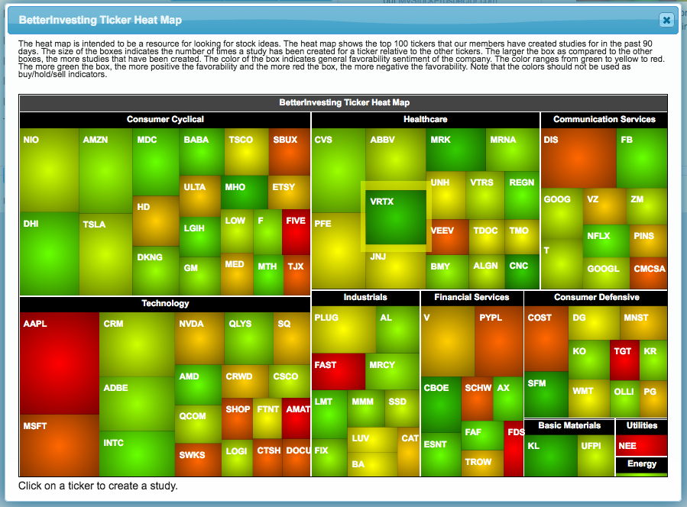
How did I find VRTX?

Slide 3
What does Vertex do?
Vertex discovers, develops, and commercializes transformative medicines for various serious diseases. Their current treatments are primarily focused on cystic fibrosis, but they also have a pipeline of drugs which includes therapies for cancer, pain, inflammatory diseases, influenza, as well as other rare diseases.

Slide 4
Treatment Portfolio

Slide 5
Long-Term Opportunities in Cystic Fibrosis

Slide 6
Plans for Near-Term Growth in Cystic Fibrosis

Slide 7
CTX001 Market Opportunity

Slide 8
Vertex Business Model

Slide 9
Revenue Growth

Slide 10
Profitability & Cash Flow

Slide 11
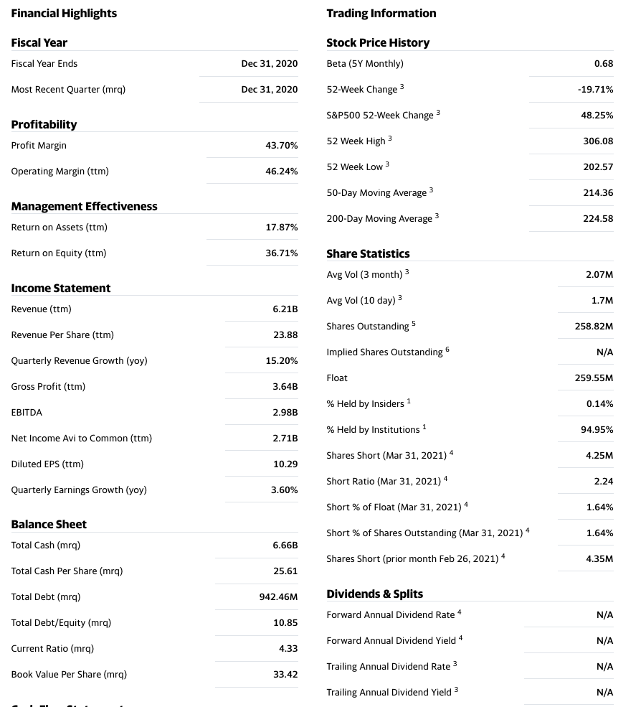
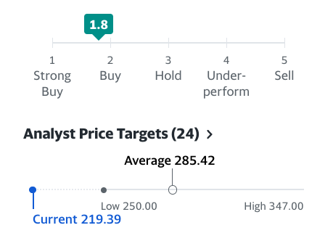
Yahoo Finance Analysis

Slide 12
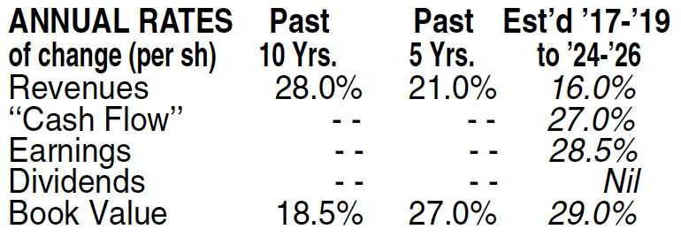
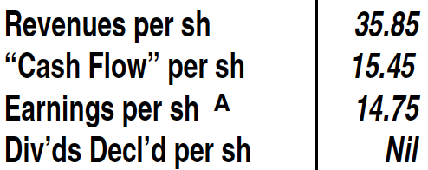
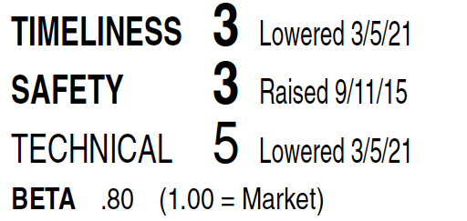
Value Line Analysis

Slide 13
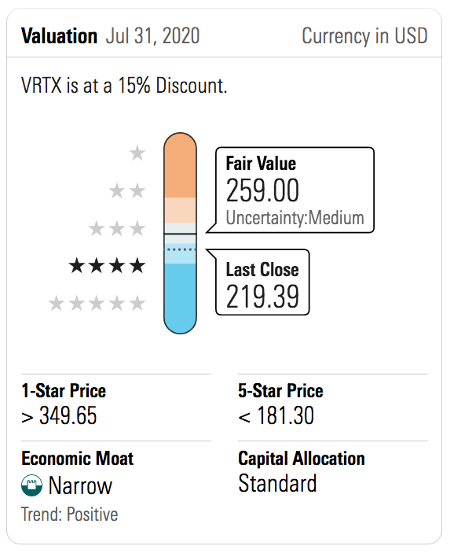
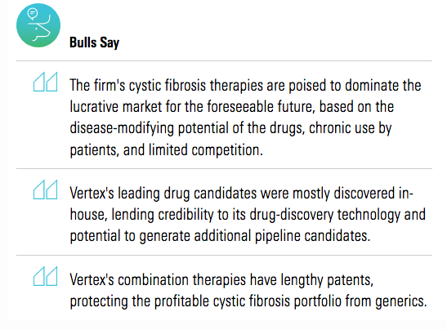
Morningstar Analysis

Slide 14
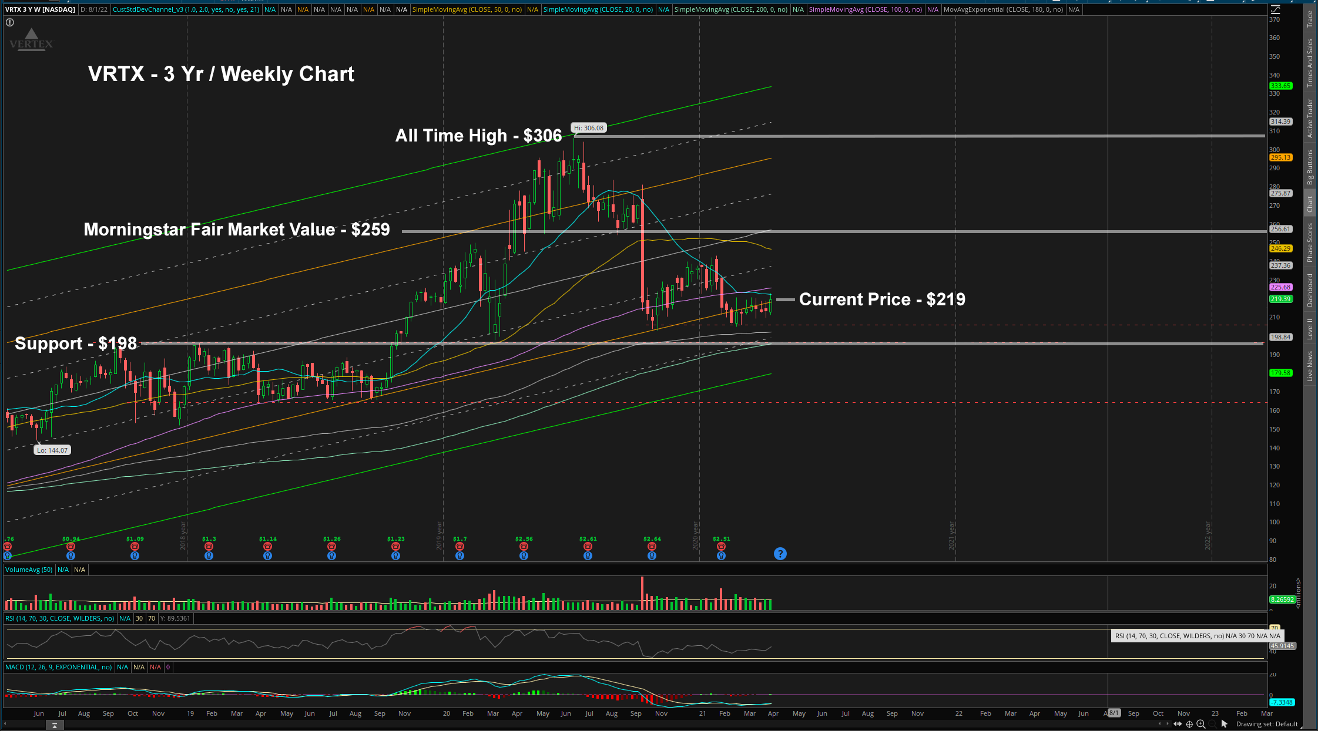
3 Year Weekly Chart Analysis

Slide 15
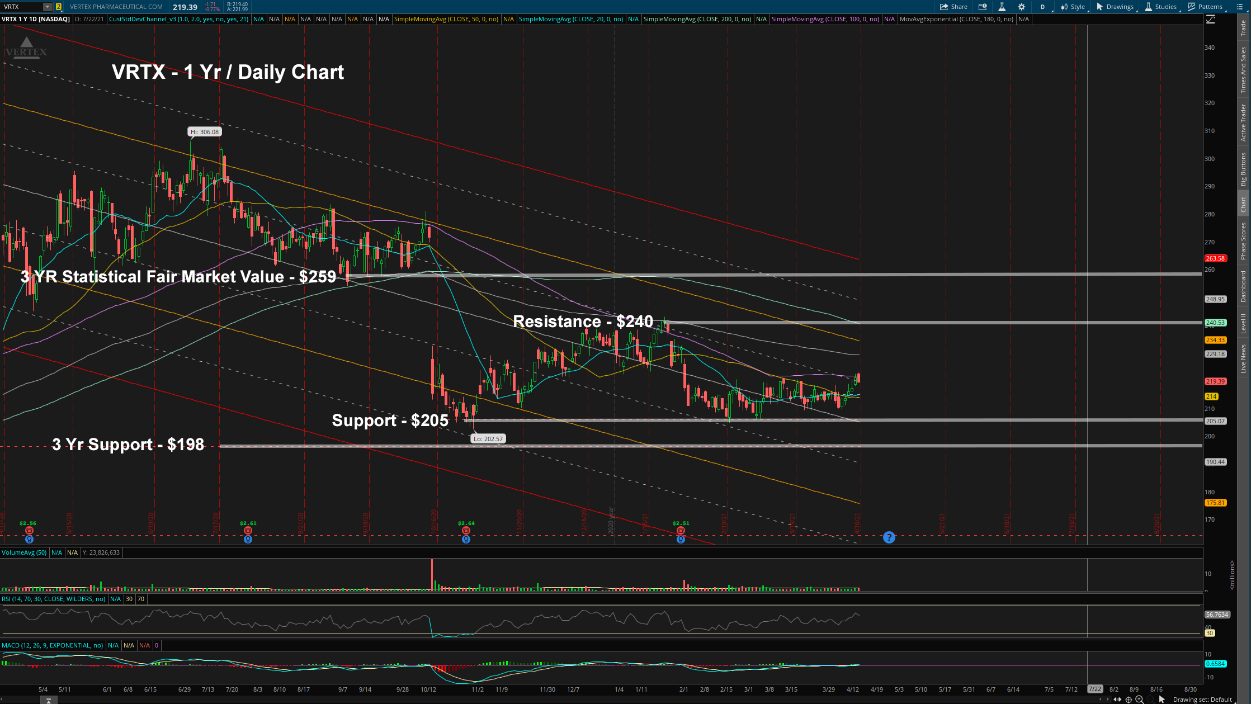
1 Year Daily Chart Analysis

Slide 16
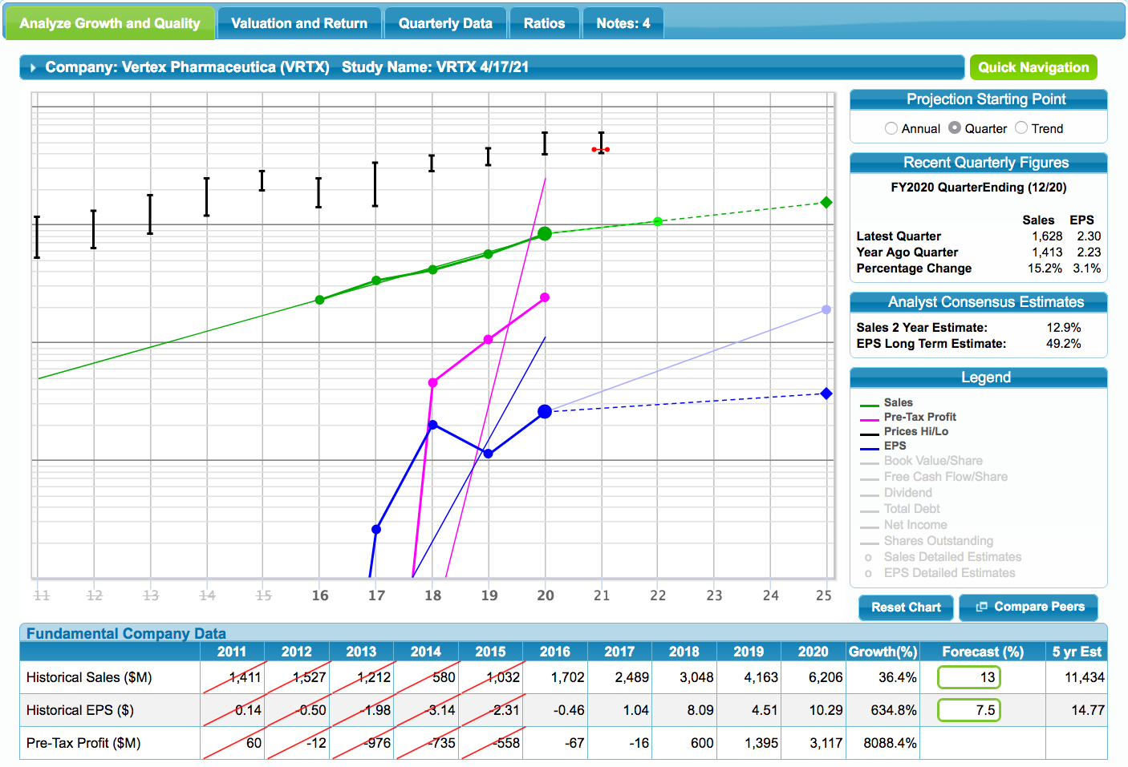
Stock Selection Guide

Slide 17
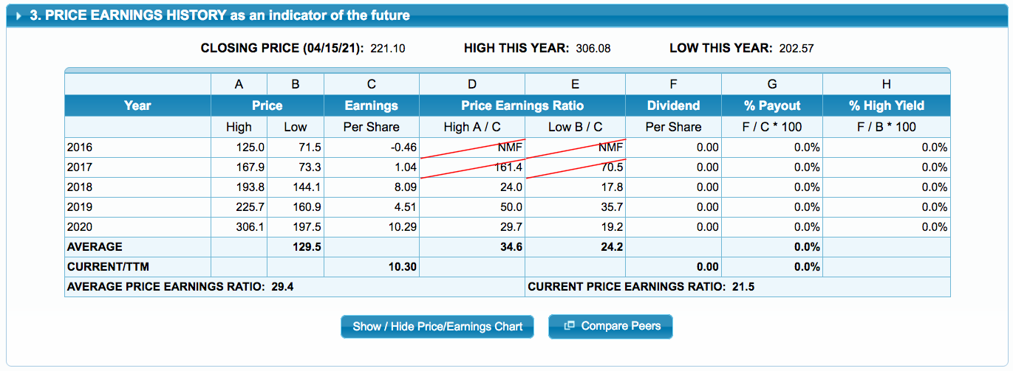
Stock Selection Guide

Slide 18
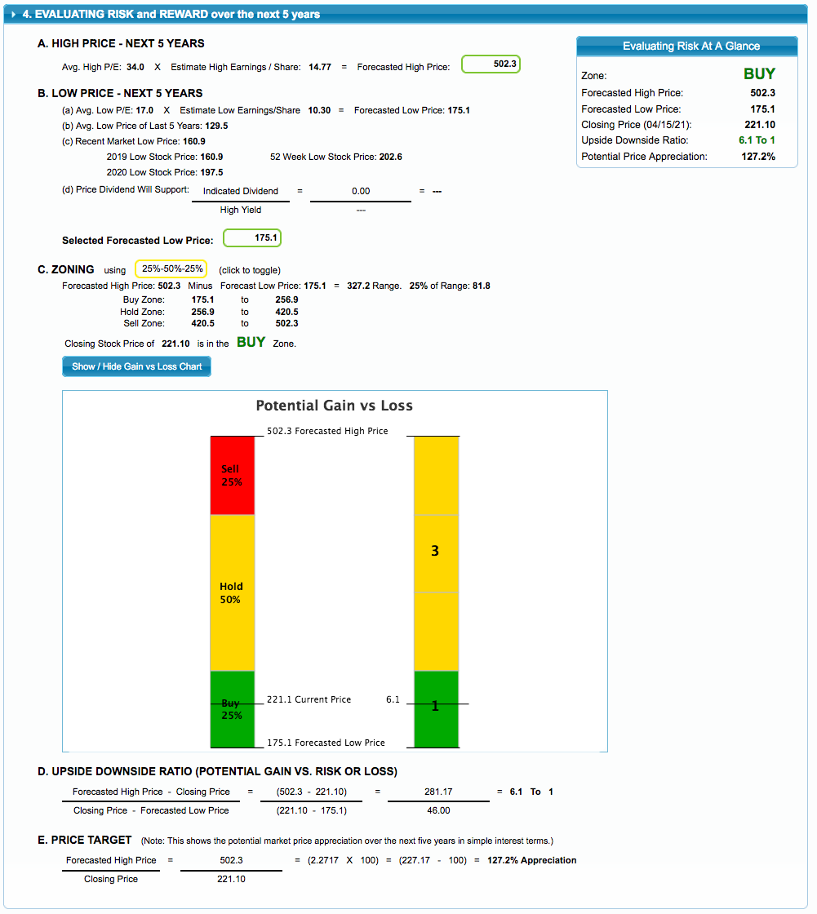
Stock Selection Guide

Slide 19
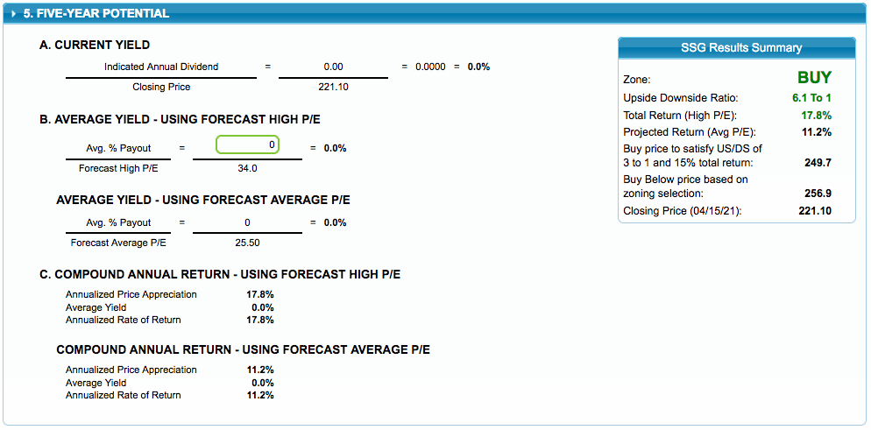
Stock Selection Guide

Slide 20
Conclusion
VRTX is a midsized explosive growth company
VRTX is a well managed company
VRTX is on sale trading near it’s 5 year average Low PE
VRTX is a worthy candidate to purchase
VRTX is a buy up to $249.00

