Slide 1
2nd quarter 2023 Earnings report
Western Alliance Bancorp (WAL)
Stock Watcher: Sheryl Patterson
September 12, 2023
Sponsored by

Slide 2
Disclaimer
The information in this presentation is for educational purposes only and is not intended to be a recommendation to purchase or sell any of the stocks, mutual funds, or other securities that may be referenced. The securities of companies referenced or featured in the seminar materials are for illustrative purposes only and are not to be considered endorsed or recommended for purchase or sale by BetterInvestingTM National Association of Investors Corporation (“BI”). The views expressed are those of the instructors, commentators, guests and participants, as the case may be, and do not necessarily represent those of BetterInvesting. Investors should conduct their own review and analysis of any company of interest before making an investment decision.
Securities discussed may be held by the presenters in their own personal portfolios. BI presenters and volunteers are held to a strict code of conduct that precludes benefiting financially from educational presentations or public activities via any BetterInvesting programs, events and/or educational sessions in which they participate. Any violation is strictly prohibited and should be reported to the CEO of BetterInvesting or the Director of Chapter Relations.
This presentation may contain images of websites and products, or services not endorsed by BetterInvesting. The presenters are not endorsing or promoting the use of these websites, products or services.
Notes:
As appropriate for live sessions, remove last line about session being recording.

Slide 6
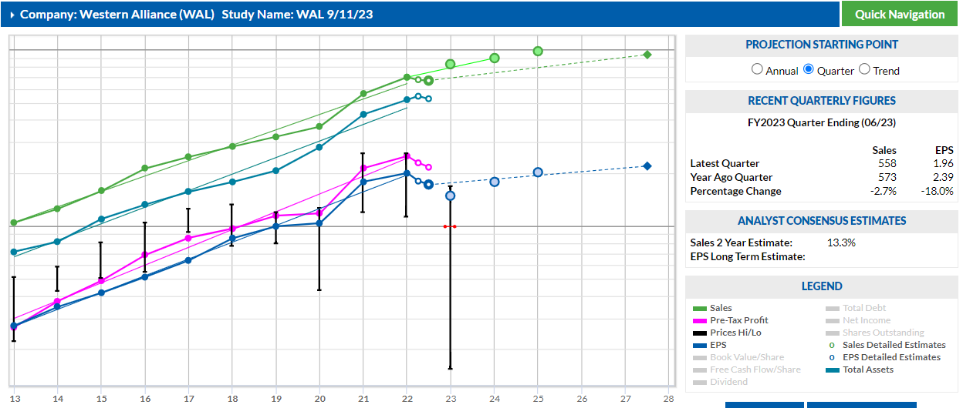

Slide 7
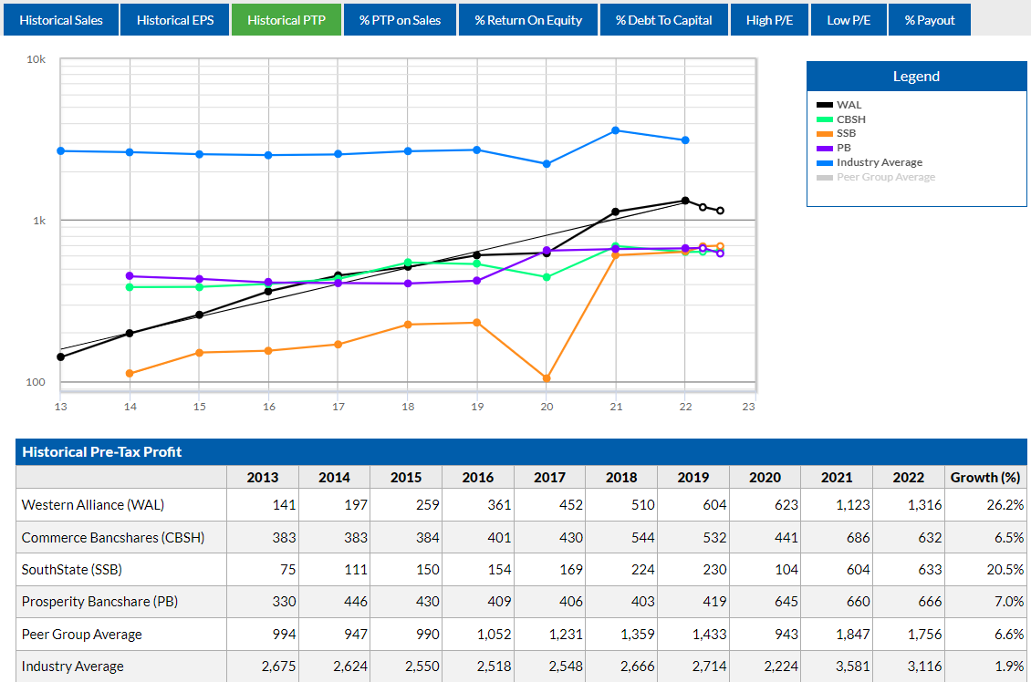

Slide 8
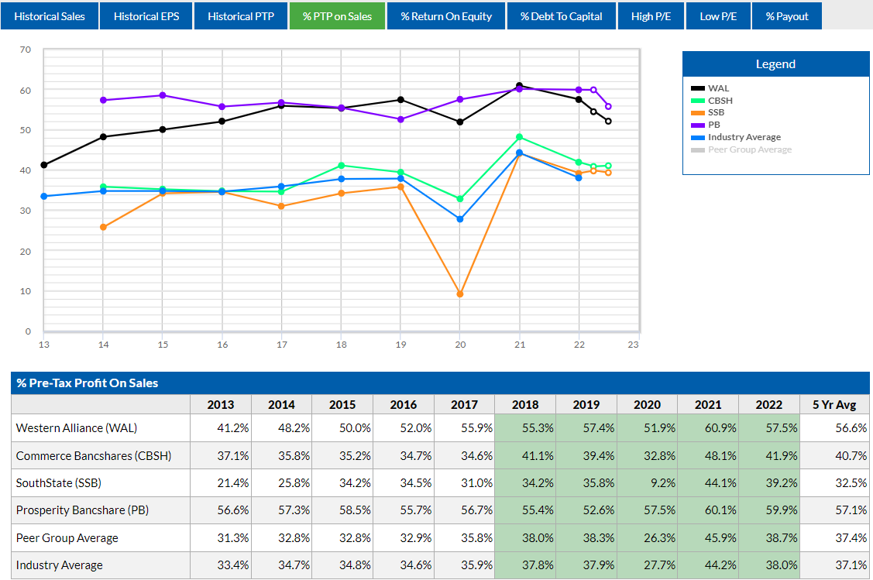

Slide 9
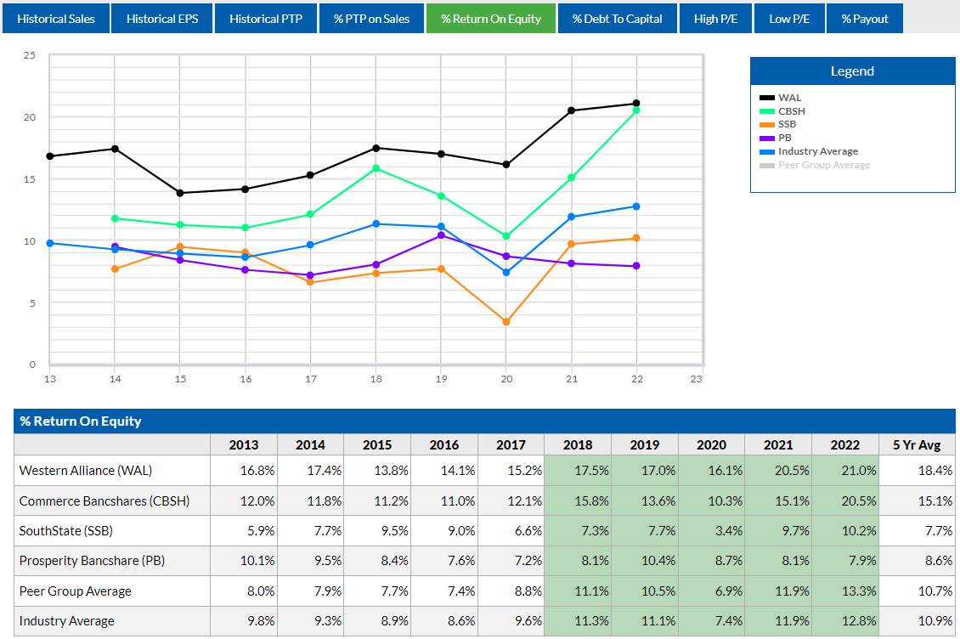

Slide 10
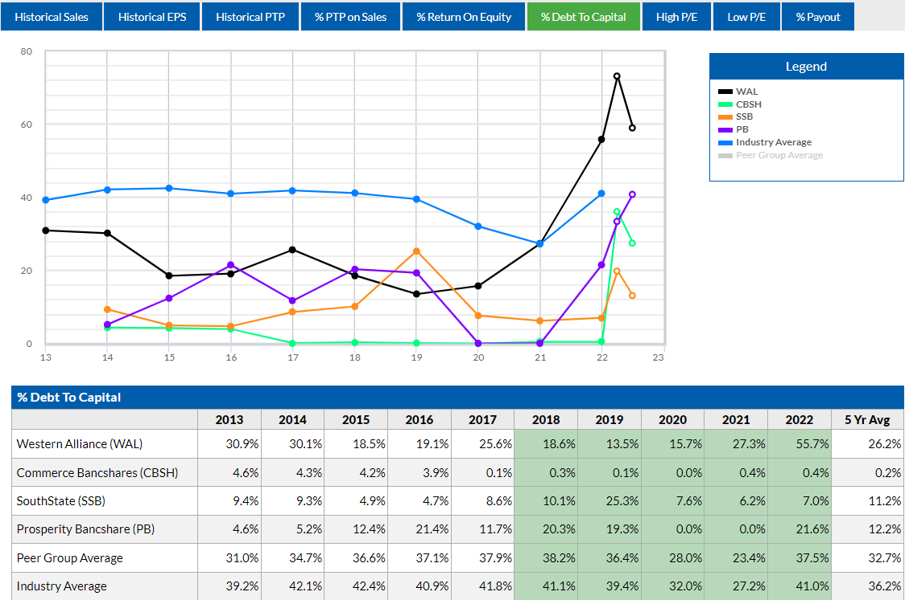

Slide 11
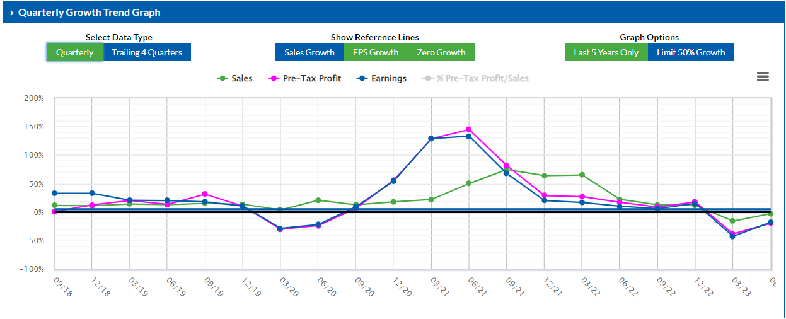

Slide 12
