Slide 1
Update and Review of the McNoVA Portfolio
(as of May 31, 2020)
McNoVA virtual meeting, Wednesday June 10, 2020
-- Wilbert Nixon

Slide 2
Introduction to Technical Analysis
-- Wilbert Nixon, McNoVA
April 11, 2018

Slide 3
“Gravity does not require our belief.”

Slide 6
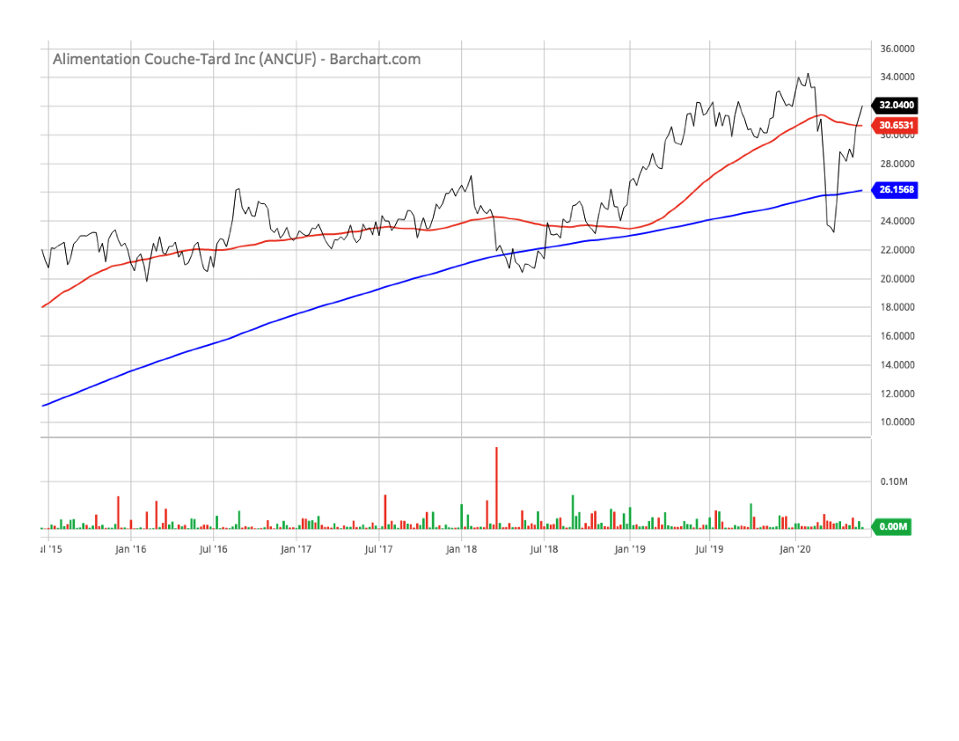
Alimentation Couche (ANCUF)(5-year line chart)

Slide 7
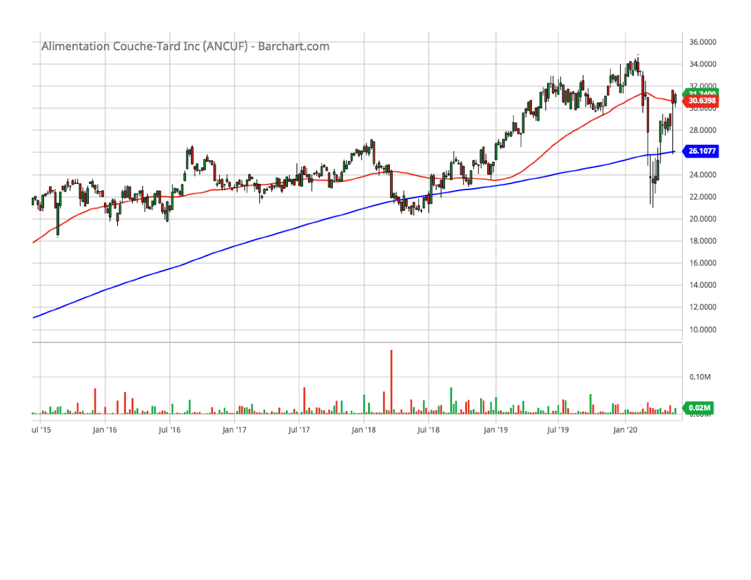
Alimentation Couche (ANCUF)(5-year chart)

Slide 8
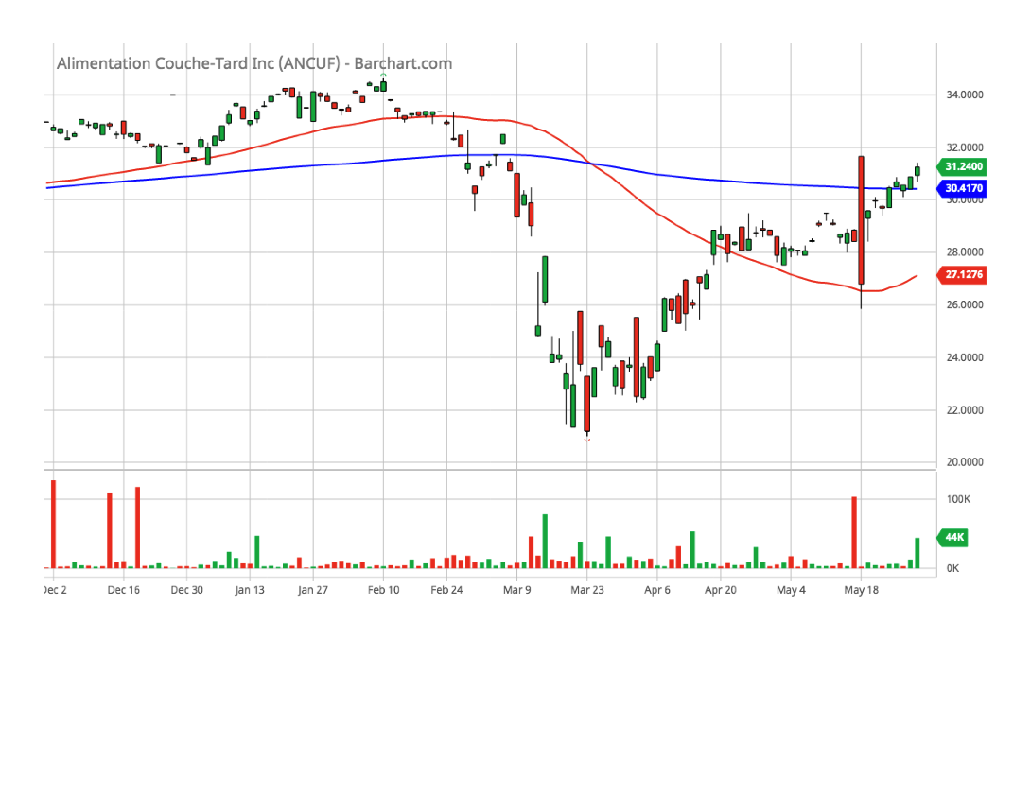
Alimentation Couche (ANCUF)(6-month chart)

Slide 9
Alimentation Couche (ANCUF)(SSG)

Slide 10
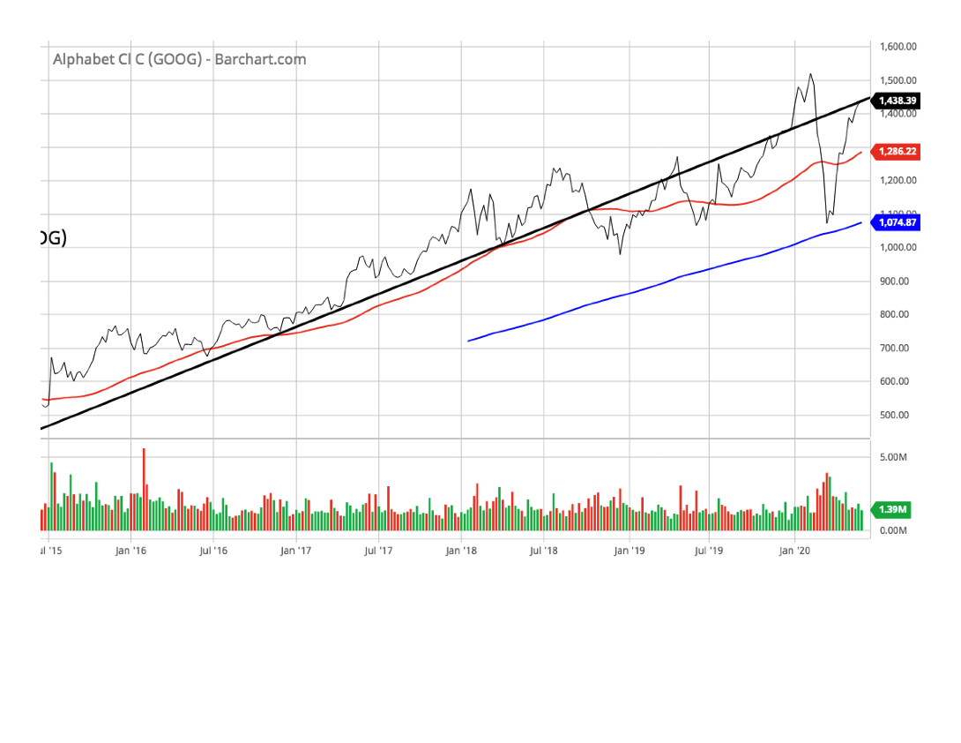
Alphabet Inc. (GOOG)(5-year line chart)

Slide 11
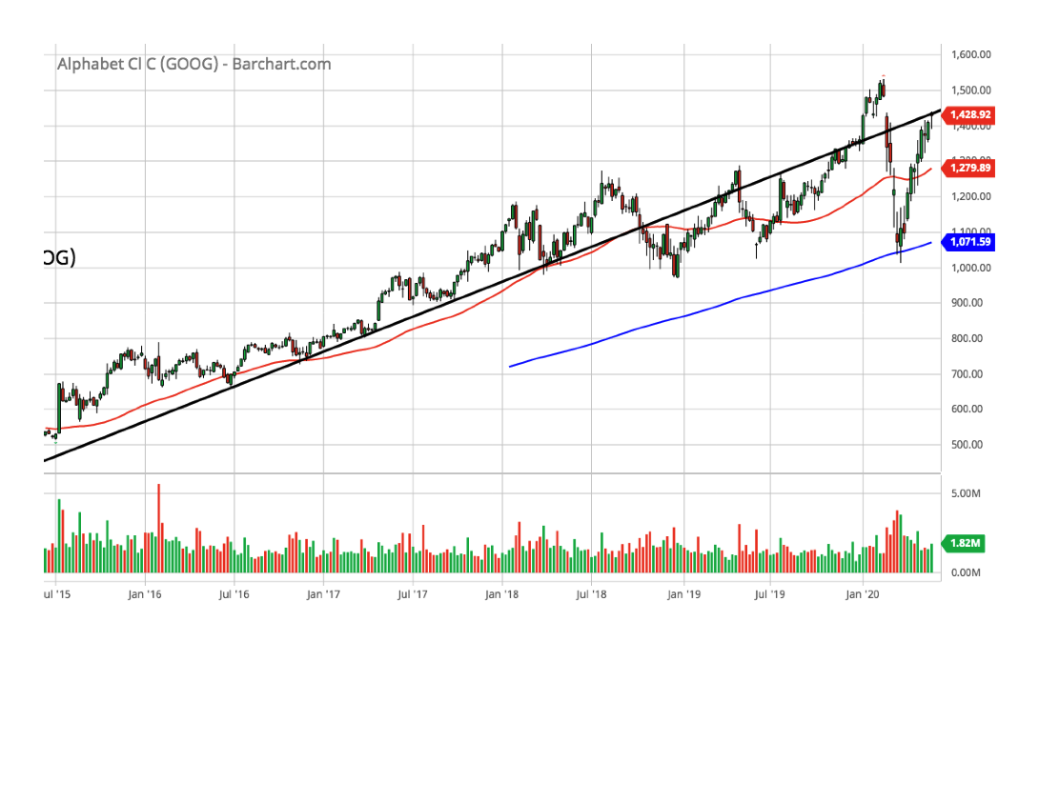
Alphabet Inc. (GOOG)(5-year chart)

Slide 12
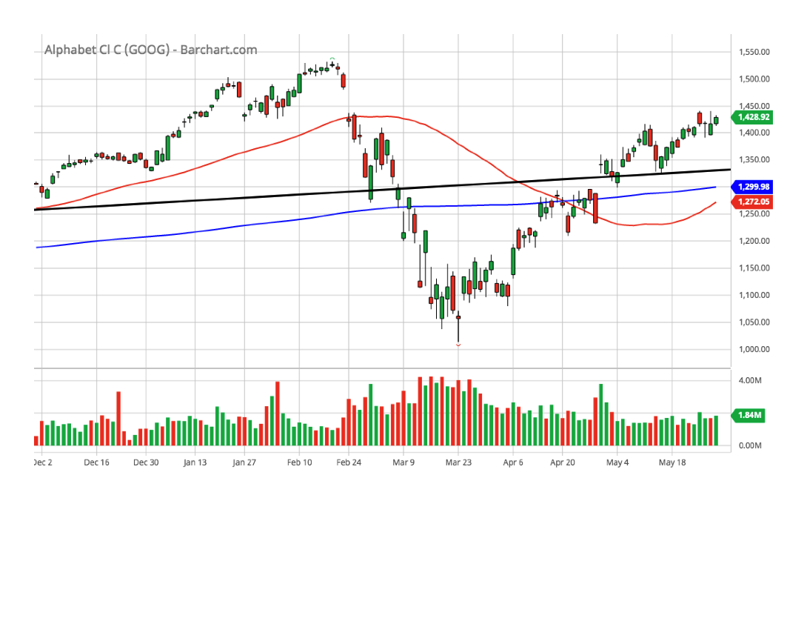
Alphabet Inc. (GOOG)(6-month chart)

Slide 13
Alphabet Inc. (GOOG)(SSG)

Slide 14
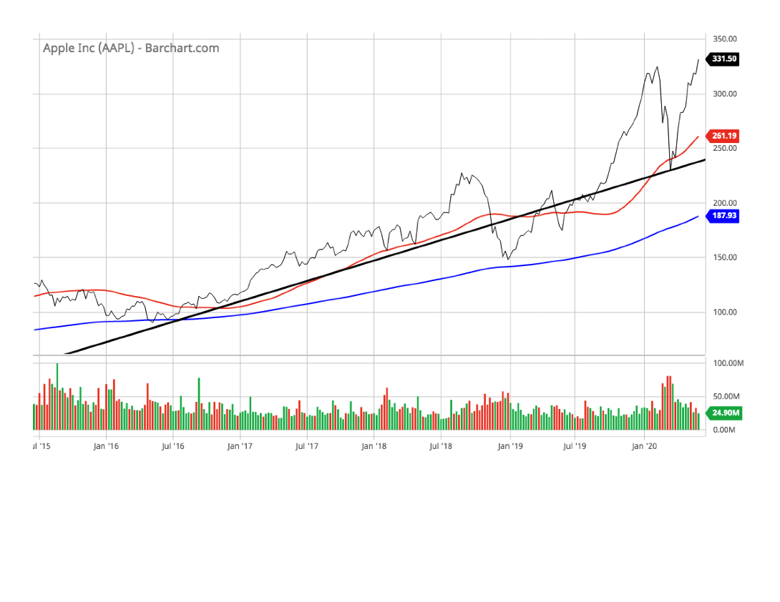
Apple Inc. (AAPL)(5-year line chart)

Slide 15
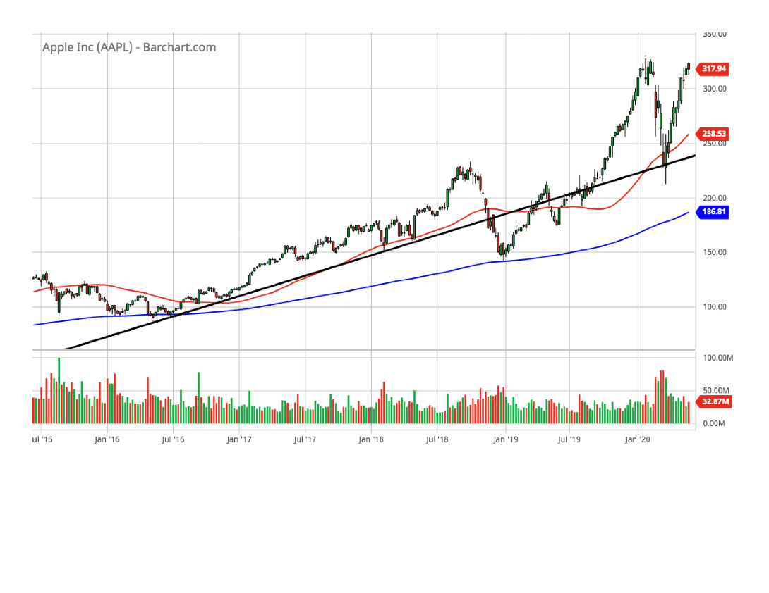
Apple Inc. (AAPL)(5-year chart)

Slide 16
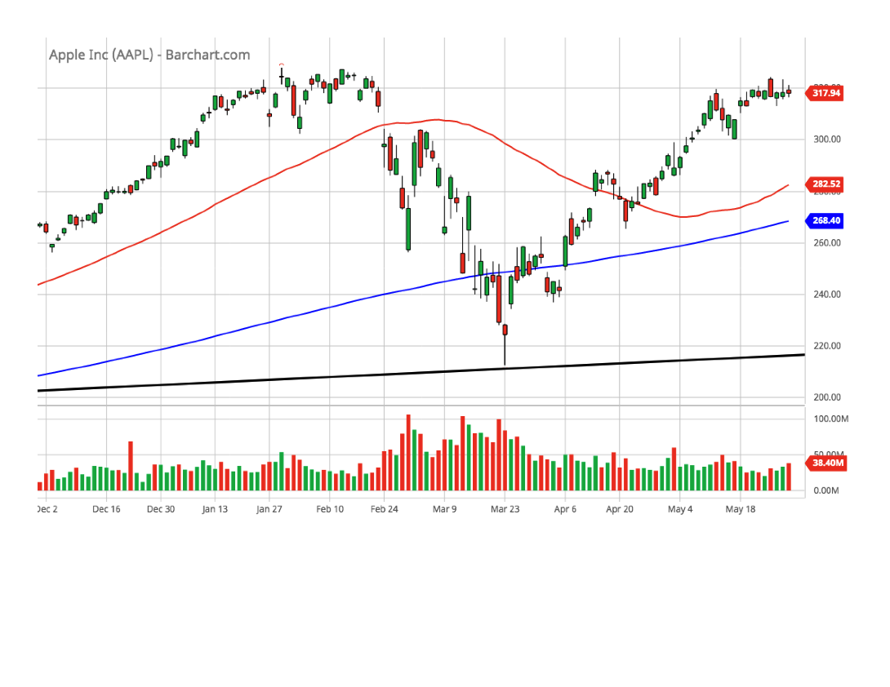
Apple Inc. (AAPL)(6-month chart)

Slide 17
Apple Inc. (AAPL)(SSG)

Slide 18
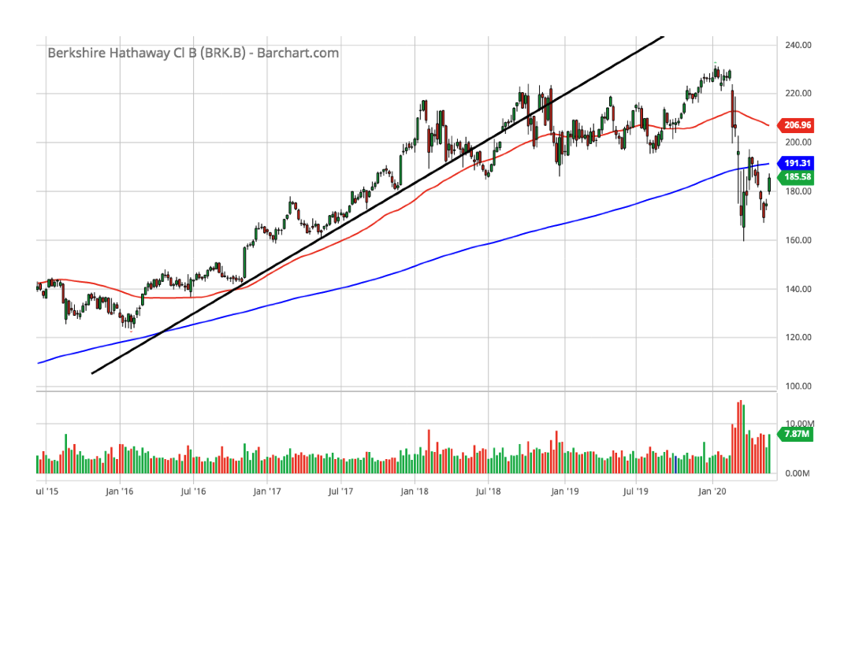
Berkshire Hathaway (BRKB)(5-year chart)

Slide 19
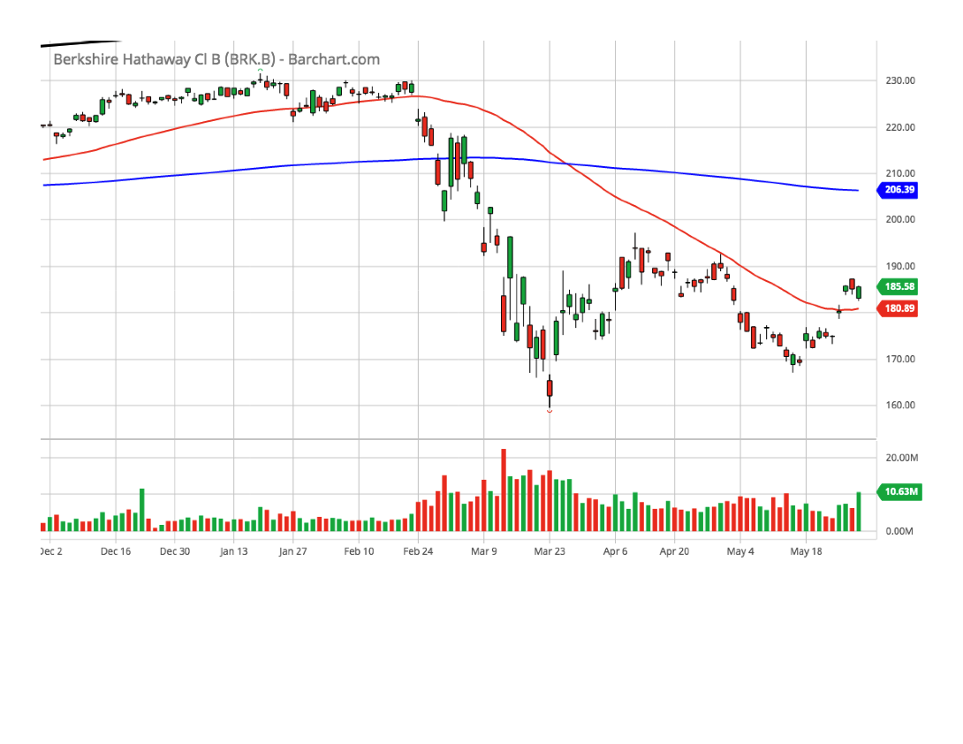
Berkshire Hathaway (BRKB)(6-month chart)

Slide 20
Berkshire Hathaway (BRKB)(SSG)

Slide 21
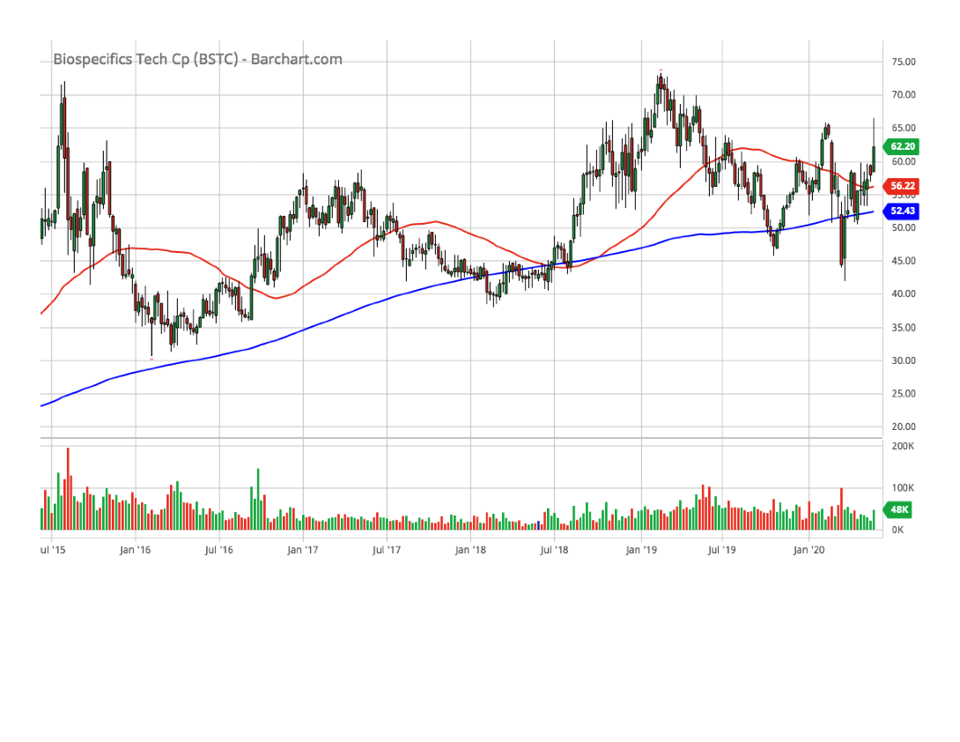
Biospecific Tech (BSTC)(5-year chart)

Slide 22
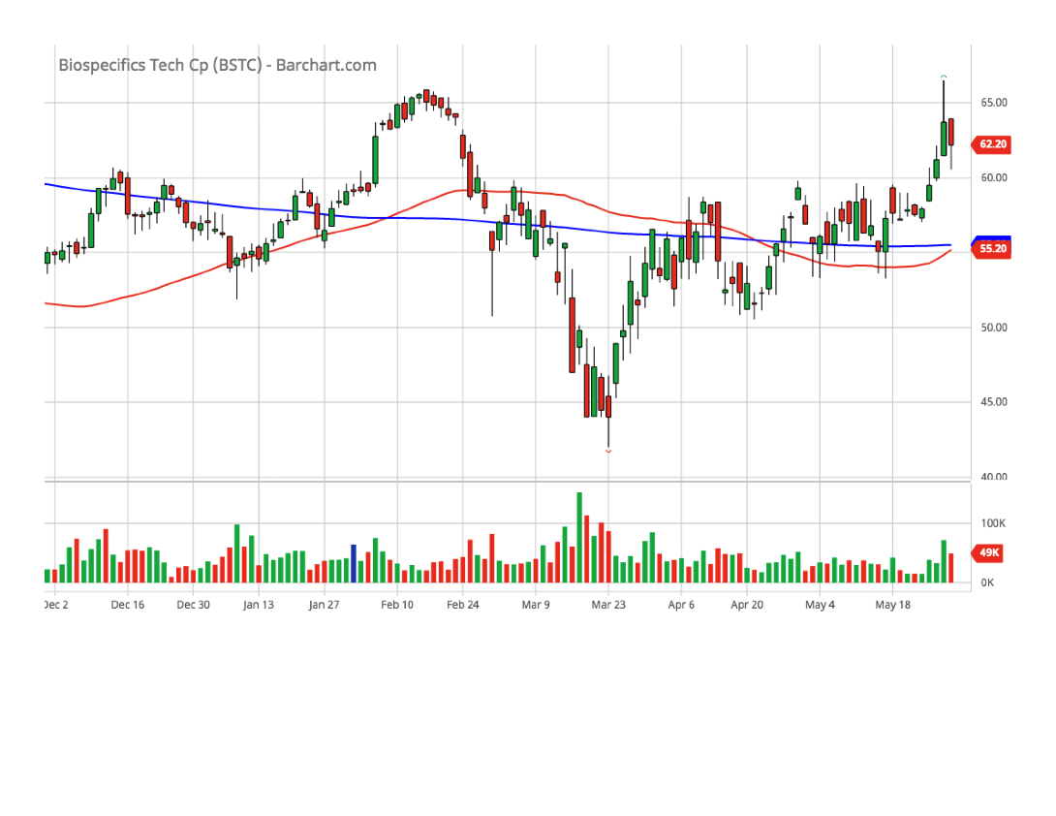
Biospecific Tech (BSTC)(6-month chart)

Slide 23
Biospecific Tech (BSTC)(SSG)

Slide 24
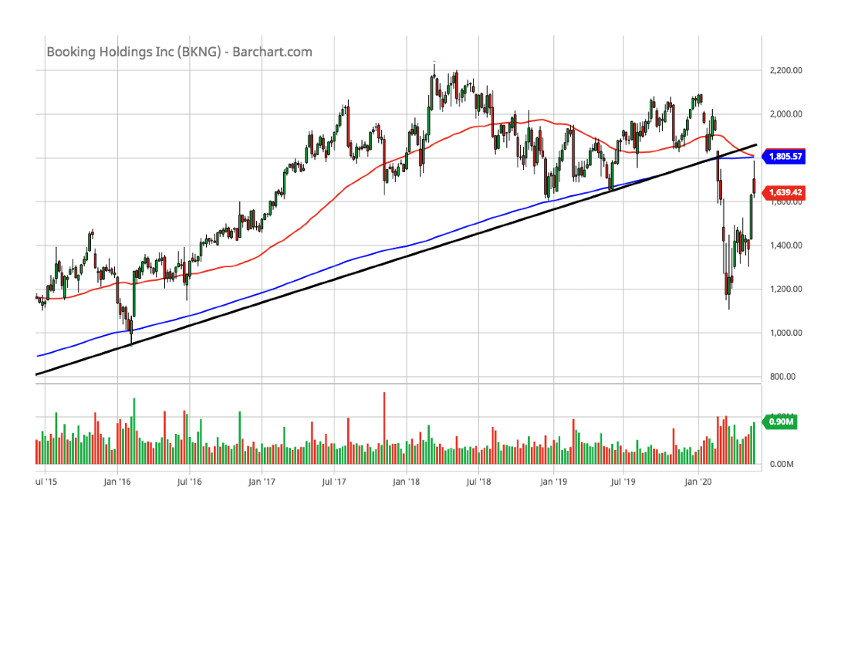
Booking Holdings, Inc. (BKNG)(5-year chart)

Slide 25
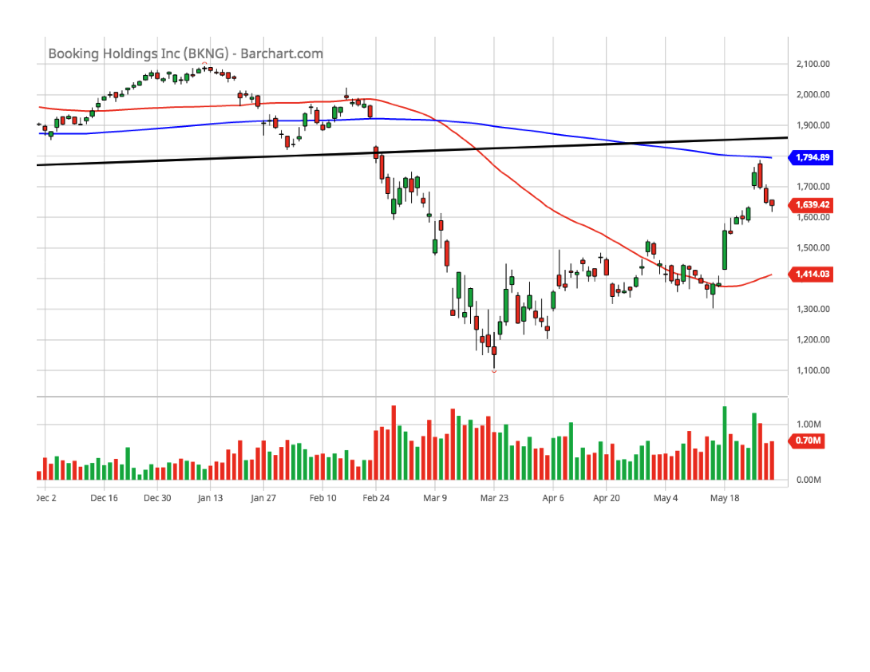
Booking Holdings, Inc. (BKNG)(6-month chart)

Slide 26
Booking Holdings, Inc. (BKNG)(SSG)

Slide 27
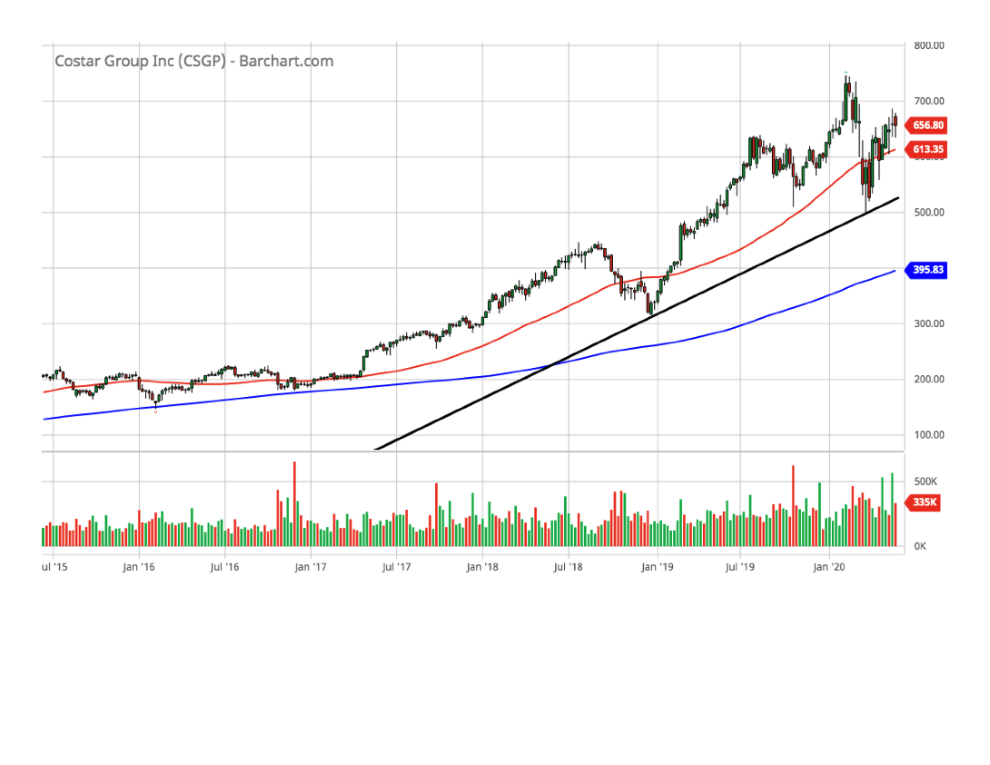
CoStar Group, Inc. (CSGP)(5-year chart)

Slide 28
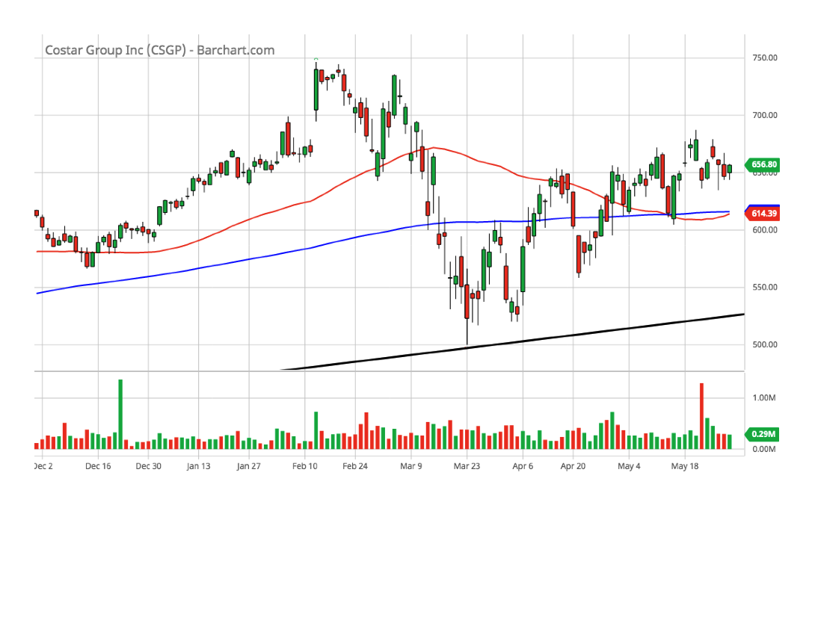
CoStar Group, Inc. (CSGP)(6-month chart)

Slide 29
CoStar Group, Inc. (CSGP)(SSG)

Slide 30
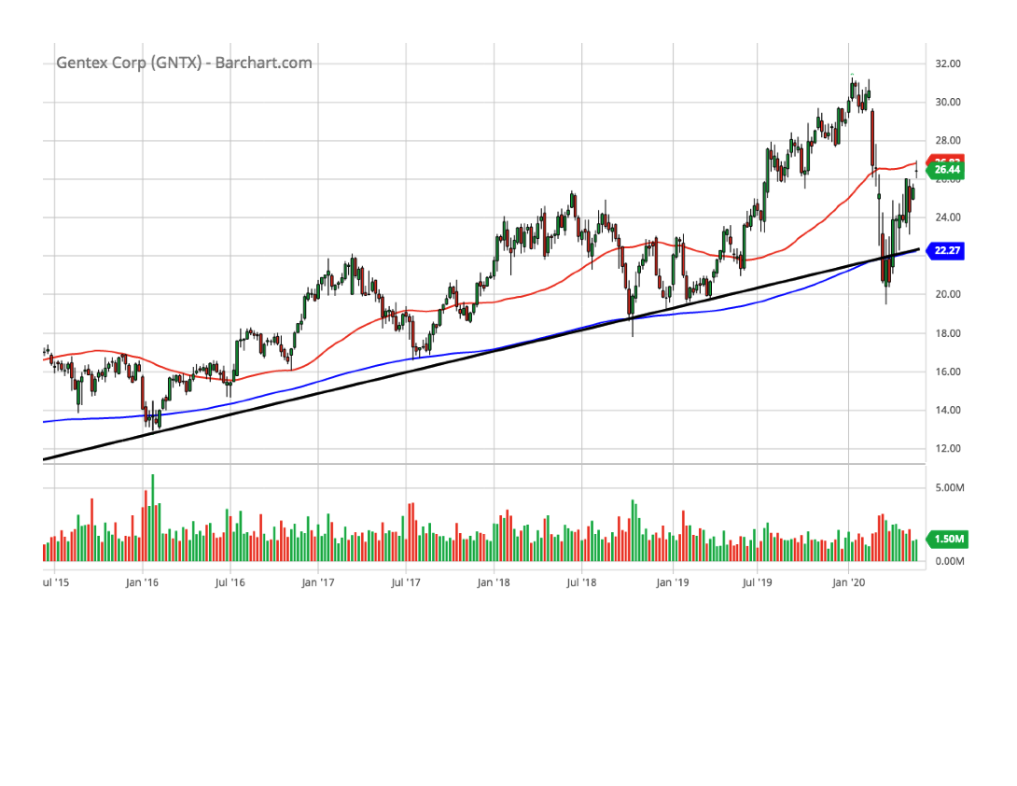
Gentex Corp. (GNTX)(5-year chart)

Slide 31
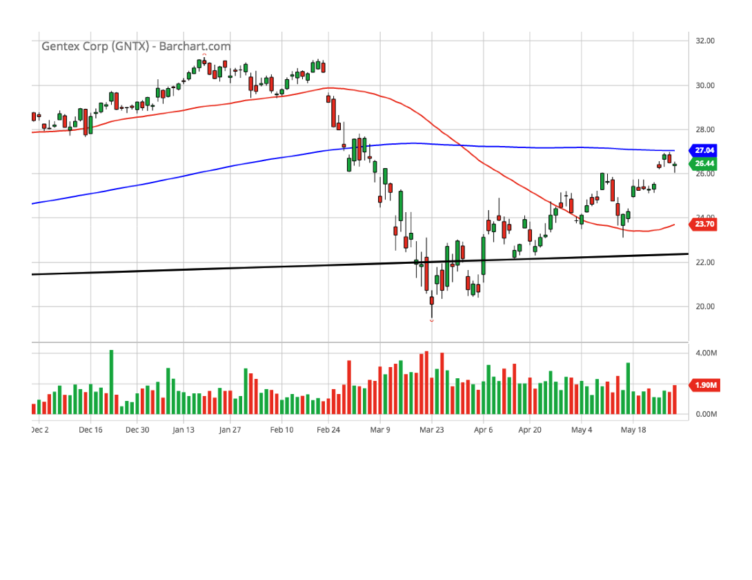
Gentex Corp. (GNTX)(6-month chart)

Slide 32
Gentex Corp. (GNTX)(SSG)

Slide 33
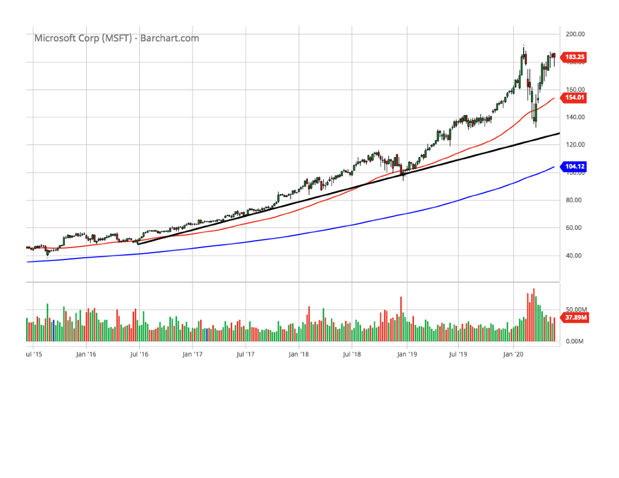
Microsoft Corporation (MSFT)(5-year chart)

Slide 34
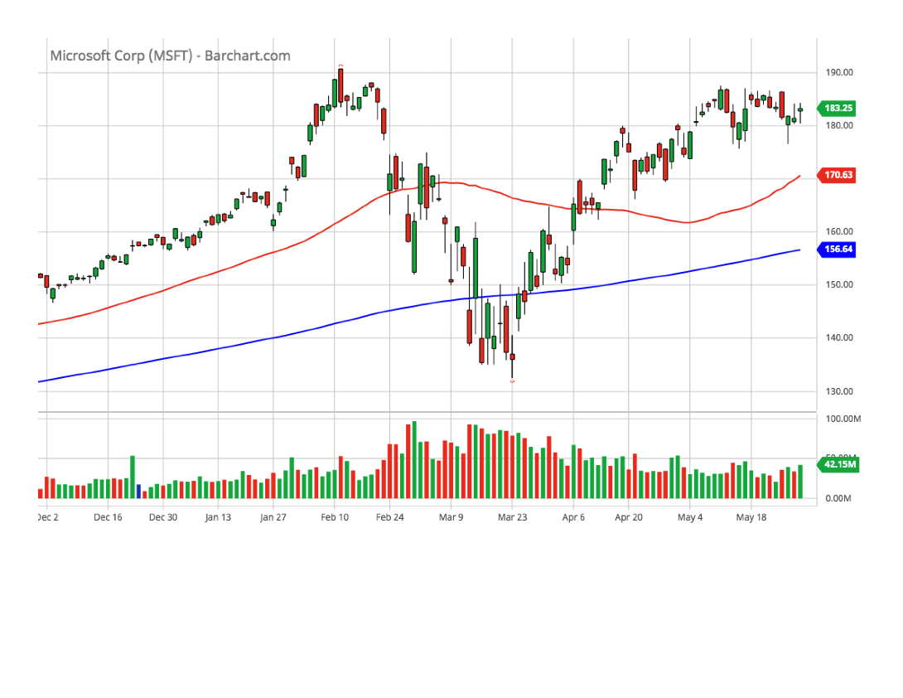
Microsoft Corporation (MSFT)(6-month chart)

Slide 35
Microsoft Corporation (MSFT)(SSG)

Slide 36
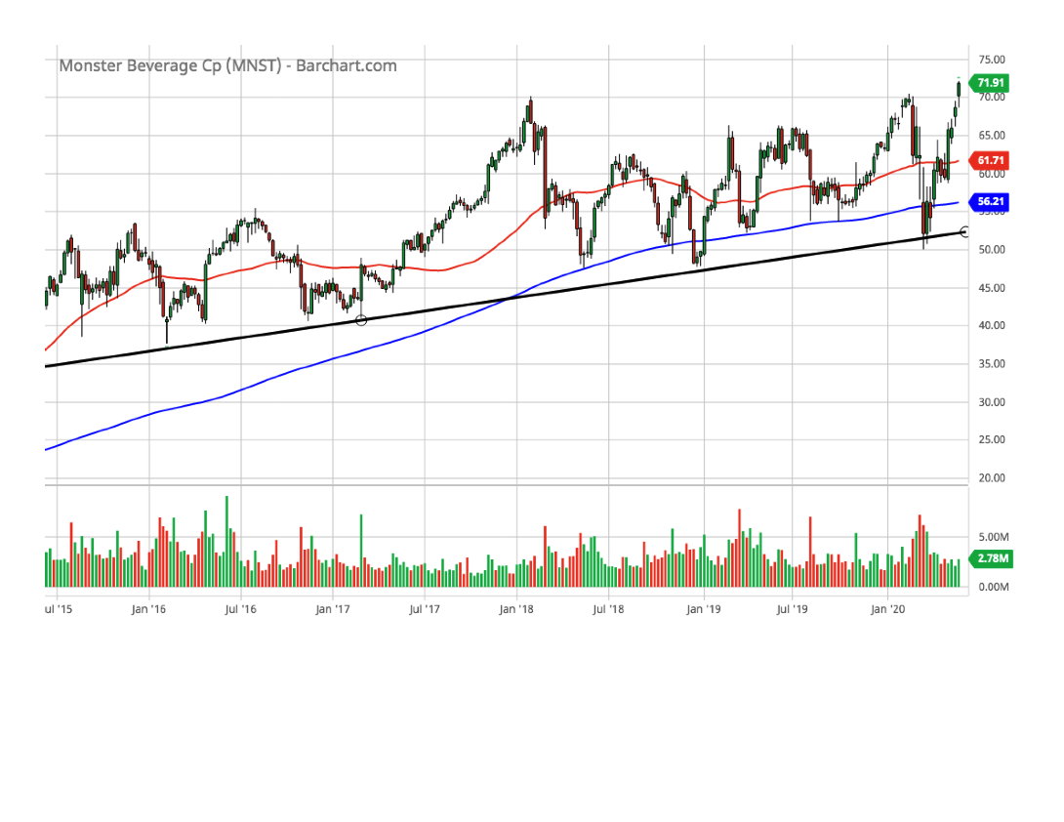
Monster Beverage Corp. (MNST)(5-year chart)

Slide 37
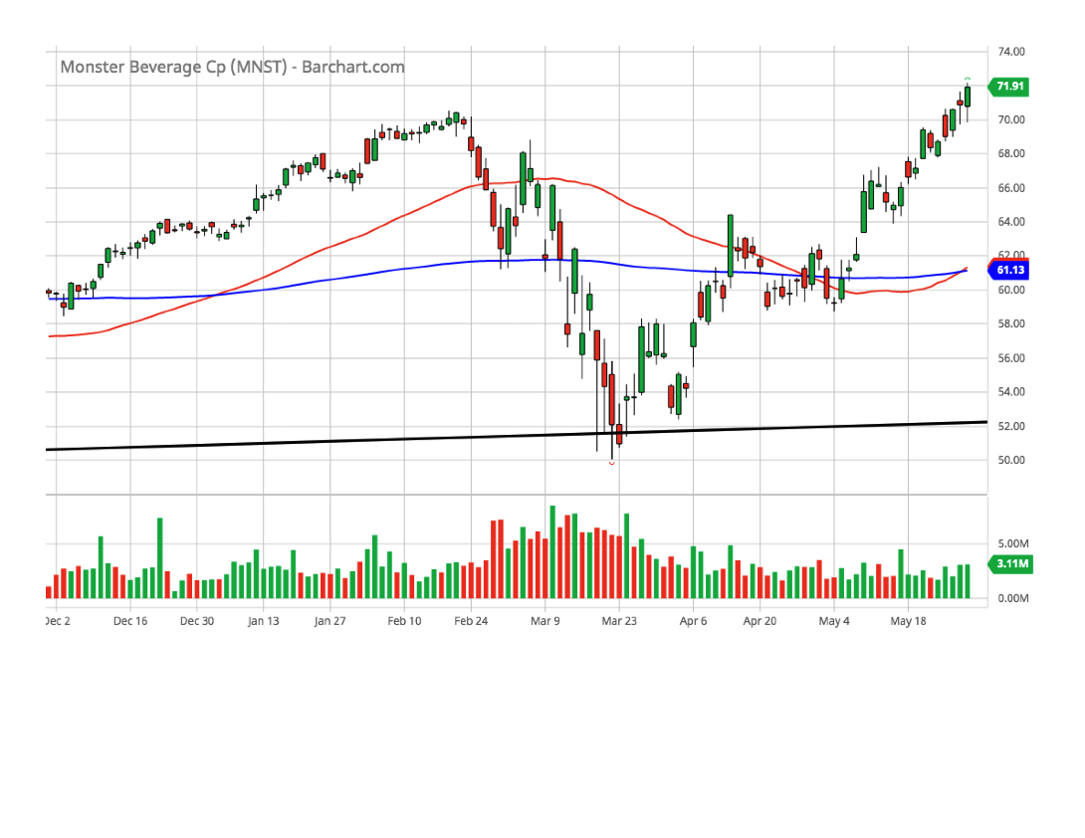
Monster Beverage Corp. (MNST)(6-month chart)

Slide 38
Monster Beverage Corp. (MNST)(SSG)

Slide 39
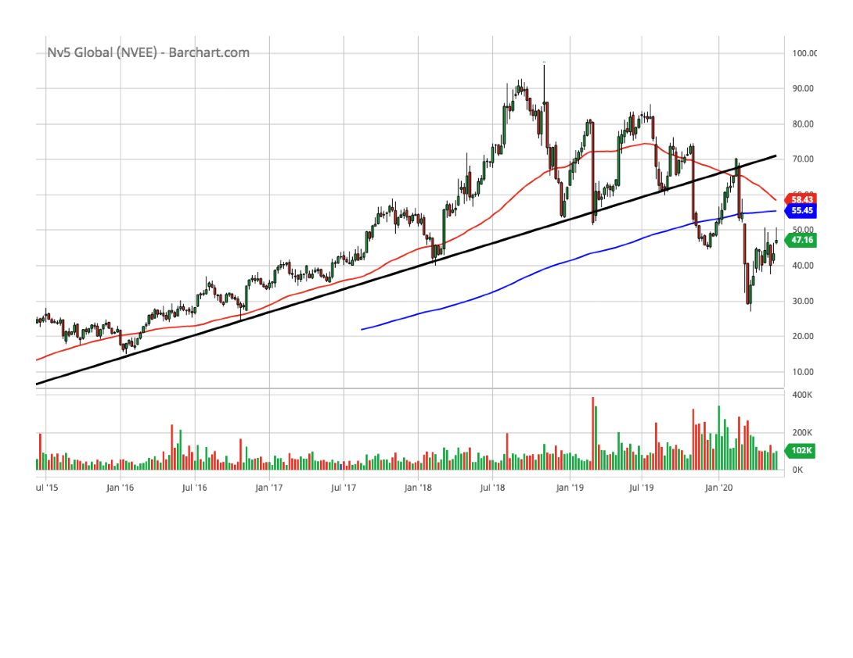
Nv5 Global Inc. (NVEE)(5-year chart)

Slide 40
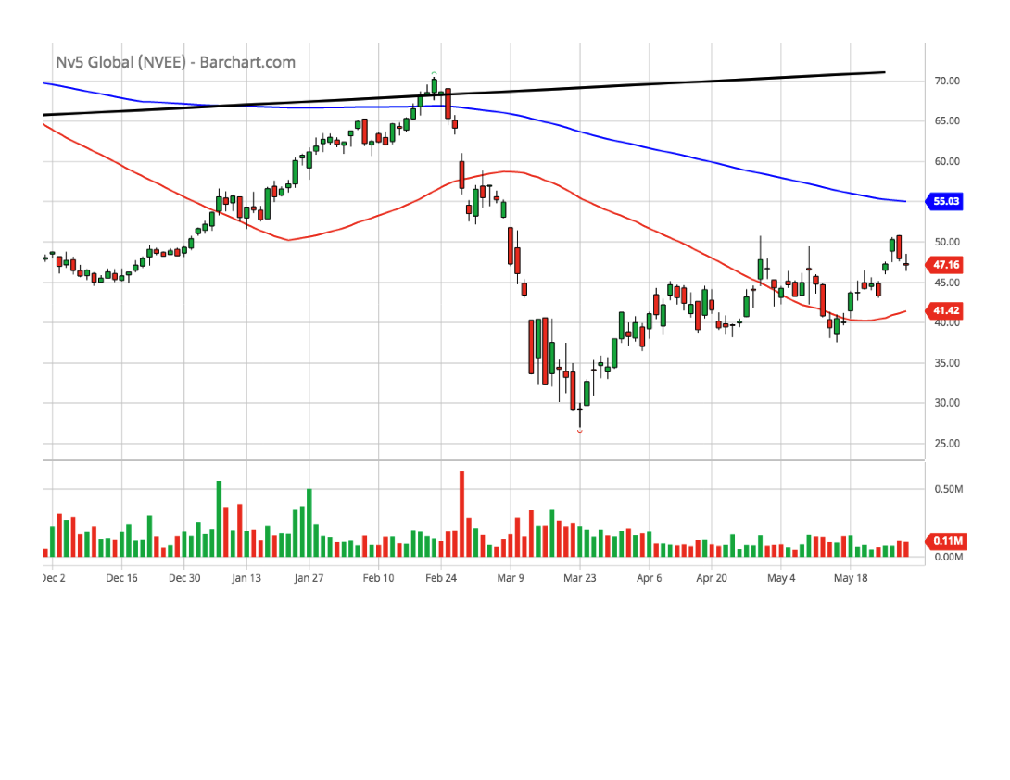
Nv5 Global Inc. (NVEE)(6-month chart)

Slide 41
Nv5 Global Inc. (NVEE)(SSG)

Slide 42
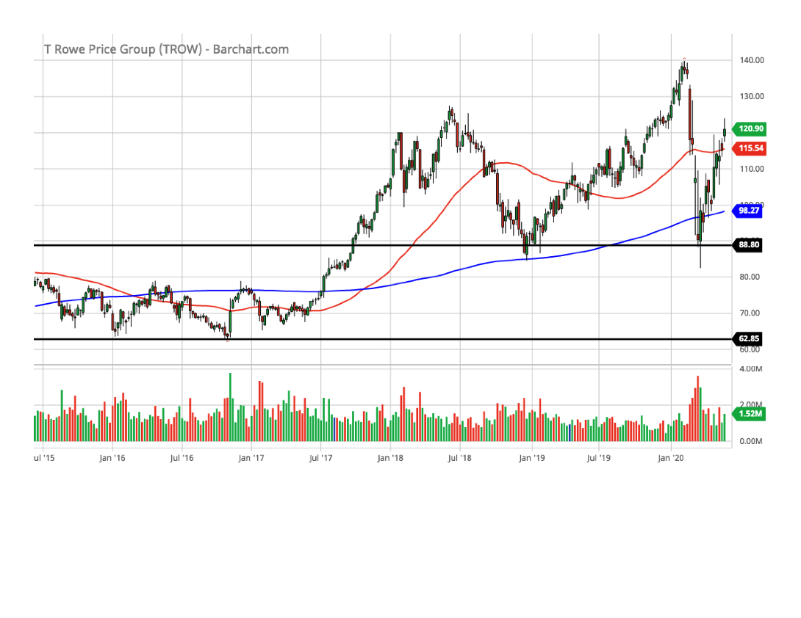
T. Rowe Price Group, Inc. (TROW)(5-year chart)

Slide 43
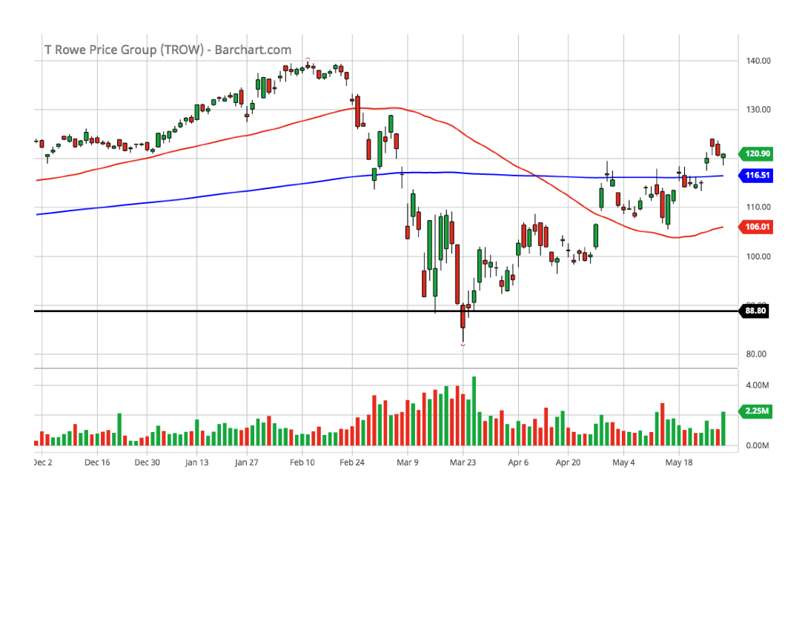
T. Rowe Price Group, Inc. (TROW)(6-month chart)

Slide 44
T. Rowe Price Group, Inc. (TROW)(SSG)

Slide 45
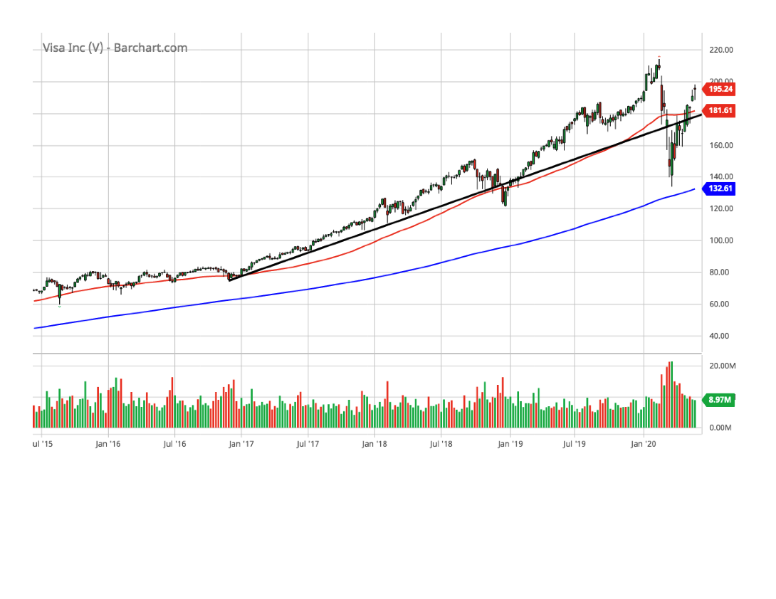
VISA, Inc. (VISA)(5-year chart)

Slide 46
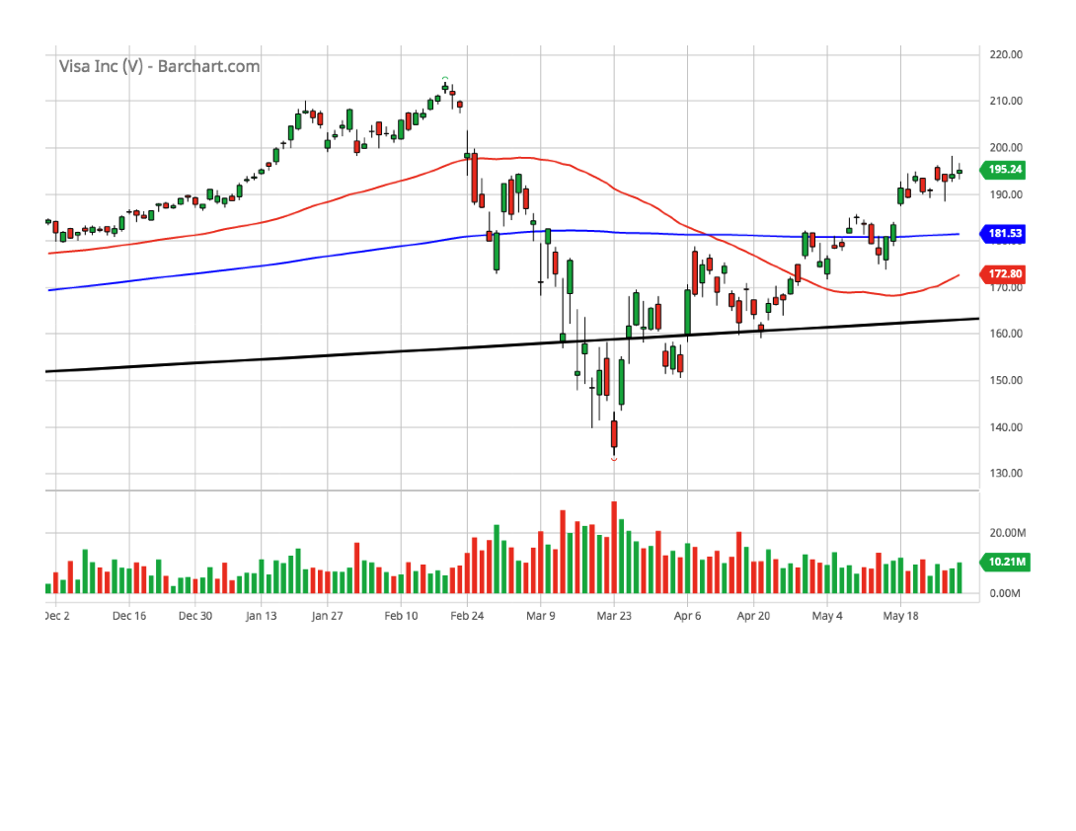
VISA, Inc. (VISA)(6-month chart)

Slide 47
VISA, Inc. (VISA)(SSG)

