Slide 1
Introduction to and Review of the McNoVA Watchlist
(as of May 31, 2020)
McNoVA virtual meeting, Wednesday June 10, 2020
-- Wilbert Nixon

Slide 2
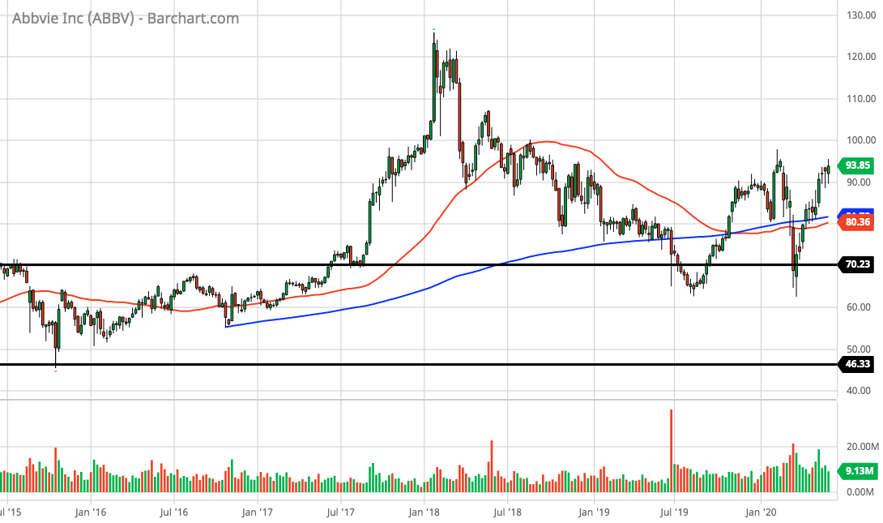
Abbvie (ABBV)(5-year chart)

Slide 3
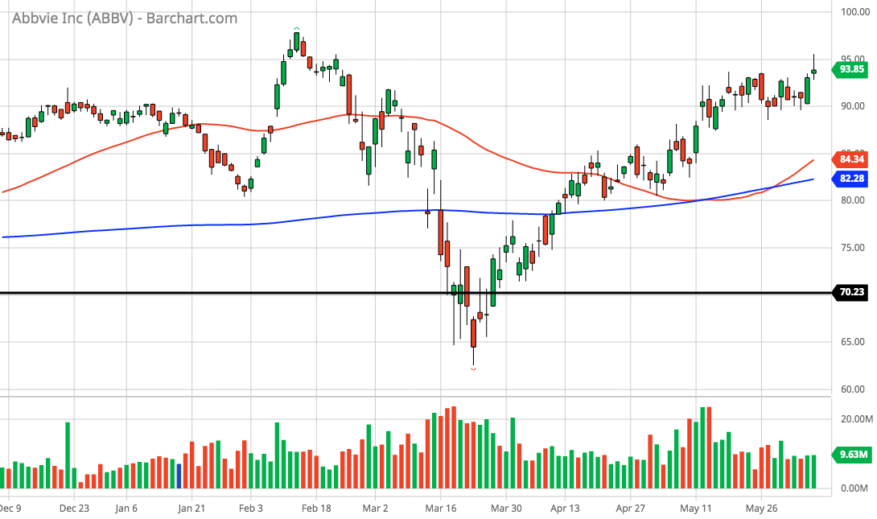
Abbvie (ABBV)(6-month chart)

Slide 4
Abbvie (ABBV)(SSG)

Slide 5
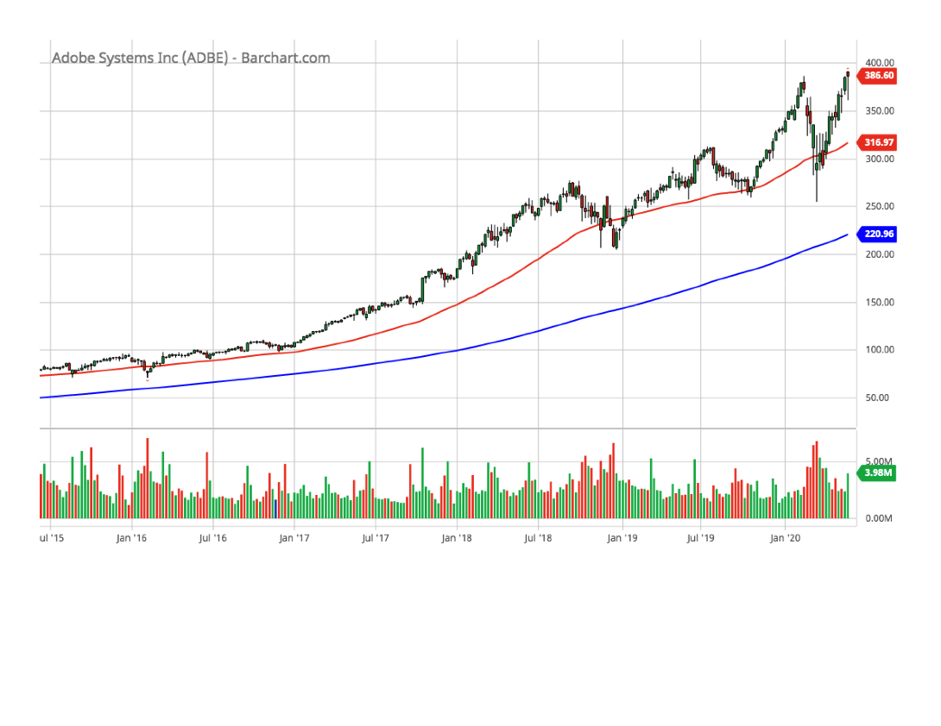
Adobe Systems (ADBE)(5-year chart)

Slide 6
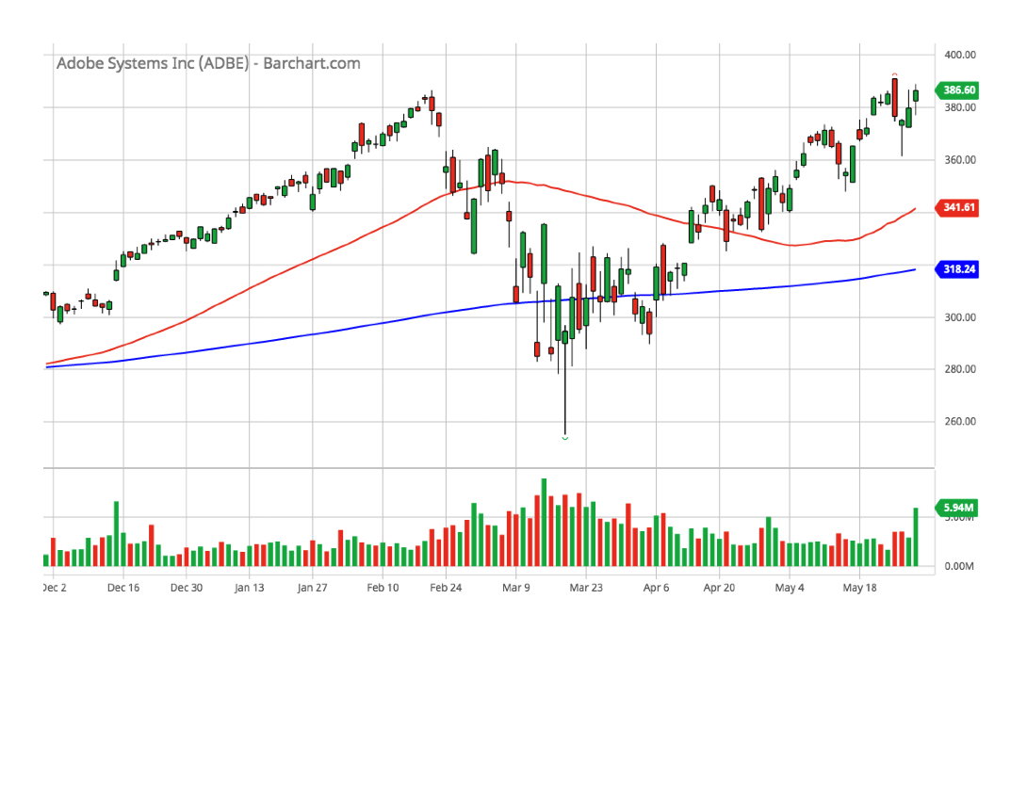
Adobe Systems (ADBE)(6-month chart)

Slide 7
Adobe Systems (ADBE)(SSG)

Slide 8
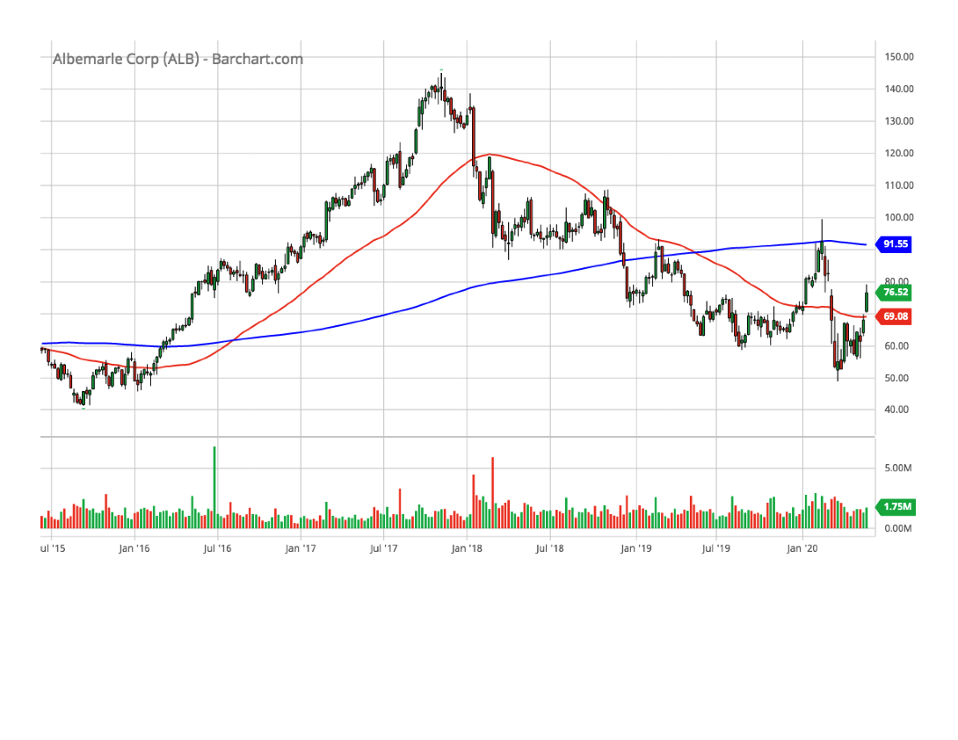
Albemarle Corp. (ALB)(5-year chart)

Slide 9
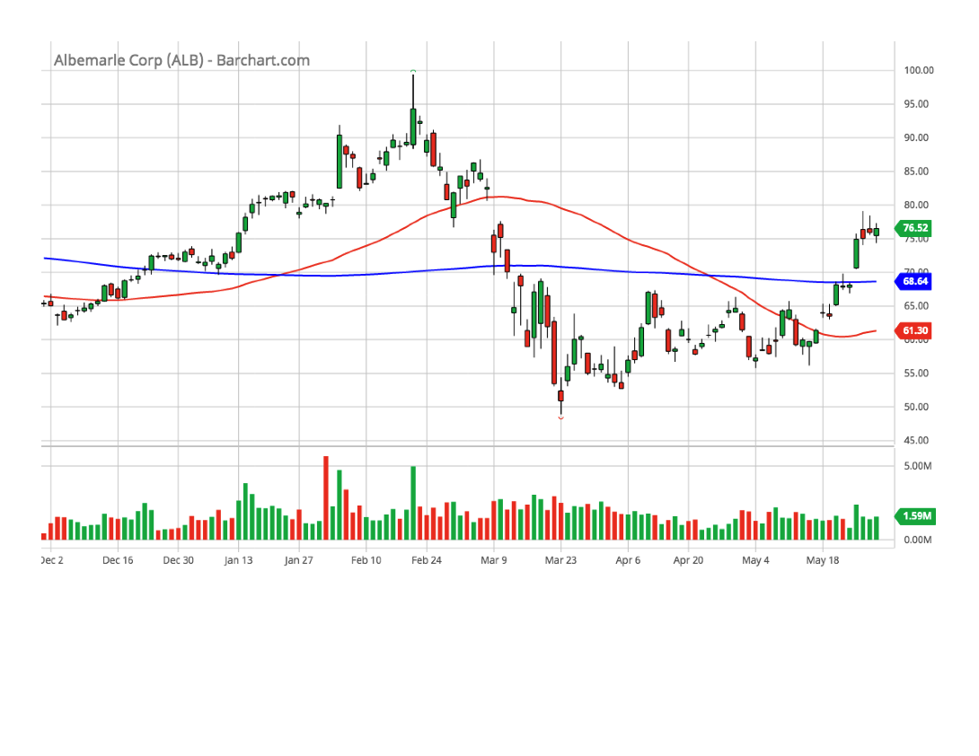
Albemarle Corp. (ALB)(6-month chart)

Slide 10
Albemarle Corp. (ALB)(SSG)

Slide 11
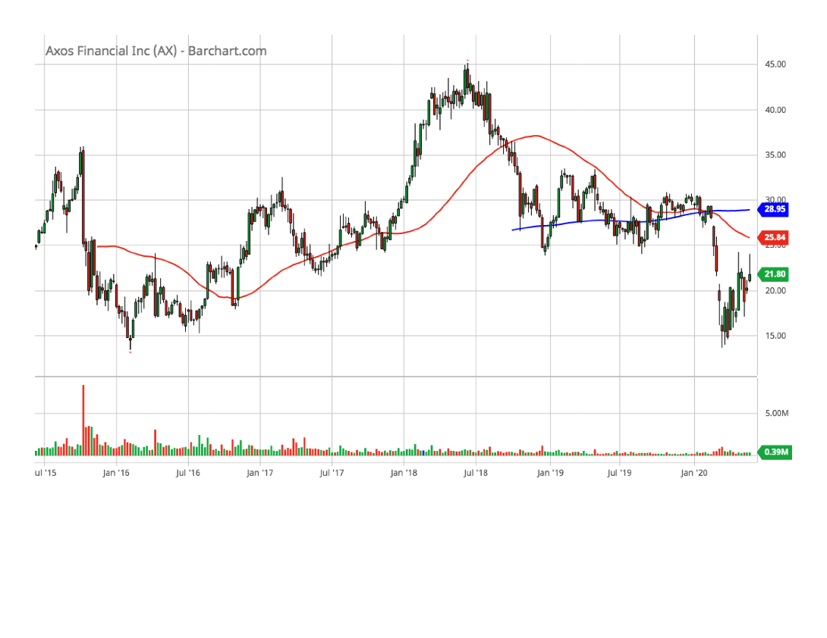
Axos Financial (AX)(5-year chart)

Slide 12
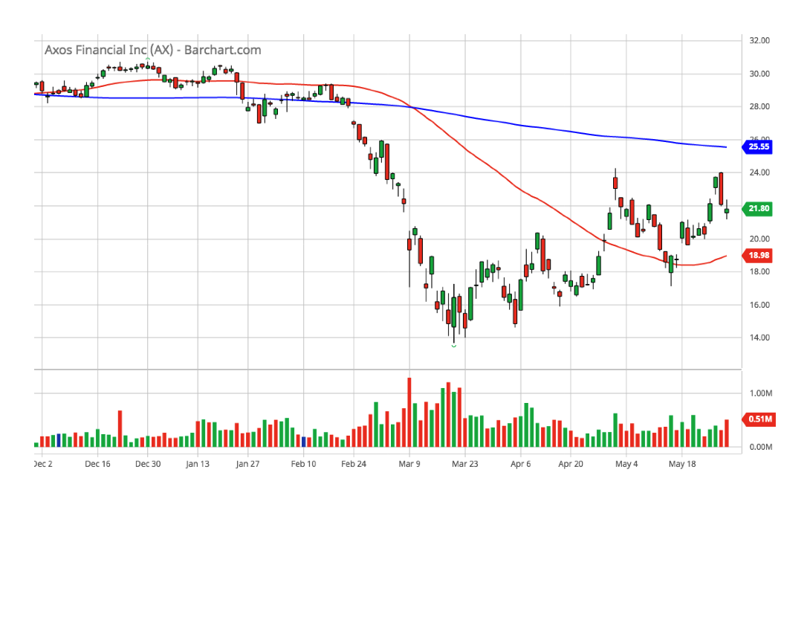
Axos Financial (AX)(6-month chart)

Slide 13
Axos Financial (AX)(SSG)

Slide 14
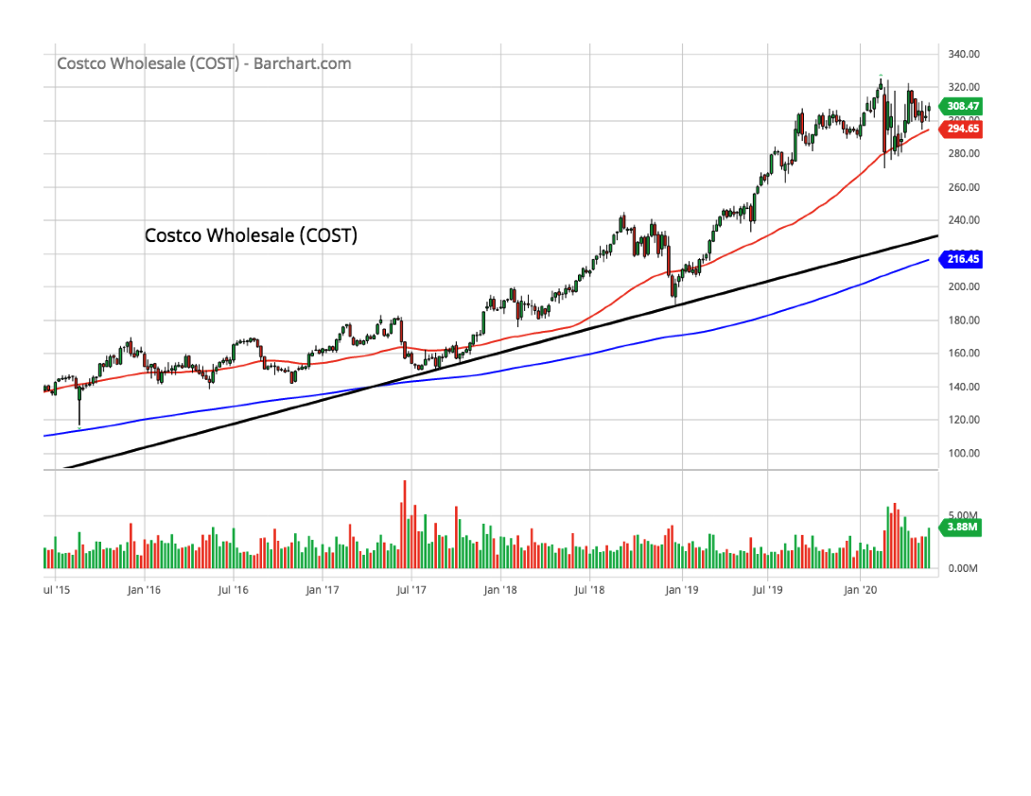
Costco Wholesale (COST)(5-year chart)

Slide 15
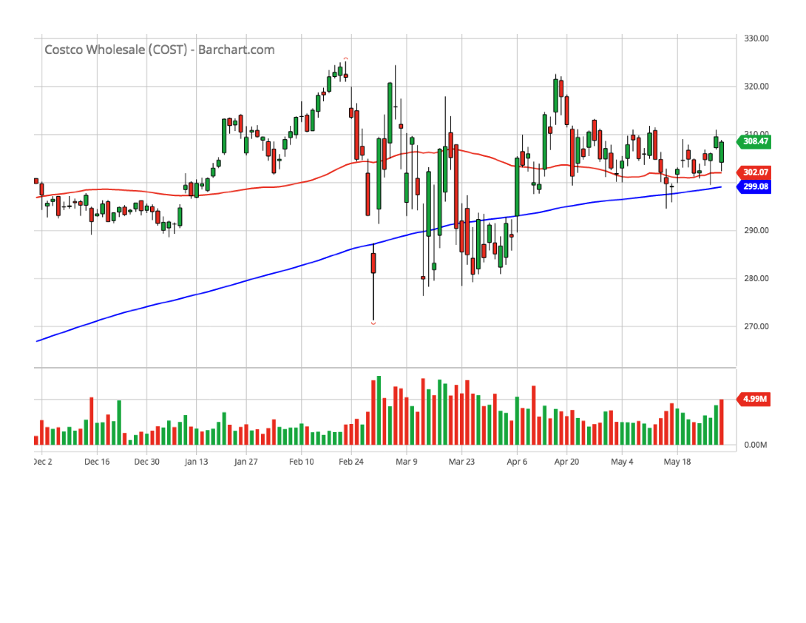
Costco Wholesale (COST)(6-month chart)

Slide 16
Costco Wholesale (COST)(SSG)

Slide 17
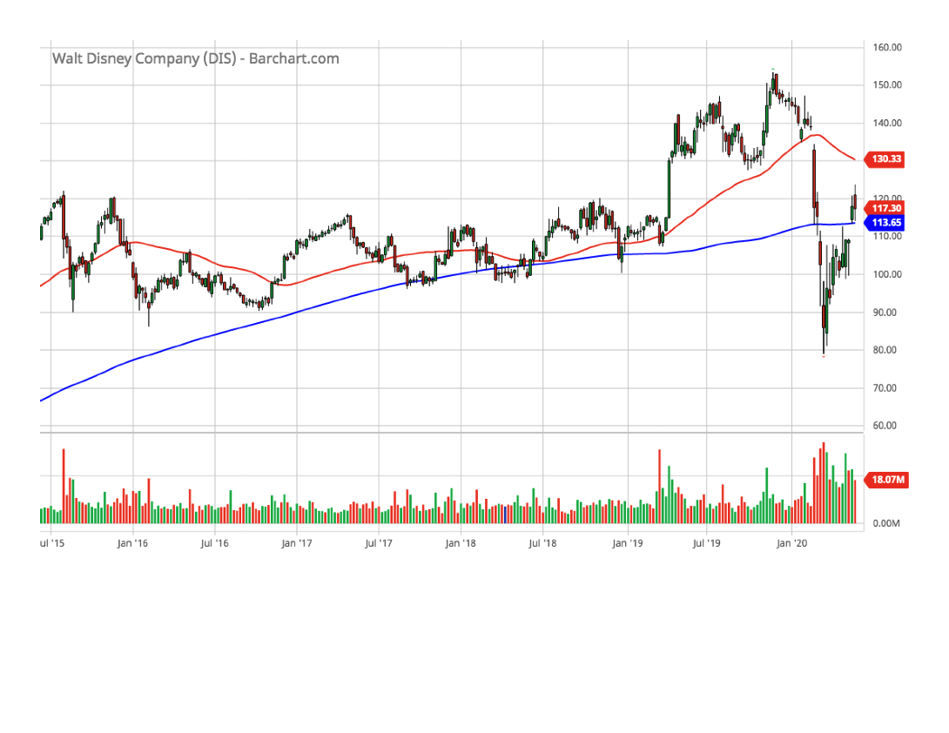
Disney (Walt) (DIS)(5-year chart)

Slide 18
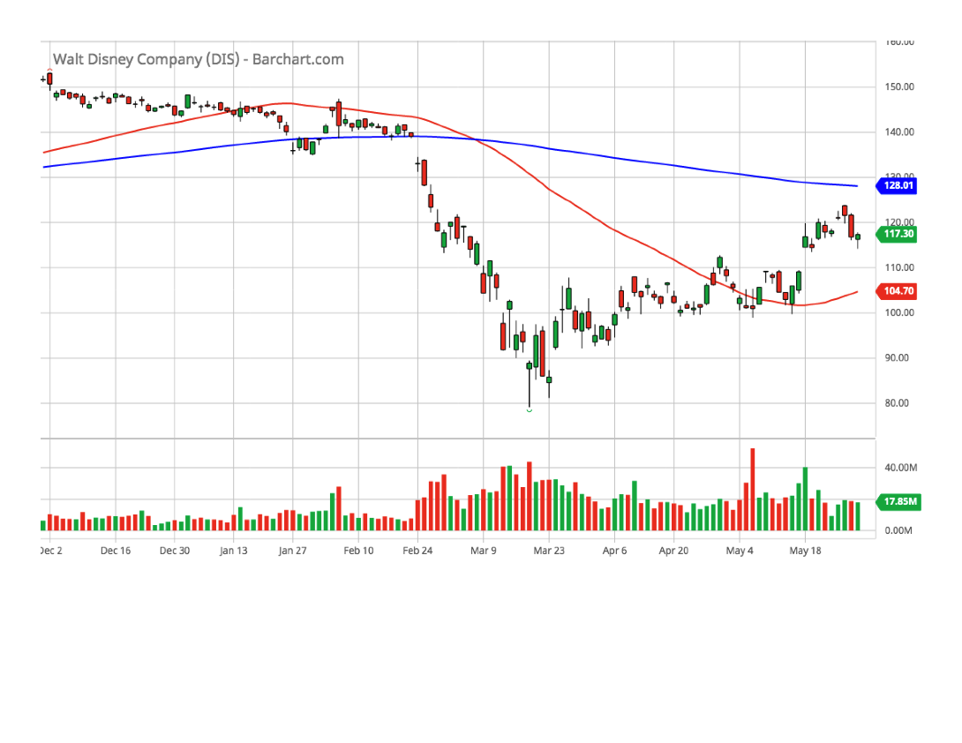
Disney (Walt) (DIS)(6-month chart)

Slide 19
Disney (Walt) (DIS)(SSG)

Slide 20
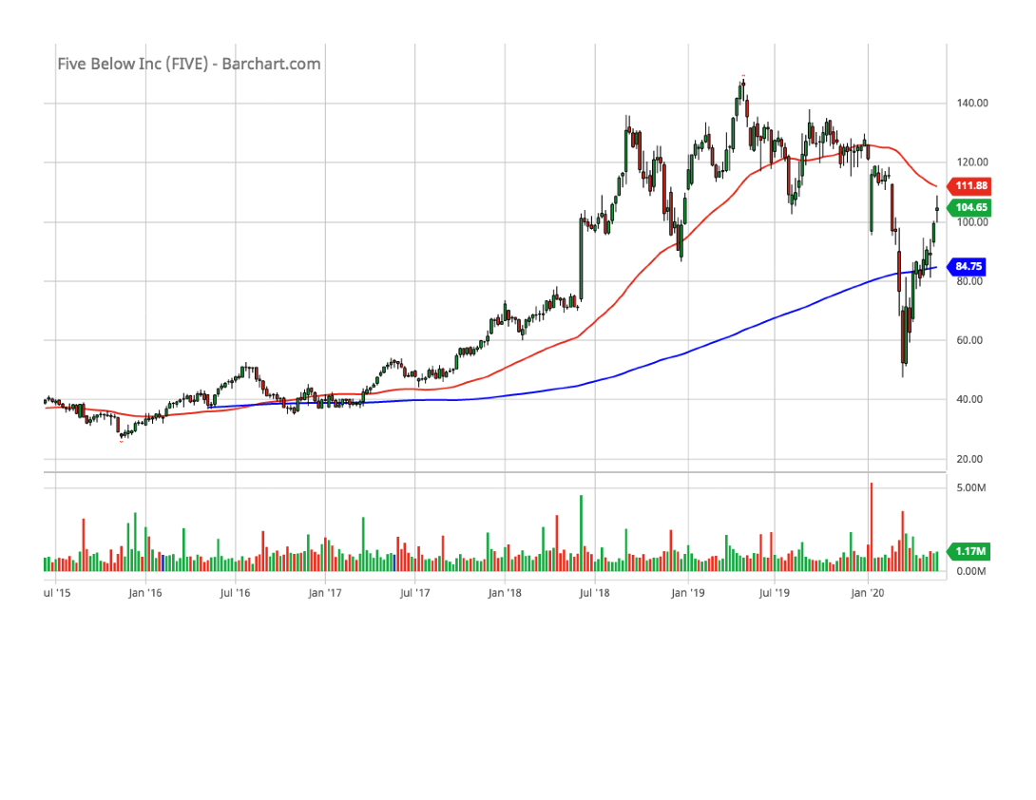
Five Below (FIVE)(5-year chart)

Slide 21
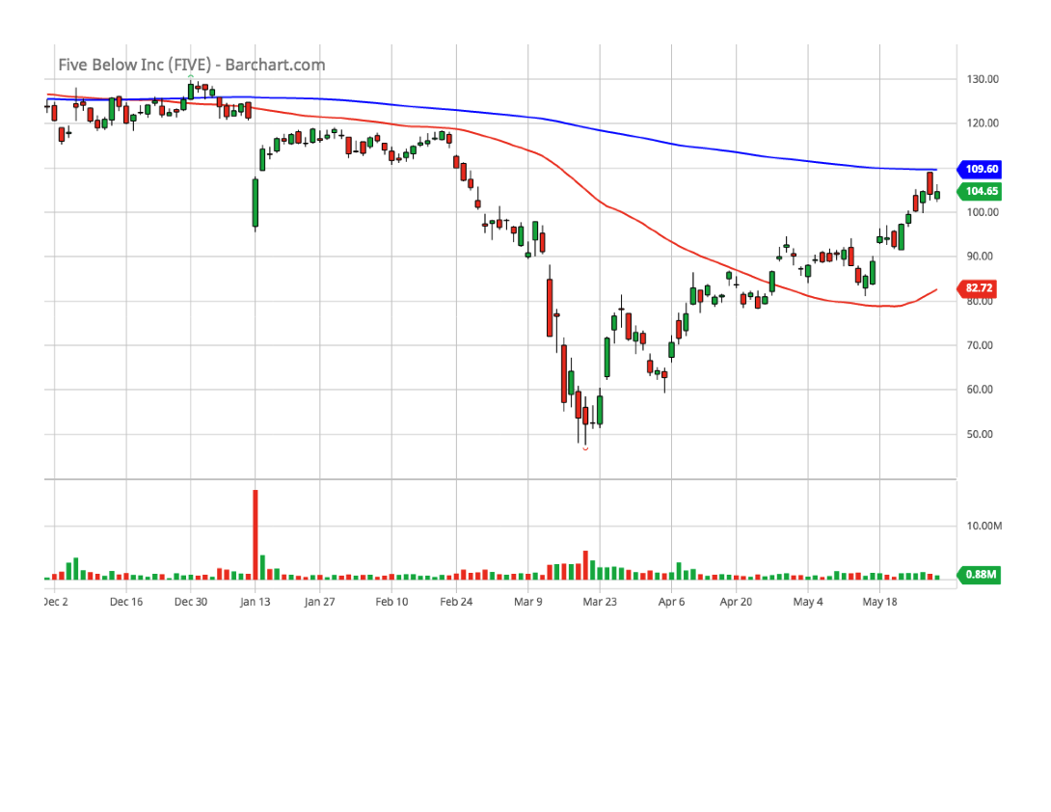
Five Below (FIVE)(6-month chart)

Slide 22
Five Below (FIVE)(SSG)

Slide 23
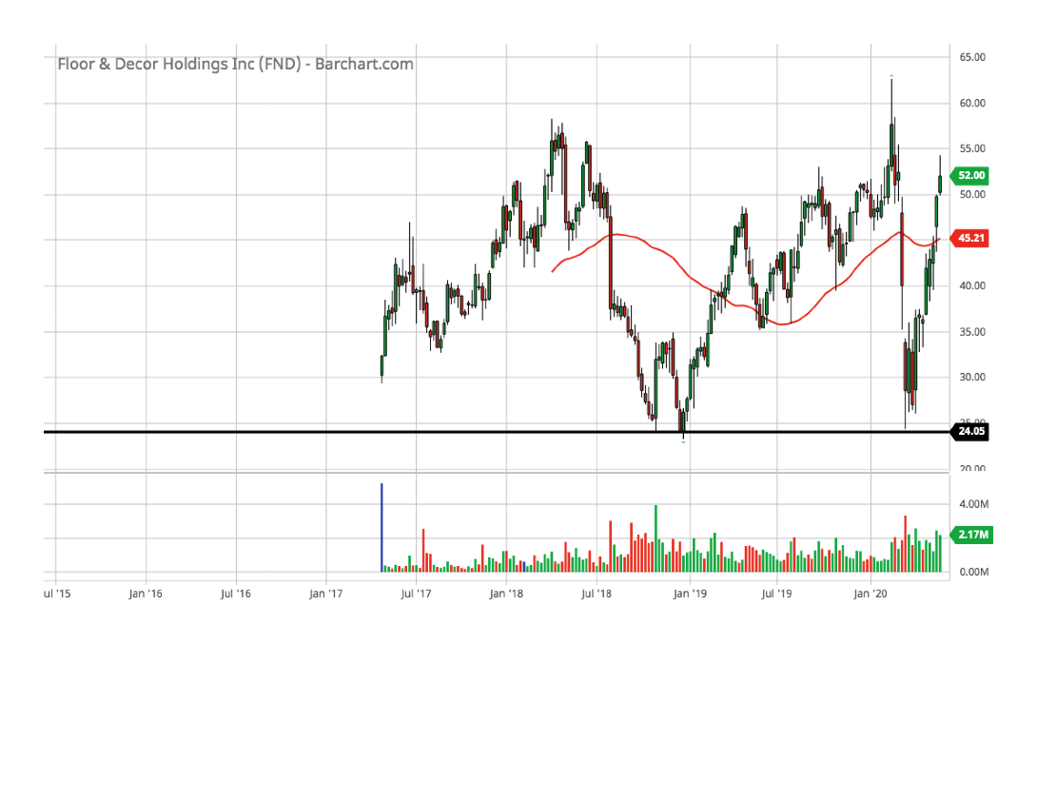
Floor & Décor (FND)(5-year chart)

Slide 24
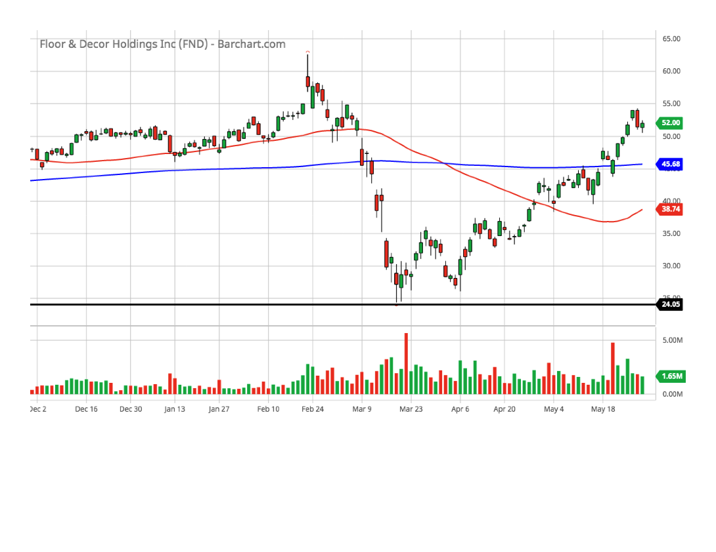
Floor & Décor (FND)(6-month chart)

Slide 25
Floor & Décor (FND)(SSG)

Slide 26
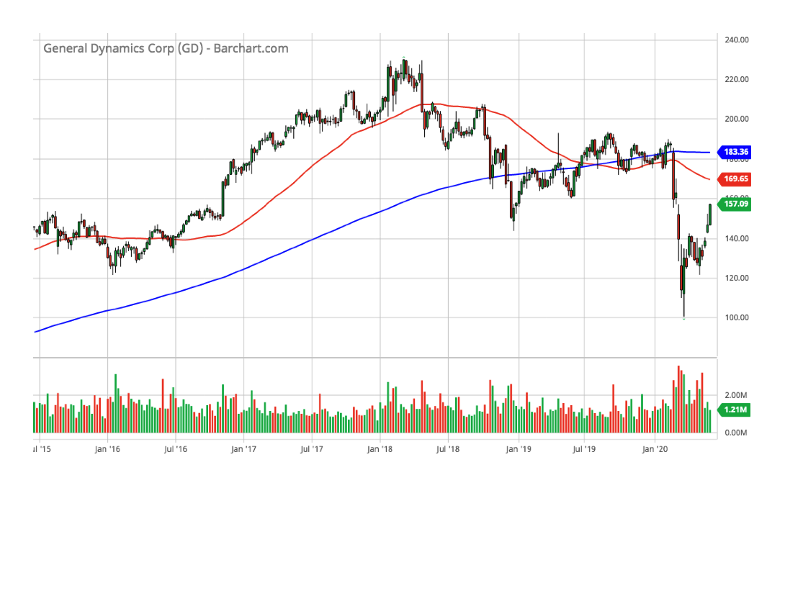
General Dynamics (GD)(5-year chart)

Slide 27
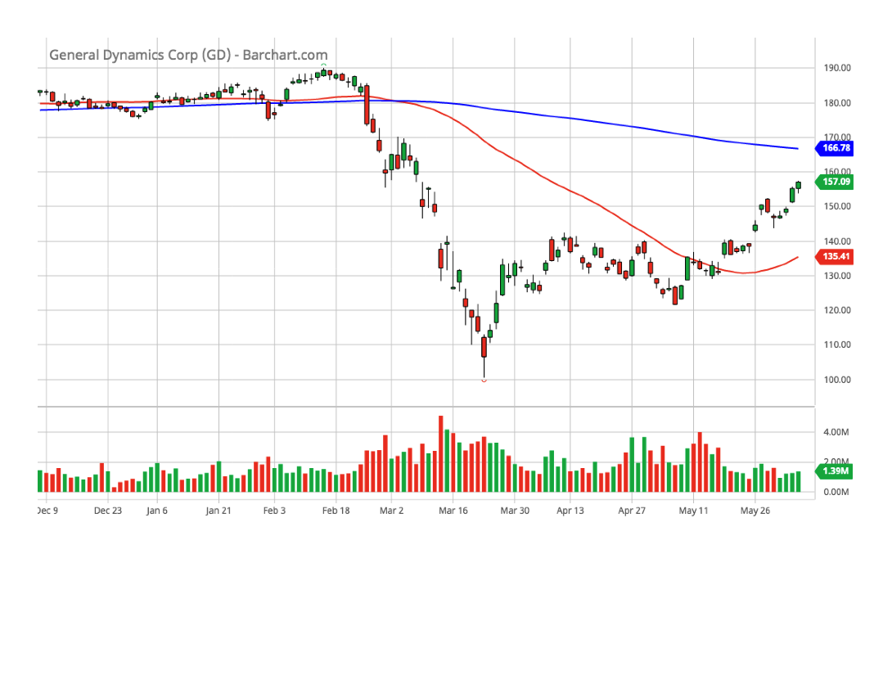
General Dynamics (GD)(6-month chart)

Slide 28
General Dynamics (GD)(SSG)

Slide 29
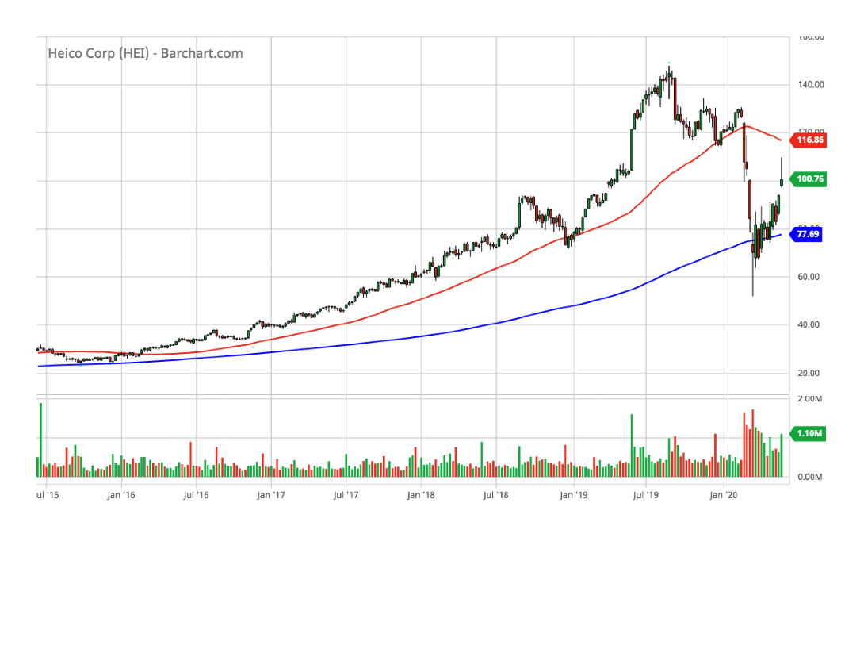
HEICO Corp (HEI)(5-year chart)

Slide 30
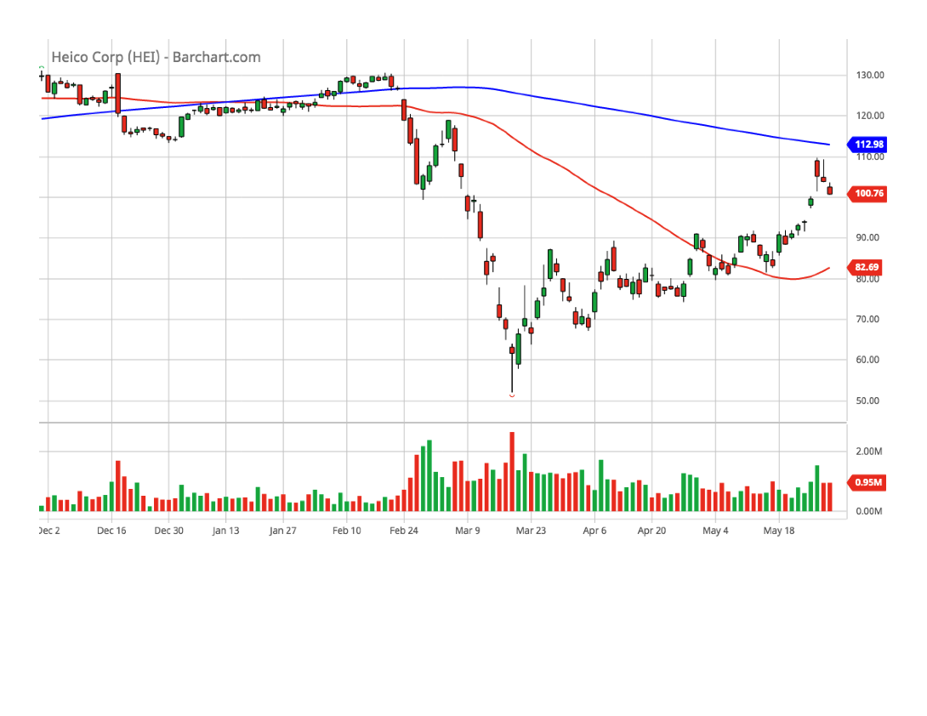
HEICO Corp (HEI)(6-month chart)

Slide 31
HEICO Corp (HEI)(SSG)

Slide 32
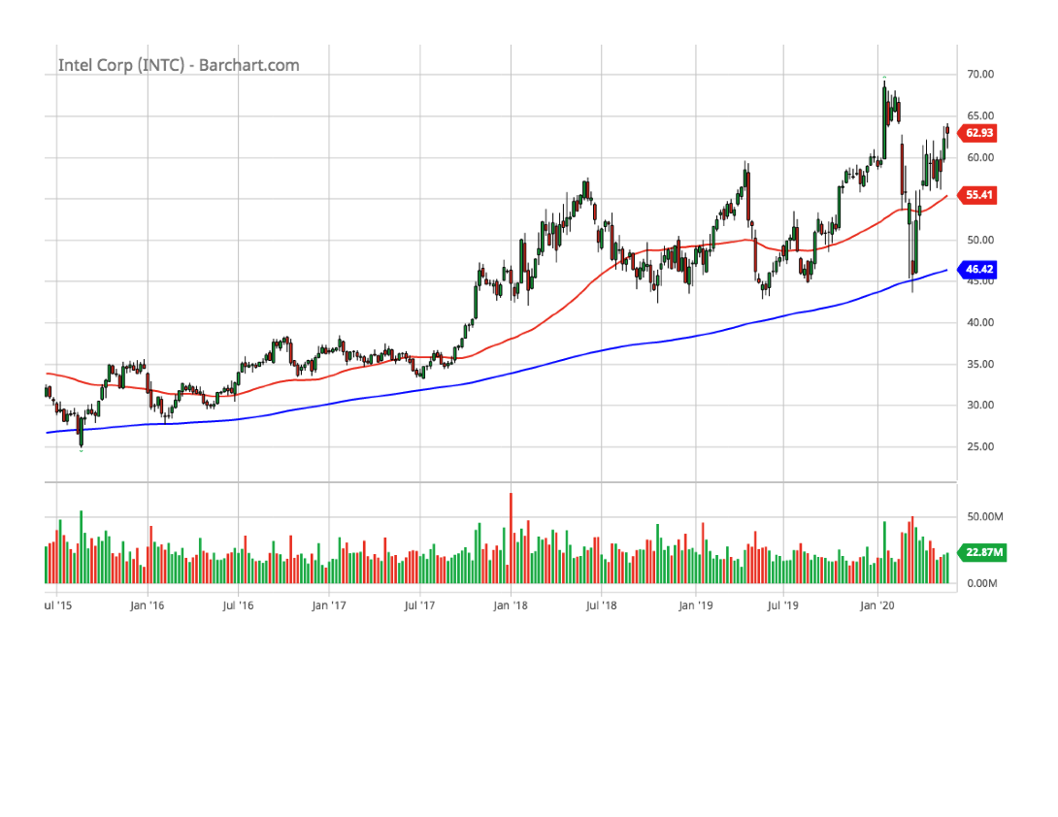
Intel (INTC)(5-year chart)

Slide 33
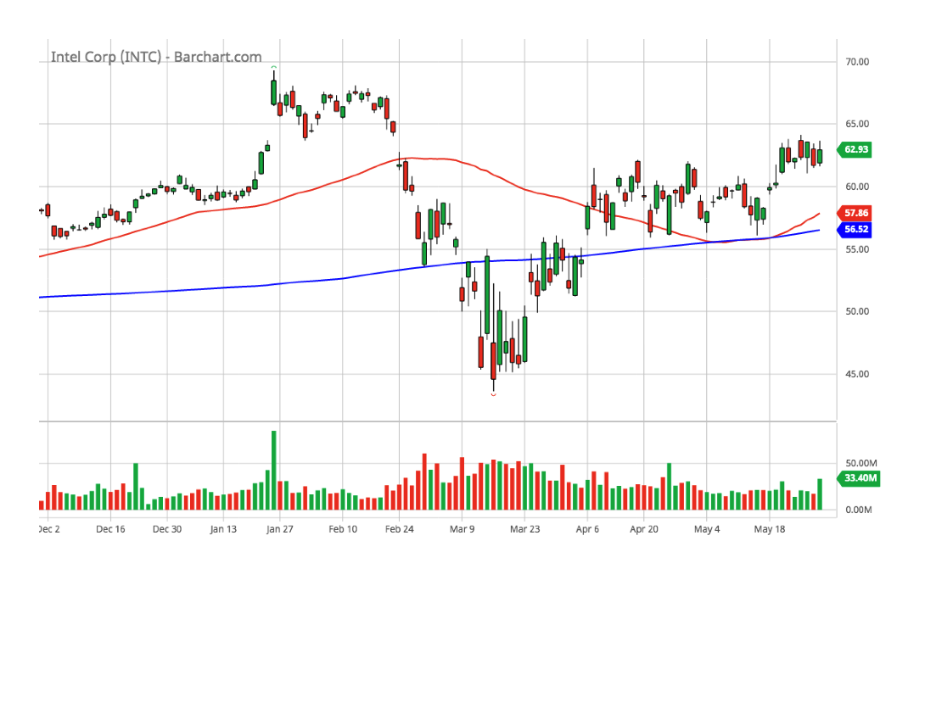
Intel (INTC)(6-month chart)

Slide 34
Intel (INTC)(SSG)

Slide 35
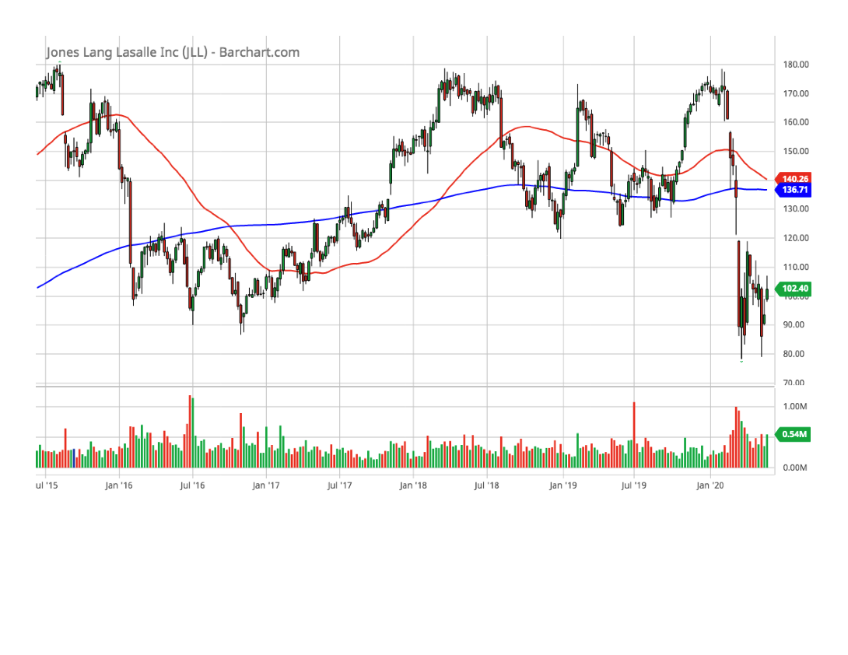
Jones Lang Salle (JLL)(5-year chart)

Slide 36
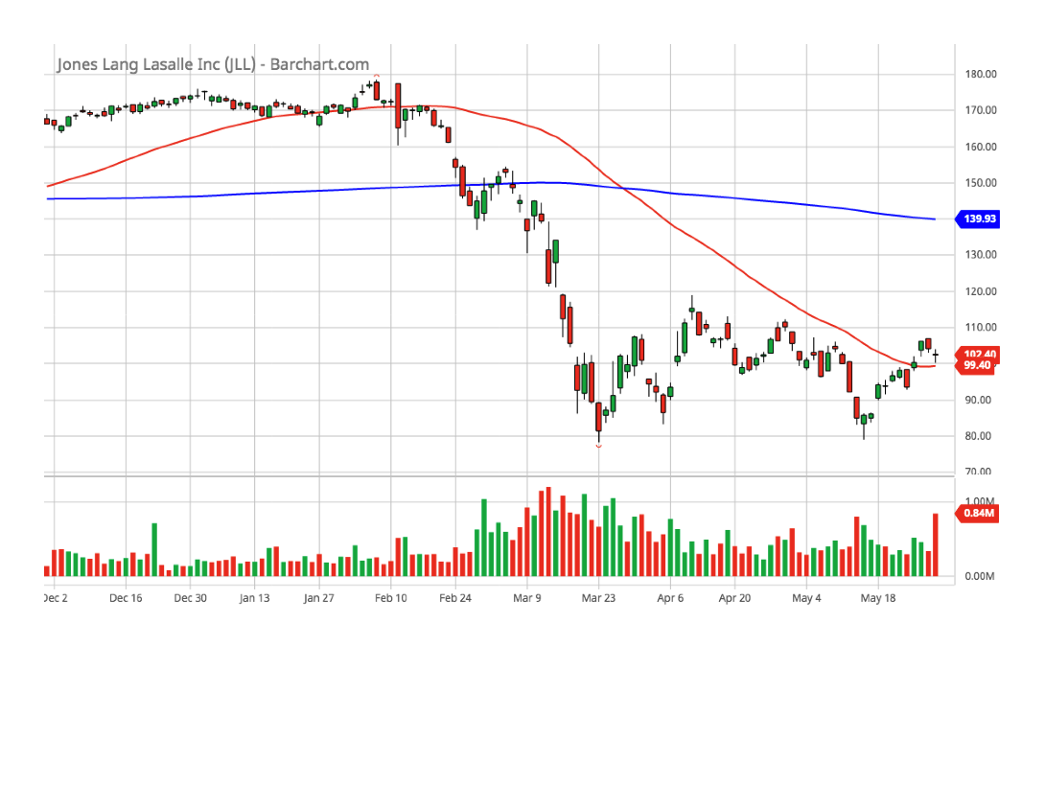
Jones Lang Salle (JLL)(6-month chart)

Slide 37
Jones Lang Salle (JLL)(SSG)

Slide 38
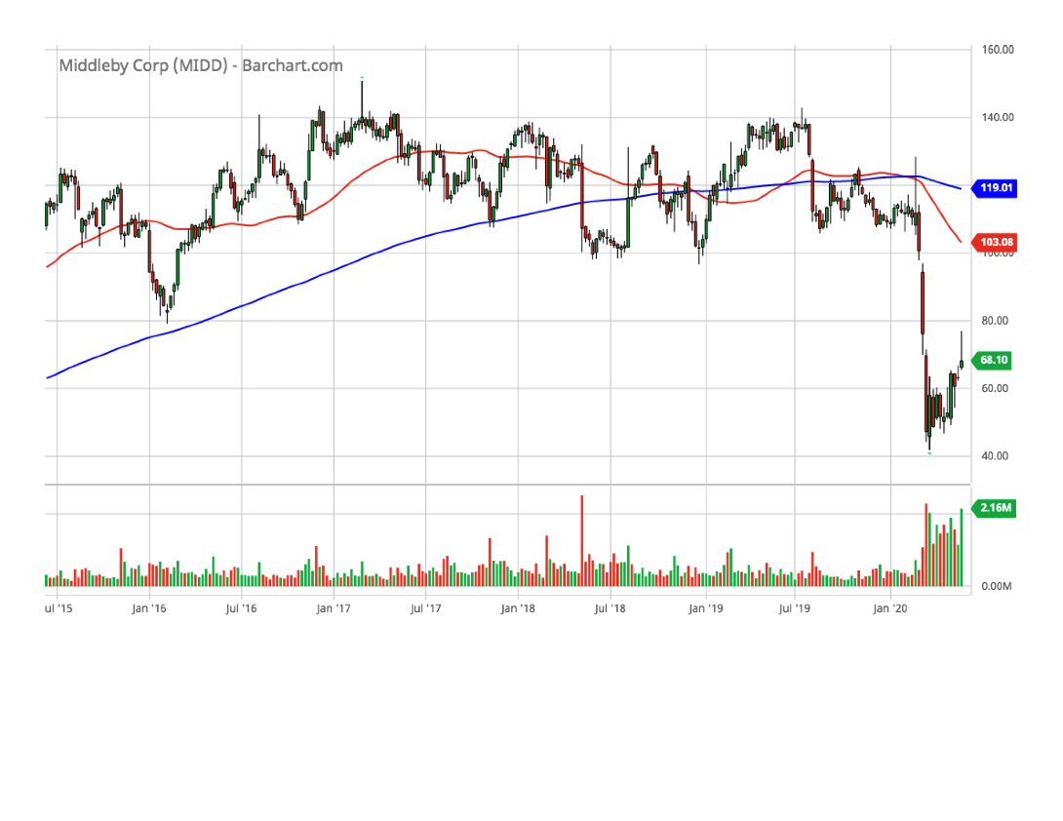
Middleby (MIDD)(5-year chart)

Slide 39
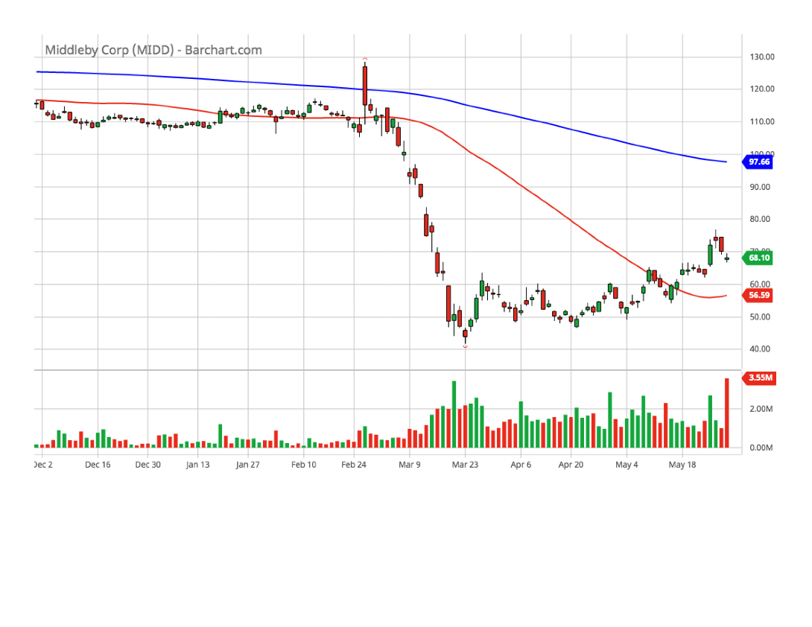
Middleby (MIDD)(6-month chart)

Slide 40
Middleby (MIDD)(SSG)

Slide 41
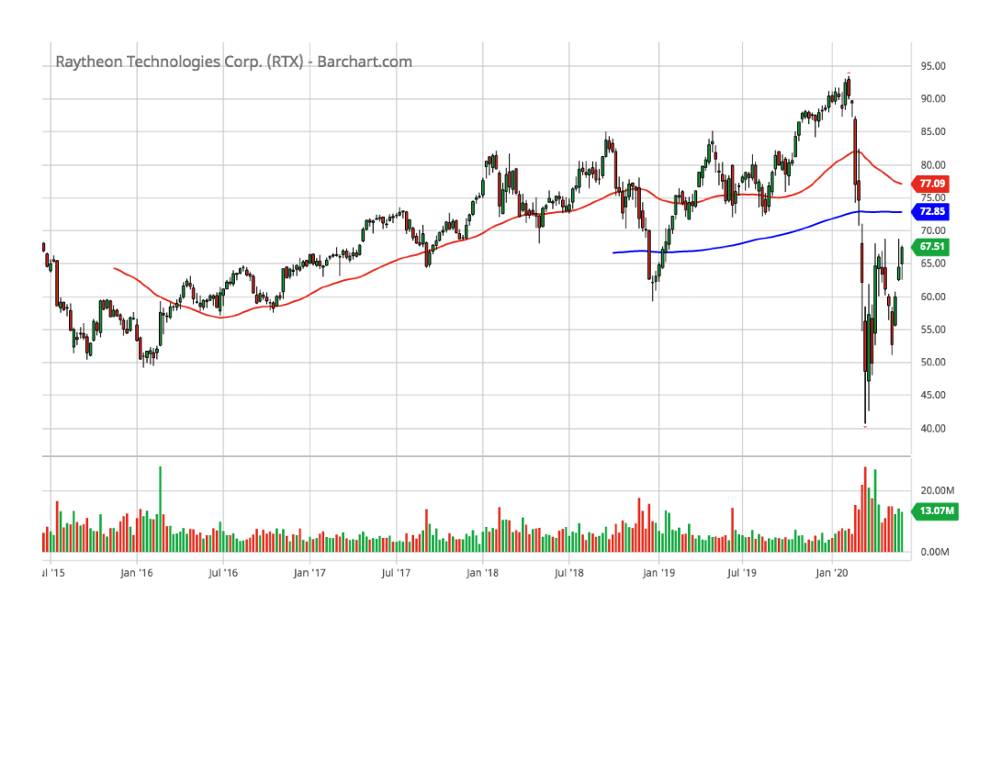
Raytheon Technologies (RTX)(5-year chart)

Slide 42
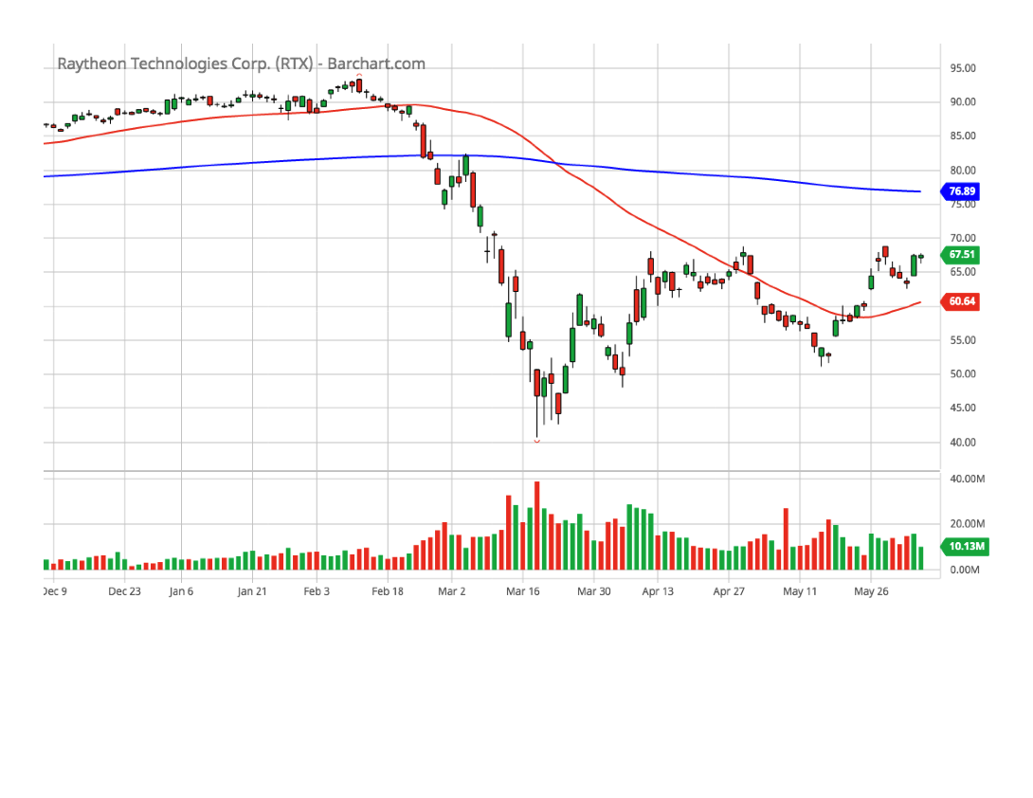
Raytheon Technologies (RTX)(6-month chart)

Slide 43
Raytheon Technologies (RTX)(SSG)

Slide 44
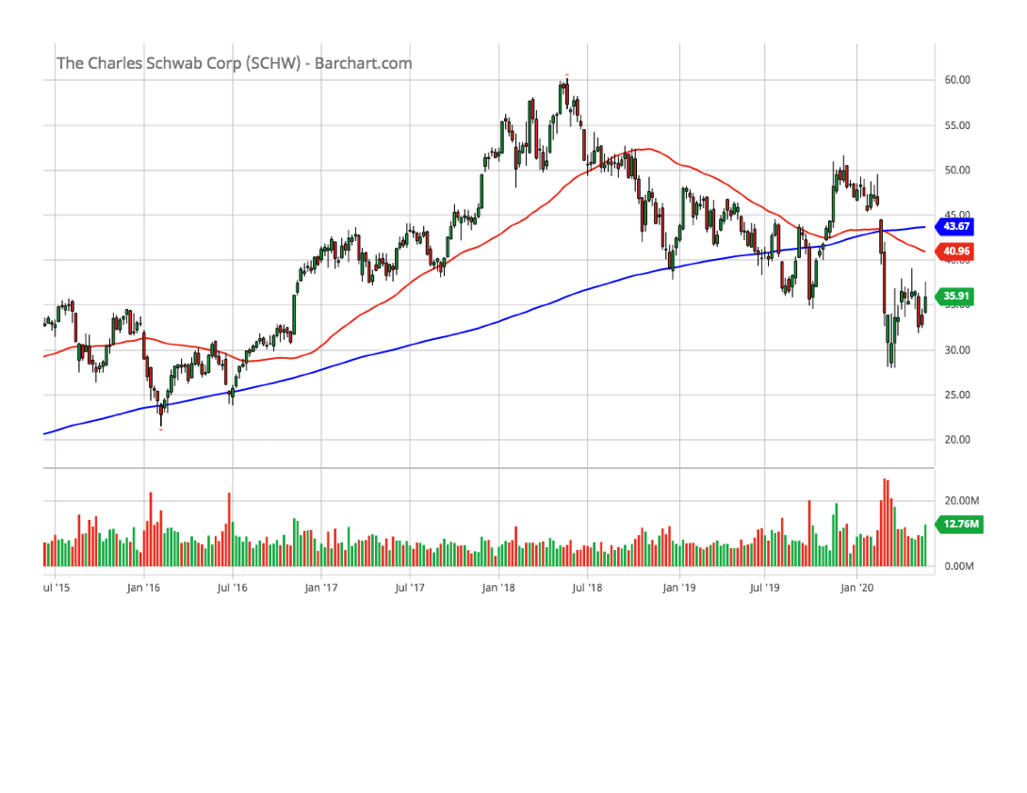
Schwab, Charles (SCHW)(5-year chart)

Slide 45
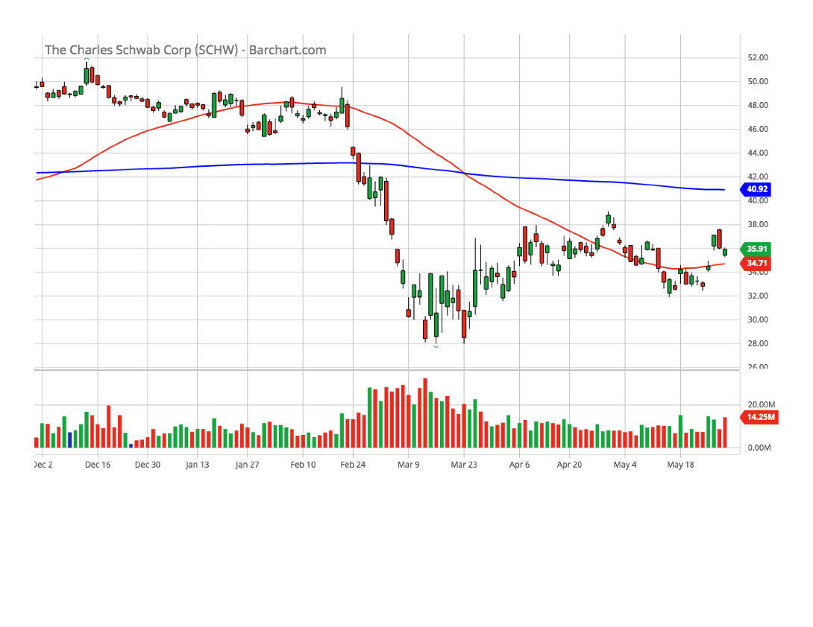
Schwab, Charles (SCHW)(6-month chart)

Slide 46
Schwab, Charles (SCHW)(SSG)

Slide 47
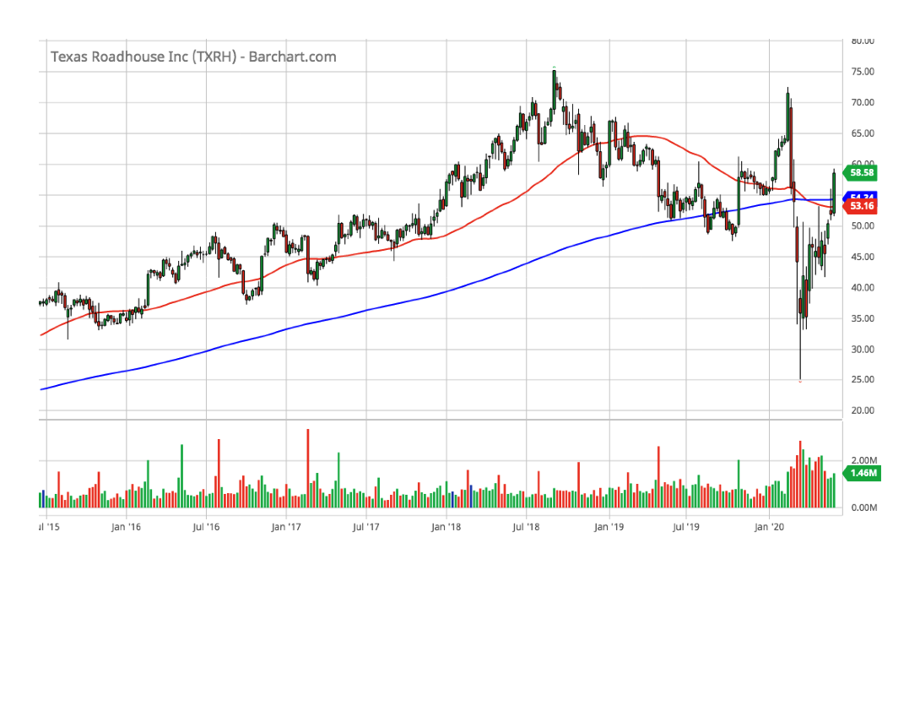
Texas Roadhouse (TXRH)(5-year chart)

Slide 48
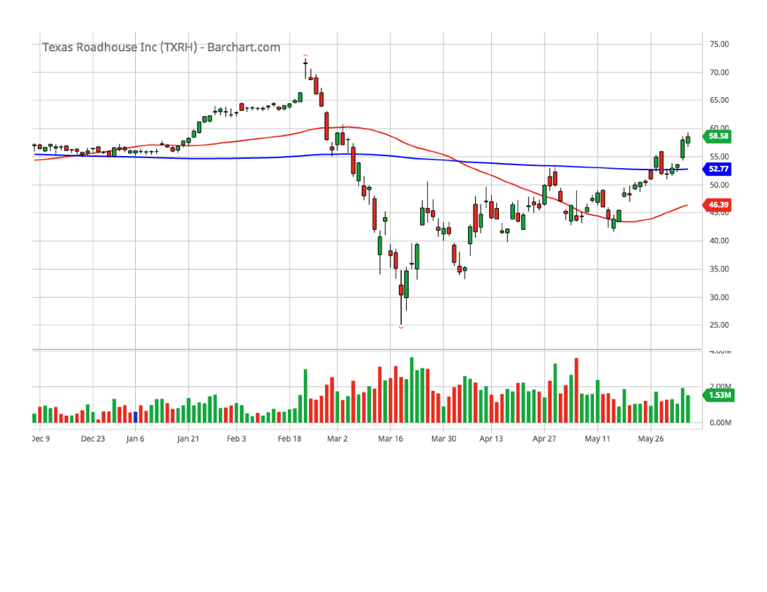
Texas Roadhouse (TXRH)(6-month chart)

Slide 49
Texas Roadhouse (TXRH)(SSG)

Slide 50
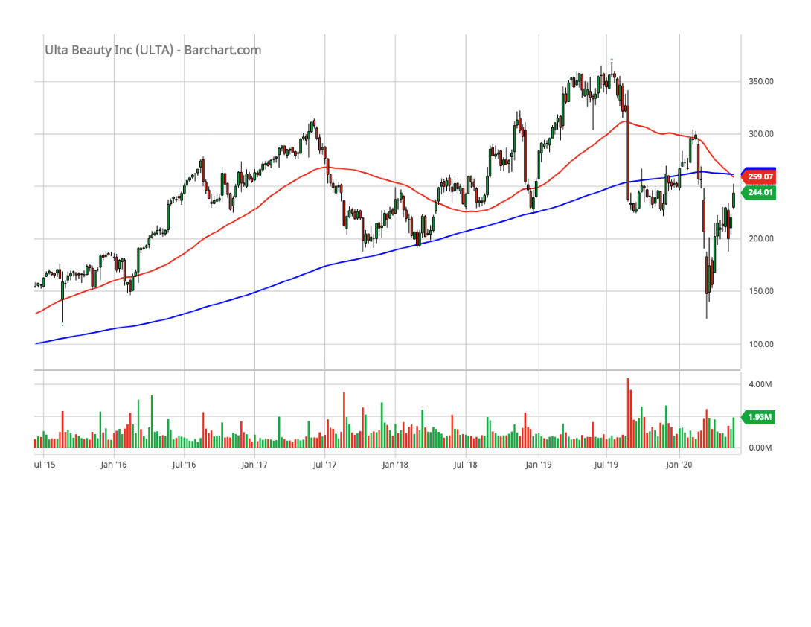
Ulta Beauty (ULTA)(5-year chart)

Slide 51
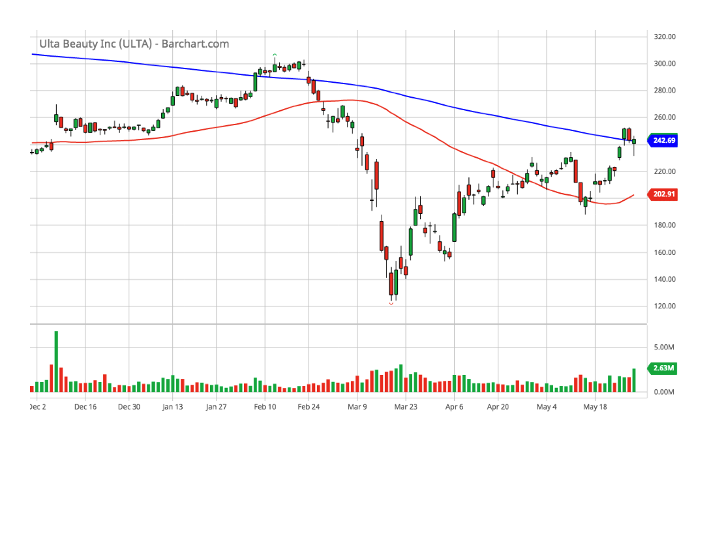
Ulta Beauty (ULTA)(6-month chart)

Slide 52
Ulta Beauty (ULTA)(SSG)

Slide 53
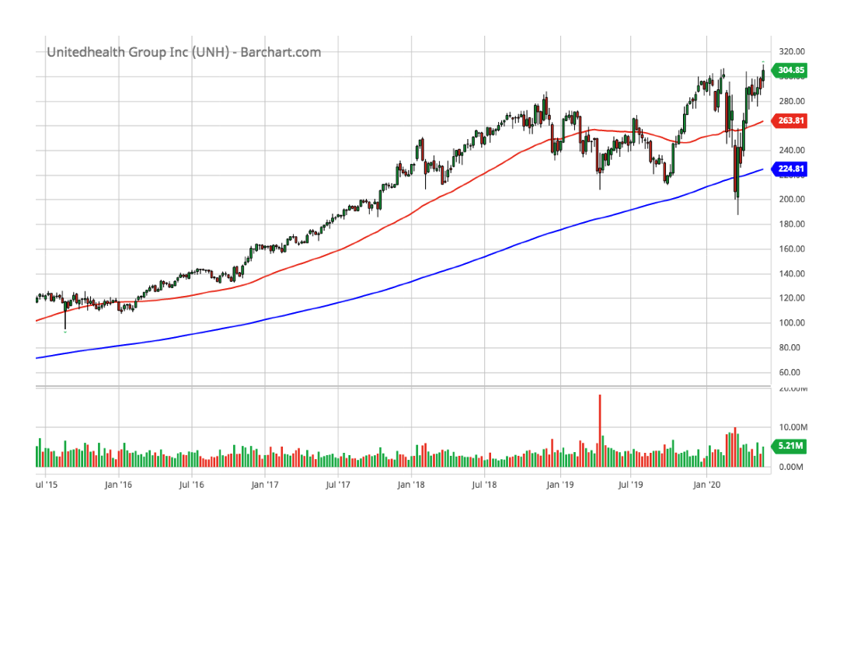
UnitedHealth Group (UNH)(5-year chart)

Slide 54
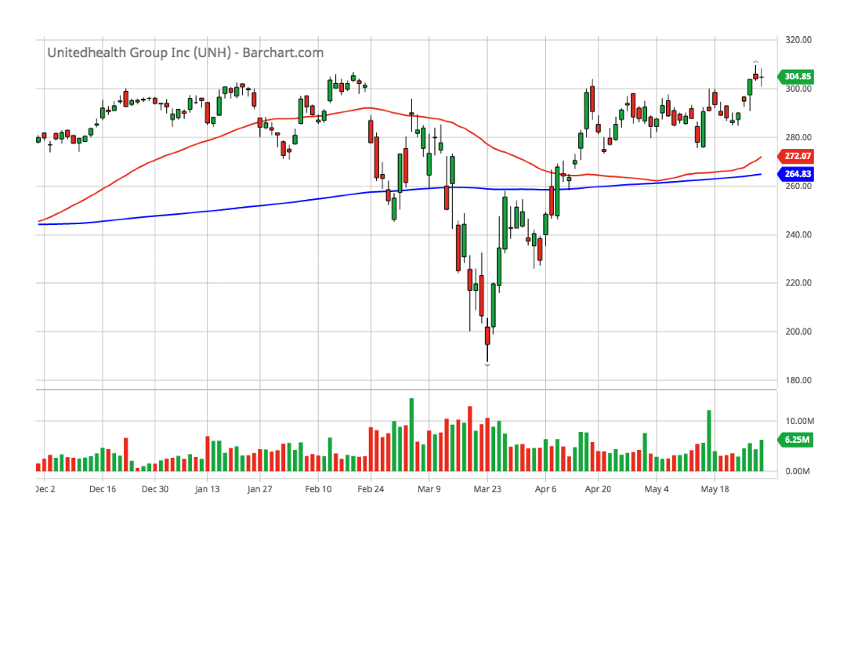
UnitedHealth Group (UNH)(6-month chart)

Slide 55
UnitedHealth Group (UNH)(SSG)

Slide 56
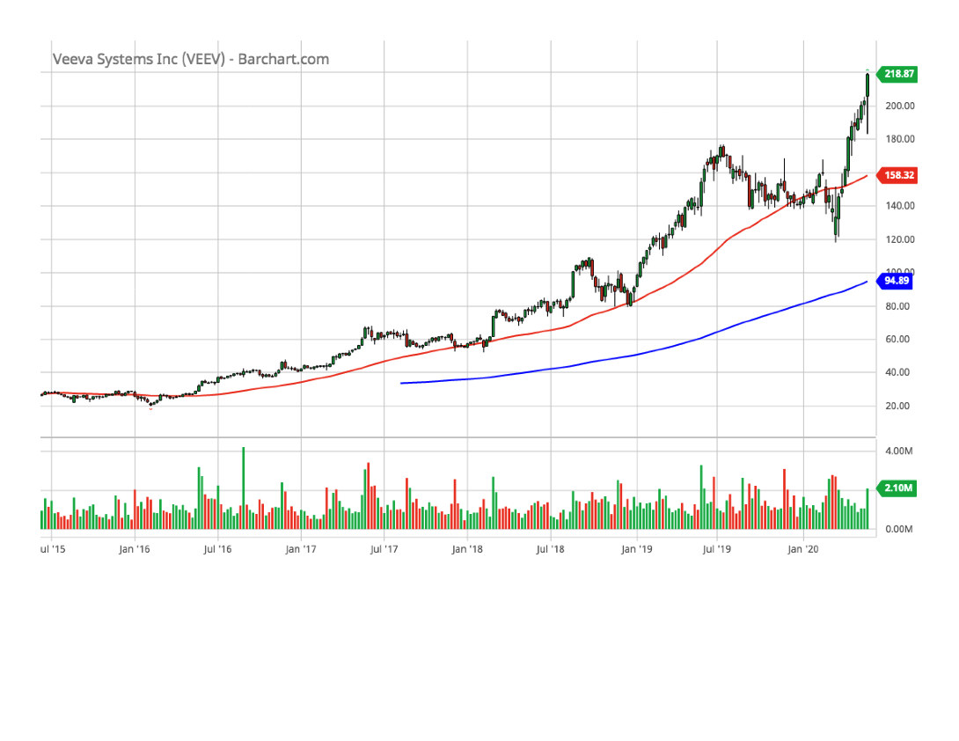
Veeva Systems (VEEV)(5-year chart)

Slide 57
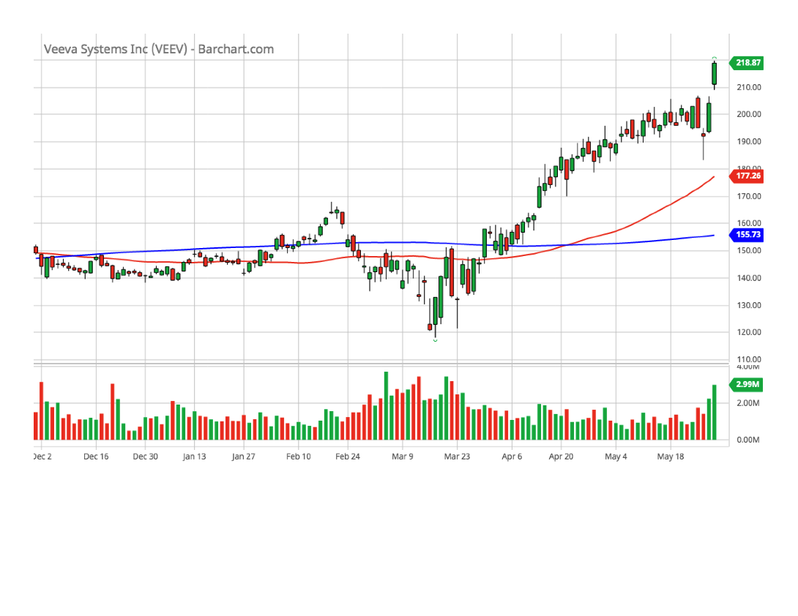
Veeva Systems (VEEV)(6-month chart)

Slide 58
Veeva Systems (VEEV)(SSG)

Slide 59
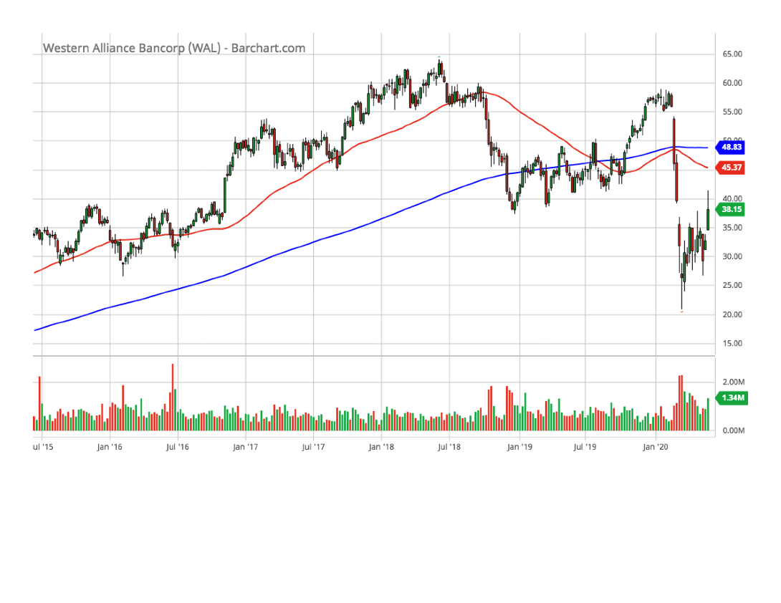
Western Alliance (WAL)(5-year chart)

Slide 60
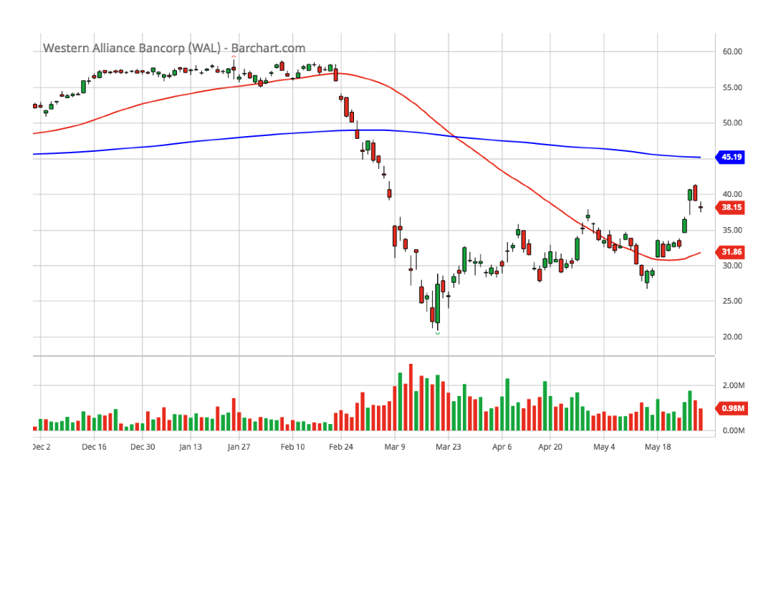
Western Alliance (WAL)(6-month chart)

Slide 61
Western Alliance (WAL)(SSG)

