Slide 1
The Basics of Stock Chart Analysis
Just as fundamental analysis requires the study of past performance to predict future price movement… so does technical analysis.

Slide 2
Candlesticks
Candlesticks represent four price points (open, close, high, and low) within a determined period of time. They also act a visual representation of emotional sentiment. Better known as “volatility.”

Slide 3
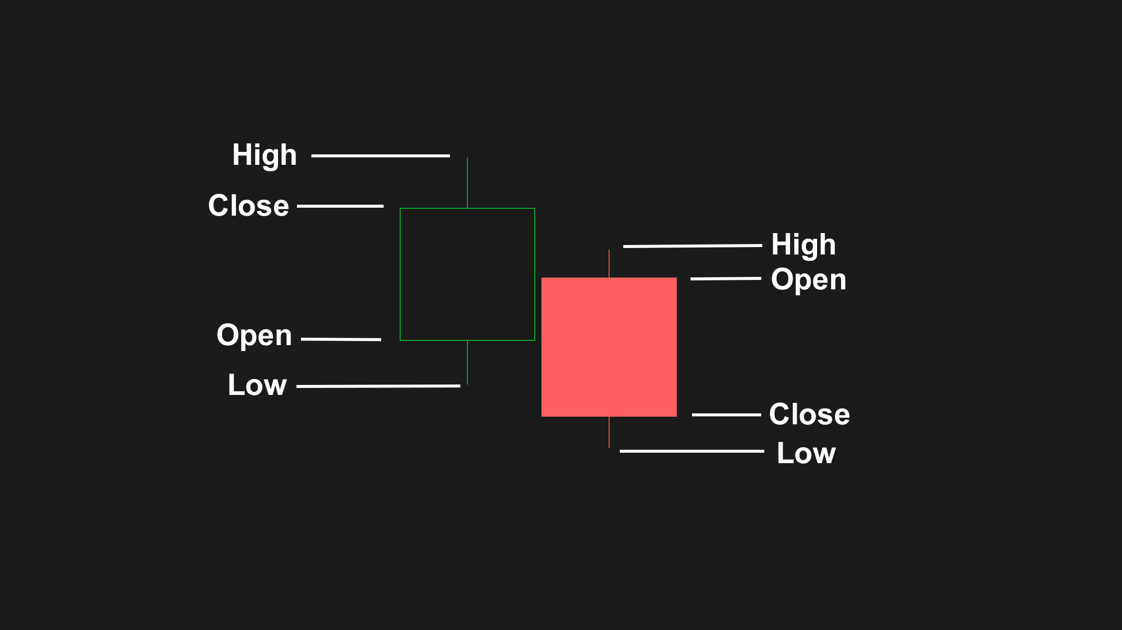
Candlesticks

Slide 4
Support & Resistance (Trend Lines/Price Levels)
Technical analysts use support and resistance levels to identify price points on a chart where the probabilities favor a reversal of a trend.
Support occurs where a downtrend is expected to pause or reverse due to a concentration of demand. Simply put… Buyers step in.
Resistance occurs where an uptrend is expected to pause or reverse due to a concentration of supply. Simply put…Sellers step in.
Both support and resistance can be identified by plotting out trend lines and price levels.
Trend Lines are recognizable lines that investors draw on charts to connect reoccurring events in a given stock’s price action. The resulting line is then used to give the investor a good idea of the direction and behavior in which an investment's value might move.
Price Levels are specific types of trend lines used to plot the exact price points at which a stock reversed trend.
The time period being analyzed and the exact points used to create a trendline vary from trader to trader. Thus these trend lines are subjective and often more than not… market psychology is often attributed to the analysis of support and resistance.

Slide 5
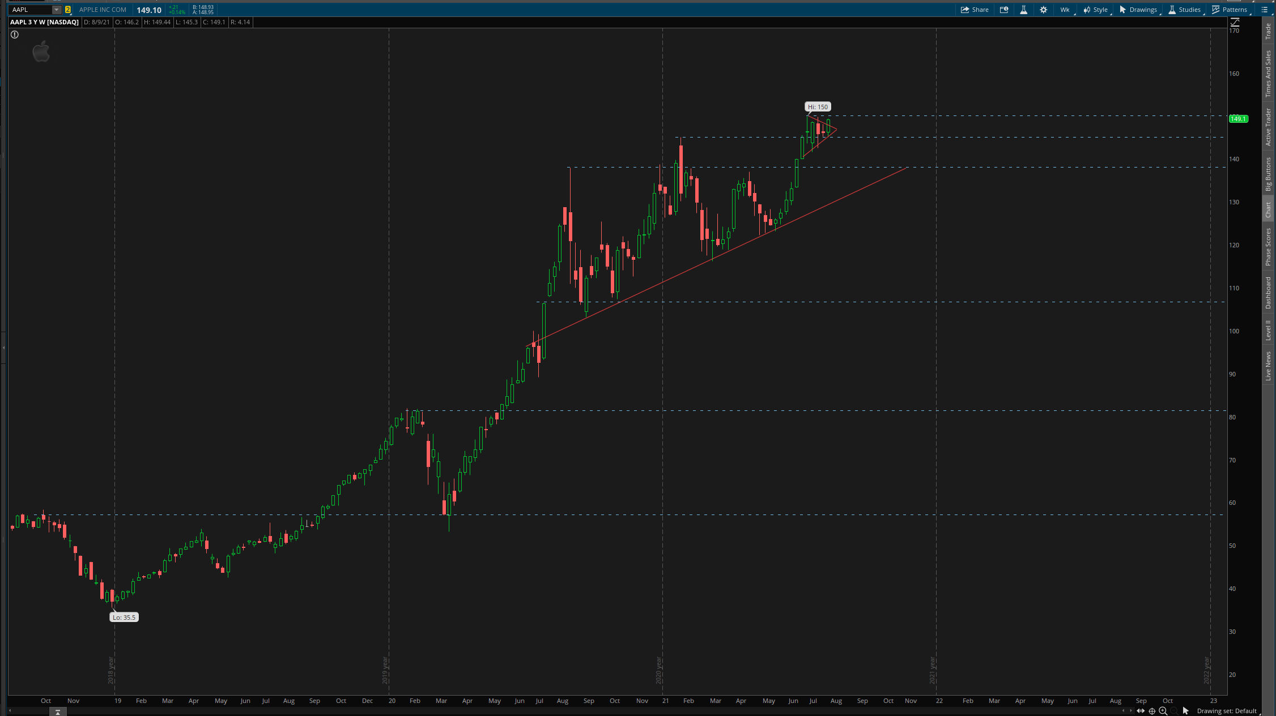
Support & Resistance (Trend Lines/Price Levels)

Slide 6
Patterns
A pattern is a recognizable configuration of price movement that is identified using a series of trend lines and price levels.
Patterns are identified by trend lines that connect common price points, such as closing prices or highs & lows, during a specific period of time.
Technical analysts seek to identify patterns as a way to anticipate the future direction of a security’s price.

Slide 7
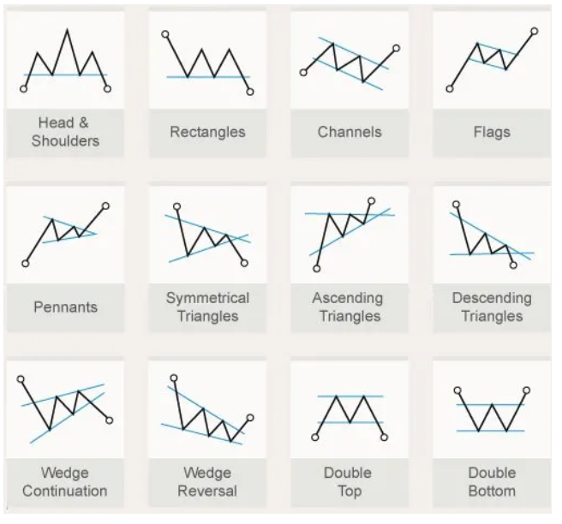
Patterns

Slide 8
EX: GE 20 Yr / Monthly Chart

