Slide 1
Portfolio Evaluation Review Technique (PERT)
For: Tropix ‘NVestors
From: Sheryl Patterson Director DC Regional Chapter
srap14@gmail.com
With recognition for slide development to: Chris Kirsop, President Puget Sound Chapter

Slide 2
Disclaimer
The information in this presentation is for educational purposes only and is not intended to be a recommendation to purchase or sell any of the stocks, mutual funds, or other securities that may be referenced. The securities of companies referenced or featured in the seminar materials are for illustrative purposes only and are not to be considered endorsed or recommended for purchase or sale by BetterInvestingTM National Association of Investors Corporation (“BI”). The views expressed are those of the instructors, commentators, guests and participants, as the case may be, and do not necessarily represent those of BetterInvesting. Investors should conduct their own review and analysis of any company of interest before making an investment decision.
Securities discussed may be held by the instructors in their own personal portfolios or in those of their clients. BI presenters and volunteers are held to a strict code of conduct that precludes benefiting financially from educational presentations or public activities via any BetterInvesting programs, events and/or educational sessions in which they participate. Any violation is strictly prohibited and should be reported to the CEO of BetterInvesting or the Director of Chapter Relations.
This presentation may contain images of websites and products or services not endorsed by BetterInvesting. The presenter is not endorsing or promoting the use of these websites, products or services.
This session is being recorded for future use.

Slide 3
Our Presentation Objectives
Review the criteria describing what we are
looking for in a quality, growth portfolio
• Show how the PERT Report can be used to
help achieve the BetterInvesting stated goal of
a 15% return per year in a quality, growth
portfolio

Slide 4
PERT Report Characteristics
• 18 Companies
• Current SSGs for each company
• SSG Methodology
– Used Analysts Consensus Estimates (ACE) for Sales and Earnings
growth estimates (where unavailable, used Morningstar or Value Line)
– Used average high P/E x projected earnings for high price.
– Used average low P/E x current earnings for low price (in some cases and recent low price in other cases).

Slide 5
Target Portfolio Characteristics
Diversification by size
– 25% small, 50% medium, 25% large
• Company size by revenue implies company size by growth rates
– small (<$1B) medium ($1B to $10B) large (>$10B)
– small (>15%) medium (10% to 15%) large (7% to 10%)
• Our goal is a portfolio growth rate of 10% or better
Diversification by sector
– Aim for 4 or more sectors to be represented (BI tool has 11 sectors)
– No more than 30% of the portfolio in any one sector
– Avoid more than 2X an equal position for any one company
– Let’s see how your portfolio stacks up
Notes:
I want to draw your attention to the Handout List, specifically the Portfolio Quickstart that details how to start and maintain a Portfolio listing. (Go to live BI website to show Portfolio listing and reports). Please remind me to return here to show you step by step how to use this part of the tool.
Now that we have the current SSG’s and have inputted them into the online SSG tool, we’re going to look at how the portfolio is doing from a diversification standpoint of sector, size, company and portfolio value.
One of the rules that we have dwelt upon in BetterInvesting is to have diversification in a portfolio. We’ll look at your portfolio by size and by that I mean the size of sales growth. You can see by this chart that a small company would be one with sales of less than $1 Billion. A medium company would have sales between $1 Billion and $10 Billion, and a large company would have sales of more than $10 Billion. To achieve diversification by size would be a split of roughly 25% small and 25% large with the remainder in mid-size growth companies. One of the biggest problems of maintaining this split is that small companies, if they are quality growth companies will not remain in the less than $1 Billion sales growth category for too long. This means that you will have to continue to remain on the hunt for quality small companies to replace those that move to Mid-size and Large. The goal is to have a total sales growth number of 10% or better.
The next diversification is by sector. Some rules of thumb include Aiming for 4 or more sectors to be represented (BI tool has 11 sectors), No more than 30% of the portfolio in any one sector, and to avoid more than 2X an equal position for any one company

Slide 6
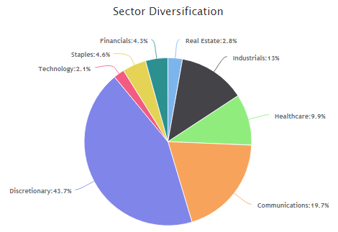
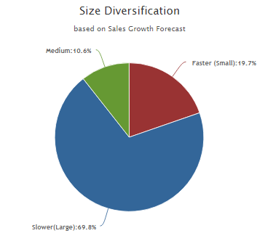
Tropix Portfolio Diversification
25%
50%
25%

Slide 7
Diversification by Company
Aim for no more companies than you can effectively monitor
Optimal Diversification can be achieved with 12-20 companies
– Less than 10 will be more volatile than the market
– More than 30 doesn’t result in anything better than matching the market volatility
– Many factors influence the “right” number
Let’s see how your portfolio stacks up

Slide 8
Diversification by Position Size
Aim to balance the portfolio value equally between companies
Avoid more than 2X an equal position for any one company
– 100% divided by number of companies = one equal position
– For example, your portfolio has 18 companies, an equal position would be 5.56% of your portfolio value , and so, 11.1% would be 2X of an equal position.
Let’s see how your portfolio stacks up

Slide 9
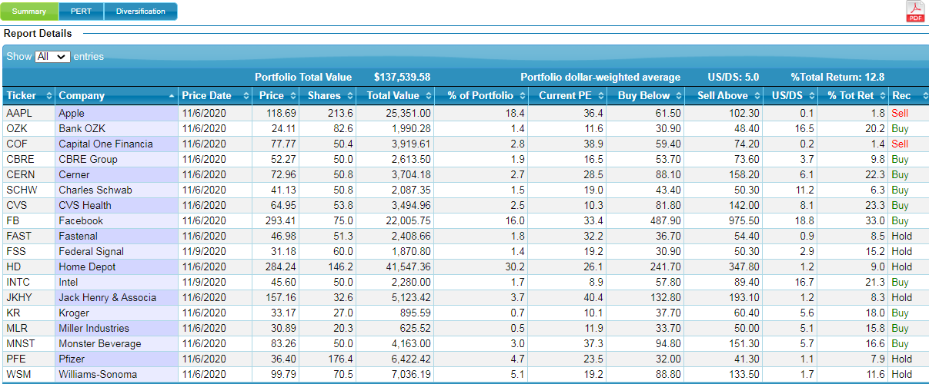

Slide 10
Portfolio Evaluation Review Technique
• The PERT Report pulls together all of the info from our SSGs into one convenient place
– The PERT Report contains A LOT of information
– Quality related information
• We can monitor how our companies are doing as compared to the judgments that we made on our SSGs for our Sales growth estimates and our Earnings growth estimates.
– Value related information
• We can monitor how our companies are looking from a Potential Total Return standpoint
• This is how we weed the garden or achieve the additional 5% of portfolio return to go with our 10%, or better, portfolio growth rates
• This is how we keep our portfolio humming along towards the BetterInvesting stated goal of a 15% return per year
Notes:
This is where all of the work and time that you put into the individual company SSGs comes together. Now that we have finished the Diversification Review, we will move on to the PERT or Portfolio Evaluation Review Technique. The PERT Report pulls together all of the info from our SSGs into one convenient place. We can monitor how our companies are doing as compared to the judgments that we made on our SSGs for our Sales growth estimates and our Earnings growth estimates.
• We can monitor how our companies are looking from a Potential Total Return standpoint
• This is how we weed the garden or achieve the additional 5% of portfolio return to go with our 10%, or better, portfolio growth rates. Also by understanding how to read the PERT chart, we may be able to use this information to make some difficult buy and sell decisions.
This is how we keep our portfolio humming along towards the BetterInvesting stated goal of a 15% return per year

Slide 11
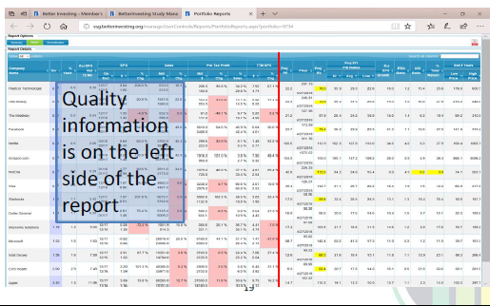
Pert Report Quality Rating
Notes:
This is how the entire PERT Report looks like when you first bring it up., a lot of columns and a lot of information.
The vertical red line splits the report by the quality information on the left and the value information on the right.
The left side is the logical analytical information provided by the data feed that we want to apply to the companies in our portfolio.

Slide 12
Notes:
So were going to start with the quality side which is the data feed from the company’s last quarter report and measure that against the Earnings per share growth from the Value side of the PERT is also from the current SSG.

Slide 13
Pert Report Quality Rating
• Four times a year, when a company reports earnings, our job is to review the PERT Report for the magenta colored fields
• The magenta colored fields represent a shortfall between the earnings growth rate that we expected the company to achieve and the growth rates that the company actually achieved
Notes:
4X a year, when a company reports earnings and those earnings have made their way into the data stream, we want to review the PERT Report for the magenta colored fields.
The magenta fields represent a shortfall between the earnings growth rate that we expected the company to achieve and the growth rates that the company actually achieved. Those are important flags for us to pay attention to.

Slide 14
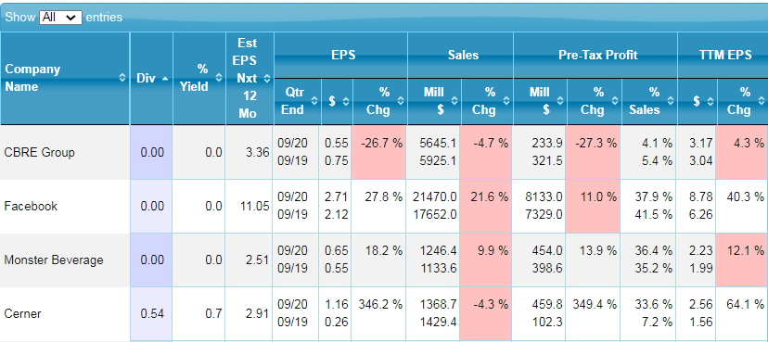
Notes:
In these next several slides we will only be looking at some of the companies in your portfolio that demonstrate those companies meeting or not meeting your estimated EPS judgement goals. In this slide Kroger’s EPS growth estimate is 6.4.
Going from left to right, this number is less than the TTM EPS, the Pre-Tax profit number and the 5 year EPS average, so no magenta in those boxes. The PERT does not list the Sales estimate from your SSG, but you can check and compare that yourself. The two numbers to the left of the % change boxes are the current quarter and the year ago quarter numbers which provide the percent change numbers for each of the four categories.

Slide 15
Notes:
In this example, although FaceBook EPS percent change numbers exceeded your SSG EPS growth estimate of 25.9, it did not meet the Pre-Tax Profit percent change percent of 21.6%. Although the box is colored magenta, this is not a time to panic or rush to sell. It just indicates that further research may be needed to understand why the number is what it is. The sales shortfall can again be checked against your SSG sales estimate and in this case is only 21.6% which is magenta because that number is less than the sale growth estimate on the SSG and it did not meet expectations.

Slide 16
Notes:
The shortfall from the positive EPS estimate judgement obviously was a clear and wide shortfall to the negative EPS change and while the twelve training month’s number was positive, it still ran short of the judgement estimate. Both the Pre-tax profit and sales comparison between the most recent quarter and the same quarter from the year before are in the negative which demands further research to explain what happened.

Slide 17
Notes:
When we look at the comparison between the estimated EPS growth from our SSG and the rest of the data column, the most important is the twelve trailing months of earnings per share. One bad quarter of reported earnings does not indicate a bad company or a bad investment. Two quarters still may not indicate a trend. Maybe at three we might want to give some thought to it. But if we can monitor our earnings to the trailing twelve that the company is achieving, that’s really the most key comparison that we want to pay attention to.
So in the case of Kroger, all is good, with FaceBook, earnings are good, but more attention is needed with the trailing twelve months earnings and the sales estimate. Looking at the magenta lets us know that we need to investigate those areas of Monster Beverage and Facebook and to do a deep dive into CBRE Group to understand the differences between our expectations and reality.

Slide 18
Notes:
Now that we are aware of the further research that needs to be done, this is when we look for where those answers may be located. I like to look at the place listed under the research tab of the SSG, mainly because I don’t have leave the company SSG page to find several excellent sites from a research and analytical view point to understand why the differences are there. You may have other sites that you go to, which is fine as long as you find your answers.

Slide 19
PERT Report: Quality Monitoring
• After doing our research and understanding the factors behind the difference between our estimates and the results reported by the company, it is ok and entirely appropriate to adjust our SSG estimates based on our new insights
• This is also the time to review Sec. 4A (High $ next 5 yrs) and Sec. 4B (Low $ next 5 yrs) and adjust them as appropriate
• This results in freshened up SSGs four times a year and helps to keep the PERT Report relevant to our personal judgements and expectations
Notes:
After doing our research and understanding the factors behind the difference between our estimates and the results reported by the company, it is ok and entirely appropriate to adjust our SSG estimates based on our new insights. Our SSGs are not frozen in time, especially when we discover new information that puts a fresh spin on expectations.
• This is also the time to review Sec. 4A (High $ next 5 years) and Sec. 4B (Low $ next 5 years) and adjust them as appropriate and that they still make sense to us.
• This results in freshened up SSGs four times a year and helps to keep the PERT Report relevant to our personal judgements and expectations. This doesn’t mean that we must change our SSGs every quarter. Once a year may be more relevant that once a quarter. If 2020 has taught us anything, it’s that one year of anomalies are not indicative of what might have happened the year before or the next year.
This side of the PERT chart indicates whether a company is a quality growth company. You can think of this part as equal to parts one and two of the SSG. That if a company does not meet this part of our review that it may not be a quality growth company or get past the barbed wire. We don’t want to trick ourselves that a company is on sale when it is not a good fit in our portfolio. There are more than 4,000 companies in the investing universe with new ones coming and we’re only looking at 12-20 of those. We can afford to be picky and patient to wait for those that are meeting our quality threshold to worry about if the valuation is there.

Slide 20
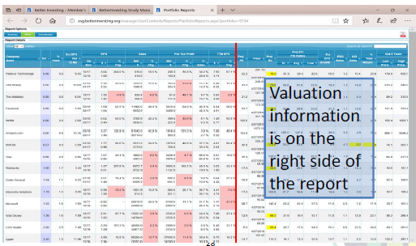
PERT Report: Valuation
Notes:
Now we’ll be looking at the valuation side of the PERT report that is more intuitive, thoughtful and subjective. Those qualities are helpful when we’re trying to evaluate where the price is today compared to where it might go in the future based on our projections.

Slide 21
PERT Report: Valuation
• The PERT Report helps us identify potential buys and sells within our portfolio
• We will look for the presence or absence of appropriate potential total return
• We will look for the presence or absence of potential P/E expansion
• We will look for the appropriate degree of risk
– Upside/Downside ratio
– Projected Relative Value
– PEG ratio
Notes:
The PERT Report helps us identify potential buys and sells within our portfolio. We’re going to be looking just at the companies your club owns, but the process that we’re doing would be the same process you would use on a watch list. We may find a good quality company where the price is too high and say that we would buy it if it came within our buy price. A good way to to achieve that is to develop a watch list PERT report. You would review that portfolio the same way we do here, so when it came time to invest new funds or sell something to free up funds for something on that watch list that finally fell within your price, you would be ready.
We will look for the presence or absence of appropriate potential total return and for the presence or absence of potential P/E expansion and if there is the appropriate degree of risk either too much if we’re buying or too little if we’re selling. We’re going to look for risk from three different directions. The Upside/Downside ratio, the projected relative value and the PEG ratio. We’ll talk a little bit more about each as we get to them on the PERT report. The Upside/Down side ratio is found on the backside of the SSG and the projected relative value and the PEG ratio are found on the key ratio tab on the SSG plus and are found through calculations of SSG data.

Slide 22
PERT Report: Valuation – Buy Guidance
• Buy when the stock is historically underpriced, ideally at or near the Projected 5‐yr Low PE ratio
• Manage risk by ensuring that
– The upside/downside ratio is greater than 3 and less than 10
– The Projected Relative value is less than 100
– The PEG ratio is less than 1.5
• Buy when the Potential Total Return is greater than 15%, or
• Buy when the Potential Total Return will improve the average Potential Total Return of your portfolio
Notes:
We’re not going to do much with those ratios except to give you some targets to reach in your evaluations on the buy side. We’re going to be looking to buy when the stock is historically underpriced which seems pretty obvious, at or near the projected 5 year low P/E ratio. However, there is a risk that there is a reason for the drop in price and to manage the risk of a falling knife, the upside/downside ratio should be between 3 and 10, with the projected relative value less than 100 and the PEG ratio less than 1.5.
You can buy when the Potential Total Return (that’s the overall total portfolio number that we’re looking for from a return standpoint) is greater than 15%, or when the Potential Total Return will improve the average Potential Total Return of your portfolio as it stands right now. Portfolio improvement is a long term ongoing process that consists of a lot of small decisions that don’t happen overnight to help our Portfolio total return stay where it needs to be.

Slide 23
PERT Report: Valuation – Potential Buys
• Obtain the Portfolio Average Return from the Summary Report
Notes:
We can start by obtaining the Portfolio Average Return from the Summary Report. After the current SSGs for each company are initiated or completed and each company and shares owned are filled into the SSG club portfolio, you click on the report button (the first button to the left of the portfolio name. That brings up a screen with three tabs on the top left.

Slide 24
The Summary Report: To Obtain the Portfolio Average Return
Notes:
The first tab brings up the summary report which when the number of shares are filled in for each company gives you the Percent Total Return number for the entire portfolio

Slide 25
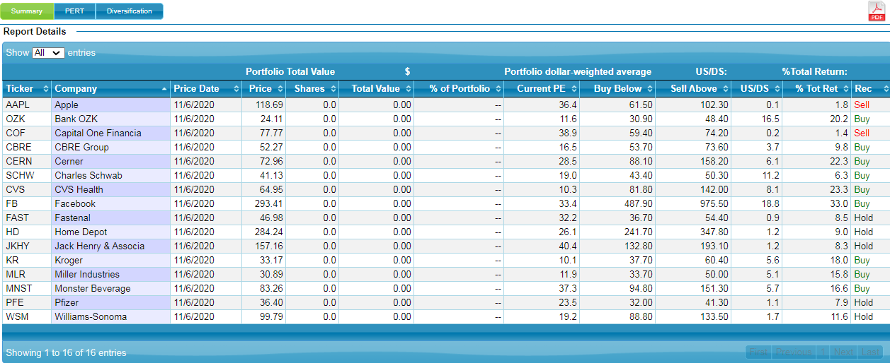
The Summary Report: To Obtain the Portfolio Average Return
Notes:
That is blown up here and is the dollar weighted average of 12.8 which is buoyed up by companies on the buy side and weighed down by companies on the sell side that we need to make note of while we go back to the PERT Chart (the middle button at the top left).

Slide 26
PERT Report: Valuation – Potential Buys
• Obtain the Portfolio Average Return from the Summary Report
• Sort the PERT report by Potential Total Return (from high to low)
• Draw a line dividing the portfolio at the Portfolio
Average Return value
– Use Potential Total Return as the first determining factor
– Buying any company above the line will improve the Portfolio Average Return
Notes:
We go back to the PERT Report that we will sort by the Potential Total Return (from high to low). We can use any of the columns in the PERT as a sort point using the arrows to determine high to low. Then we will draw a line dividing the portfolio at that Average Number that we got from the summary report of 12.8. And that looks like

Slide 27
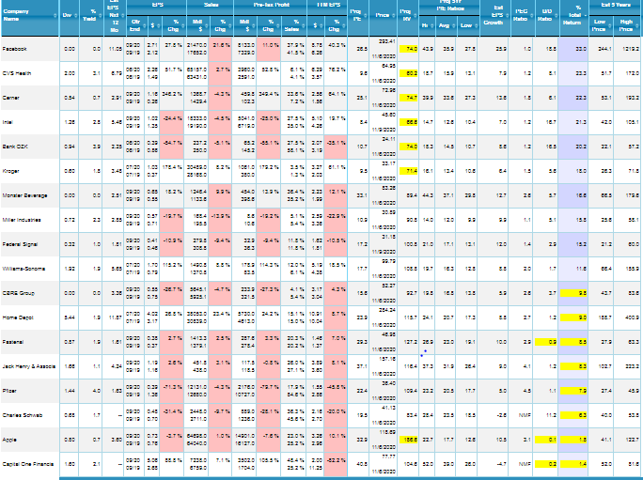
PERT Report – Potential Buys
Notes:
This. This. Here is again the entire screen shot of the PERT Report All the data in the far right hand column is the percent Total Return and by clicking on the little downside arrow with the green line dividing those companies closest to my average return value. Companies above the green line have a higher potential return average and those below have a lower potential return average. If I were to purchase any of the companies above the green line they would help to raise the total portfolio return average. These companies might be where we would look to invest, when we get additional funds from club member dues, if these companies still demonstrated that they are quality growth companies.

Slide 28
PERT Report – Potential Buys
• Test the companies above the line for acceptable downside risk based on the Upside/Downside ratio greater than 3
– An Upside/Downside ratio greater than 10 typically means that the low price in Section 4B on our SSG is not low enough
– An Upside/Downside ratio greater than 10 typically means that we should re‐evaluate our low price
Notes:
We can now determine which of those companies above the line are likely buy candidates by subjecting them to our risk criteria for acceptable downside risk based on the Upside/Downside ratio greater than 3, but lower than 10. Remember that an upside/downside ratio greater than 10 typically means that the low price in Section 4B of our SSG is not low enough and that means that we should re‐evaluate our low price to see if we need to change our judgements. Sometimes it’s as simple as making sure that our projected low price is lower than the current price.

Slide 29
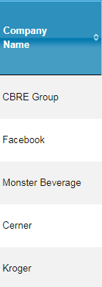
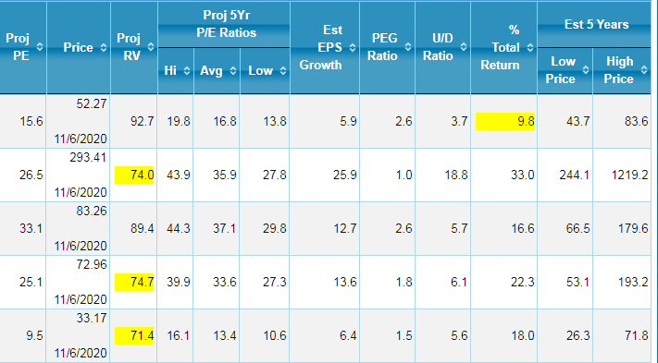
PERT Report – Potential Buys
Notes:
Now for presentation purposes while all of the companies listed have upside/downside ratios of greater than three, Facebook has a value of greater than 10. In real life I would reevaluate to see of the low price is too high, but for this purpose, we will leave it alone. All of these companies are above the green line which means they have a total return above 12.8.

Slide 30
PERT Report: Valuation - Potential Buys
• Test the companies above the line for acceptable downside risk based on the Upside/Downside ratio greater than 3
• Test the companies above the line for acceptable downside risk based on the Relative Value less than 100
• Test the companies above the line for acceptable growth risk based on the PEG ratio less than 1.5
Notes:
Next we’ll go to the second bullet which is testing the companies above the line that have acceptable downside risk based on the relative value less than 100 and also meet the third bullet of a PEG ratio that is less than 1.5.

Slide 31
PERT Report – Potential Buys
Notes:
So again these are companies above the green line with Downside ratios of more than three and that also have projected relative value of less than 100 and a PEG ratio of 1.5 or less. Both of these ratio are not located on the SSG but are calculated from data found on the SSG. Now we have gone from including all of the companies on this list to only Facebook and Kroger that have acceptable risk and we would in real life challenge Facebook with an upside greater than 10.

Slide 32
PERT Report: Valuation - Potential Buys
Test the companies above the line for acceptable downside risk based on the Upside/Downside ratio greater than 3
• Test the companies above the line for acceptable downside risk based on the Relative Value less than 100
• Test the companies above the line for acceptable growth risk based on the PEG ratio less than 1.5
• Test the companies above the line for potential P/E expansion based on the Projected P/E being at, or near, the Projected 5‐yr Low P/E ratio
Notes:
Finally, we’re going to test the companies above the green line for the forth bullet that looks for potential P/E expansion based on the Projected P/E being at or near the projected 5 year low P/E ratio.

Slide 33
PERT Report – Potential Buys
Notes:
Comparing projected P/E to the 5 year projected P/E low (see the numbers edged in pink) indicating in the cyclical nature of the company that we are down near the bottom of the P/E cycle and that there is room for P/E expansion as we hold our investment into the future. Additionally, this P/E expansion may get us from the 10% portfolio return to the 15% that we are reaching for.
Another way to look at the comparison is to check the projected P/E against the projected five year average P/E ratio. By choosing stocks that have a lower projected P/E than the projected 5 year average P/E you are protecting yourself from overpaying for a stock. These are all ratios based on our SSG data and it gives us confirmation that these companies may be candidates for buying based on the risk criteria.

Slide 34
PERT Report: Valuation – Sell Guidance
• Sell when the stock is historically overpriced, ideally at or near the Projected 5‐yr High PE ratio
• Manage risk by ensuring that
– The upside/downside ratio is less than 1
– The Projected Relative value is greater than 150
– The PEG ratio is greater than 2.0
• Sell when the Potential Total Return is less than 10%
Notes:
The next section is the sell guidance. We are going to look for sell candidates when a stock is at or near the projected 5 year high PE ratio. We are not about keeping companies forever. Manage the risk by not just doing the reverse of buy but by changing the number because we want to harvest those companies that have reached their potential and we will mange the risk with an upside/downside ratio that is less than 1. The projected relative value greater than 150 and a PEG ratio greater than 2. We can then sell when the Potential Total Return is less than 10%.

Slide 35
PERT Report: Valuation – Potential Sells
• Re‐sort the PERT report by Potential Total Return (from low to high)
• Draw a line dividing the portfolio at the Portfolio Average Return value
– Use Potential Total Return as the first determining factor
– Selling any company above the line will improve the Portfolio Average Return
Notes:
We’re going to resort the PERT report once again by the Potential Total Return but this time the sort will be from low to high. We will then draw our green line dividing at the Portfolio average return value of 12.8 and we will use the potential total return as the first determining factor, making any company above the line a sell candidate, thus improving the portfolio average return.

Slide 36
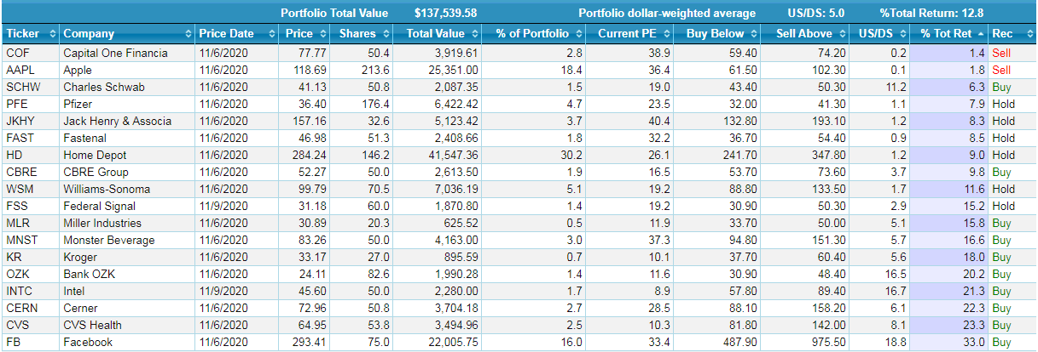
PERT Report: Potential Sells
Notes:
I’m using the summary report here so you can see all of the companies that fall below the total return of 12.8.

Slide 37
PERT Report: Valuation – Potential Sells
• Test the companies above the line for unacceptable downside risk based on the Upside/Downside ratio less than 1
• Test the companies above the line for unacceptable downside risk based on the Relative Value greater than 150
• Test the companies above the line for unacceptable growth risk based on the PEG ratio greater than 2.0
• Test the companies above the line for the lack of potential P/E expansion based on the Projected P/E being at, or near, the Projected 5‐yr High P/E ratio
Notes:
We’re not going to go one by one with the criteria as we did with the potential buy criteria, but will look at all four together on the PERT report slides. First we will test for unacceptable downside risk based on the upside downside ratio of less than one, and the relative value numbers greater than 150. We will test for unacceptable growth risk of PEG ratio greater than 2 and almost the most important criteria for the lack of potential P/E expansion based on the projected P/E being at or near the projected 5 year high P/E ratio which means the potential for P/E expansion is almost nonexistent.

Slide 38
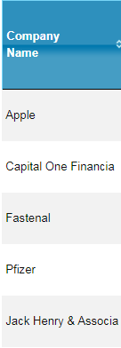
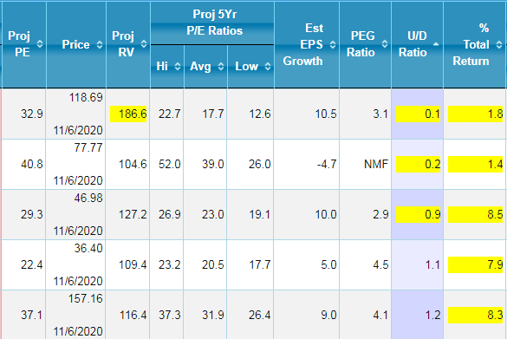
PERT Report: Potential Sells
Notes:
So three companies meet the criteria of the upside/downside ratio less than one but the next two could easily fall into that category since the science is not exact and 1.1 and 1.2 are very close to being less than 1.
The next criteria of projected relative value that is greater than 150 applies to only Apple. The third criterial of PEG ratio greater than 2 applies to Apple, Fastenal, Pfizer and Jack Henry, although we don’t really know about Capital One because the PEG indicates non meaningful data.
Finally, Fastenal, Pfizer and Jack Henry’s Projected P/E are close to or greater than the projected 5 year high P/E ratio which indicates little or no room for P/E expansion. All of these are signaling that we might think about selling and using the funds for companies meeting the potential buy list either already in the portfolio or on the watch list. Making sure that we don’t hold onto companies past the point where they have given us all that we’ve asked for.

Slide 39
PERT Report: In Summary
• The PERT Report is your portfolio report card – Be sure all the SSGs in your portfolio are up‐to‐date
– Quickly see whether or not your stocks are meeting your growth expectations (QUALITY)
– Quickly identify which stocks would improve the expected return of the entire portfolio (VALUATION)
• Use the PERT Report to make investment decisions that improve both the quality and the potential return of your portfolio!
Notes:
We can use the PERT Report two ways, either as a portfolio report card where all of our SSGs are up-to-date so we can quickly see whether or not our stocks are meeting their growth expectation on the quality side and if not quickly find where the disconnect is because quality is most important.
Second that we can quickly identify stocks that would improve the expected return of the entire portfolio. or can be used to make investment decisions and drill down to ensure that the portfolio is moving toward the 15% total return goal. This being found on the valuation side of the report

Slide 40
Regular Monthly Chapter Sponsored Events
1. Money Matters Book Discussion – 2nd Tuesday 7:30-9 pm. Link: https://global.gotomeeting.com/join/804623085
2. MicNOVA Model Inv Club – 3rd Tuesday 7-9 pm
https://global.gotomeeting.com/join/251997157
3. MCMC Montgomery Cnty Model Inv Club - 3rd Wednesday 7-9 pm
https://global.gotomeeting.com/join/745127301

