Slide 1

Understanding ETFs (Exchange Traded Funds)
Building ETFs in Your Portfolio
Arvind K Krishna
July 12, 2022
MICNOVA

Slide 2
MODEL INVESTMENT CLUB (MICNOVA) DISCLAIMER
• The information presented and discussed in this model club meeting is for demonstration and educational purposes only. The securities of companies referenced or featured in the meeting materials, presentation and discussion are for illustrative purposes only and are not to be considered endorsed or recommended for purchase or sale by BetterInvesting™ / National Association of Investors™. The views, opinions expressed and decisions made by club partners regarding the purchase and sale of stocks or other assets are those of the partner(s), and do not necessarily reflect the views and opinions of BetterInvesting. No recommendation to purchase or sell any stock, mutual fund, or other security referenced is being made on behalf of BetterInvesting.
• Securities discussed may be held by the club partners and presenters in their own personal portfolios or in those of their clients. BetterInvesting presenters and volunteers are held to a strict code of conduct that precludes benefiting financially from educational presentations or public activities via any BetterInvesting programs, events and/or educational sessions in which they participate. Any violation is strictly prohibited and should be reported to the CEO of BetterInvesting or the Director of Chapter Relations.
• This meeting may contain images of websites and products or services not endorsed by BetterInvesting. The presenter is not endorsing or promoting the use of these websites, products or services.
• We may record this session for our future use.

Slide 3
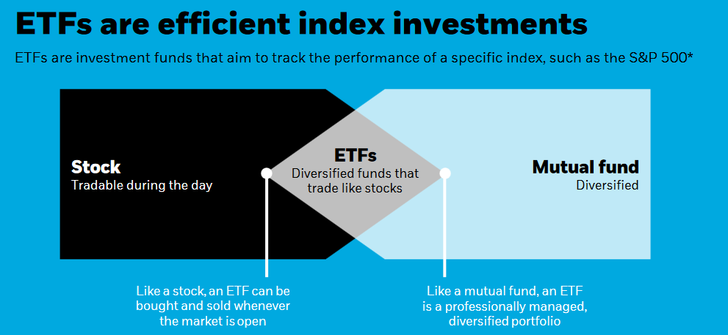


Slide 4
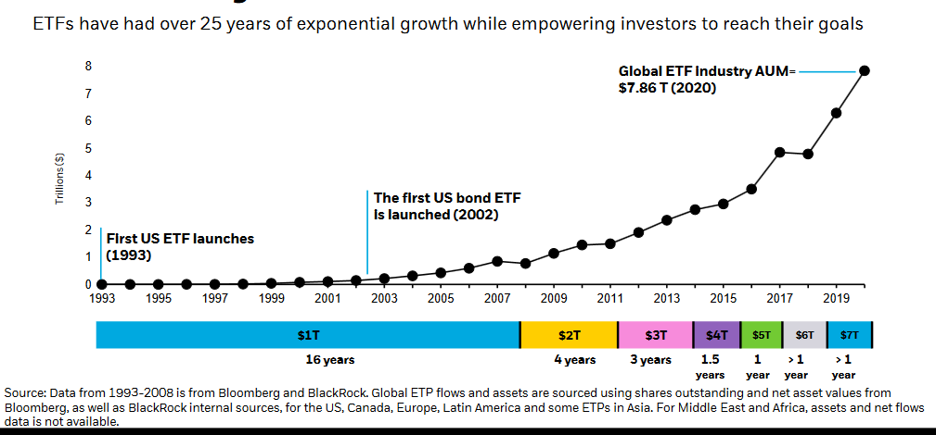
The History of ETFs Exponential Growth

Slide 5
What is an ETF?
An exchange-traded fund (ETF) is a basket of securities you buy or sell through a brokerage firm on a stock exchange.
Like index funds, passively managed ETFs seek to track the performance of a benchmark index, while actively managed ETFs seek to outperform a benchmark index.
ETFs trade like a common stock on an exchange, and therefore, they experience price changes throughout the day as they're bought and sold.
There are no restrictions on how often you can buy and sell stocks or ETFs.
ETF prices are displayed as the Bid (the price someone is willing to pay for your shares) and the Ask (the price at which someone is willing to sell you shares).
ETFs may trade at a Premium or Discount to the net asset value of the underlying assets.

Slide 6
Trading ETFs
ETFs, like stocks, are trading on the secondary market.
When buying or selling ETFs and stocks, you can use a variety of order types, including market orders or limit orders
You can place stop loss orders and stop limit orders, as well as "immediate or cancel," "fill or kill," "all or none," "good 'til canceled," and several other types of orders. You can also execute short sales.
ETFs and stocks do not carry sales charges, but you will be charged a commission each time you execute a trade online (unless the ETF is part of a commission-free online trading program).

Slide 7
ETFs are not traded like a Mutual Index Fund
When you invest in an ETF you are buying into a pooled investment vehicle, similar to a mutual fund.
Unlike mutual funds, which investors can buy or sell only once per day, ETFs are traded throughout the day on organized stock exchanges, just like common stock.
ETFs are bought or sold intraday at different prices. Mutual fund trades are executed once a day, at a single price.
ETFs are bought and sold at market prices, not at net asset value (NAV) like mutual funds.

Slide 8
ETFs Pros and Cons
ETFs have some unique benefits over stocks. Here are some of the pros to trading ETFs as an alternative to trading individual stocks.
  Safety through diversification
  Access to more markets
  Tax Efficiency
  Liquidity issue
  Lower trading commissions
  Better odds of follow through
ETFs offer a number of benefits, the low-cost and myriad investment options available through ETFs can lead investors to make unwise decisions.
Not all ETFs are alike. Execution prices and tracking discrepancies can cause unpleasant surprises for investors.

Slide 9
ETF Disadvantages - unpleasant surprises for investors
Buying High & Selling Low
  ETFs have two prices, a bid and an ask. Investors should be aware of the spread between the price they will pay for shares (ask) and the price a share could be sold for (bid). In addition, it helps to know the intraday value of the fund when you are ready to execute a trade.
    General Liquidity - Higher liquidity can shrink bid/ask spreads and Lower Liquidity tend to have larger bid/ask spreads.
    Higher Volatility in the Market – Can lead to Higher Spreads and affect premiums or discounts to NAVs
Tracking Error
  ETF managers are supposed to keep their funds’ investment performance in line with the indexes they track. That mission is not as easy as it sounds. There are many ways an ETF can stray from its intended index. That tracking error can be a cost to investors.
Some ETFs are Complicated
  Certain ETFs may be more complex based on their strategies or holdings. Careful.

Slide 10
ETF Cost Considerations
Many ETFs can be inexpensive, but as with all investments, you should be aware of the costs. Here are the costs most commonly associated with ETFs:
  Trade Commissions - The fees your brokerage company charges each time you buy or sell a listed ETF which can range from $0-$20 per trade for online trades, depending on number of trades.
  Operating Expense Ratio (OER) - The ongoing management fee charged for an ETF by the fund’s sponsor. This can vary widely, with the industry asset-weighted average. OER for passively managed ETFs being 0.05% – 0.19%.
  Bid/Ask Spreads & Premiums/Discounts - Trading costs can also include two misunderstood and sometimes overlooked items: Bid/Ask spreads and changes in discounts and premiums to an ETF's net asset value (NAV).
  Bid/Ask spread is computed by taking the difference between the asking price and the bid price then dividing by the mid-price of the ETF, this is taken over the trailing period of one month. A lower number here indicates it has historically been more efficient to trade in and out of compared to a fund with a higher bid/ask spread.
  EXAMPLE: Bid Price $100.50, Ask Price $100.52, Mid-Price $100.51
  SPREAD: 100.52-100.50= .02 .02/100.51= .02%
  Understand Fair Value: Is the fund trading at a premium or discount to NAV?

Slide 11
ETF Types
An ETF can fill almost every investment niche, from small-cap stocks to emerging market bonds to commodities.
EQUITY ETFs, Such as:
  International ETFs
  Sector ETFs
  Dividend ETFs
  Market CAP Index ETFs
Non-Equity ETFs – an ETF can hold non-equity securities, such as bonds, commodities, and currencies.
Most ETFs are passively managed, which means a portfolio manager references a published index to determine which securities to hold and how to weight those securities in their portfolios.
some ETFs are actively managed—that is, the portfolio manager makes investment decisions for the fund.

Slide 12
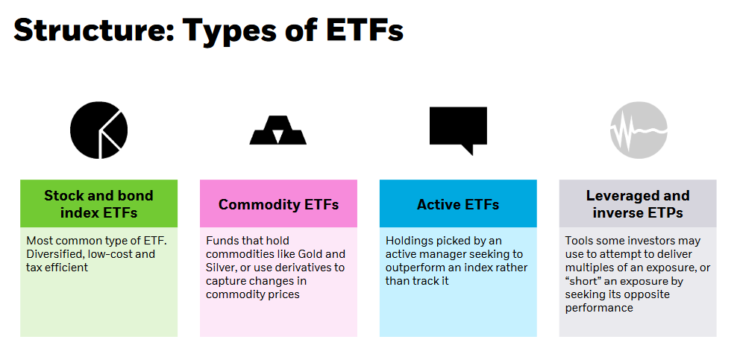
Source: iShares by BlackRock

Slide 13
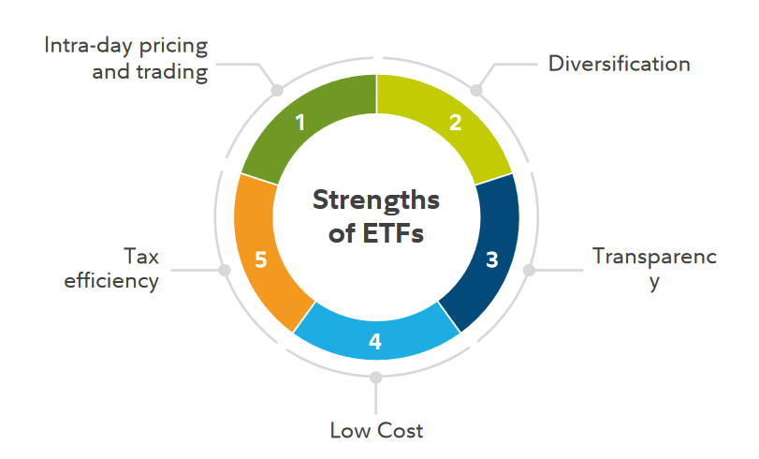
Why ETFs in Your Portfolio? – Understand ETF Benefits

Slide 14
Individual Benefits of ETFs
Trading Flexibility
  ETFs are bought and sold during the day when the markets are open. The pricing of ETF shares is continuous during normal exchange hours.
  Short selling is also available to ETF investors. Shorting entails borrowing securities from your brokerage firm and simultaneously selling those securities on the market. The hope is that the price of the borrowed securities will drop and you can buy them back at a lower price at a later time.
Portfolio diversification and risk management
  ETFs are now traded on virtually every major asset class, commodity, and currency in the world. through ETFs an investor can buy or sell stock market volatility or invest on a continuous basis in the highest yielding currencies in the world.
Transparency
  Most ETFs disclose their holdings on a daily basis.
Lower Costs
  ETF operation costs can be streamlined compared to open-end mutual funds. Lower costs are a result of client service–related expenses being passed on to the brokerage firms that hold the ETF securities in customer accounts.
Tax Benefits
  ETFs have 2 major tax advantages compared to mutual funds.
    Capital Gains at the end of ETF sale and
    Dividends (qualified and unqualified)taxed at different rates based upon Investor’s Taxable Income.

Slide 15
ETF efficiency: How to evaluate an ETF?
Not all ETFs are equally efficient so it’s important to follow a fund’s expense ratio, tracking results, and capital gains history when evaluating an ETF.
The main input is a fund’s expense ratio
How well did the ETF replicate the performance of its index?
A statistic that looks at how far an ETF has lagged its benchmark, on average, over a one-year period.
Since the principal task of most ETFs is to track an index, funds that deviate from their index—even for short periods—are less efficient and less well run.
Capital Gains Distributions. This can be measured by taking the average capital gains paid out to shareholders over a recent period divided by NAV at the time. Lower values are better here, as they maximize tax efficiency.
Risks - the last factor investors should consider is risks. Is the ETF likely to close?

Slide 16
Tax Rules For Losses on ETFs
Losses in ETFs usually are treated just like losses on stock sales, which generate capital losses. The losses are either short term or long term, depending on how long you owned the shares.
One of the opportunities that holding ETF shares presents is the ability to cherry-pick shares to be sold for optimum tax results.
If you buy substantially identical security within 30 days before or after a sale at a loss, you are subject to the Wash Sale Rule. This prevents you from claiming the loss at this time
ETFs can be used to avoid the Wash Sale Rule while maintaining a similar investment holding. This is because ETFs typically are an index for a sector or other group of stocks and are not substantially identical to a single stock.

Slide 17
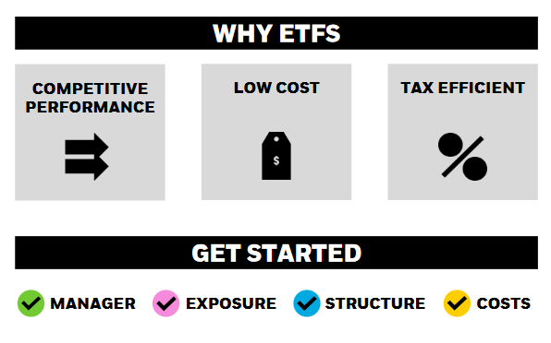
SUMMARY
Before investing in any ETF, you should consider its investment objective, risks, charges and expenses.

