Slide 1
Economic Moats
Education for August 9, 2022
Based on Craig Braemer’s and Ann Cuneaz’sTicker Talk Nov. 18, 2020
Jo Murphy

Slide 3
Source: Pat Dorsey, Morningstar

Slide 8
Summary so far:

Slide 11
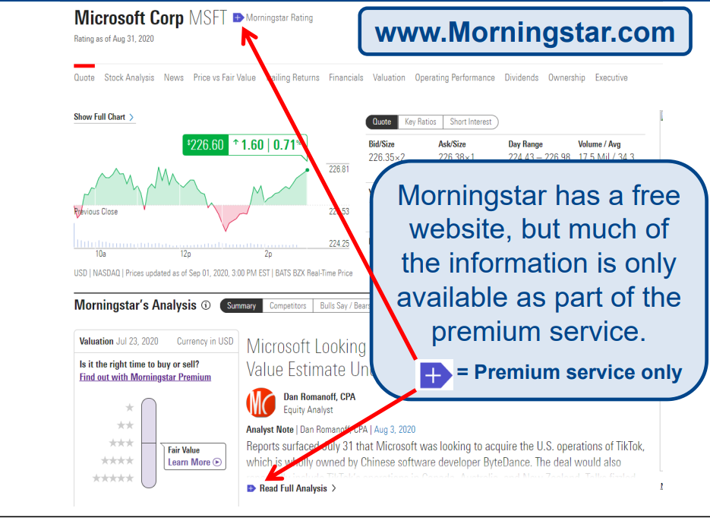

Slide 12
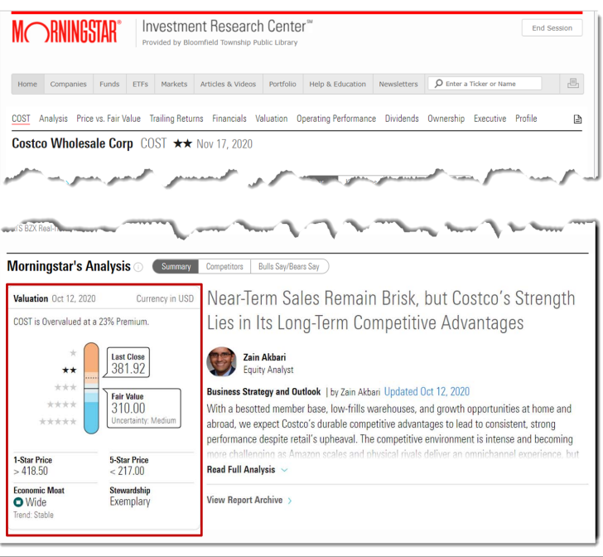

Slide 13
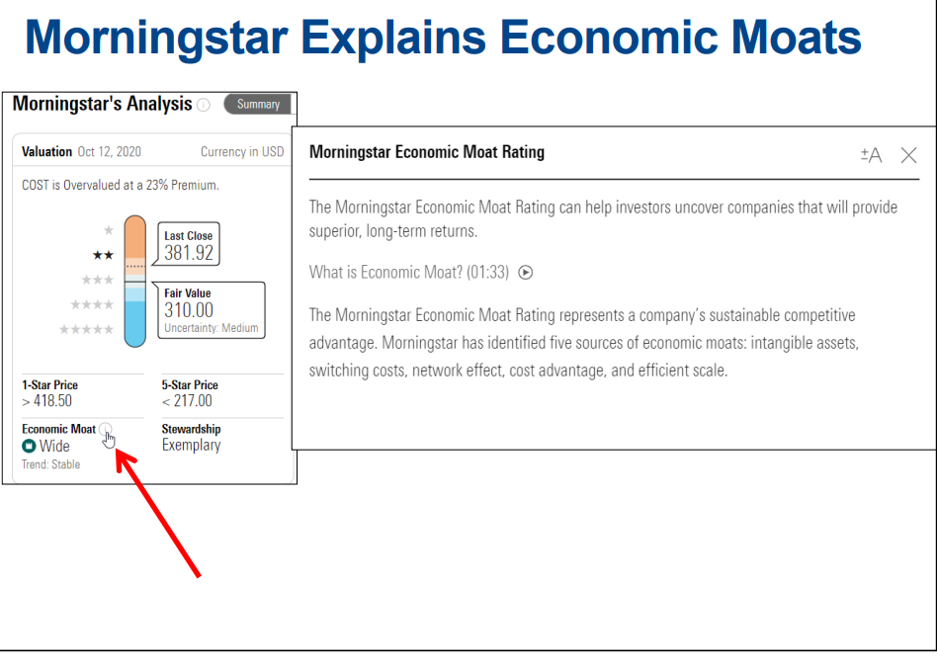

Slide 14
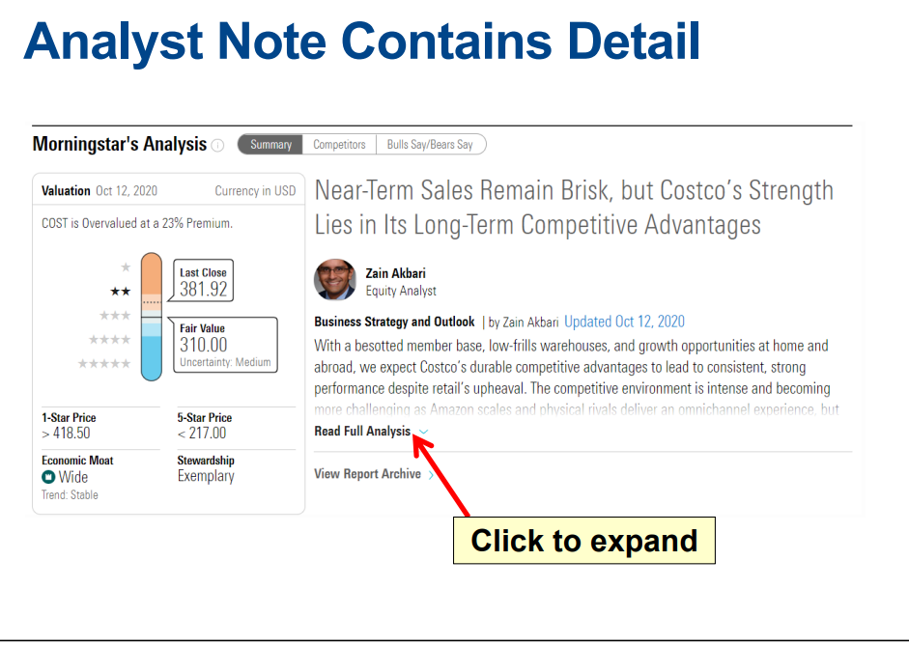

Slide 20
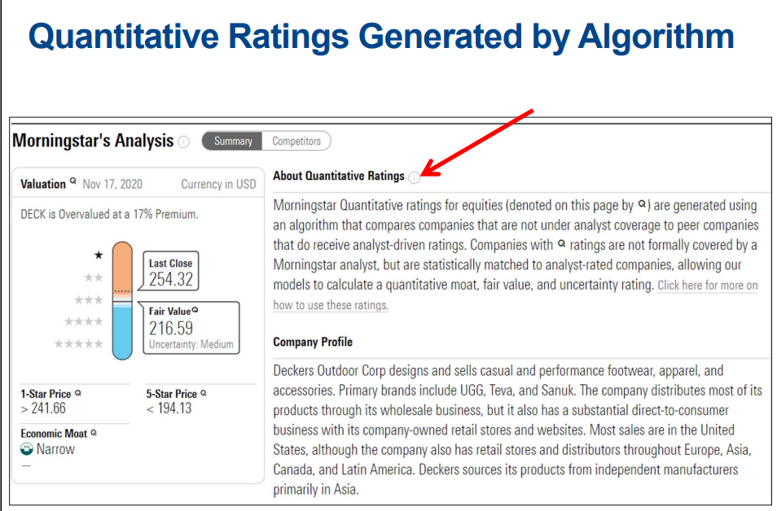

Slide 23
Questions?

