Slide 1
Technical Analysis vs. Fundamental Analysis During Stock Valuation
Arvind K Krishna
July 11, 2023

Slide 2
Primary Methods to Analyze Securities
Two Approaches used to analyze securities & investment decisions:
Fundamental Analysis (FA)
Technical Analysis (TA)
Both approaches are being used by investors around the globe for market-related decisions. However, they are different from each other
Fundamental Analysis involves analyzing a company’s financial statements to determine the Fair (intrinsic) Value of business (stock)
Technical Analysis assumes that a security's price already reflects all publicly available information and instead focuses on the statistical analysis of Price & Volume movements

Slide 3
Fundamental Analysis (FA) of stock analysis involve:
Evaluate a stock using its underlying metrics: Sales, Earnings, Debt, Equity, P/E Ratios, Economic Conditions, Industry Trends & Company Management.
gain insight into a company’s future growth prospects and determine whether its stock price is at a fair value.
It is based on the thought that prices don’t correspond to the effect of fundamentals in the short-term, in the long run, the stock prices will adjust to the fundamentals
Many investors analyze stocks based on their fundamentals—but fundamental factors aren't always reflected in the market price.
Objective of FA is investing, since it is a LT approach – helps to decide whether a stock is overvalued or undervalued based on its intrinsic value.

Slide 4
Technical Analysis (TA) for evaluating Stocks
Technical Analysis - Evaluating a stock using its Charts, Trends, Price, Volume data and predicts the stock’s future price. .
Study historical price movements & trading volume - Looking for certain patterns and trading behavior.
Belief that past trading activity and price changes of a security can be valuable indicators of the security's future price movements.
Based on the historical price movement of the stock rather than the fundamentals. Instead, Analyses the past trends & predicts future prices accordingly.
(TA) differs from (FA) in that the stock's price and trading volume are the only inputs. Assumption is that all known fundamentals are factored into price
(TA) is a clear favorite of short-term traders – provides insight into where to Enter or Exit a Trade or where to place a Stop Loss.

Slide 5
Two different ways to approach Technical Analysis
Top Down Approach
Often taken by Short-term Traders
The top-down approach is a macroeconomic analysis that looks at the overall economy before focusing on individual securities.
A trader would first focus on economies, then sectors, and then companies for stocks.
Focus on short-term gains as opposed to long-term valuations.
For example, a trader may be interested in stocks that broke out from their 50-day moving average as a buying opportunity.
Bottom Up Approach
Often taken by Long-term Traders

Slide 6
(TA) Bottom- up Approach for LT Investors
The bottom-up approach focuses on individual stocks as opposed to a macroeconomic view.
It involves analyzing a stock that appears fundamentally interesting for potential entry and exit points.
For example, an investor may find an undervalued stock in a downtrend and use technical analysis to identify a specific entry point when the stock could be bottoming out.
They seek value in their decisions and intend to hold a long-term view of their trades.

Slide 7
Commonly used (TA) Indicators and Charting Patterns include:
In general, Technical Analysts look at the following indicators:
Price trends
Chart patterns
Trading Volume
Support and Resistance Levels
Momentum Indicators
RSI – Relative Strength Indicator
Oscillators
Moving Averages
Bollinger Bands
Beta (β)

Slide 8
What is RSI – Relative Strength Index?
RSI is a momentum indicator that measures recent price changes as it oscillates between 0 and 100. The RSI provides short-term buy and sell signals and is used to track the overbought and oversold levels of an asset.
Low RSI levels, below 30, generate buy signals and indicate an oversold or undervalued condition.
High RSI levels, above 70, generate sell signals and suggest that a security is overbought or overvalued.
RSI of 50 denotes a Neutral Level or balance between bullish & bearish positions.
RSI measures how quickly the price of an asset moves - commonly used when markets are trending. RSI may be misleading at times.
Other RSI trading signals - when overbought and oversold asset prices don't change course right away - via divergences, failure swings, centerline crossovers.
Moving Average Convergence Divergence (MACD), Exponential Moving Average (EMA) & Moving Average Crossovers - allow traders to verify RSI indicators.

Slide 9
Technical Analysis Terms – Used in Charts
Bollinger Bands A chart overlay that shows the upper and lower limits of 'normal' price movements based on the Standard Deviation of prices.
Moving Averages Line and Signal Line Chart overlays that show the 'average' value over time. Simple Moving Averages (SMAs) and Exponential Moving Averages (EMAs), Signal Line and MACD - function as a trigger for buy and sell signals for Traders
Beta (β) is a measure of market risk & volatility—or systematic risk—of a security or portfolio compared to the market as a whole (usually the S&P 500). Stocks with betas higher than 1.0 can be interpreted as more volatile than the S&P 500.
Divergence - Describes signals of prices that move in a opposite direction from a Technical Indicator. Divergence can be Positive (+) when asset price hits new Low (indicator value climbs) or Negative (-) when asset price hits new High (indicator hits a new low).
Oscillators – are Momentum indicators used to make High and Low banks that exist between two different extremes to pinpoint asset corrections and price breakouts.

Slide 10
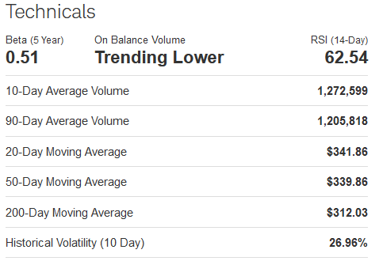
VRTX Technical Indicators As of 1:00 PM ET Monday, 07/03/2023

Slide 11
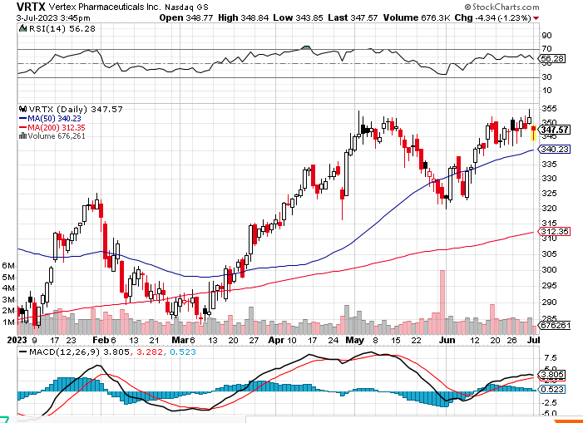

Slide 12
VRTX Technical Indicators As of 1:00 PM ET Monday, 07/03/2023
Trend Analysis
VRTX appears to be in a strong bullish trend. Its 200-day moving average is upwards sloping and the MACD histogram is above 0. Comparative Relative Strength analysis shows that this issue is lagging the S&P 500.
Volume
Today's volume was lighter than usual, trading 688,440 shares, versus an average of 1,331,178 shares per day during the last twelve months. The On Balance Volume indicator (OBV) shows that longer term accumulation has given way to near term selling pressure by traders.
Momentum
Momentum for VRTX, as measured by a 14-period Slow Stochastic Oscillator, is waning. This means that investors are less aggressive in their recent purchases and may even be taking profits in positions bought at lower prices.
Volatility
Bollinger Bands® use standard deviation of closing prices around a moving average to measure volatility. Presently, the Bollinger Bands® for VRTX are of a normal width, and signal that volatility has been in-line with the norm for this stock.

Slide 13
Can technical analysis be used to evaluate long-term investments?
However, technical analysis can be a beneficial tool to evaluate long-term investments when combined with fundamental analysis. Evaluation of the historical performance of a company or broad market is often done through quantitative analysis.
Technical analysis, or using charts to identify trading signals and price patterns, may seem overwhelming or esoteric at first.
Beginners should first understand why technical analysis works as a window into market psychology to identify opportunities to profit.

Slide 14
Conclusion
There’s really no wrong or right way to analyze a stock. It depends on your personality, trading style, trading time frame, and so much more. End of day, you want to use any and every tool that can help you make smarter trading decisions.
If you’re new to the markets, try both technical and fundamental analysis to find what works best for you and your strategy. Some of the best traders use a combination of both forms of analysis.
Combining both techniques is probably the wisest move. Must do some fundamental analysis of the stocks to begin with
Technical analysis can then help you decide when and where to enter a stock, where to place your stop loss, and how to manage your position.
The great thing is, you can make your own hybrid form of stock analysis

Slide 15
What is my Take-Away?
The Bottom Line
Many investors leverage both fundamental and technical analysis when making investment decisions since technical analysis helps fill in the gaps of knowledge.
Try a hybrid of technical and fundamental analysis to analyze stocks.
By developing an understanding of technical analysis, traders and investors can improve their long-term risk-adjusted returns
but it's important to understand and practice these techniques before committing real capital to avoid costly mistakes.

