Slide 1
Using the BI Stock Screener to find Great Stocks in Targeted Industries
Educational Presentation to MicNova, October 10, 2023 by Gladys Henrikson Adapted from “Search & Sort Using BetterInvesting Screener,” by Marion Michel, Bite of BINC, May 2023

Slide 2
Disclaimer
The information in this presentation is for educational purposes only and is not intended to be a recommendation to purchase or sell any of the stocks, mutual funds, or other securities that may be referenced.
The securities of companies referenced or featured in the seminar materials are for illustrative purposes only and are not to be considered endorsed or recommended for purchase or sale by BetterInvesting™ / National Association of Investors™.
The views expressed are those of the commentator and do not necessarily represent those of BetterInvesting.
Investors should conduct their own review and analysis of any company of interest before making an investment decision. • Securities discussed may be held by the commentator in her own personal portfolio.
BetterInvesting presenters and volunteers are held to a strict code of conduct that precludes benefitting financially from educational presentations or public activities via any BetterInvesting programs, events and/or educational sessions in which they participate. Any violation is strictly prohibited and should be reported to the CEO of BetterInvesting or the Director of Chapter Relations.
This presentation may contain images of websites and products or services not endorsed by BetterInvesting. The presenter is not endorsing or promoting the use of these websites, products or services.

Slide 3
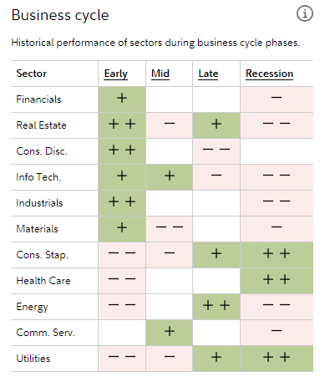
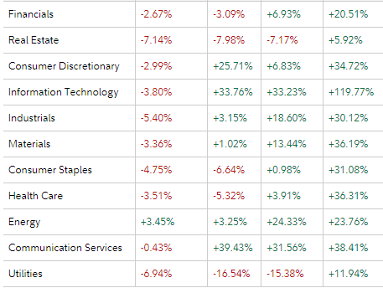
US Sector Performance YTD (9/23) - per Fidelity

Slide 4
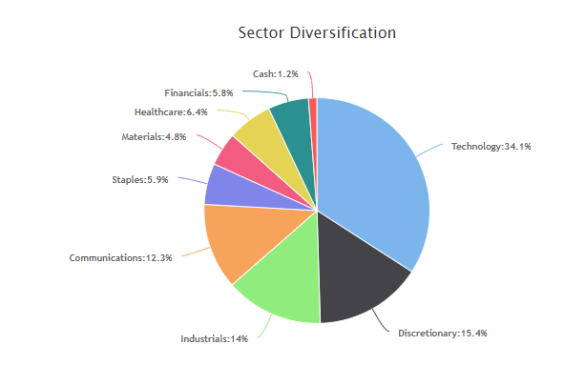
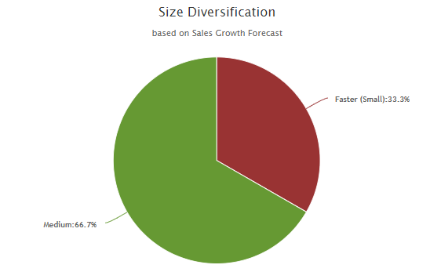
MicNova Portfolio as of Oct 2023

Slide 5
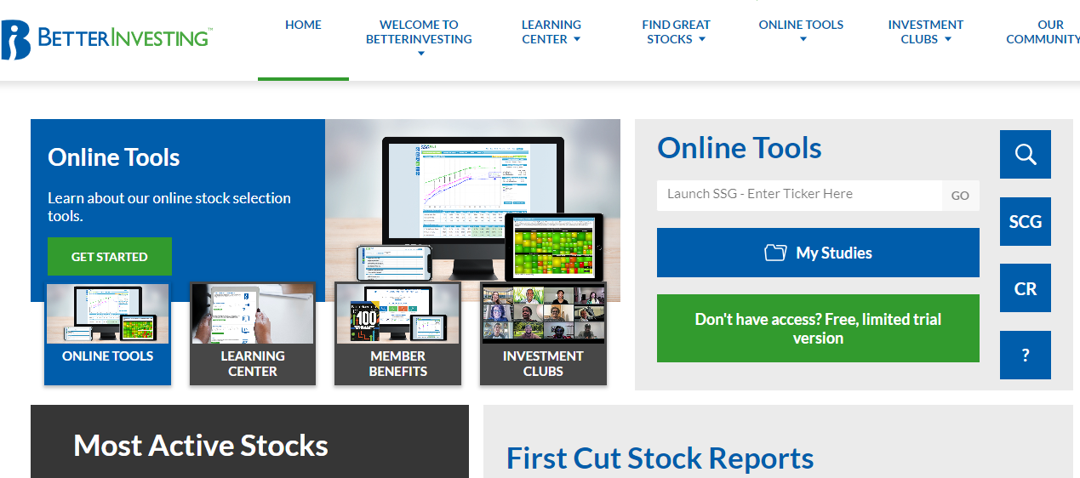
Go to Better Investing Screeners Through Home Page Magnifying Glass

Slide 6
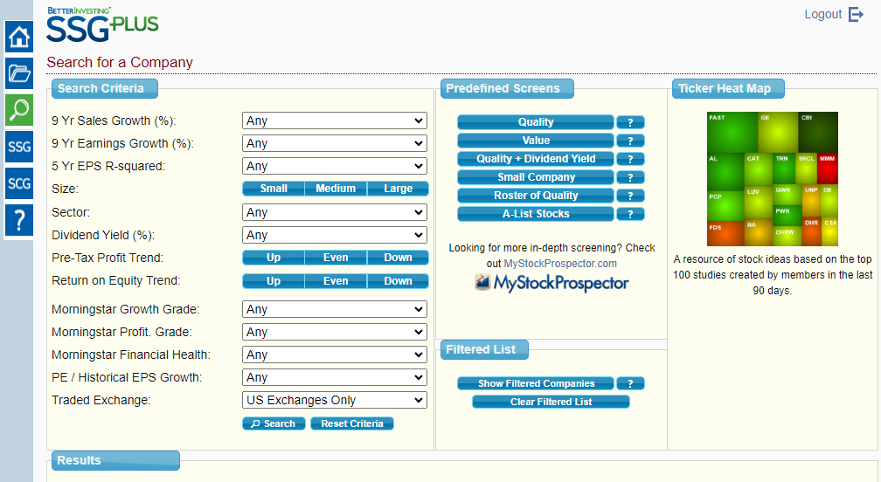
Magnifying Glass Leads to Three Types of Screeners for Stocks
Column 3: Ticker Heat Map – BI Member Stock Studies/Interest
Column 2: Predefined Screens, Note new, last, feature: “A-List”
Column 1: Customizable
Screen-13 Search Criteria

Slide 7
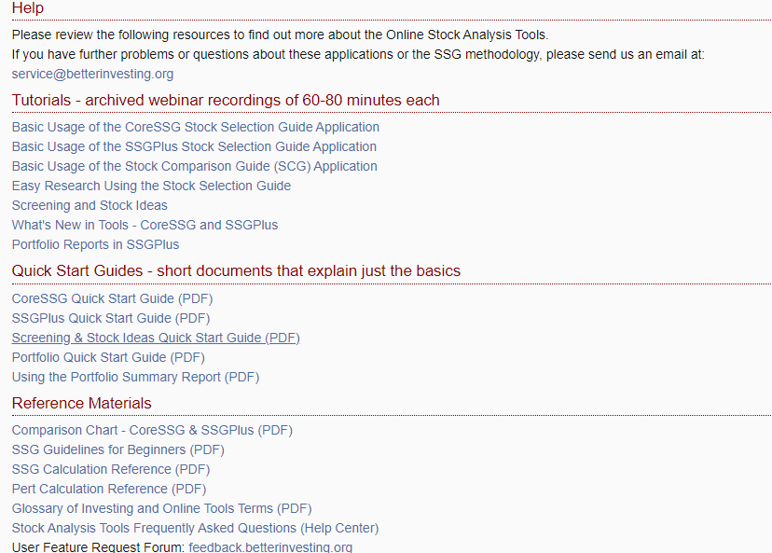
SSG Screening Tools – Getting Started
? = Tutorials for Using Screening Tools
Tutorials Screening Tools

Slide 8
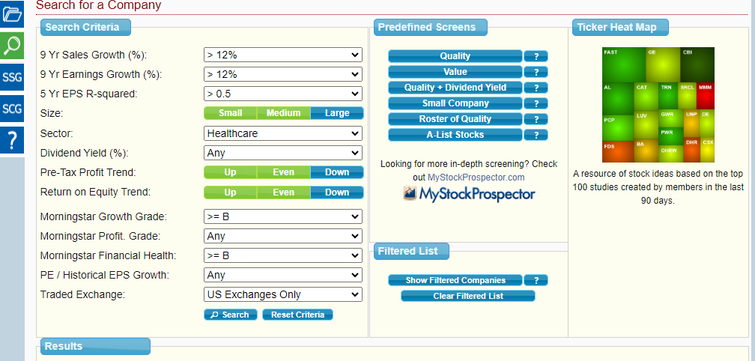
SSG We’ll Use “Custom” Screening for Health Care, Column “1”
Column 1: Select Search Criteria (10 of 13 chosen)

Slide 9
Results from Customized Search (9 companies)

Slide 10
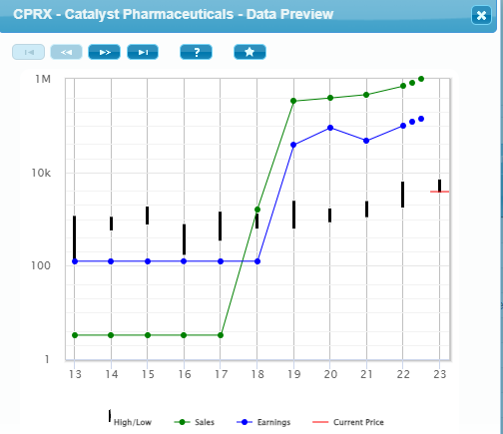
1. Click On Thumbnail Icon & 2. Cycle Through Graphs
1
2

Slide 11
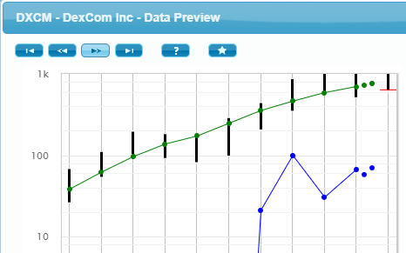
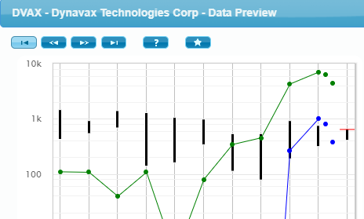
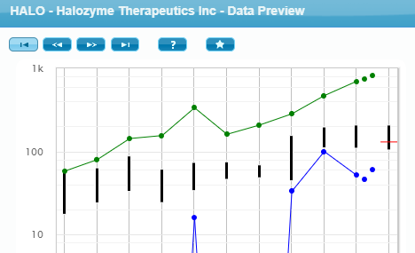
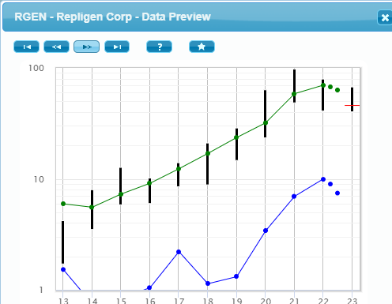
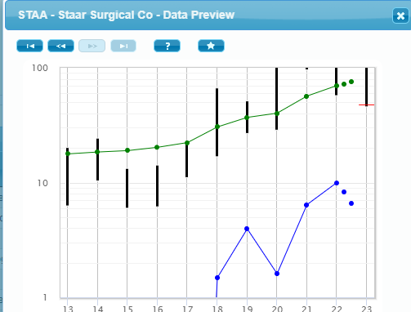
Eliminated 5 Stocks from Thumbnail Graphs (e.g. Erratic Earnings)

Slide 12
Run SSGs on Remaining 4 Stocks. Save to “My Studies” (I used shortcut for SSG judgements: Member Sentiment “Median” numbers)

Slide 13
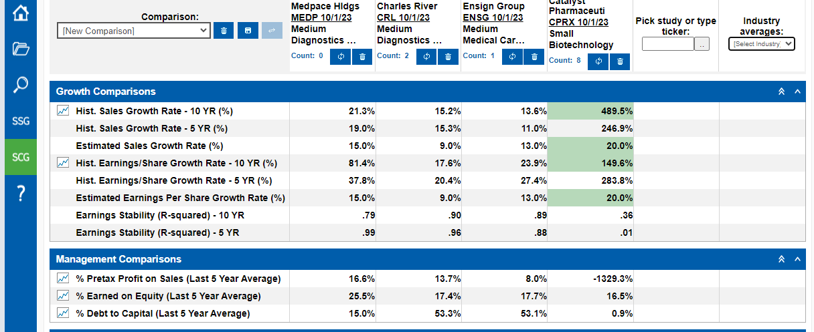
Open SCG and add tickers (1) to find Best. Also choose Industry Averages (2) (Ideally same industry; here, three; just picked one)
1
2

Slide 14
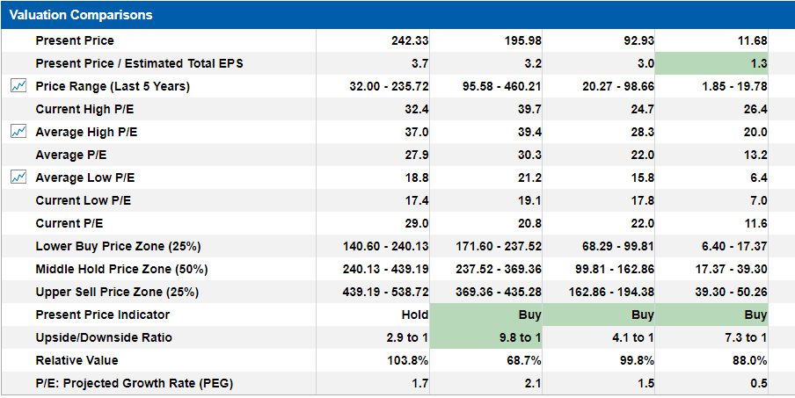
Review Stock Comparison Guide Results

Slide 15
For Further References on Using the BI Stock Screener
On Better Investing (BI) Website: “BITE OF BINC, 2023,” May 2023. Better Investing Screener – by Marion Michel
On Better Investing (BI) Website, under BI Video Learning Library, Ticker Talk, May 2023. Watch Video to see Ken Kavula demonstrate BI Stock Screener and Stock Comparison Guide
Digging into the BI, On You Tube, watch BI’s DMV Chapters’ video presentations:
September 2023 – includes presentation on Medpace
Oct 2, 2023- includes presentation on Catalyst

