Slide 1
First Cuts in Investment Research
12/12/2023
Presented By Paul O’Mara,
MICNOVA VP
Notes:
Main Presentation Title Slide
Showcasing a logo/art

Slide 2
Notes:
General Disclaimer Slide.
Note: Please ensure to check the copyright and usage of any image that is used for your slides.

Slide 3
Notes:
Model Club Disclaimer Slide.
Note: Please ensure to check the copyright and usage of any image that is used for your slides.

Slide 4
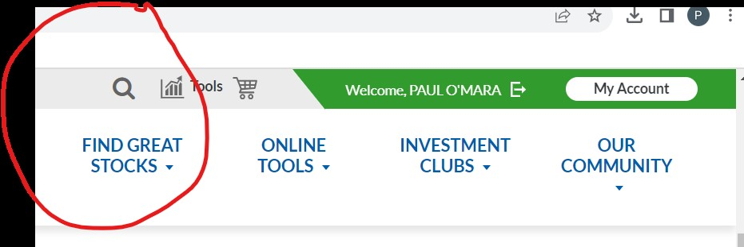

Slide 5
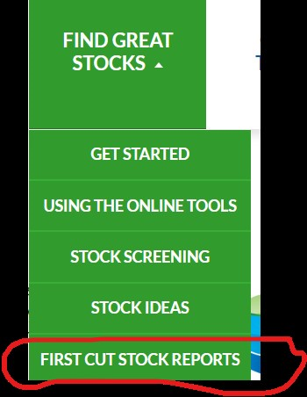

Slide 8
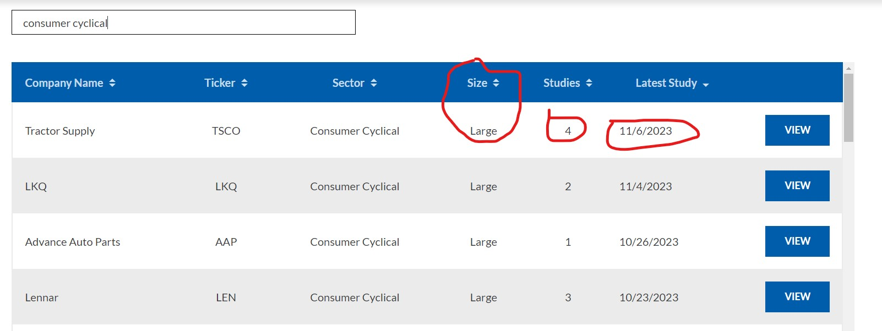

Slide 10
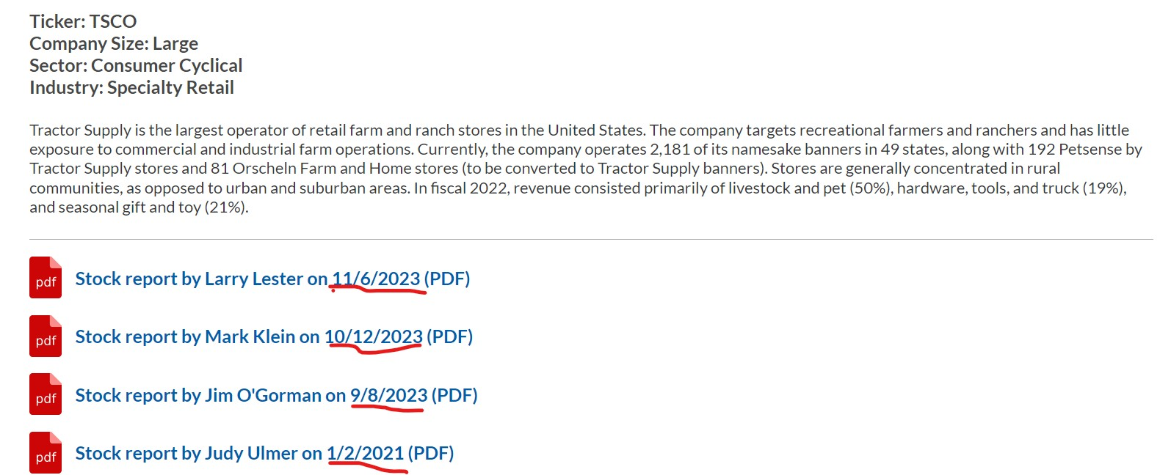

Slide 11
Tractor Supply (Larry Lester)
Discuss why you consider this to be a high quality, growth company that should be investigated further.
Please include comments on historical sales and EPS growth, pre-tax profit margin, return on equity, and debt.
Tractor Supply is a solid quality growth company because the company has increased sales over the past few years and has continued growing the number of company-owned operating stores. The company has been in business since 1938 and has over 2300 stores in 49 states. The stock performance has been steady, with annual sales growth of 11%, annual earnings growth of 17% and pre-tax profits averaging 10%.
Projected growth rate for earnings per share: 8% Why did you select this rate?
Value Line predicts 11.5% earnings growth rate. Eight percent was used in the SSG to be more conservative.

Slide 15
QUESTIONS?

